Slide 1
WILL’S JOURNEY HOME
SEPT 26 2017

Slide 2

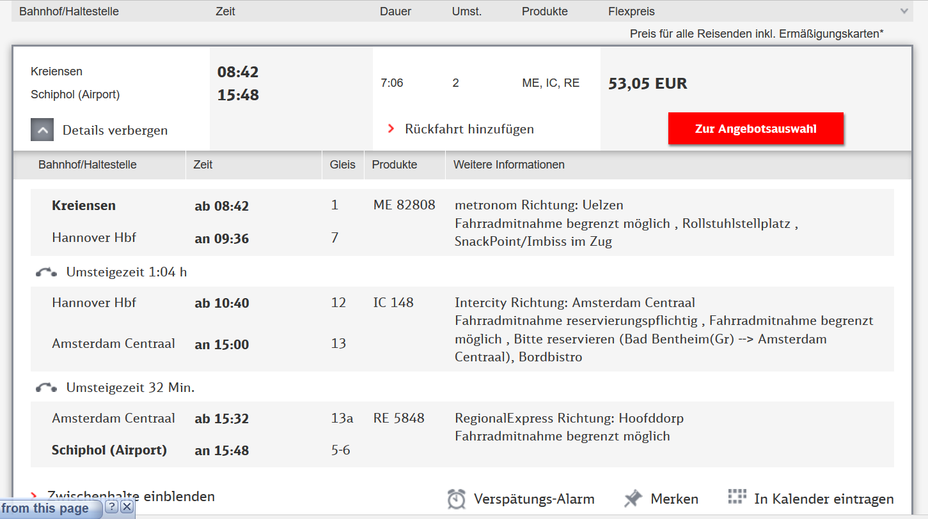
£46.62

Slide 3
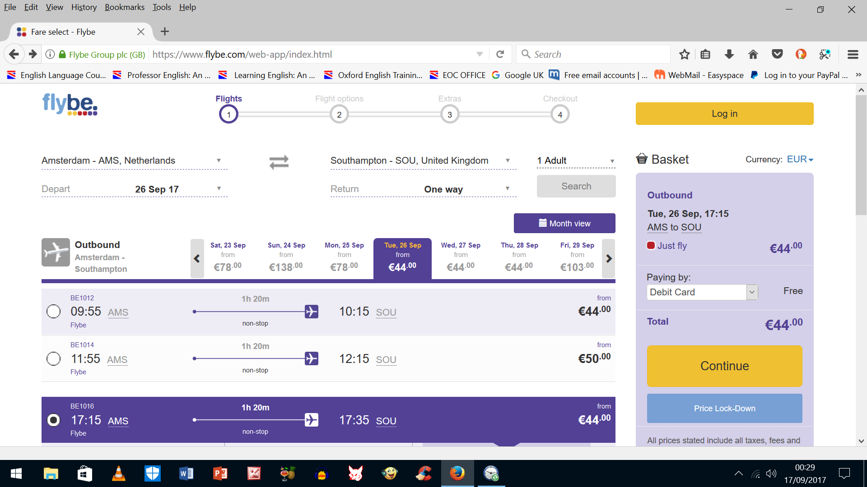
£38.67
£38.67

Slide 4
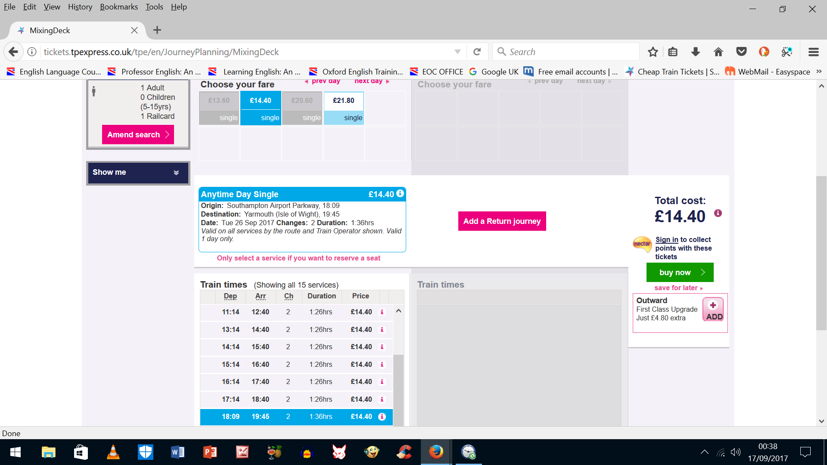
FIRST TRANSPENNINE EXPRESS

