Slide 1
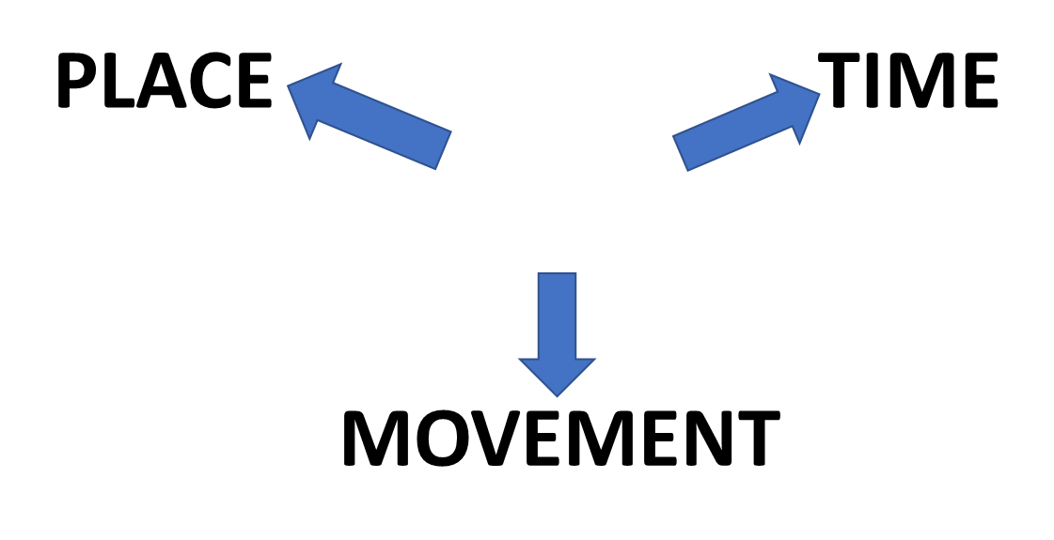
A GENERAL GUIDE TO SOME MAIN PREPOSITIONS
BY
WITH
FROM

