Slide 1
EVERY PICTURE TELLS A STORY OR
CREATES A THOUGHT
IN YOUR IMAGINATION

Slide 2
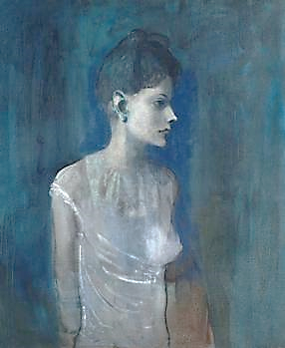

Slide 3
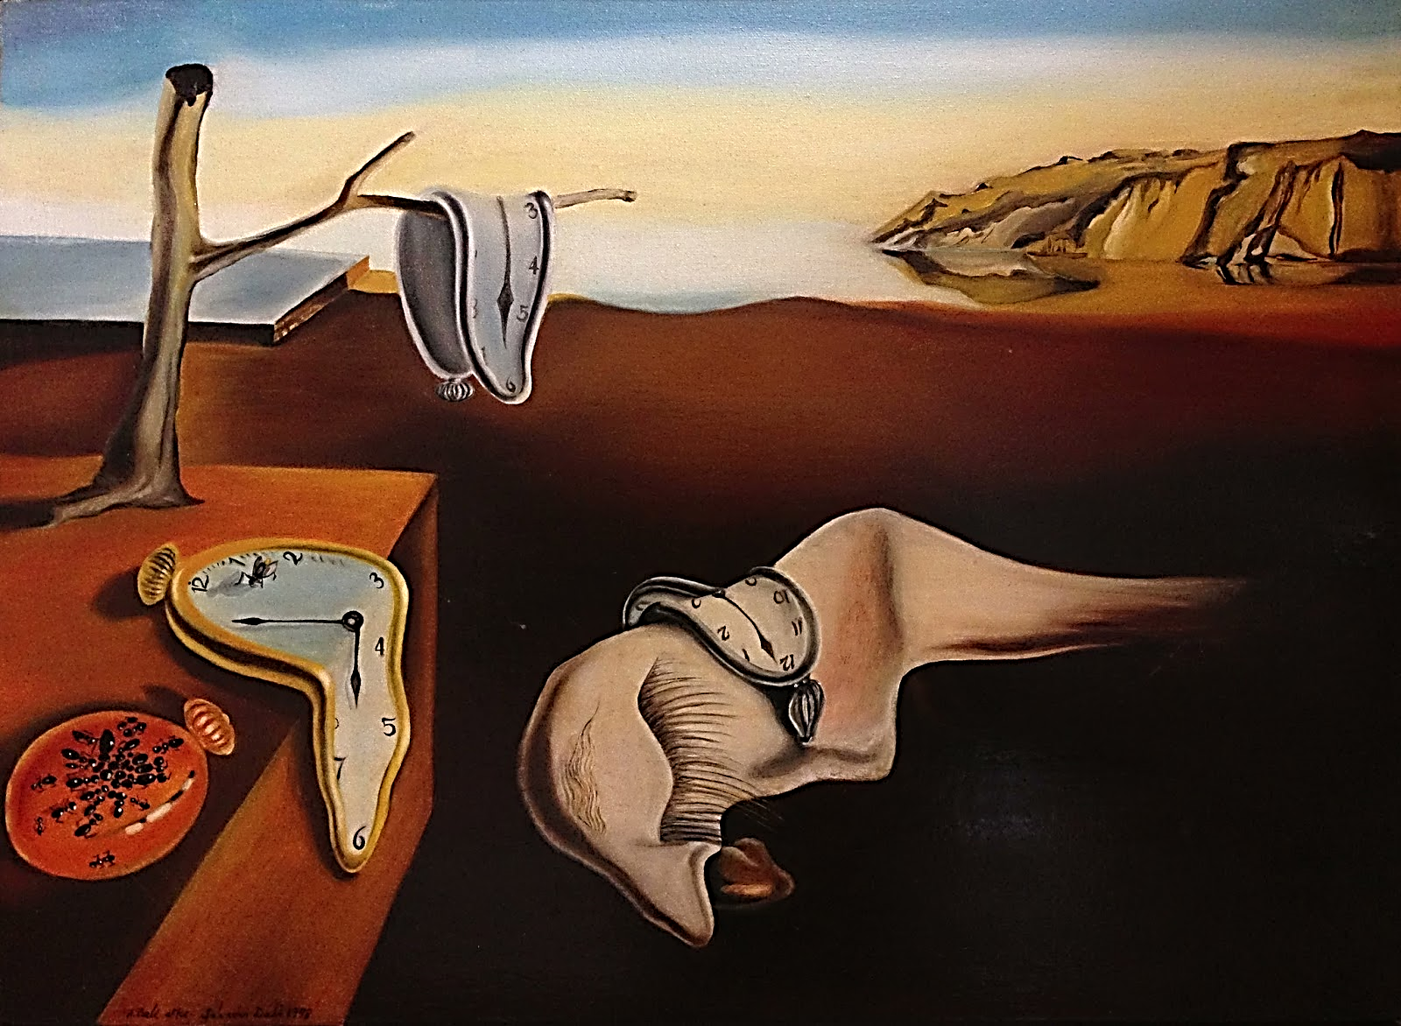

Slide 4


