Slide 1
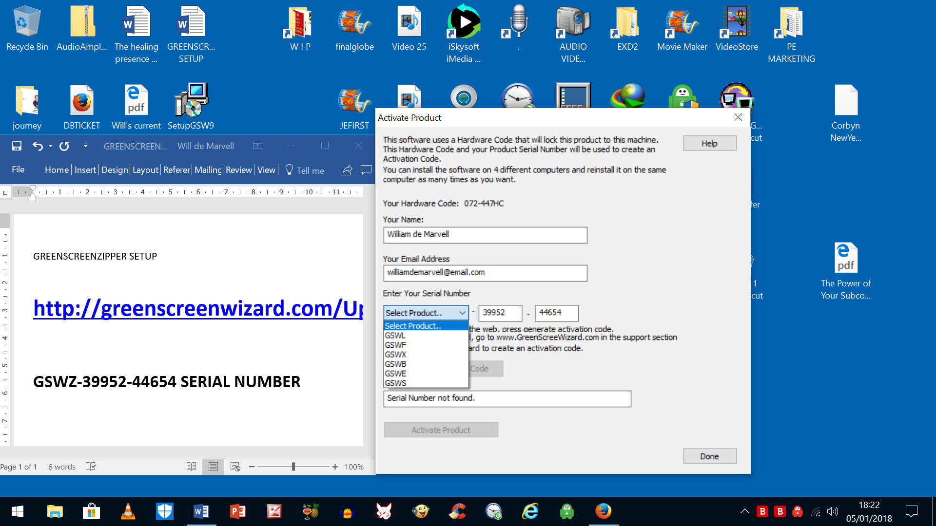
There is NO GSWZ

