Slide 1

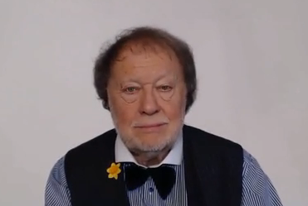
WE ASK A LOT OF QUESTIONS !
QUESTIONS OF PLACE AND TIME
QUESTIONS ABOUT EVENTS AND OPINIONS
ASKING QUESTIONS IS A VERY IMPORTANT ACTIVITY IN OUR LIVES

Slide 2




THE GERUND IS THE ING FORM USED AS A NOUN

