Slide 1
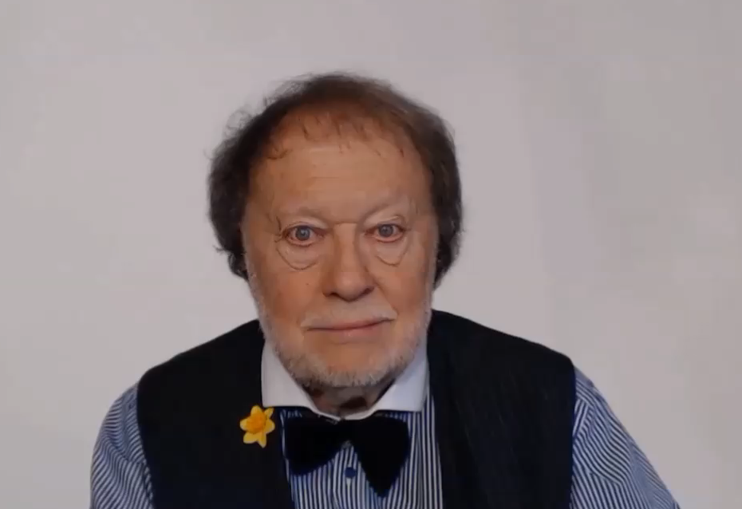
THE ‘ING’ THING-WHATEVER IS IT?

Slide 2
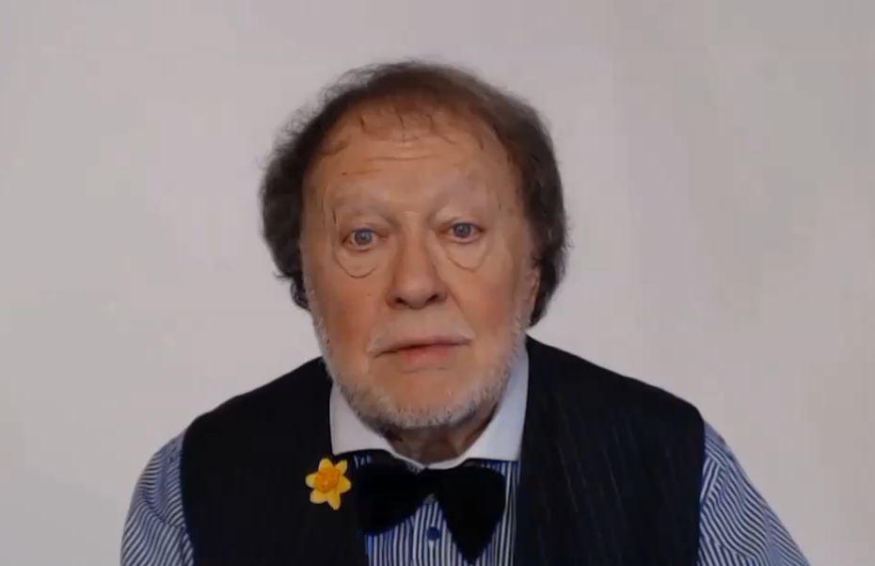
SOME ACTIVITIES ARE
SO IMPORTANT
THAT WE USE THE VERB AS A SPECIAL KIND OF NOUN

Slide 3
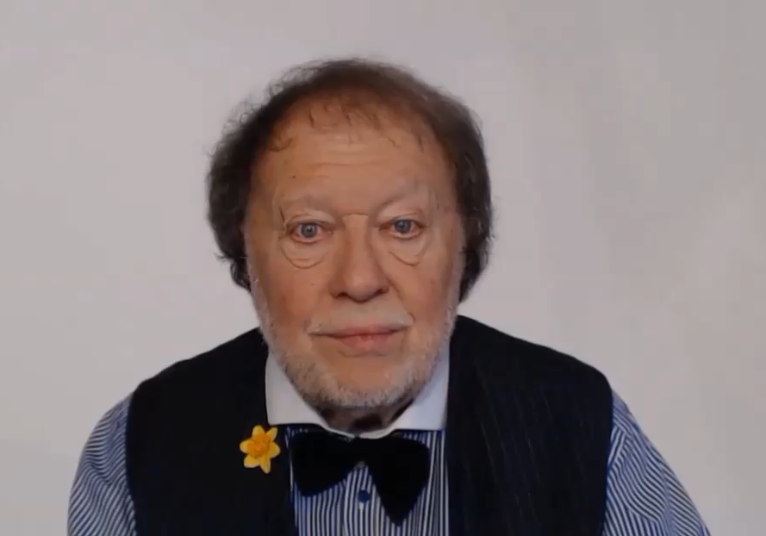
LET’S INVESTIGATE THIS STRANGE AND INTERESTING
LANGUAGE USE

Slide 4
SHOPPING
I WAS SHOPPING YESTERDAY
I MUST GET THE SHOPPING FROM THE CAR
VERB
NOUN

Slide 5
SIGHTSEEING
I WILL BE SIGHTSEEING IN MADRID
I ENJOYED THE SIGHTSEEING IN PARIS LAST WEEK
VERB
NOUN

Slide 6
SHOPPING
I WAS SHOPPING YESTERDAY
I MUST GET THE SHOPPING FROM THE CAR
SIGHTSEEING
I WILL BE SIGHTSEEING IN MADRID
I ENJOYED THE SIGHTSEEING IN PARIS LAST WEEK

Slide 7
FISHING
SWIMMING
CYCLING
RUNNING
DANCING

Slide 8
FISHING
SWIMMING
CYCLING
RUNNING
DANCING

