Slide 1
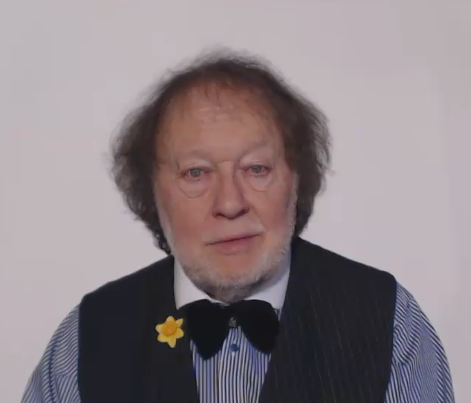
MY WARMEST THANKS TO YOU

