Slide 1
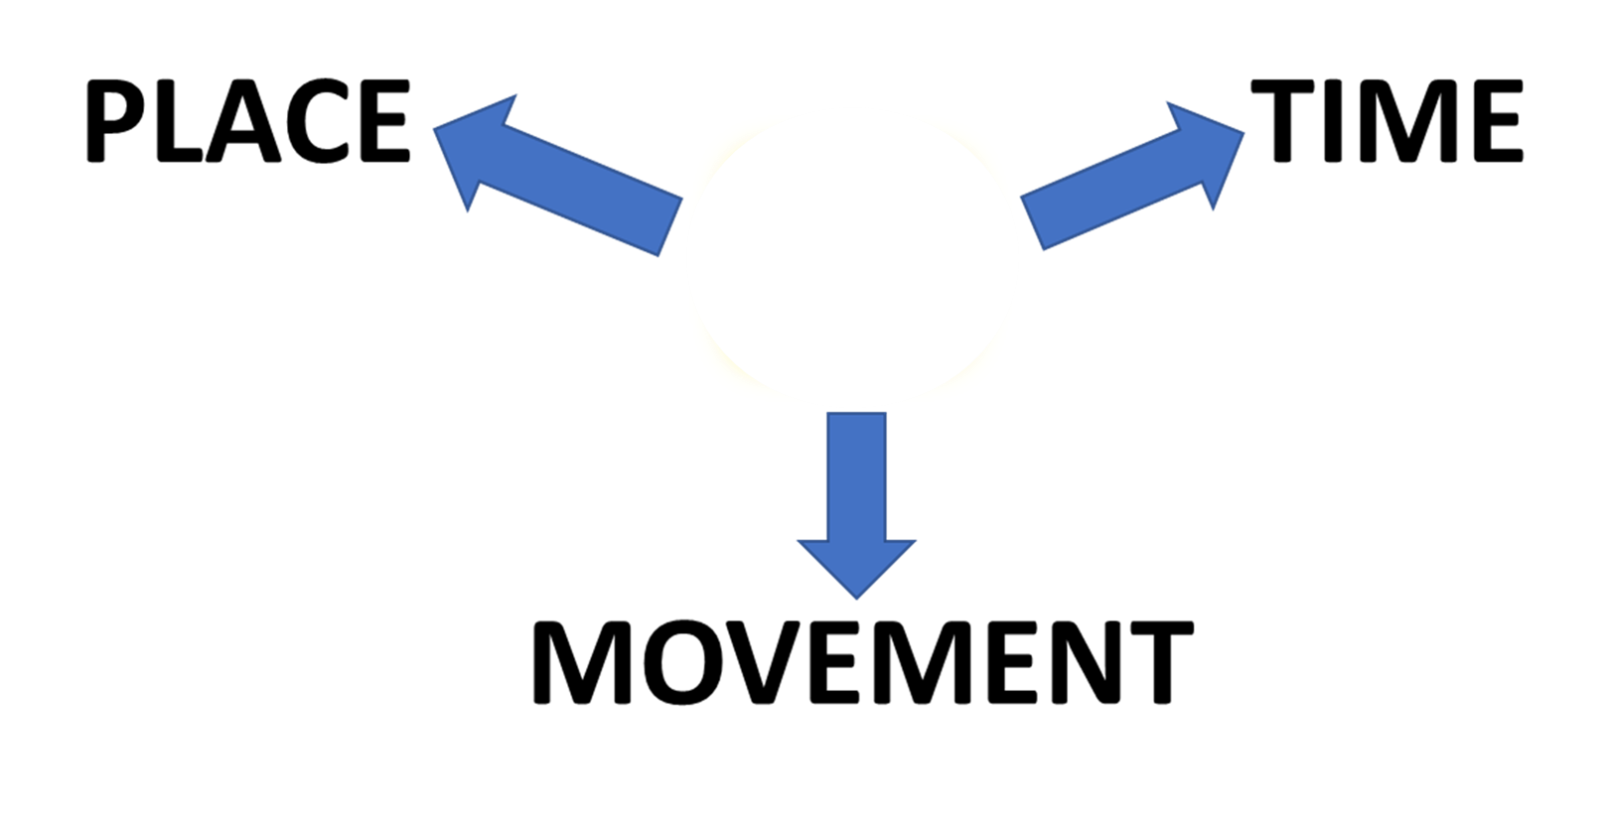

PREPOSITIONS
AT
AT

Slide 2
AT
FOR PLACE

Slide 3
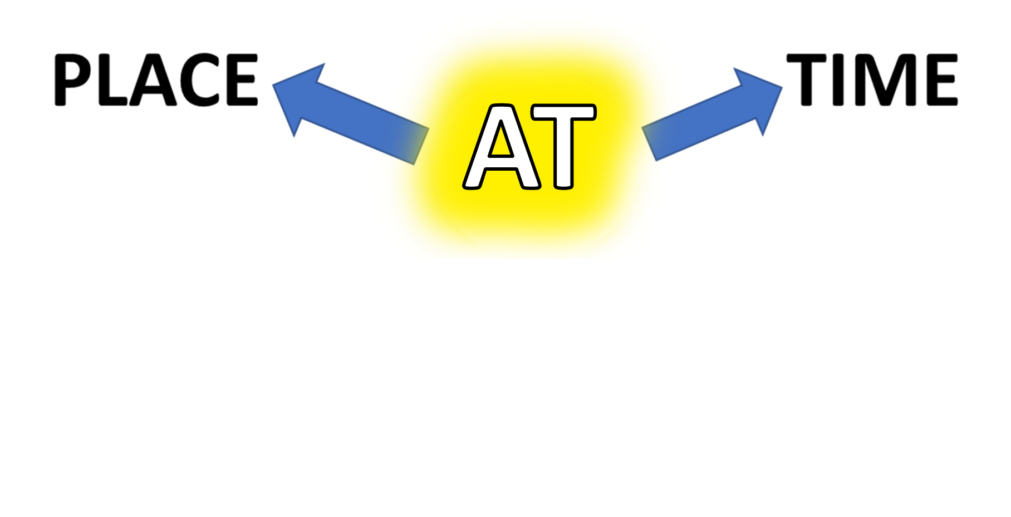
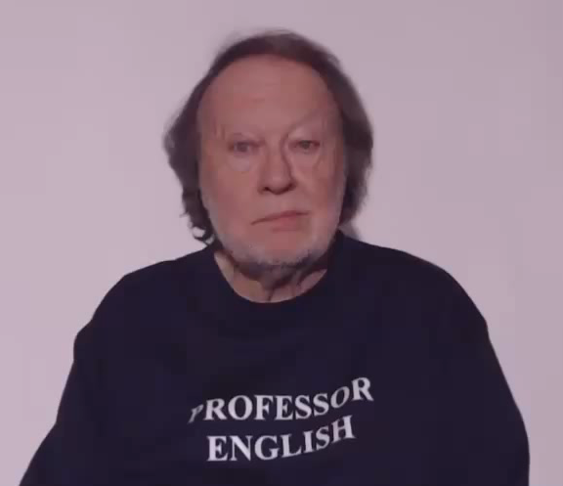
PREPOSITIONS

Slide 4
PREPOSITIONS

Slide 5
PREPOSITIONS
AT

Slide 6

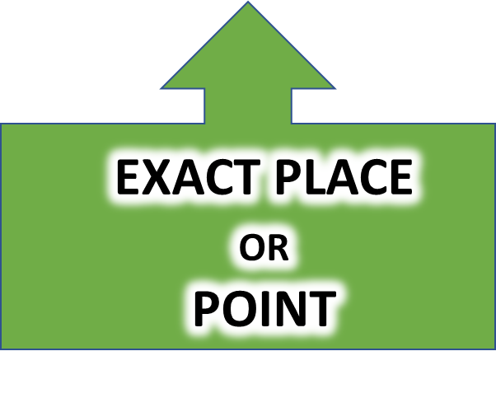

IMPORTANT NOTE!
PLACE
HAS TWO ASPECTS
LOCATION AND POSITION
GENERAL AREA
STOP THE VIDEO WHILE YOU CHECK

Slide 7
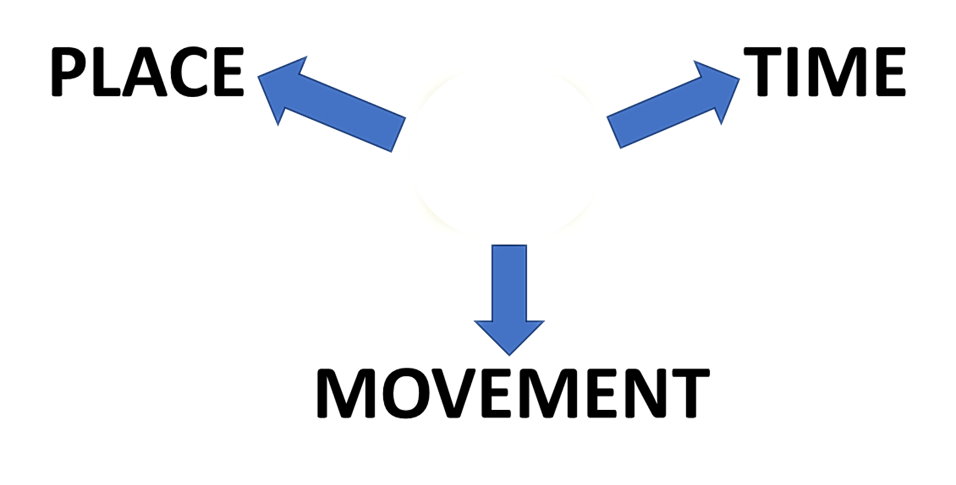
PREPOSITIONS
AT
GENERAL
LOCATION
RELATIVE POSITION
SPECIFIC POSITION

Slide 8
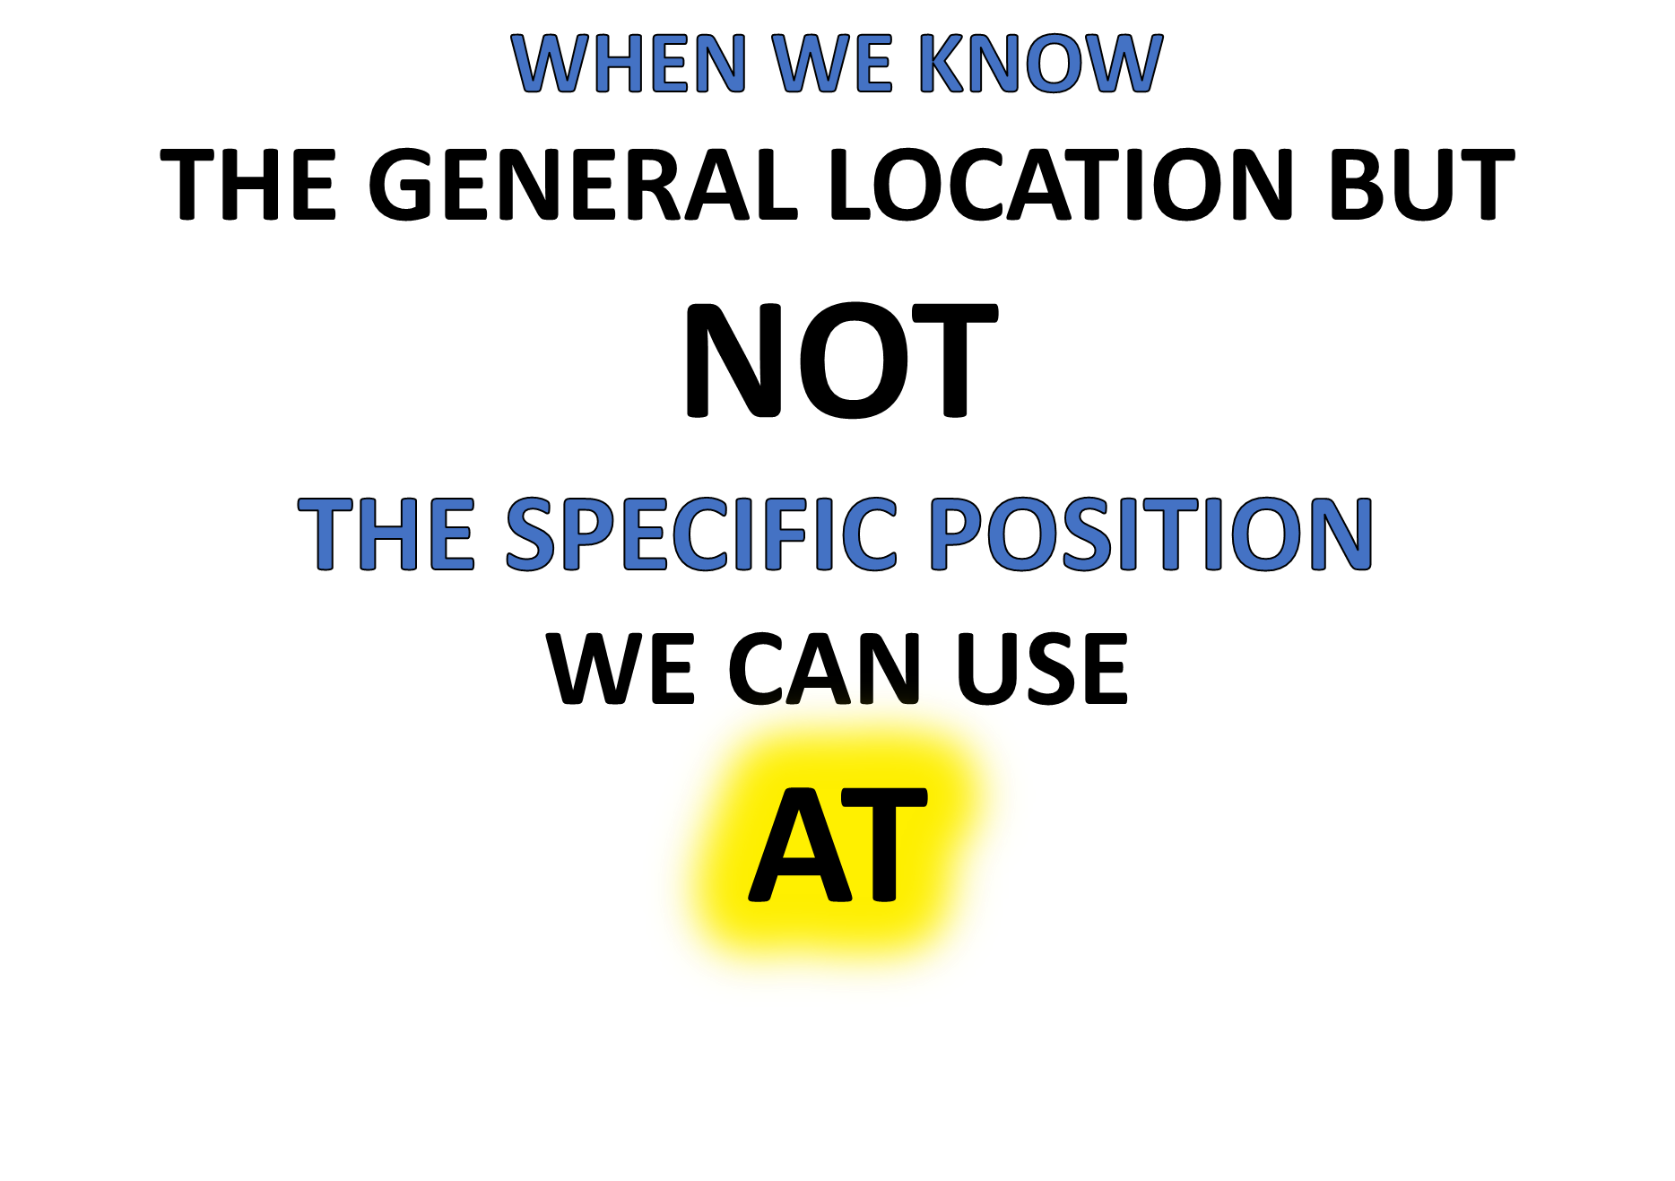
CHECK THIS WORD
“BOB IS AT THE AIRPORT BUT I DON’T KNOW WHEREABOUTS”

Slide 9
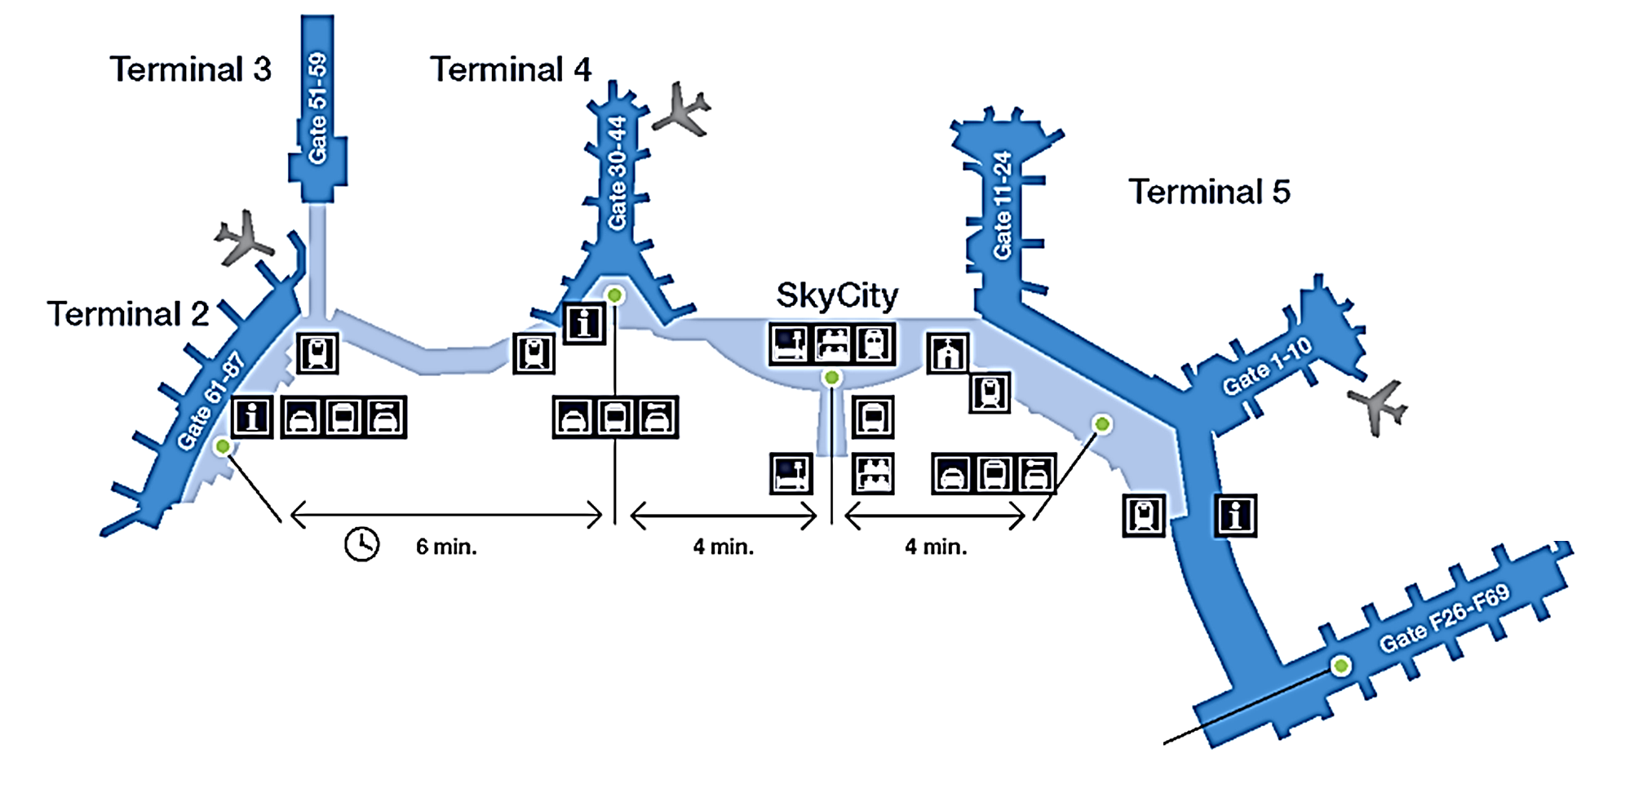
IS HE
AT TERMINAL 3?
AT THE AIRPORT!
IS HE
AT TERMINAL 5?
WHERE IS BOB?
IS HE
AT
THE INFORMATION POINT?

Slide 10
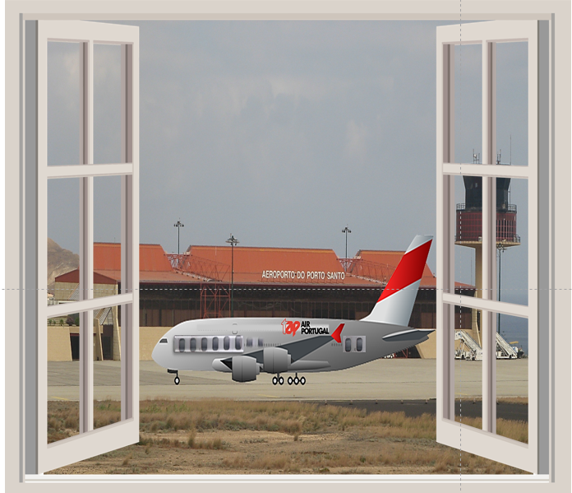



I WONDER WHERE SHE IS AT
THE AIRPORT?

Slide 11
WHEN WE KNOW
THE RELATIVE POSITION
WE CAN ALSO USE
AT
THE HOUSE IS AT THE BEACH NEAR THE SEA

Slide 12


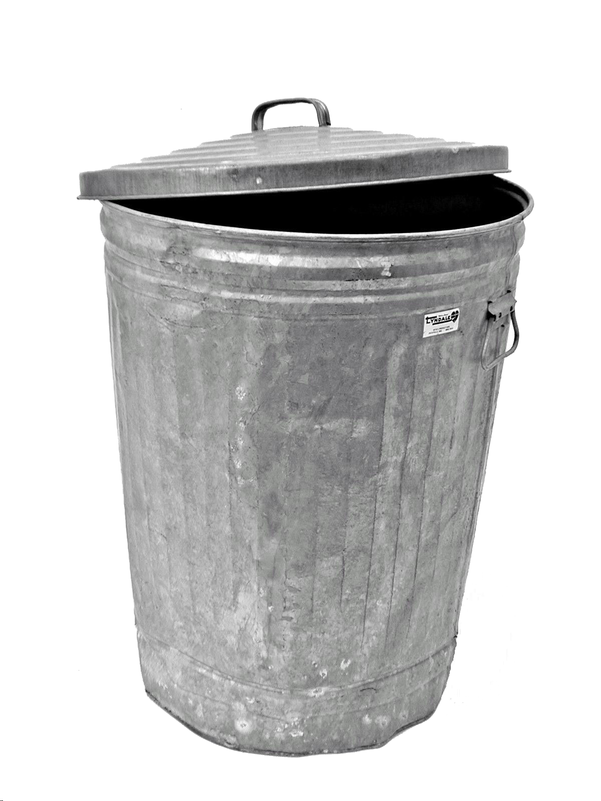



THE TREE IS
AT
THE BACK OF THE HOUSE
THE BIN IS
AT
THE SIDE OF THE HOUSE
THE DOOR IS
AT
THE FRONT OF THE HOUSE
THE HOUSE IS AT THE BEACH NEAR THE SEA
RELATIVE POSITIONS!

Slide 13
WE CAN USE
AT
WHEN WE KNOW
THE SPECIFIC POSITION
EXACTLY

Slide 14
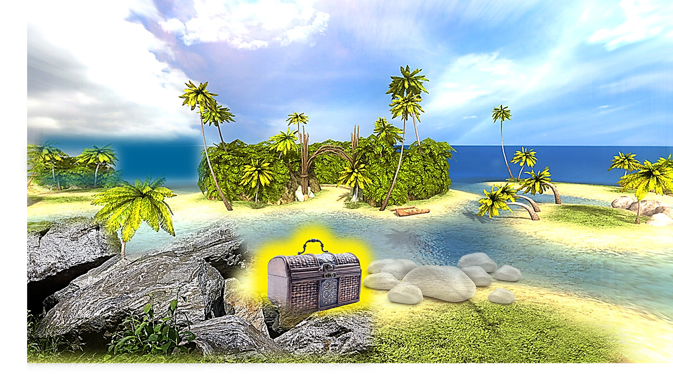
THE TREASURE IS…
AT
THE WHITE ROCKS

Slide 15
THE TREASURE IS…
AT
THE WHITE ROCKS

Slide 16
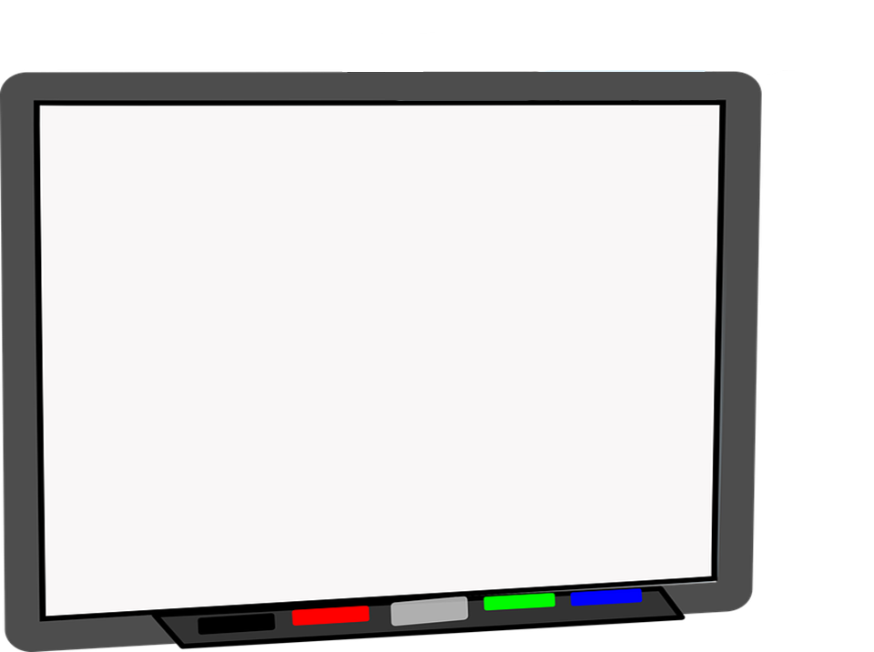
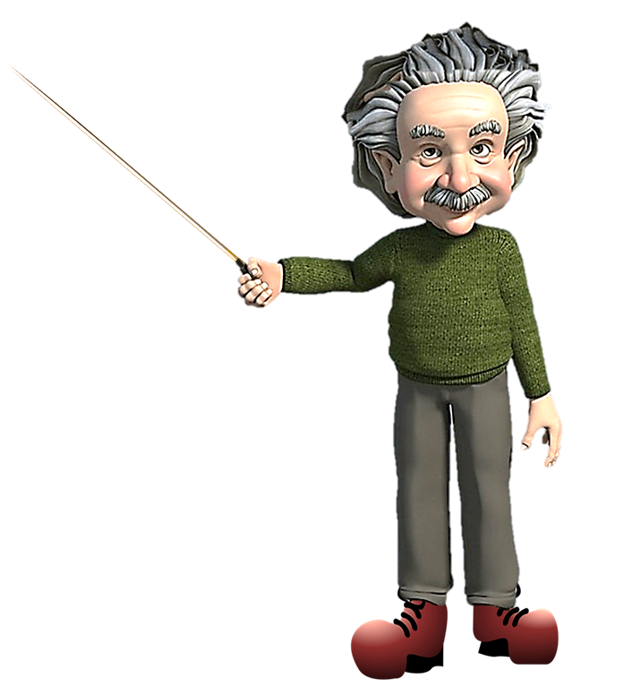
MY EXACT POSITION IS
THIS BOARD!
AT
THE PROFESSOR IS AT THE WHITEBOARD

