Slide 1
OTHER MAIN VERB USES OF GET
WHAT TIME WILL WE GET THERE ?
THIS MEANS ARRIVE
I DON’T GET IT PLEASE EXPLAIN !
THIS MEANS UNDERSTAND

Slide 2

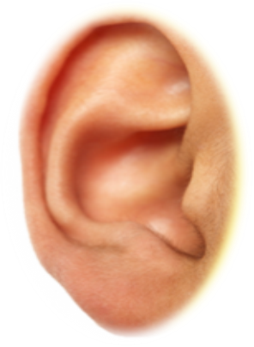

STORY BOARD

