Slide 1


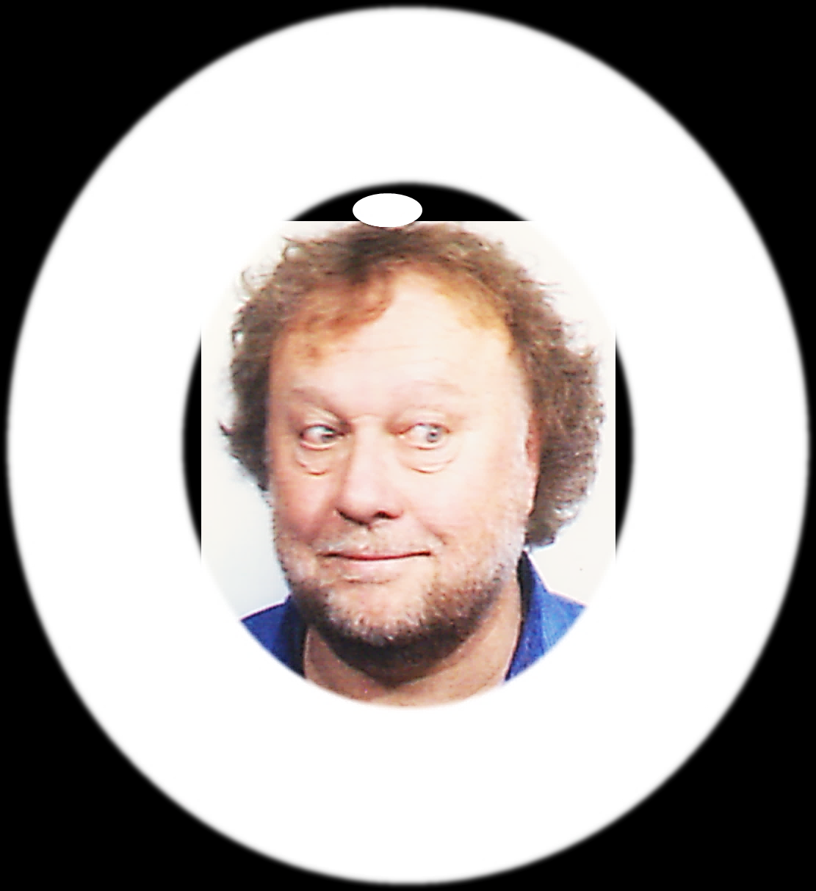
AGREEING AND DISAGREEING
I don’t think we should change the plan
I am sure it would be better!

