Slide 1


OXFORD
THE ENGLISH RESOURCE

Slide 2

WELCOME TO YOUR REVOLUTION IN LEARNING ENGLISH
LET PROFESSOR ENGLISH
GUIDE YOU THROUGH KEY ASPECTS OF
THE ENGLISH LANGUAGE

Slide 3
THE PROFESSOR ENGLISH TEAM
HEARTILY THANKS

Slide 4
THE PROFESSOR ENGLISH TEAM
HEARTILY THANKS

Slide 5
THE PROFESSOR ENGLISH TEAM
HEARTILY THANKS

Slide 6
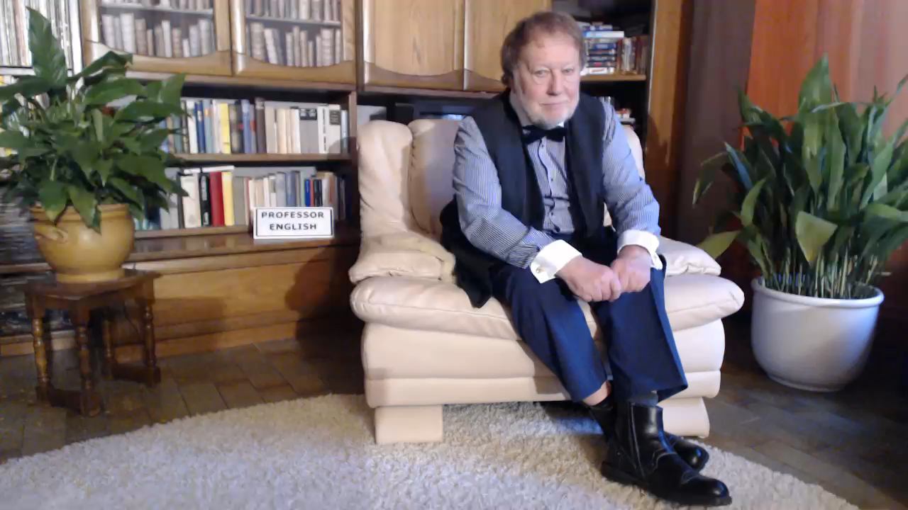

Slide 7


