Slide 1
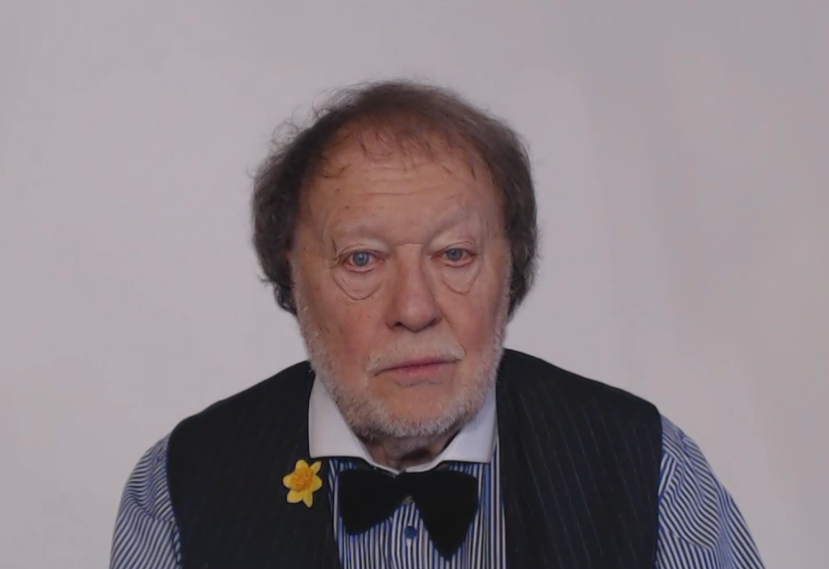
LET’S TALK ABOUT QUANTITIES

Slide 2
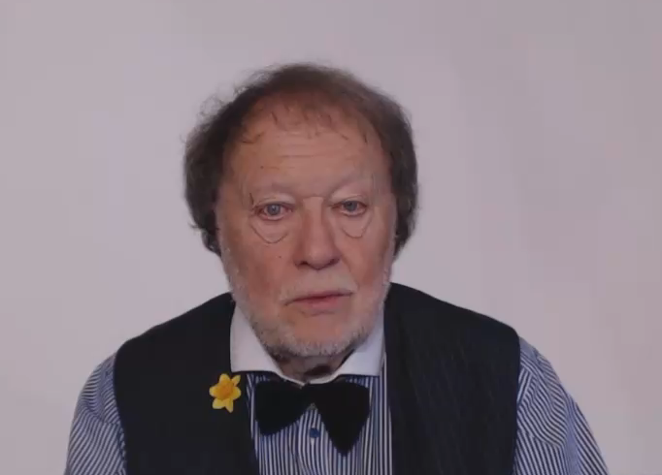
LET’S TALK ABOUT QUANTITIES

Slide 3

COUNTABLE
UNCOUNTABLE
WHAT ARE THESE ?

Slide 4

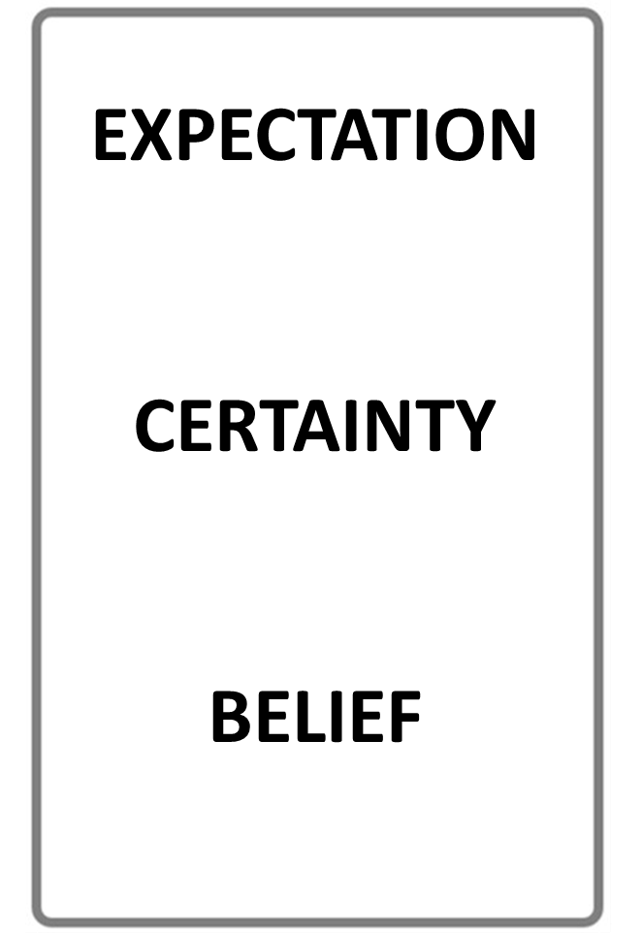

THE NUMBER
OF THINGS
QUANTITY
WHAT’S THE DIFFERENCE?
AMOUNT
UNCOUNTABLE SIZE
STOP THE VIDEO WHILE YOU CHECK

Slide 5

QUANTITY IS OFTEN COUNTABLE
TWO FRIENDS
FIVE BOOKS
MANY PEOPLE
MAYBE ONE HUNDRED
AMOUNT IS OFTEN UNCOUNTABLE
A LOT OF HAPPINESS
SOME GOOD FRIENDSHIP
LOTS OF GOOD LUCK
SOME MONEY, MAYBE MILLIONS!

Slide 6
QUANTITY IS USUALLY COUNTABLE
AMOUNT IS USUALLY UNCOUNTABLE
BUT…

Slide 7
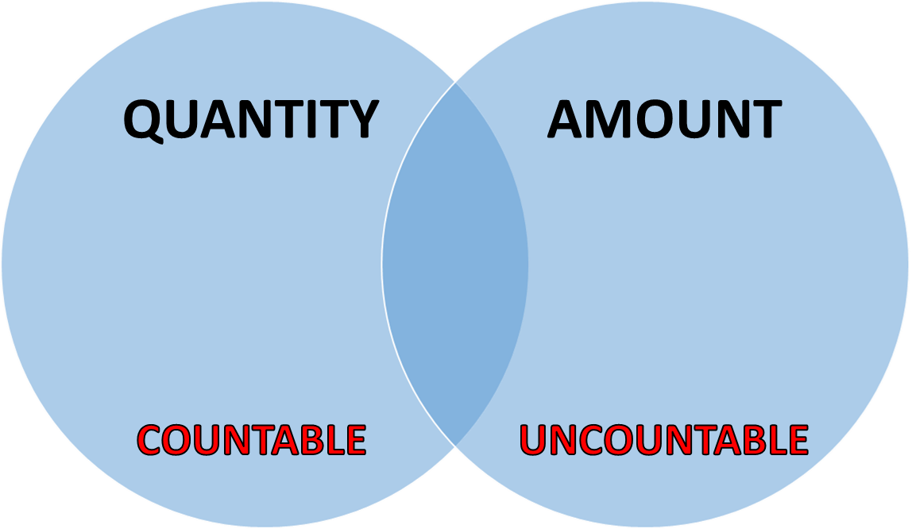

PLEASE NOTE!
IN EVERYDAY CONVERSATIONS THERE IS OFTEN PERSONAL CHOICE
PEOPLE OFTEN USE EITHER

Slide 8
THE FOLLOWING EXAMPLES SHOW THE DIFFERENCE BETWEEN
COUNTABLE
AND
UNCOUNTABLE
NOUNS

Slide 9

KEY EXAMPLES
What is a Noun?
Anything that can be counted, singular or plural :
a person, a car, a few apples, lots of books
Your glass is on the table.
How many people are in the room?
There are three ways to reach the sea.
There’s one interesting old tree in my garden.

Slide 10

KEY INFORMATION
What is an Noun?
Anything that cannot be counted is an uncountable noun
Uncountable nouns are not individual objects
They are always singular and must be used with singular verbs
The following examples show typical
uncountable
nouns

Slide 11

KEY EXAMPLES
Noun Examples
Singular verbs must be used with uncountable nouns
There is no more coffee in the pot.
Would you like more money?
I want to get correct information
You should always aim for excellence
Please get better equipment
Can we explain the data?

Slide 12


Slide 13


Slide 14


Slide 17
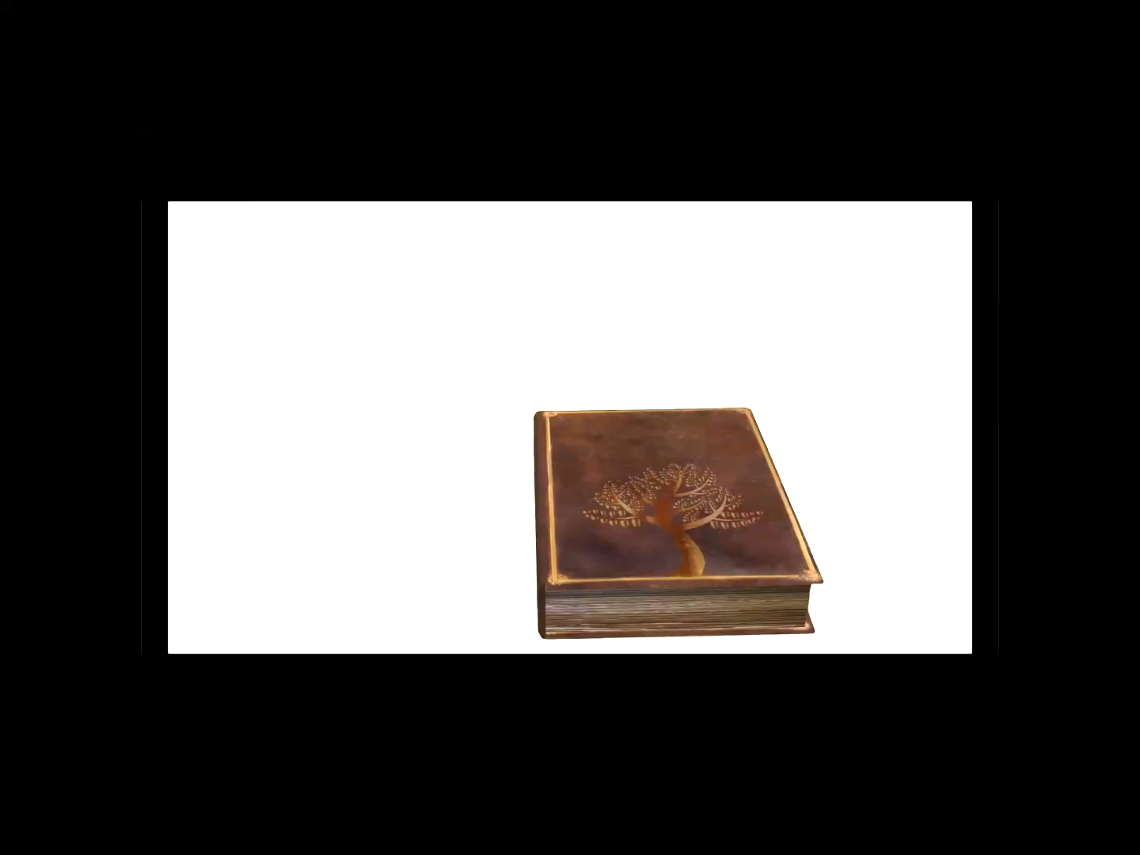

Slide 18
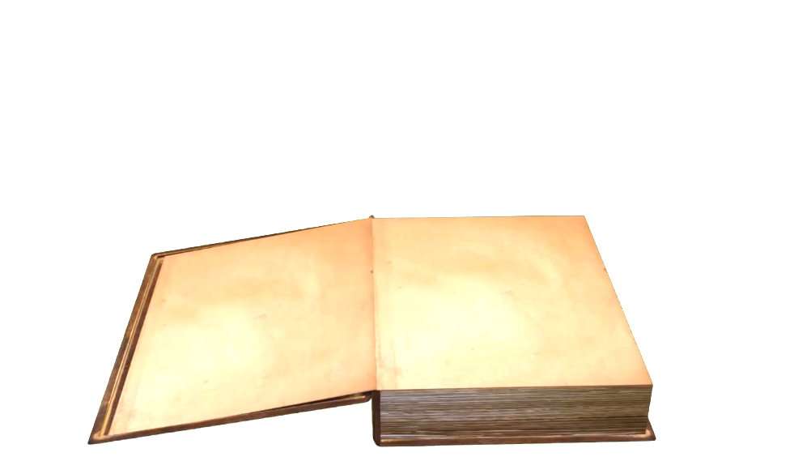


Slide 19


Slide 20
SOME ANY NONE
QUESTION OR NO QUANTITY
A POSITIVE QUANTITY
NOT EVEN ONE

Slide 21
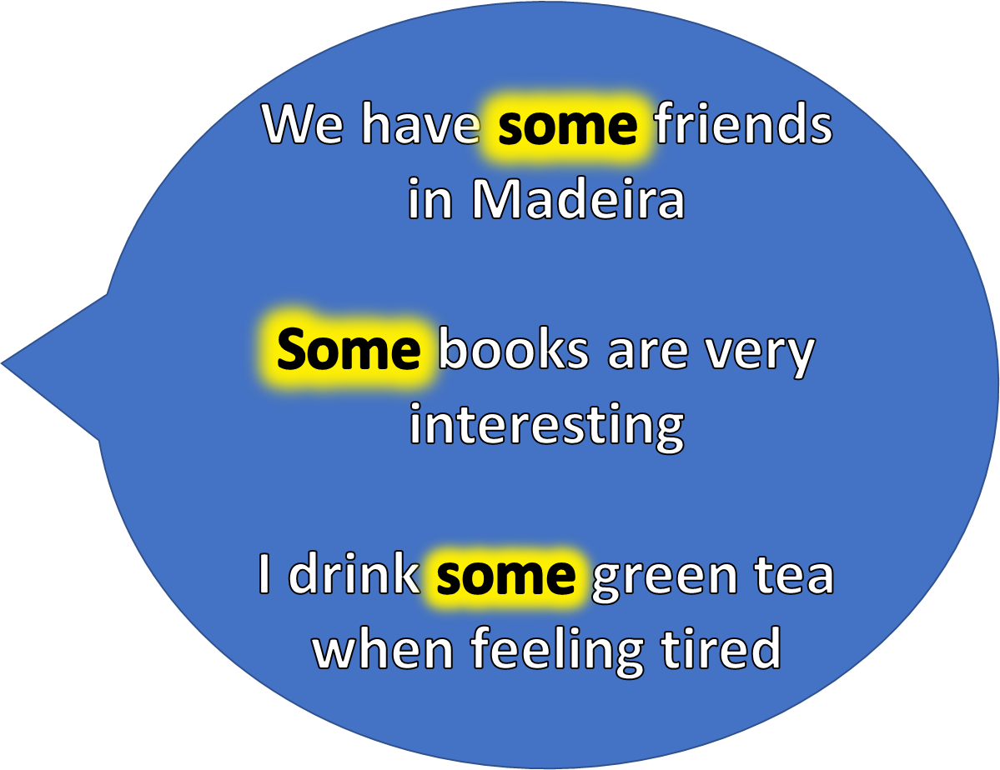
SOME
A POSITIVE QUANTITY

Slide 22
Are there any interesting places here?
Have you any friends in Paris?
I don’t drink any tea, I prefer coffee
ANY
QUESTION OR NO QUANTITY

Slide 23
I would like friends in Madeira but I have none
None of these books is very interesting
NONE
NOT EVEN ONE

Slide 24

MORE
KEY WORDS!

Slide 25
M A N Y M U C H
COUNTABLE QUANTITY
UNCOUNTABLE
QUANTITY

Slide 26
AND MORE…

Slide 27
A LITTLE A FEW
SMALL UNCOUNTABLE QUANTITY
SMALL COUNTABLE QUANTITY

Slide 28
KEY EXAMPLES
ONLY A FEW PEOPLE
ONLY A LITTLE

Slide 29
A LITTLE LOTS OF
SMALL UNCOUNTABLE QUANTITY
LARGE COUNTABLE QUANTITY

Slide 30
KEY EXAMPLES
A LITTLE
LOTS OF

Slide 31
KEY EXAMPLES

Slide 32
YOU CAN USE
EITHER!
A LOT OF LOTS OF
LARGE
COUNTABLE OR UNCOUNTABLE QUANTITY

Slide 33
KEY EXAMPLES
LOTS OF
A LOT OF

Slide 34
ENOUGH SUFFICIENT PLENTY
CORRECT QUANTITY
CORRECT QUANTITY
MORE THAN ENOUGH

Slide 35
WHAT’S THE DIFFERENCE?
ENOUGH
SUFFICIENT
IN GENERAL THEY MEAN THE SAME

Slide 36
KEY EXAMPLES
ENOUGH
SUFFICIENT
PLENTY

Slide 37
KEY EXAMPLES

Slide 38
QUANTITY SUMMARY!
MUCH MANY
SOME
ANY
ENOUGH = SUFFICIENT
PLENTY
LARGE
COUNTABLE
LARGE
UNCOUNTABLE
NON SPECIFIC
QUESTIONS AND NEGATIVES
MORE NOT NEEDED
MORE THAN ENOUGH
STOP THE VIDEO WHILE YOU CHECK

Slide 39
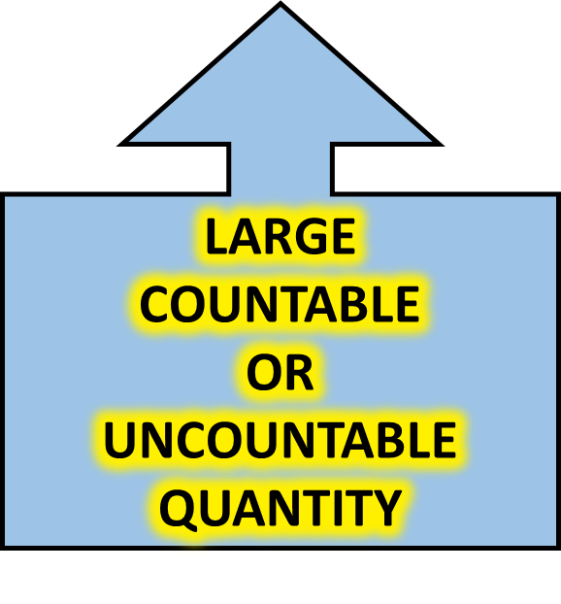
QUANTITY SUMMARY!
LOTS OF = A LOT OF
STOP THE VIDEO WHILE YOU CHECK

Slide 40


Slide 41
QUANTITY IS OFTEN COUNTABLE
TWO FRIENDS
FIVE BOOKS
MANY PEOPLE
MAYBE ONE HUNDRED
AMOUNT IS OFTEN UNCOUNTABLE
A LOT OF HAPPINESS
SOME GOOD FRIENDSHIP
LOTS OF GOOD LUCK
SOME MONEY, MAYBE MILLIONS!

Slide 43


LISTENING PRACTICE
JUST LISTEN...

Slide 45

NOW READ THE STORY
THEN LISTEN
AND READ AGAIN

Slide 46
Jane and Jack took a trip to the mountains last autumn. They travelled by train to an old attractive hillside village, one of many in the mountains. The area is much like the alps, with many picturesque woods and valleys.
Jack likes the hills and Jane loves the woods. There are plenty of both! The evenings can be a little cold but there is a lot of sunshine during the day. Jack and Jane have visited lots of locations and have even made a few local friends
They would like to live there, Jack wants to start a business making sundials! The challenge is that there are very few homes for sale and they have only a little money.
Oh well, they can dream…..

Slide 47
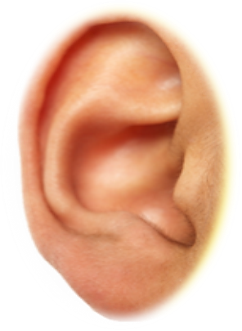

STORY BOARD

Slide 48
Jane and Jack took a trip to the mountains last autumn. They travelled by train to an old attractive hillside village, one of many in the mountains. The area is much like the alps, with many picturesque woods and valleys.
Jack likes the hills and Jane loves the woods. There are plenty of both! The evenings can be a little cold but there is a lot of sunshine during the day. Jack and Jane have visited lots of locations and have even made a few local friends
They would like to live there, Jack wants to start a business making sundials! The challenge is that there are very few homes for sale and they have only a little money.
Oh well, they can dream…..

Slide 49

READ THE DIALOGUE
THEN LISTEN
AND READ AGAIN

Slide 50
Jane
Jake
Jane
Jake
Jane
Jake

Slide 51

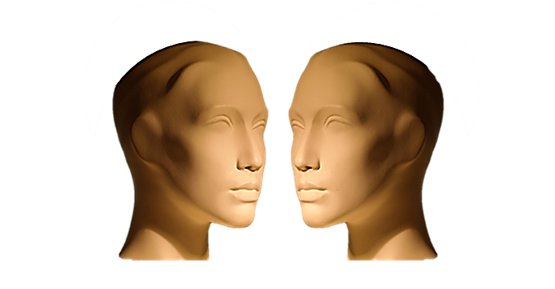
TYPICAL DIALOGUE
JUST LISTEN...

Slide 52
Jane
Jake
Jane
Jake
Jane
Jake

