Slide 1
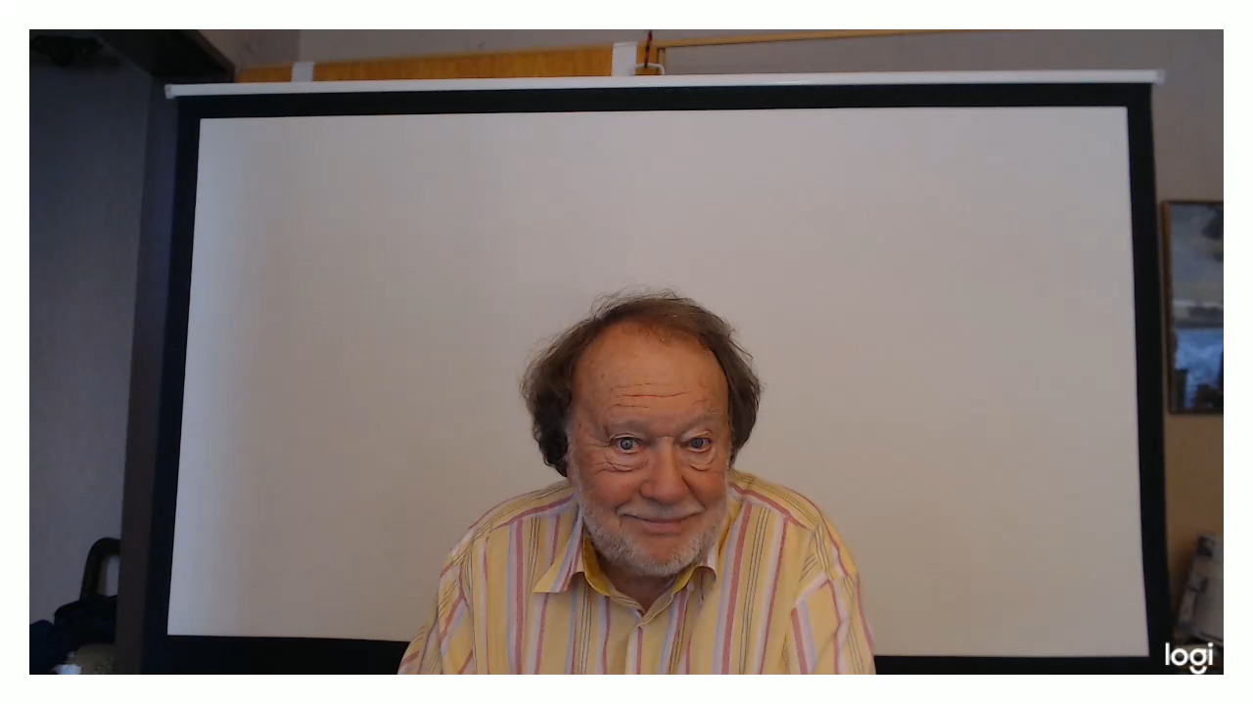
AGREEING
AND
DISAGREEING

Slide 2



SOME WAYS WE COMMUNICATE
TO AGREE
TO DISAGREE
TO COMPROMISE
TO HAVE THE SAME OPINION
TO HAVE A DIFFERENT OPINION
TO FIND AGREEMENT BETWEEN DIFFERENCES
STOP THE VIDEO WHILE YOU CHECK

Slide 3
AGREEING
DISAGREEING
Let's have a camping holiday, in a hot country by the sea.
Yes, why not? We'll just take a week off.
We could fly to Malaga and hire a four-wheel drive.
I'll go along with that.
But, I think we should also invite some females.
And I'll go along with that! Why don't you ask Mitzi?
Mitzi, I'm planning a great holiday, touring and camping in Spain.
Are you interested?
Count me in, it sounds wonderful. Is it just you and me?
What about me?
You find your own girlfriend!

Slide 4
AGREEING
DISAGREEING
I really like that crazy friend of yours. He's so funny. Why don't you go out with him?
Certainly not! I wouldn't go out with him if he was
the last guy on earth.
I don't agree. In fact, we were going to come and see you tomorrow.
It's out of the question. I shan't even open the door.
I know you like him really. You should go out with him, at least once.
No way! If you like him so much why don't you go out with him.

Slide 5



WATCHING AND LISTENING PRACTICE
NOTICE THIS...

Slide 6


Slide 7

AGREEMENT
A POSITIVE YES !
WE CAN SEE EYE TO EYE
TOTAL AGREEMENT
THAT’S EXACTLY HOW I FEEL
YOU HAVE A POINT THERE
MAYBE AGREEMENT
I WAS JUST GOING TO SAY THAT
I COULDN’T AGREE MORE
TOTAL AGREEMENT
ABSOLUTELY

Slide 8
DISAGREEMENT
DIFFERENT OPINION
WE DON’T SEE EYE TO EYE
I TAKE YOUR POINT BUT
I TEND TO DISAGREE I WITH YOU
I’M AFRAID I HAVE TO DISAGREE WITH YOU
I’M AFRAID I CAN’T SEE IT THAT WAY
I BEG TO DIFFER
THAT’S NOT ALWAYS THE CASE

Slide 9
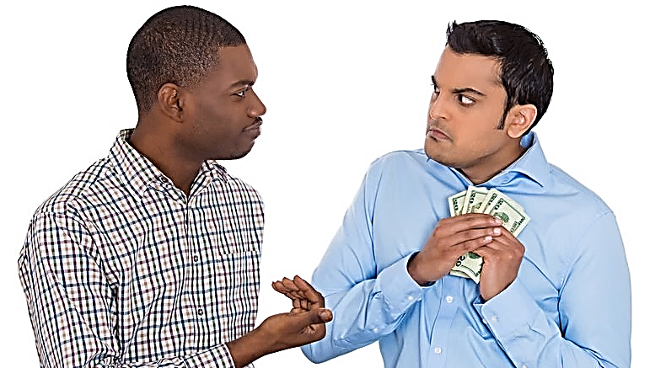

Slide 10
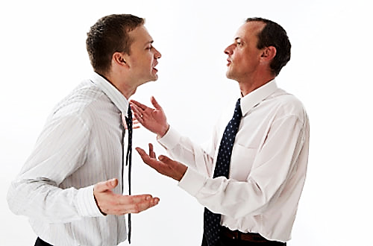

Slide 11
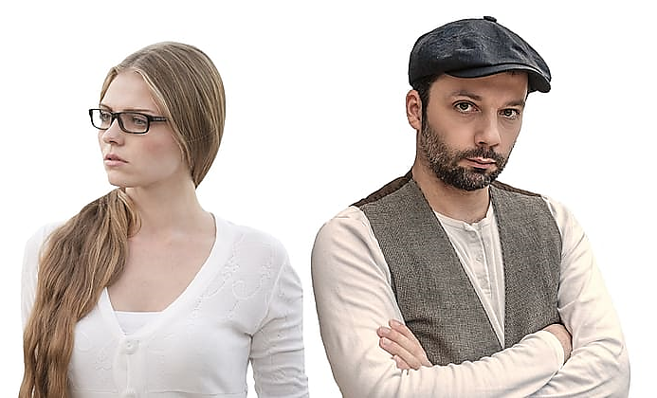

Slide 12
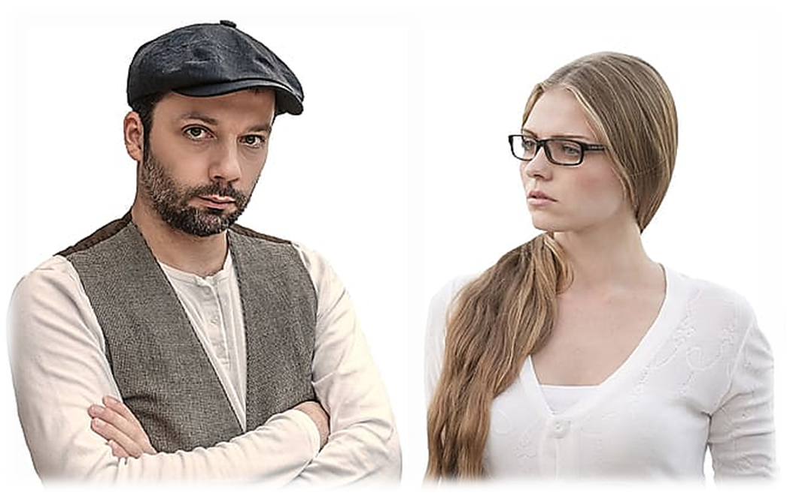

Slide 13

WE AGREE!

Slide 14
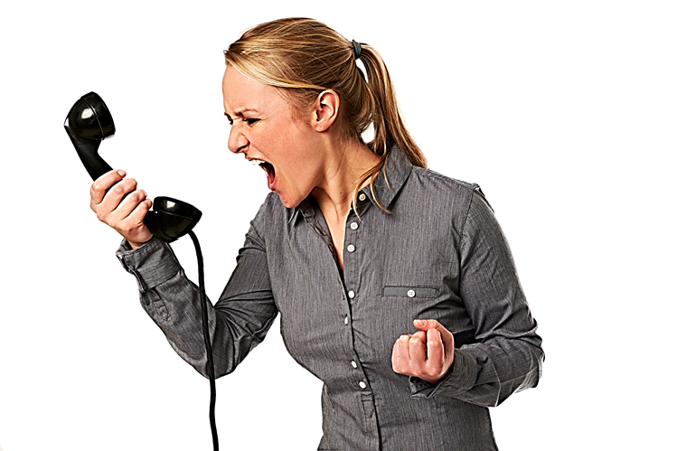

THEY DISAGREE!.........

Slide 15


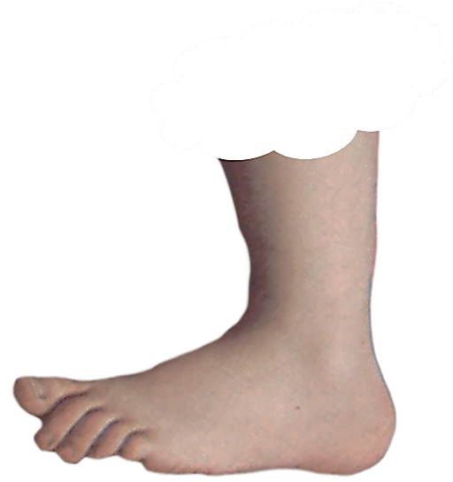
A SUCCESSFUL RESULT AFTER DISAGREEING
AND THEN
AGREEING
IS
AN
AGREEMENT BETWEEN DIFFERENCES
A COMPROMISE
FOOTNOTE
FOOTNOTE

Slide 16
NOW CLICK THE
MORE
BUTTON

Slide 24
SOME WAYS WE COMMUNICATE
TO COMPROMISE
TO AGREE
TO DISAGREE
TO FIND AGREEMENT BETWEEN DIFFERENCES
TO HAVE THE SAME OPINION
TO HAVE A DIFFERENT OPINION
STOP THE VIDEO WHILE YOU CHECK

Slide 25
STOP THE VIDEO WHILE YOU CHECK

Slide 26
COMPROMISE

Slide 27
WATCHING AND LISTENING PRACTICE
NOTICE THIS...

Slide 28
THEY DISAGREE!.........

Slide 29
AGREEMENT
WE CAN SEE EYE TO EYE
THAT’S EXACTLY HOW I FEEL
YOU HAVE A POINT THERE
I WAS JUST GOING TO SAY THAT
I COULDN’T AGREE MORE
ABSOLUTELY

Slide 31

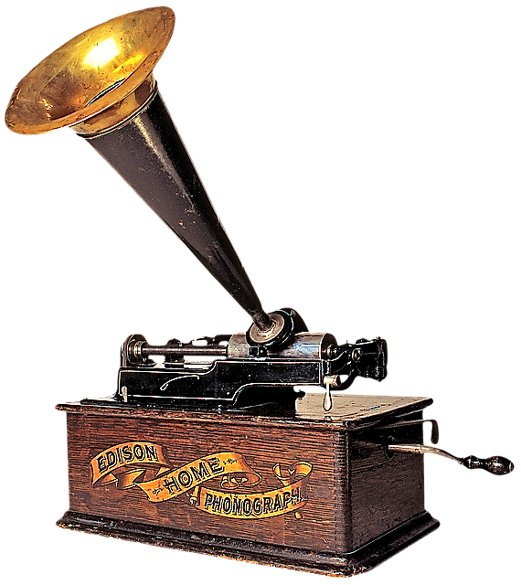
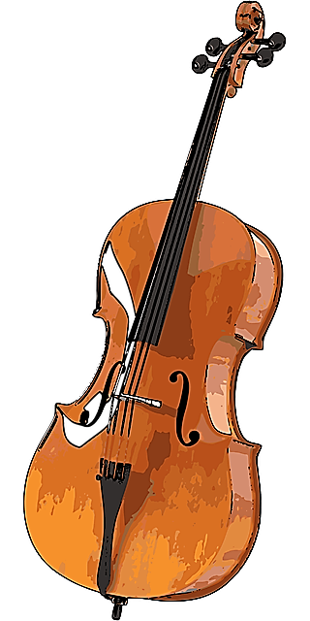
AGREEMENT
NOW LISTEN TO THE POSITIVE RISING MELODY

Slide 32
AGREEMENT
A POSITIVE YES !
WE CAN SEE EYE TO EYE
TOTAL AGREEMENT
THAT’S EXACTLY HOW I FEEL
MAYBE AGREEMENT
YOU HAVE A POINT THERE
I WAS JUST GOING TO SAY THAT
I COULDN’T AGREE MORE
ABSOLUTELY
TOTAL AGREEMENT

Slide 33

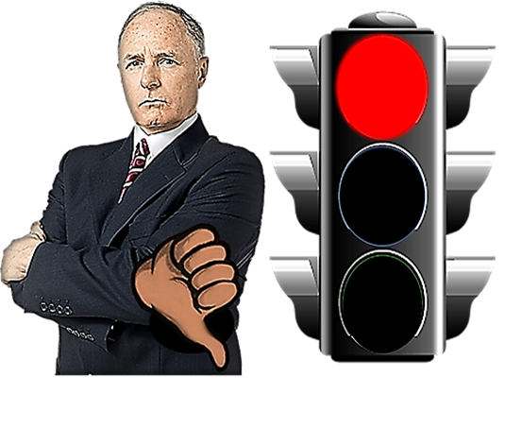
DISAGREEMENT
NOW LISTEN TO THE NEGATIVE FALLING MELODY

Slide 34
DISAGREEMENT
DIFFERENT OPINION
WE DON’T SEE EYE TO EYE
I TAKE YOUR POINT BUT
DIFFERENT OPINION
I TEND TO DISAGREE WITH YOU
DIFFERENT OPINION
I’M AFRAID I HAVE TO DISAGREE WITH YOU
DIFFERENT OPINION
I’M AFRAID I CAN’T SEE IT THAT WAY
DIFFERENT OPINION
I BEG TO DIFFER
DIFFERENT OPINION
THAT’S NOT ALWAYS THE CASE

Slide 35


NOW LISTEN TO THE
RISING AND FALLING MELODIES
OF AGREEMENT AND DISAGREEMENT

