Slide 1
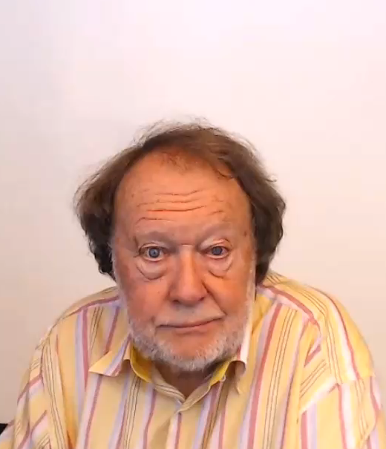
WHAT IS
MEDIATING?

Slide 2
WHAT IS
MEDIATING?

