Slide 1
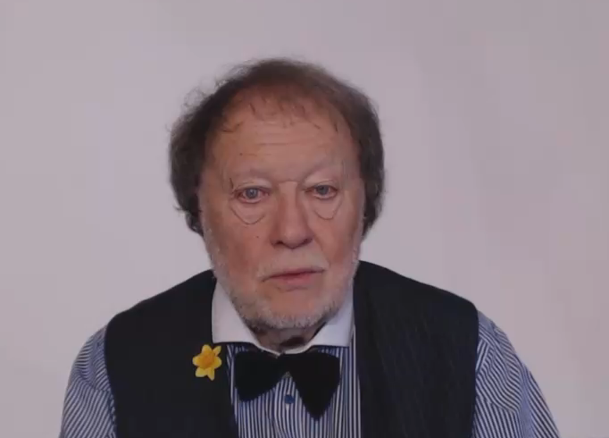
LET’S TALK ABOUT QUANTITIES

Slide 2

COUNTABLE
UNCOUNTABLE
WHAT ARE THESE ?

Slide 3

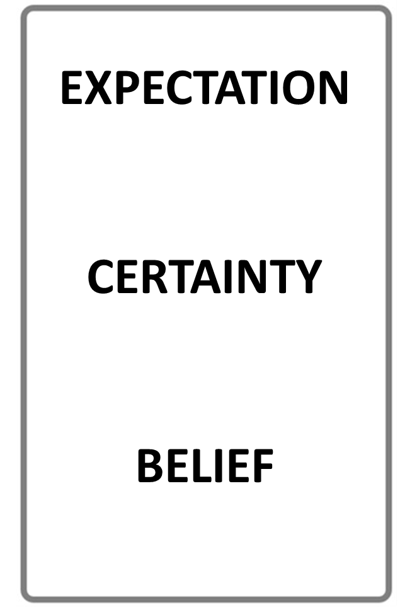

THE NUMBER
OF THINGS
QUANTITY
WHAT’S THE DIFFERENCE?
AMOUNT
UNCOUNTABLE SIZE
STOP THE VIDEO WHILE YOU CHECK

Slide 4

QUANTITY IS OFTEN COUNTABLE
TWO FRIENDS
FIVE BOOKS
MANY PEOPLE
MAYBE ONE HUNDRED
AMOUNT IS OFTEN UNCOUNTABLE
A LOT OF HAPPINESS
SOME GOOD FRIENDSHIP
LOTS OF GOOD LUCK
SOME MONEY, MAYBE MILLIONS!

Slide 5
QUANTITY IS USUALLY COUNTABLE
AMOUNT IS USUALLY UNCOUNTABLE
BUT…

Slide 6
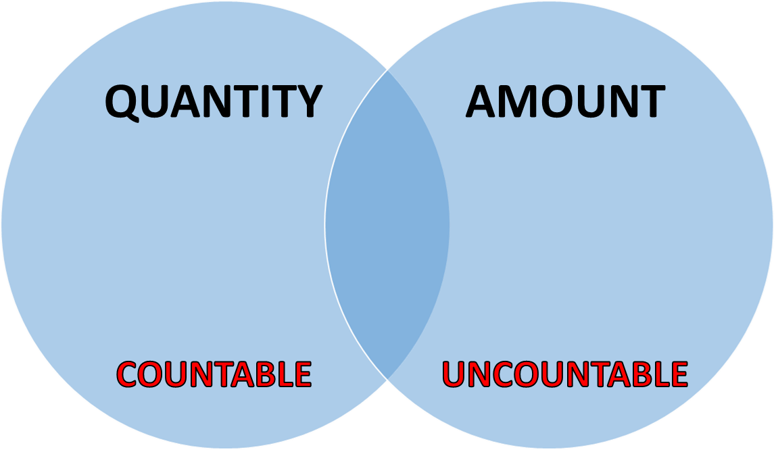

PLEASE NOTE!
IN EVERYDAY CONVERSATIONS THERE IS OFTEN PERSONAL CHOICE
PEOPLE OFTEN USE EITHER

Slide 7
THE FOLLOWING EXAMPLES SHOW THE DIFFERENCE BETWEEN
COUNTABLE
AND
UNCOUNTABLE
NOUNS

Slide 8

KEY EXAMPLES
What is a Noun?
Anything that can be counted, singular or plural :
a person, a car, a few apples, lots of books
Your glass is on the table.
How many people are in the room?
There are three ways to reach the sea.
There’s one interesting old tree in my garden.

Slide 9

KEY EXAMPLES
Noun Examples
Plural verbs are often used with countable nouns
There are hundreds of flowers in the wood.
Do you have horses on your farm?
We need to get correct facts
There are interesting books in the library
We must buy new shoes
People often run marathons

Slide 10

KEY INFORMATION
What is an Noun?
Anything that cannot be counted is an uncountable noun
Uncountable nouns are not individual objects
They are always singular and must be used with singular verbs
Look at the following examples

Slide 11

KEY EXAMPLES
Noun Examples
Singular verbs must be used with uncountable nouns
There is no more coffee in the pot.
Would you like more money?
I want to get correct information
You should always aim for excellence
Please get better equipment
Can we explain the data?

Slide 12
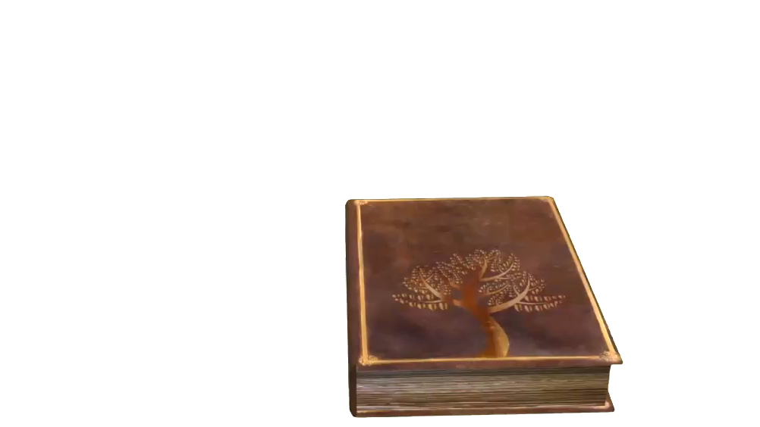
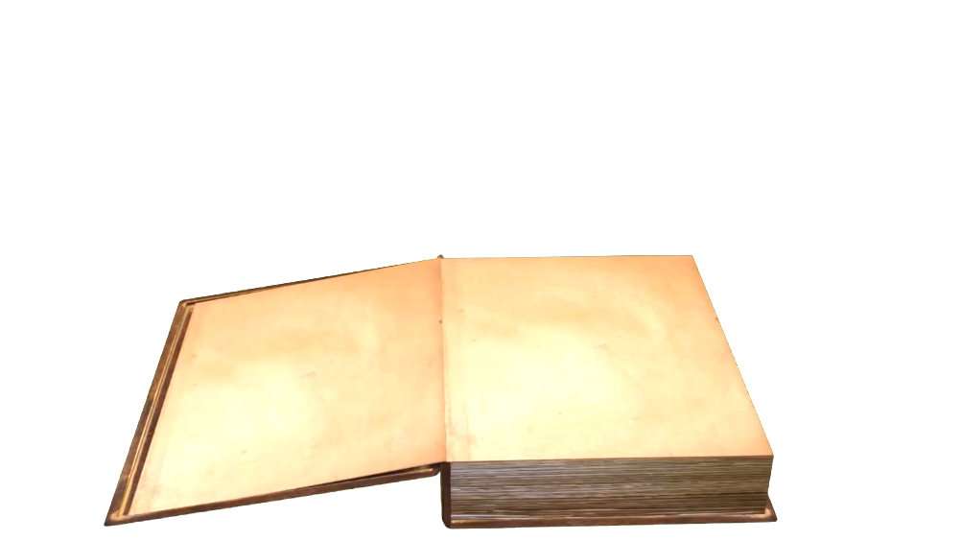



Slide 13
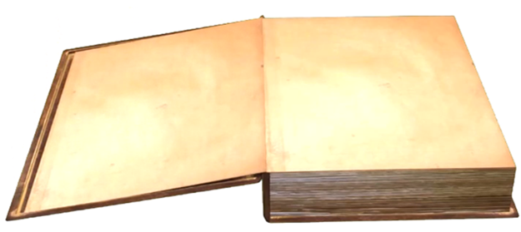
SOME ANY NONE
QUESTION OR NO QUANTITY
A POSITIVE QUANTITY
NOT EVEN ONE!

Slide 14
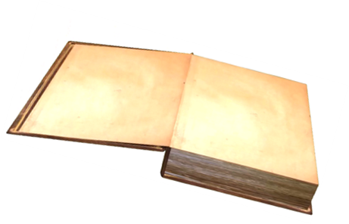
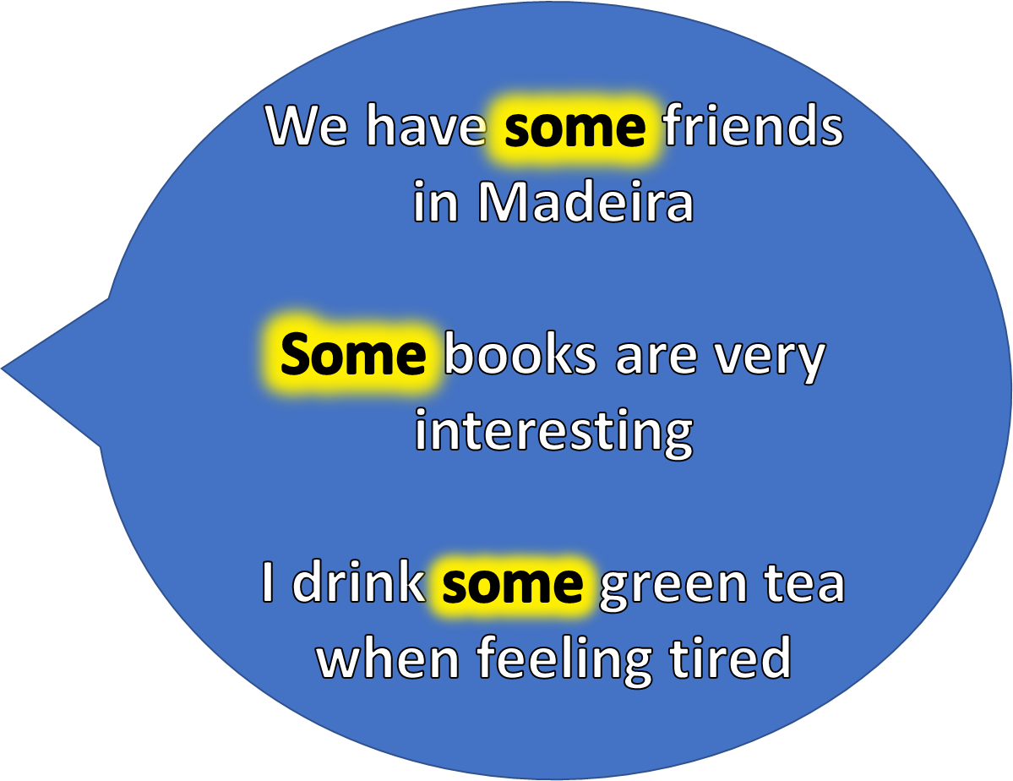
EXAMPLES
SOME
A POSITIVE QUANTITY

Slide 15
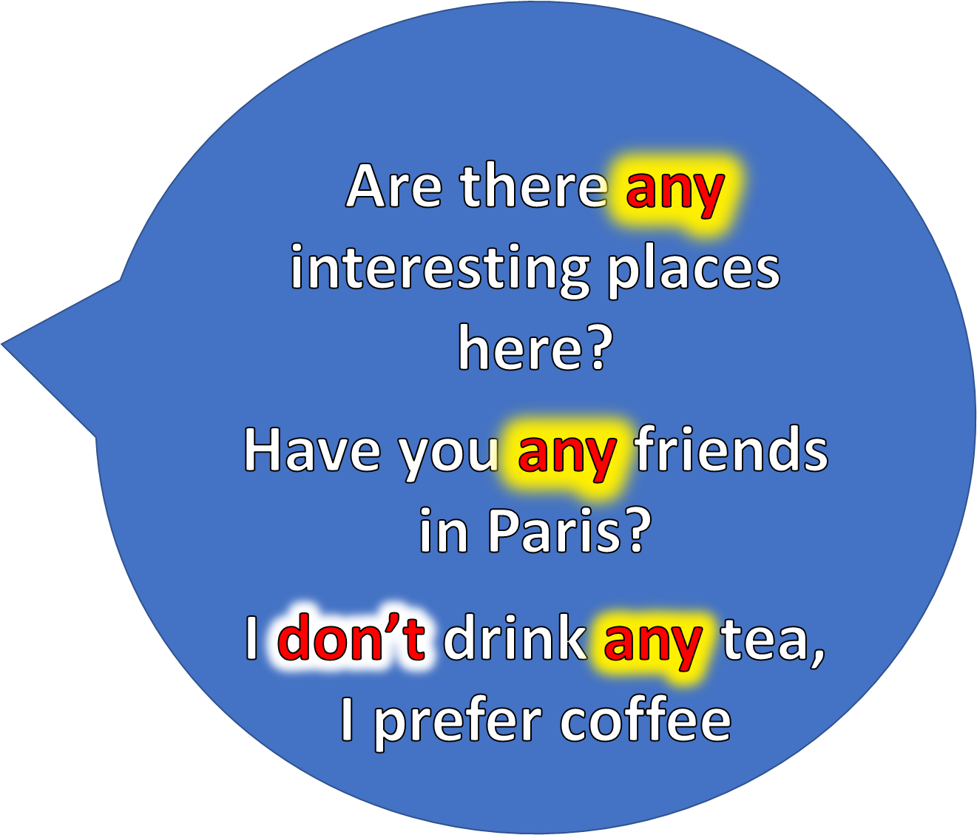

EXAMPLES
ANY

Slide 16
EXAMPLES
I would like friends in Madeira
but I have none
None of these books is very interesting
NONE
NOT EVEN ONE !

Slide 17
MORE
KEY WORDS!

Slide 18
M A N Y M U C H
COUNTABLE QUANTITY
UNCOUNTABLE
QUANTITY

Slide 19
EXAMPLES
HOW MANY PEOPLE LIVE IN YOUR TOWN ?
HOW MUCH TIME IS THERE BEFORE THE TRAIN LEAVES ?

Slide 20
AND MORE…

Slide 21
A LITTLE A FEW
SMALL UNCOUNTABLE QUANTITY
SMALL COUNTABLE QUANTITY

Slide 22
KEY EXAMPLES
ONLY
A FEW
PEOPLE VISIT THE POLAR REGIONS
OFTEN THERE IS ONLY
A LITTLE
FOOD IN POOR COUNTRIES

Slide 23

A LOT LOTS OF
LARGE COUNTABLE
OR UNCOUNTABLE QUANTITY
LARGE COUNTABLE
OR UNCOUNTABLE QUANTITY

Slide 24
YOU CAN USE
EITHER!
A LOT OF LOTS OF
LARGE
COUNTABLE OR UNCOUNTABLE QUANTITY

Slide 25
MANY PEOPLE USE
EITHER!
A LOT OF LOTS OF
LARGE
COUNTABLE OR UNCOUNTABLE QUANTITY

Slide 26


KEY EXAMPLE
I HAVE TOOLS IN MY TOOL BOX

Slide 27
ENOUGH SUFFICIENT PLENTY
CORRECT QUANTITY
CORRECT QUANTITY
MORE THAN ENOUGH

Slide 28

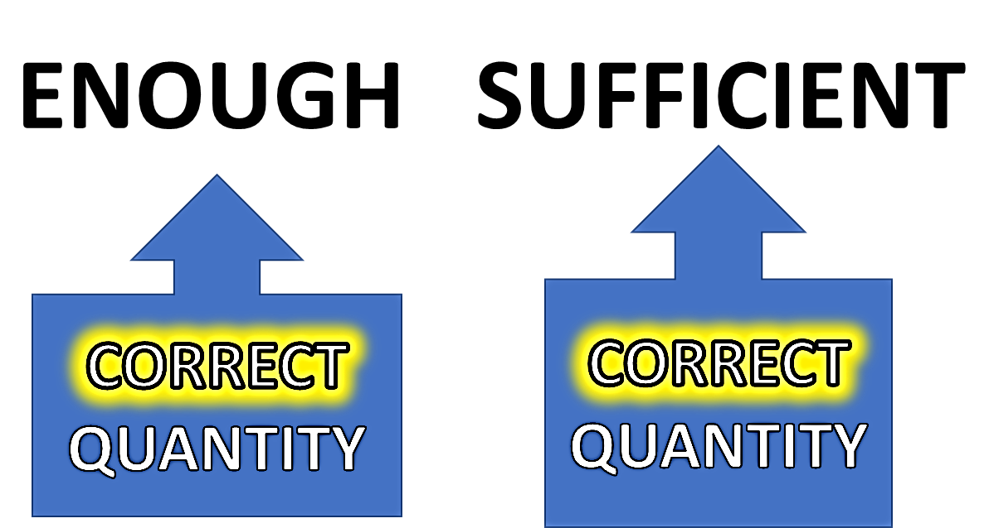

Slide 29
WHAT’S THE DIFFERENCE?
ENOUGH
SUFFICIENT
IN GENERAL THEY MEAN THE SAME

Slide 30
WHAT’S THE DIFFERENCE?
ENOUGH
SUFFICIENT
MANY PEOPLE USE EITHER!

Slide 31
KEY EXAMPLES
ENOUGH
SUFFICIENT
PLENTY

Slide 32
QUANTITY SUMMARY!
MUCH MANY
SOME
ANY
ENOUGH = SUFFICIENT
PLENTY
LARGE
COUNTABLE
LARGE
UNCOUNTABLE
NON SPECIFIC
QUESTIONS AND NEGATIVES
MORE NOT NEEDED
MORE THAN ENOUGH
STOP THE VIDEO WHILE YOU CHECK

Slide 33
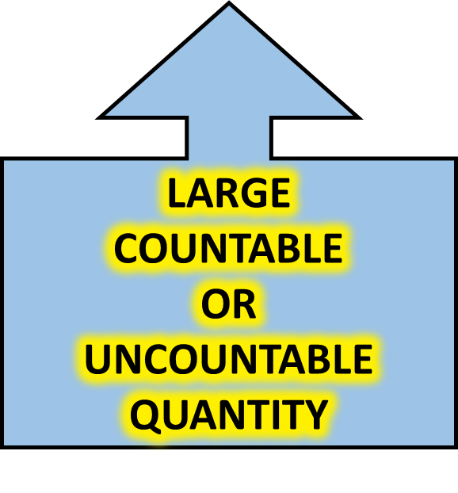
QUANTITY SUMMARY!
LOTS OF = A LOT OF
STOP THE VIDEO WHILE YOU CHECK

Slide 34


Slide 35
QUANTITY IS OFTEN COUNTABLE
TWO FRIENDS
FIVE BOOKS
MANY PEOPLE
MAYBE ONE HUNDRED
AMOUNT IS OFTEN UNCOUNTABLE
A LOT OF HAPPINESS
SOME GOOD FRIENDSHIP
LOTS OF GOOD LUCK
SOME MONEY, MAYBE MILLIONS!

Slide 36

NOW READ THE STORY
THEN LISTEN
AND READ AGAIN

Slide 37
Jane and Jack took a trip to the mountains last autumn. They travelled by train to an old attractive hillside village, one of many in the mountains. The area is much like the alps, with many picturesque woods and valleys.
Jack likes the hills and Jane loves the woods. There are plenty of both! The evenings can be a little cold but there is a lot of sunshine during the day. Jack and Jane have visited lots of locations and have even made a few local friends
They would like to live there, Jack wants to start a business making sundials! The challenge is that there are very few homes for sale and they have only a little money.
Oh well, they can dream…..

Slide 38
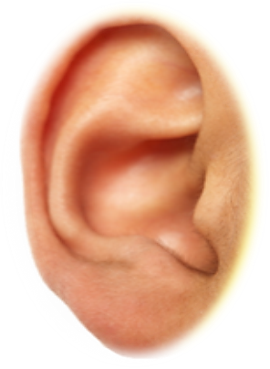

STORY BOARD

Slide 39
Jane and Jack took a trip to the mountains last autumn. They travelled by train to an old attractive hillside village, one of many in the mountains. The area is much like the alps, with many picturesque woods and valleys.
Jack likes the hills and Jane loves the woods. There are plenty of both! The evenings can be a little cold but there is a lot of sunshine during the day. Jack and Jane have visited lots of locations and have even made a few local friends
They would like to live there, Jack wants to start a business making sundials! The challenge is that there are very few homes for sale and they have only a little money.
Oh well, they can dream…..

Slide 40


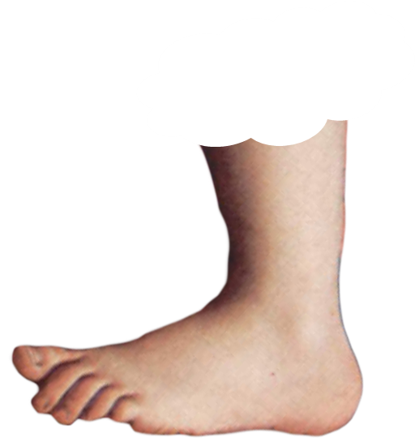
AFTER CHECKING OUT THE
MORE
BUTTON
VISIT
https://en.oxforddictionaries.com
FOOTNOTE
FOOTNOTE

Slide 41
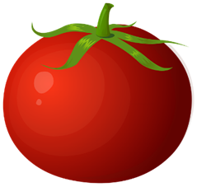
SOME
ANY
NONE
A FEW
MUCH
MANY

Slide 42
A LITTLE
ENOUGH
SUFFICIENT
LOTS OF
A LOT OF
PLENTY

Slide 43
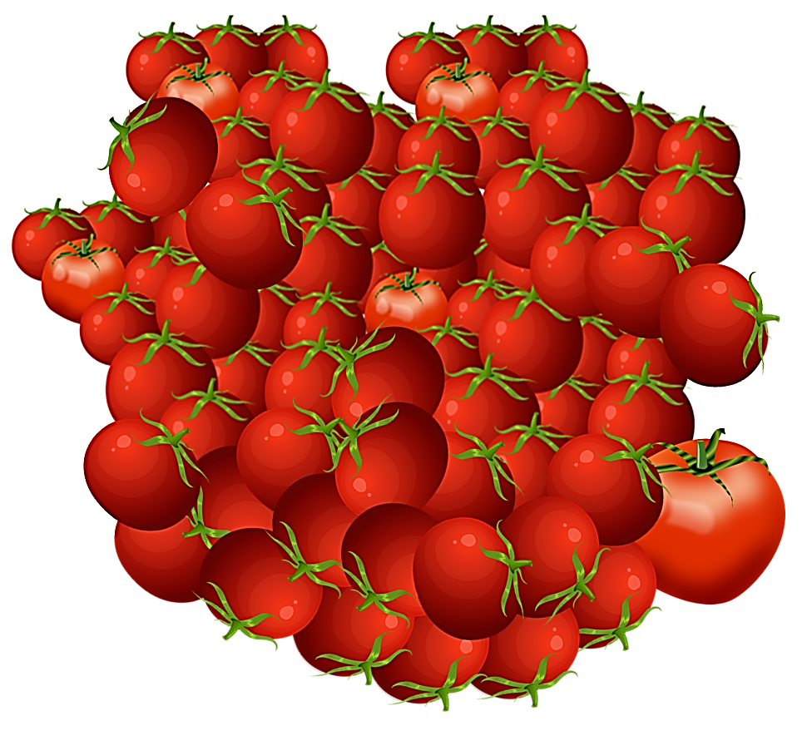

Slide 44

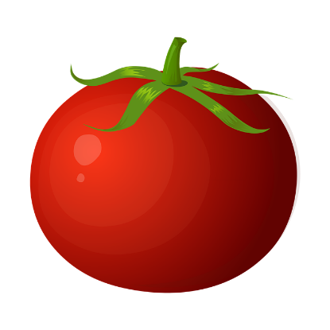

NONE
NOT EVEN ONE
SOME
ONE

Slide 45

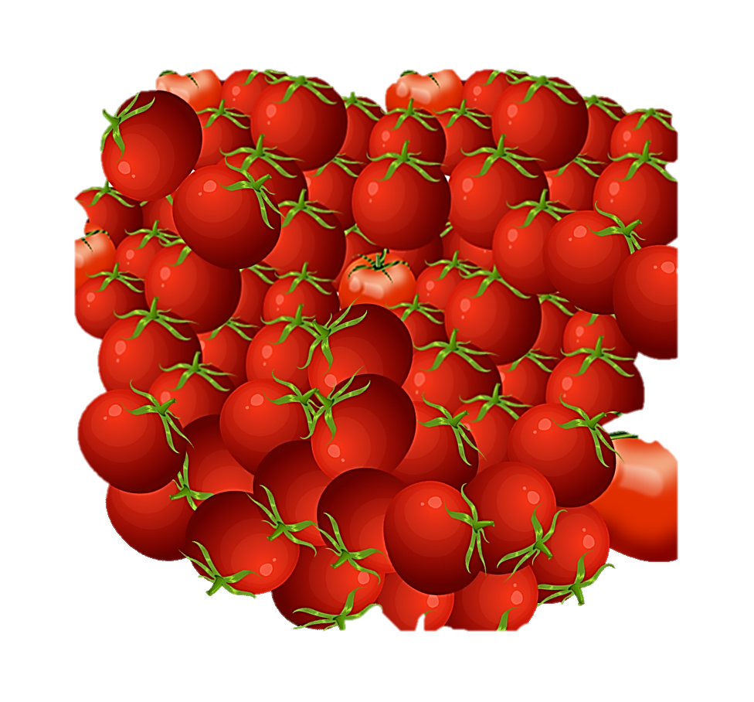

Slide 46
