Slide 1


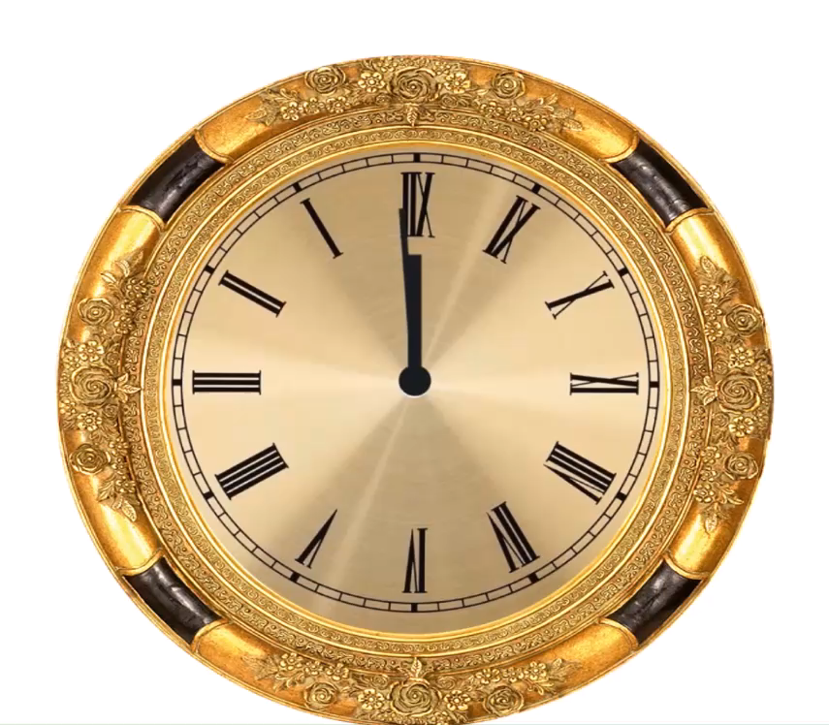

THE HISTORYSCOPE
STEP
BACK IN TIME WITH
KEVIN SHAW

