Slide 1
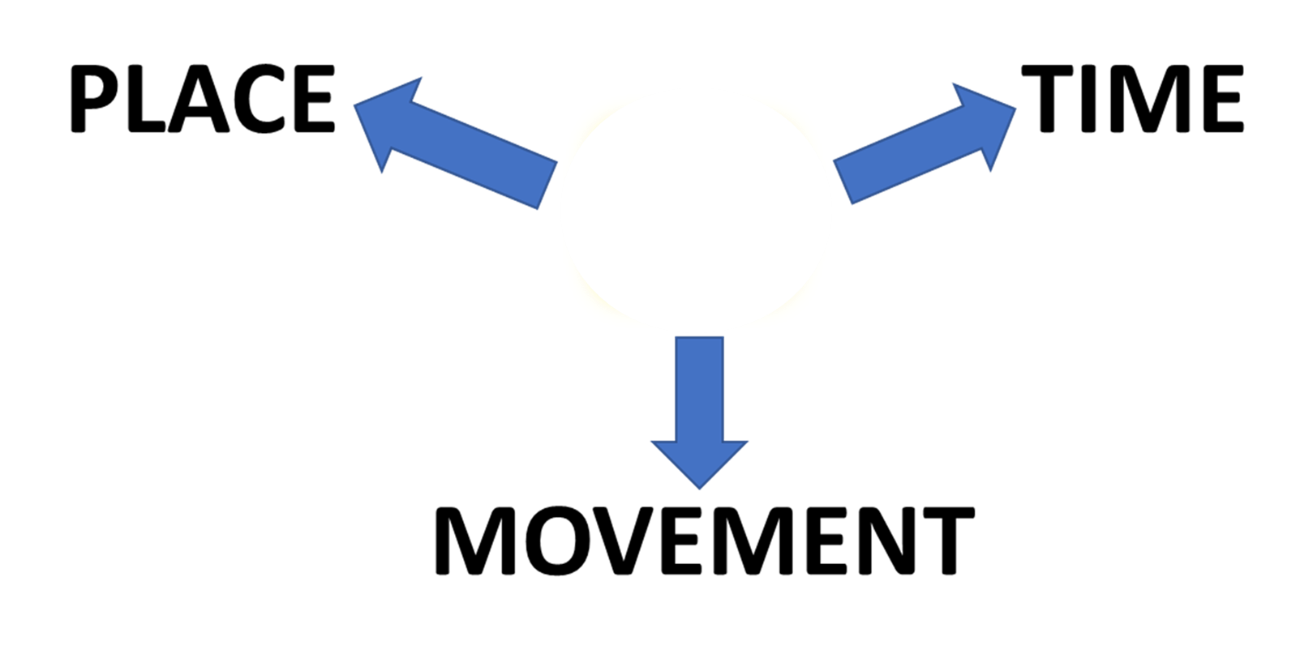

PREPOSITIONS
IN
IN

Slide 2
PREPOSITIONS
PLACE
IN

Slide 3



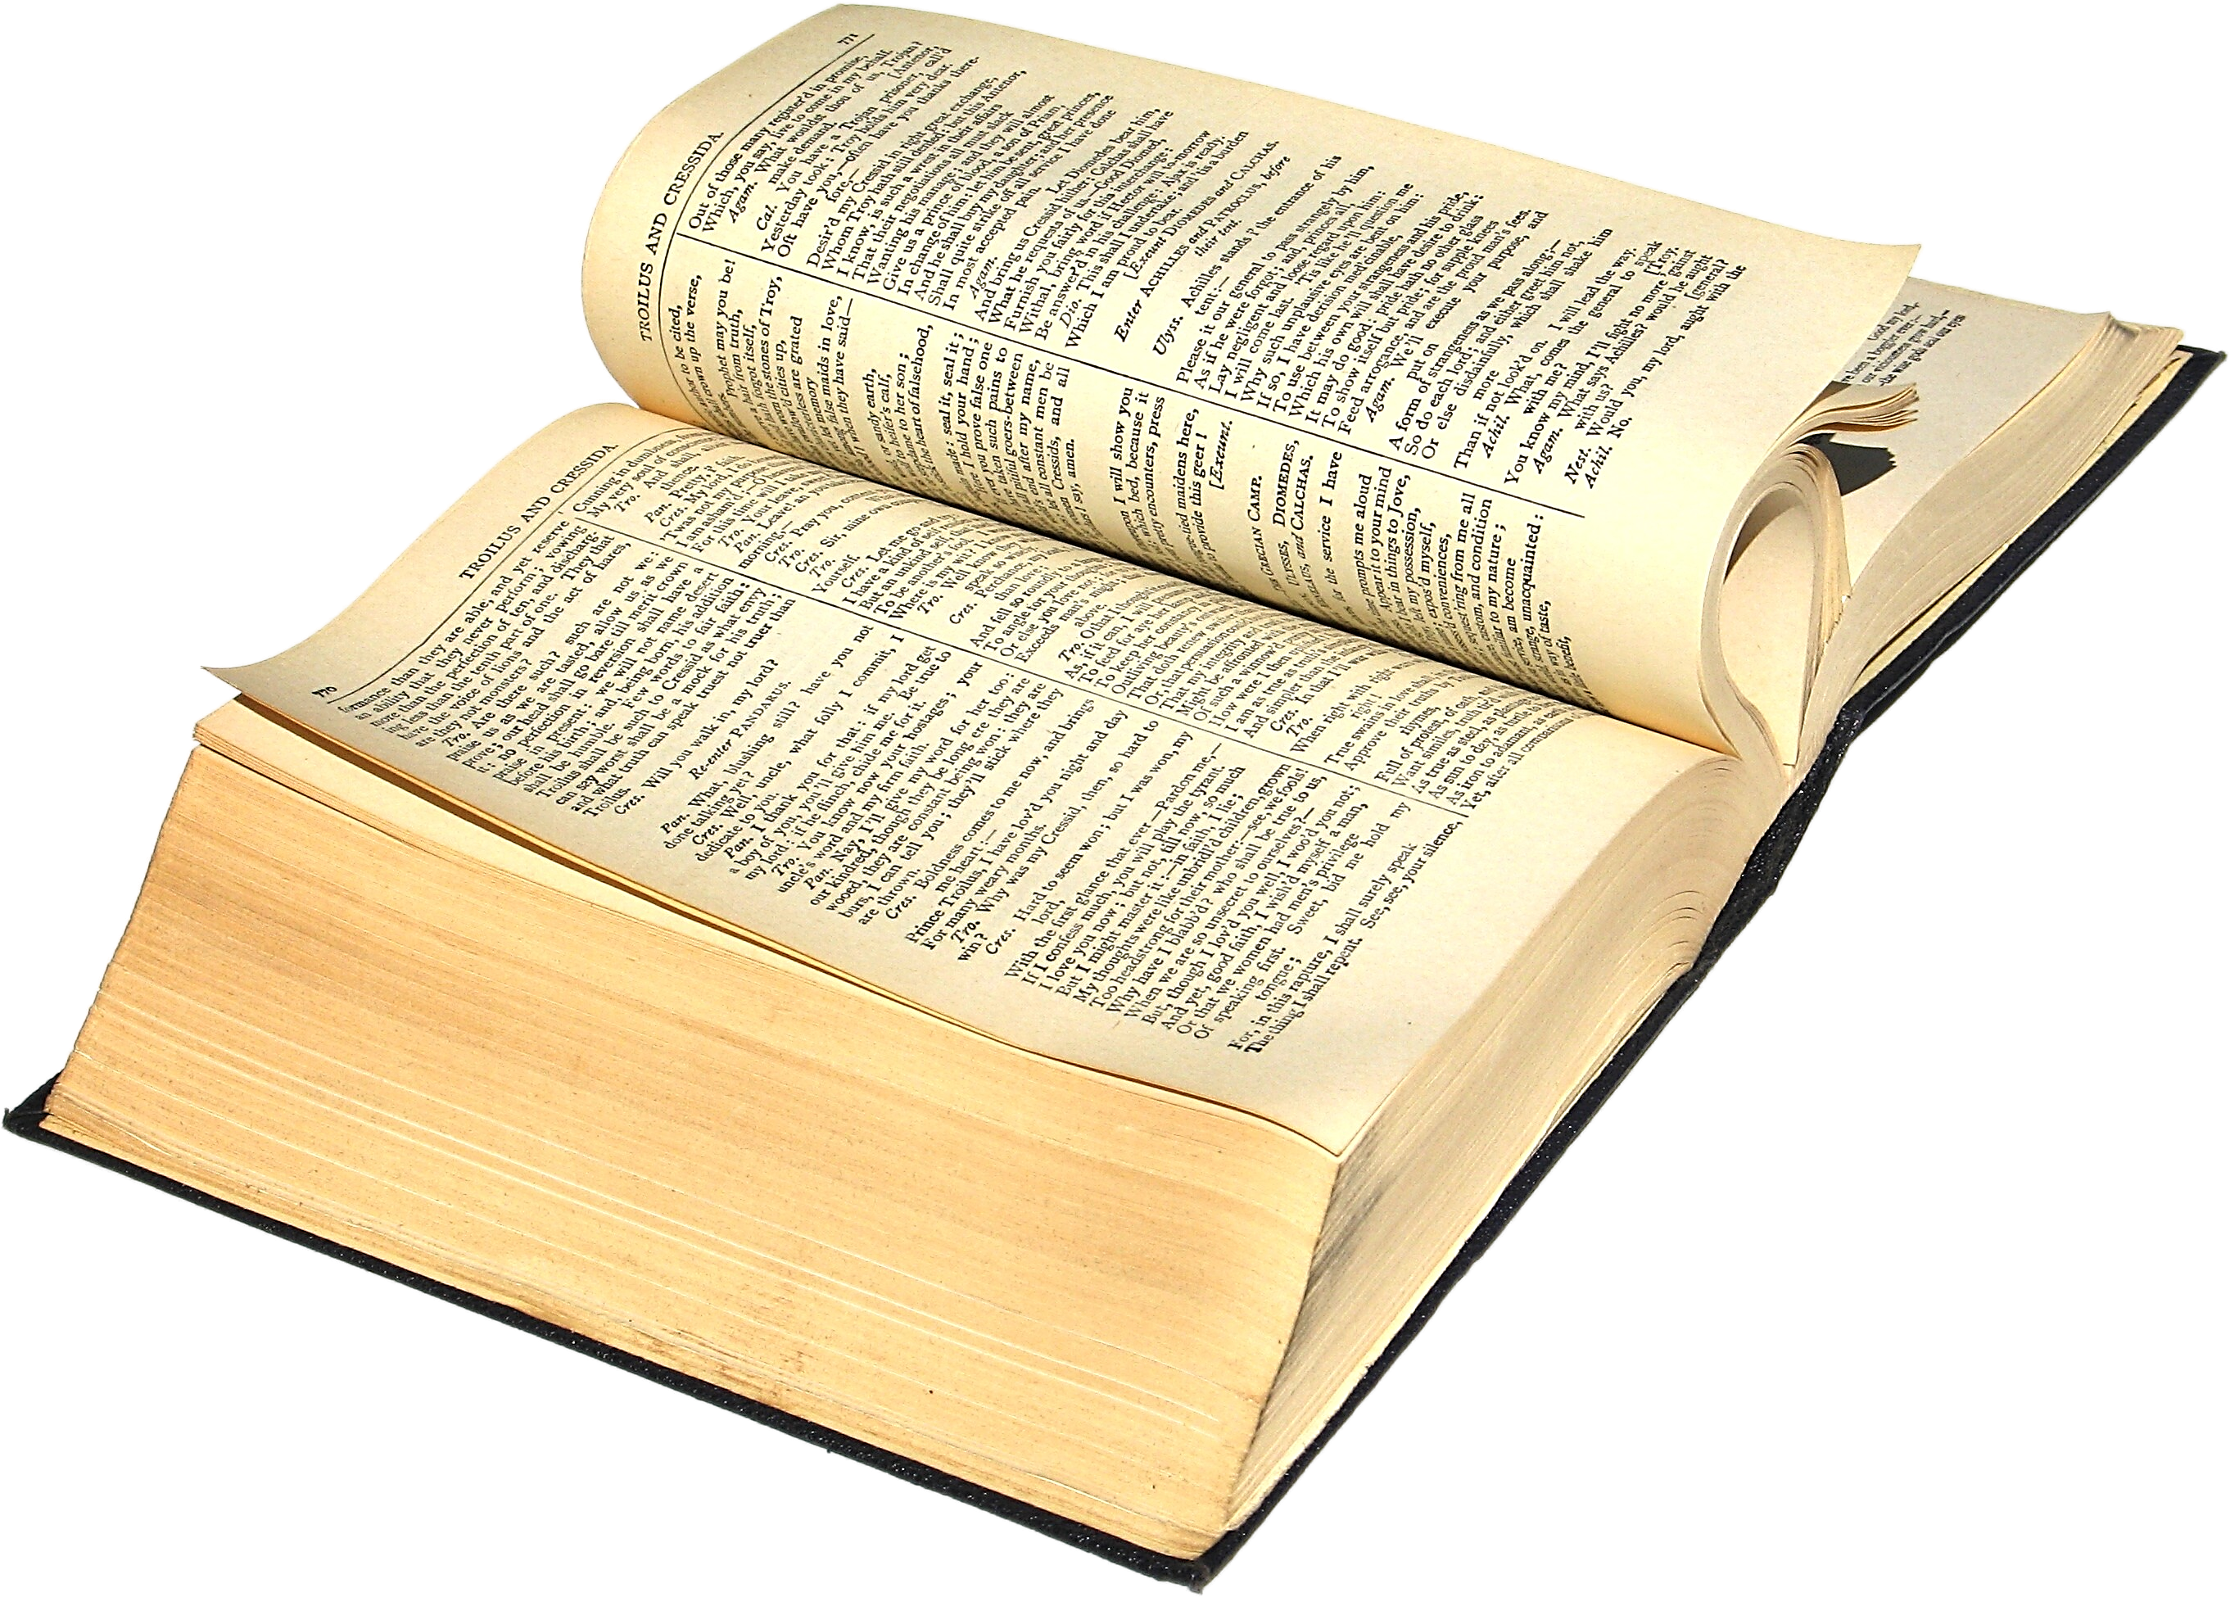
PREPOSITIONS
JENNY LIVES
IN
LONDON
I READ IT
IN
A BOOK
THE TEA IS
IN
THE POT!

Slide 4
TYPICAL EXAMPLES
PLACE
TYPICAL EXAMPLE

Slide 5
TYPICAL EXAMPLES!

Slide 7
PREPOSITIONS
TIME
IN

Slide 8
PREPOSITIONS
TIME
IN

Slide 9

TIME
THE TRAIN LEAVES
THE NEXT FIVE MINUTES
IN

Slide 10
IN TIME
MEANS
NOT LATE

Slide 11
TYPICAL EXAMPLES
TYPICAL EXAMPLE
TIME

Slide 12
TYPICAL EXAMPLES!

Slide 13

PREPOSITIONS
IN
MOVEMENT

Slide 14
PREPOSITIONS
IN
MOVEMENT

Slide 15


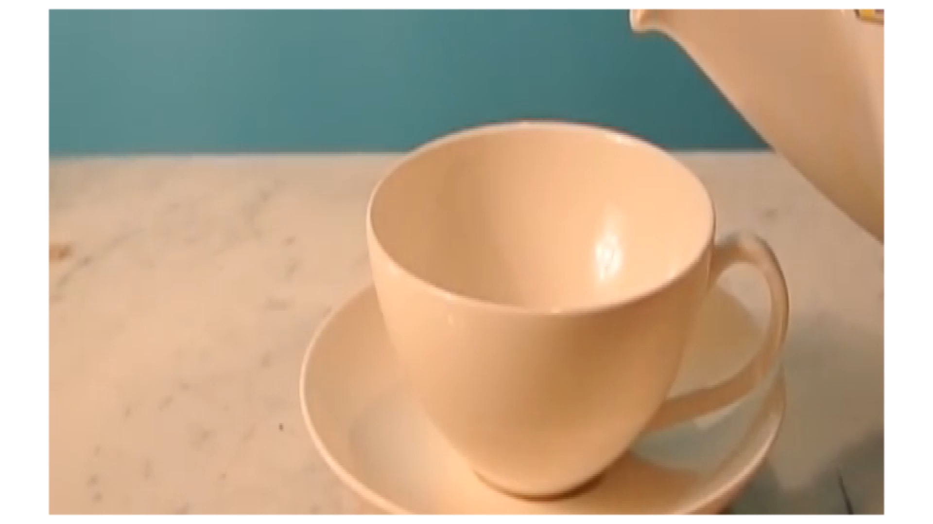


MOVEMENT

Slide 16
MOVEMENT
THE TEA POURS OUT OF THE TEAPOT AND
INTO
THE CUP

Slide 17
POSITION
IN
AND
MOTION OR
DIRECTION
INTO
WHAT’S THE DIFFERENCE?

Slide 18
SOME EXAMPLES
POSITION
IN
THE BASKET IS IN THE CAR
MOTION
INTO
JACK TRAVELLED DEEP INTO THE JUNGLE

Slide 19

JEFF:
SUE:
JEFF:
SUE:
JEFF:
SUE:
JEFF:
SUE:

Slide 20

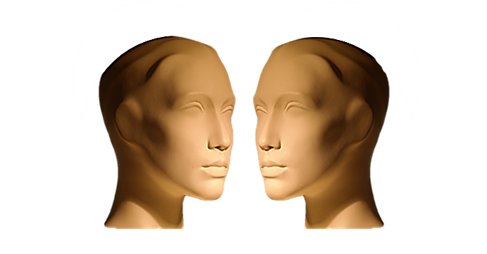

TYPICAL DIALOGUE
JUST LISTEN...

Slide 21
JEFF:
SUE:
JEFF:
SUE:
JEFF:
SUE:
JEFF:
SUE:

Slide 22

PREPOSITIONS
SUMMARY
IN

Slide 23


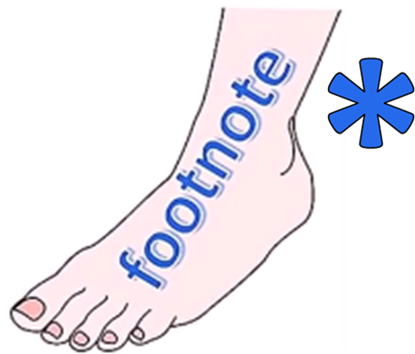
ENGLISH LANGUAGE STUDY
IN TIME MEANS NOT LATE
ON TIME MEANS PUNCTUAL
CHECK
THIS
WORD

Slide 24
MORE ENGLISH LANGUAGE STUDY!
IN A HURRY
MEANS
FAST ACTIVITY
IN FACT
MEANS
TRUTH
CHECK
THIS
WORD

Slide 25
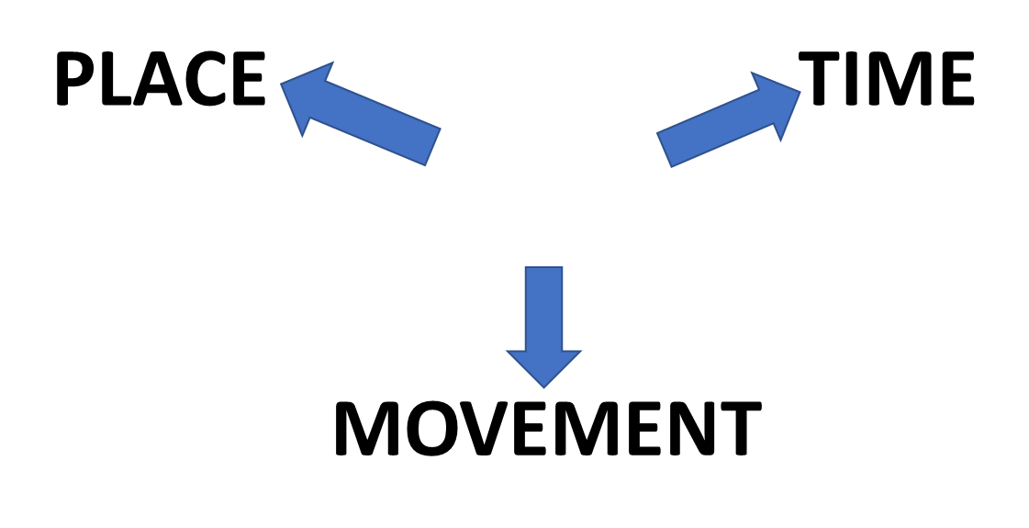
IN
ON
AT

Slide 30
TYPICAL EXAMPLES
PLACE
TYPICAL EXAMPLE
TYPICAL EXAMPLE
TIME
TYPICAL EXAMPLE
MOVEMENT

Slide 31
TYPICAL EXAMPLES!

