Slide 1



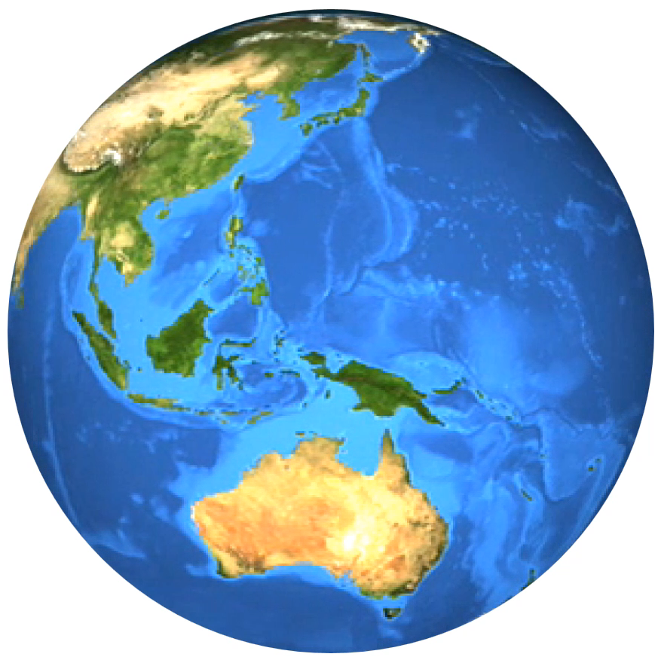

THE HISTORYSCOPE
BACK IN TIME WITH KEVIN SHAW

Slide 4
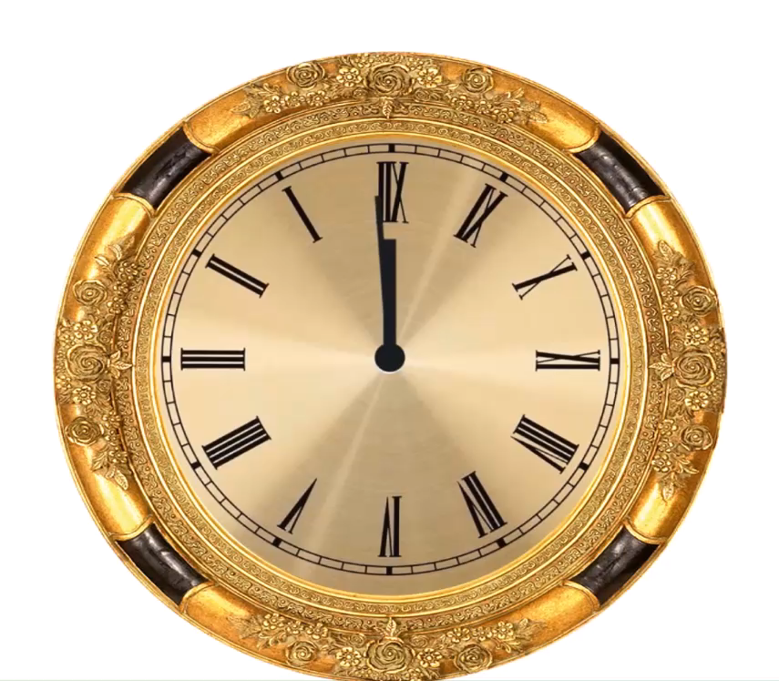

Slide 5
THE HISTORYSCOPE
BACK IN TIME WITH KEVIN SHAW

