Slide 1




THE HISTORYSCOPE

Slide 2

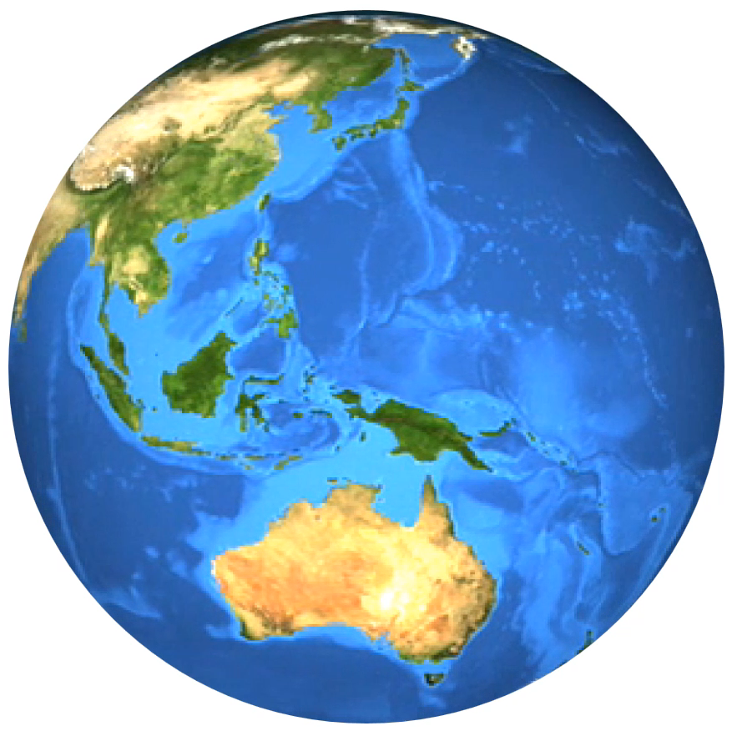
THE HISTORYSCOPE
BACK IN TIME WITH KEVIN SHAW

Slide 8
BACK IN TIME WITH KEVIN SHAW

