Slide 1
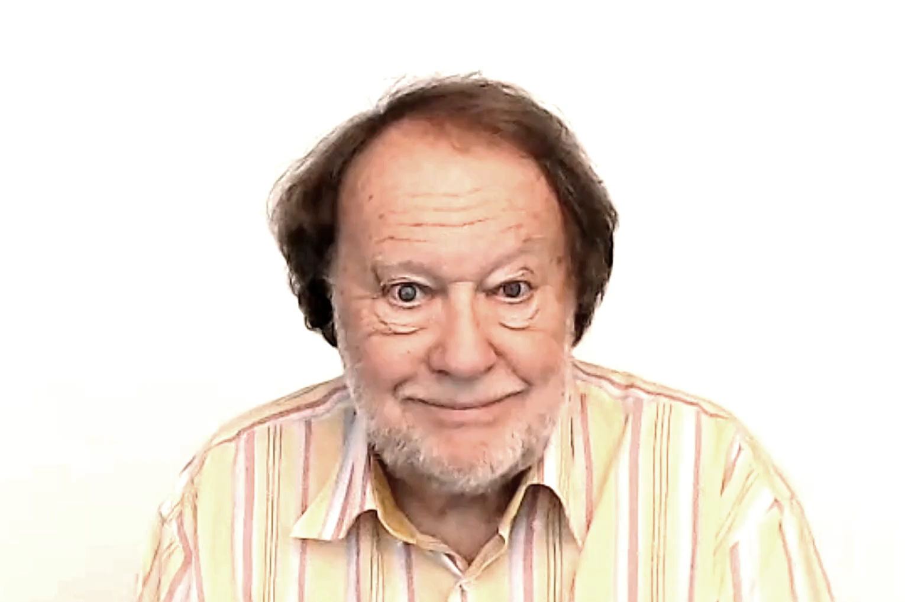


Slide 3
FUTURE PLANNED ACTION
WE ARE GOING TO VISIT FRIENDS IN PRAGUE
FUTURE PLAN
VERB

Slide 4
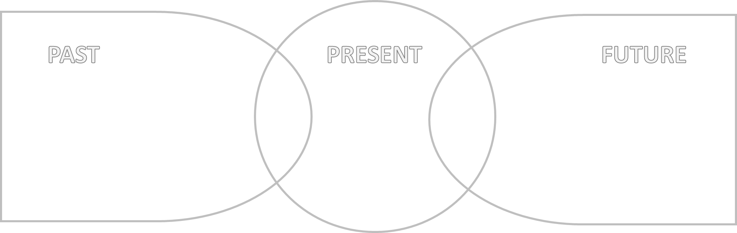
FUTURE PLANNED ACTION
WE ARE
GOING TO VISIT
FRIENDS
IN PRAGUE
FUTURE PLAN
VERB

Slide 5
INTENDED DESTINATION
WE ARE GOING TO PRAGUE
TRAVEL NOW OR LATER
DESTINATION

Slide 6

INTENDED DESTINATION
TRAVEL NOW OR LATER
WE ARE
GOING TO
PRAGUE

Slide 7






Slide 8



Slide 9



Slide 10


Slide 18
PAST
PRESENT
FUTURE

Slide 19

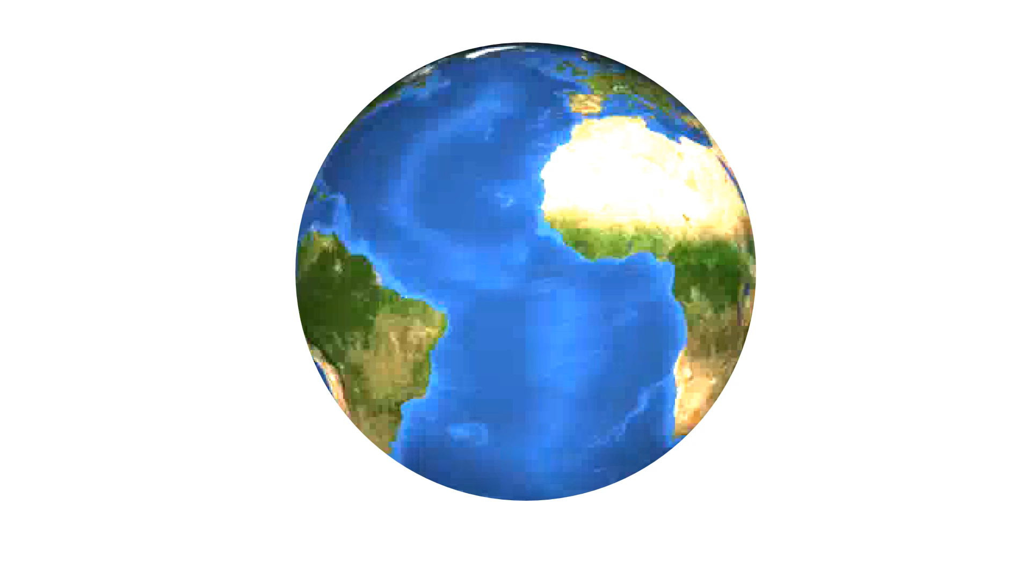


Slide 20


Slide 25
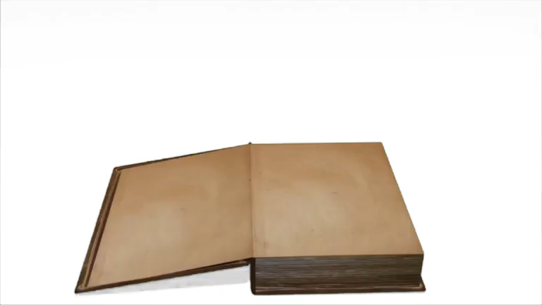

Slide 26
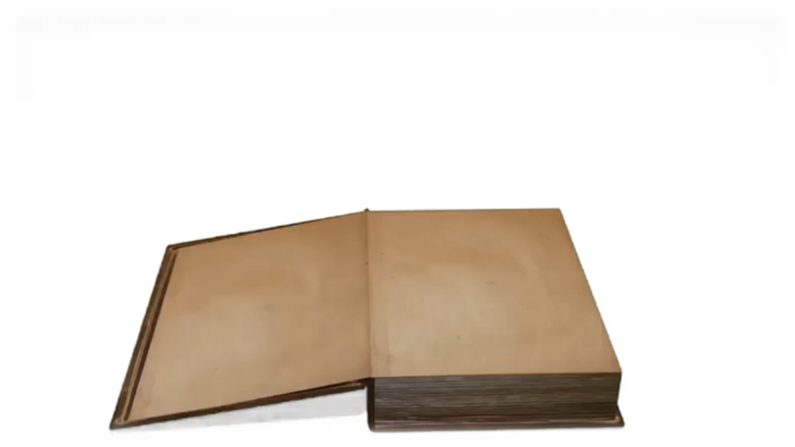


Slide 28
TASMANIA

