Slide 1

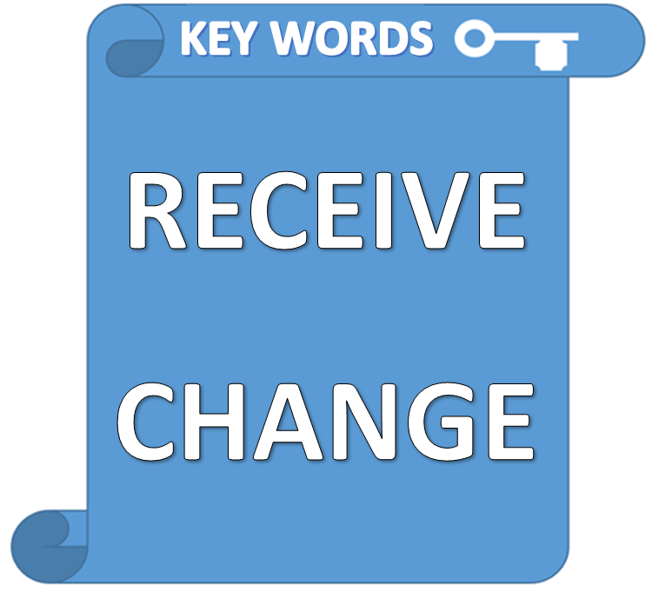

Slide 2

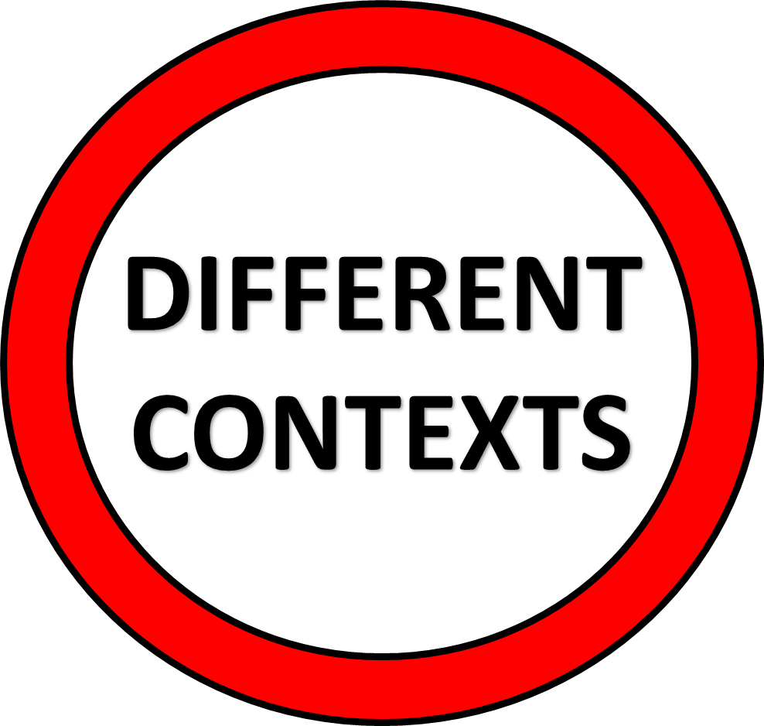
GET
RECEIVE
CHANGE

Slide 3

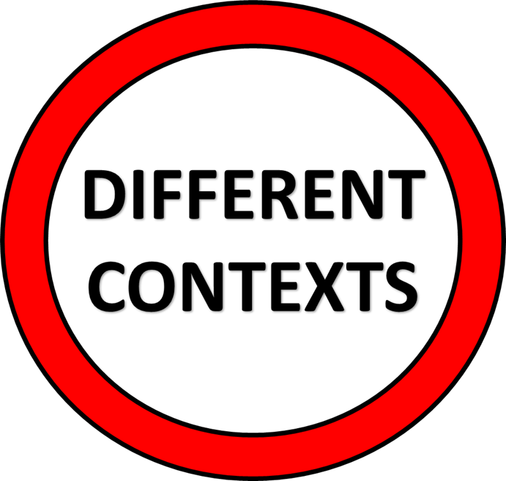
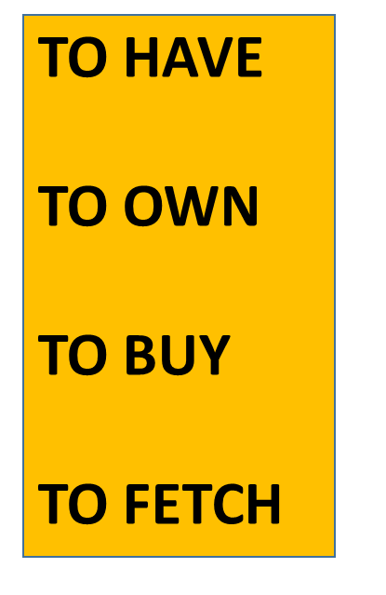
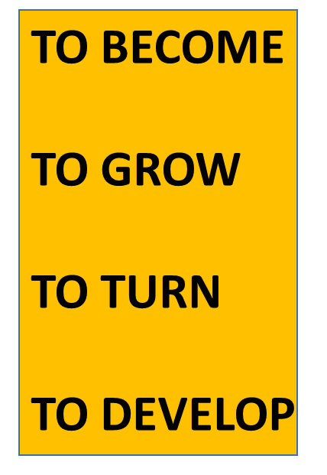
GET
CHANGE
NO
CONNECTION

Slide 4

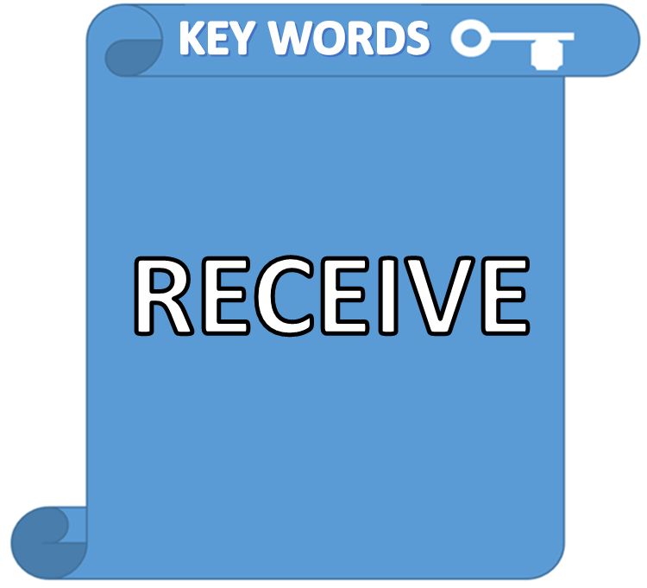
WHEN PEOPLE GIVE YOU PRESENTS YOU
RECEIVE GIFTS

Slide 5
GET
RECEIVE
GET CAN BE USED INSTEAD OF
THESE VERBS
TO HAVE
TO OWN
TO BUY
TO FETCH

Slide 6
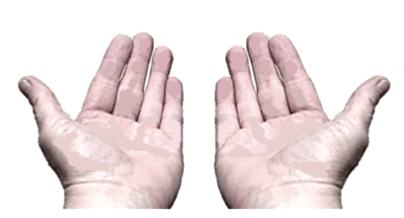




WE MANY DIFFERENT THINGS EVERY YEAR
WE MAIL IN THE POST
WE PRESENTS FROM FRIENDS

Slide 7

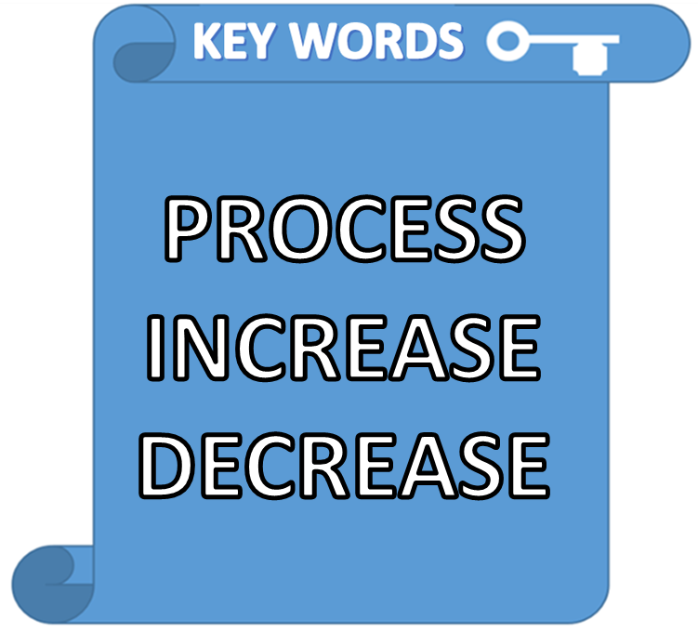
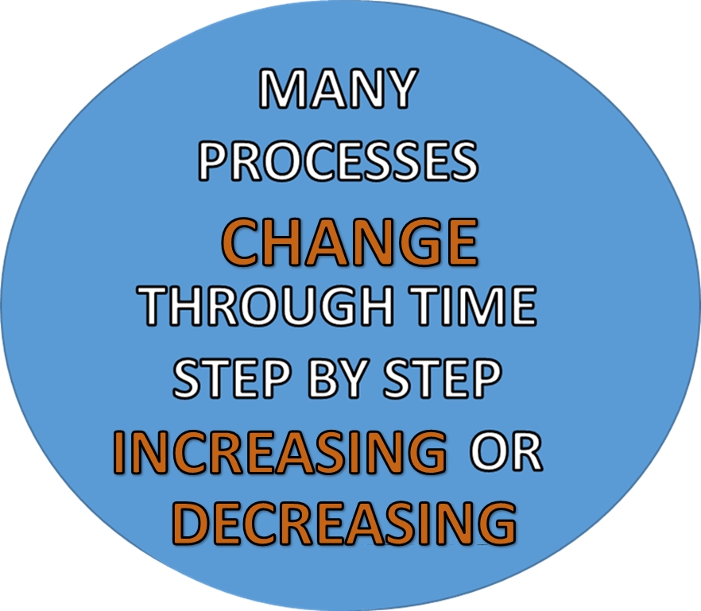

Slide 8


STEP BY STEP

Slide 9



THE
BALLOON
LARGER!
AS IT GOT CLOSER

Slide 10
GET
CHANGE
GET CAN BE USED INSTEAD OF
THESE VERBS
TOO !
TO BECOME
TO GROW
TO TURN
TO DEVELOP

Slide 11
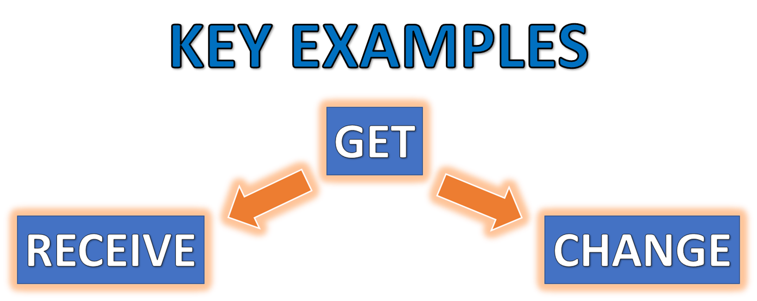
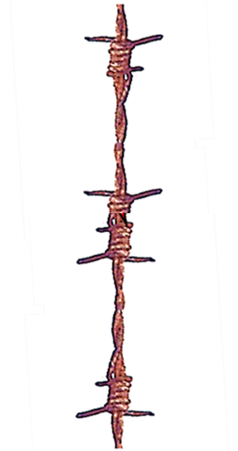
EVERY DAY WE GET FOOD
EVERY DAY WE GET OLDER
NOUN
ADJECTIVE

Slide 12

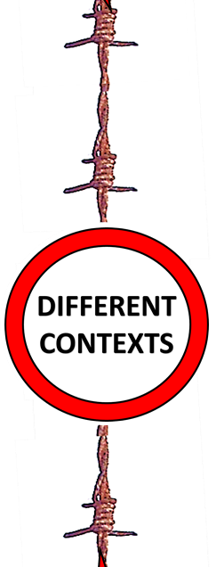

MORE EXAMPLES
YOU GET FOOD
WE GET HAPPY
WE GET INFORMATION
PEOPLE GET TIRED
PEOPLE GET IDEAS
YOU GET OLDER

Slide 13


GET- FOLLOWED BY
A NOUN
GET- FOLLOWED BY
AN ADJECTIVE

Slide 14



THIS IS THE FIRST
LESSON
NOW CLICK

