Slide 1
A DESCRIPTION OF MEANING
When we understand a relationship between two or more thoughts
then meaning has begun.
MEANING INTERFACE
THOUGHT 1
AHA!
THOUGHT 2
As the matrix of thoughts increases understanding deepens
and the awareness of meaning expands.

Slide 2
THOUGHT
THOUGHT
THOUGHT
THOUGHT
THOUGHT
As the matrix of thoughts increases understanding deepens
and the awareness of meaning expands.

Slide 3
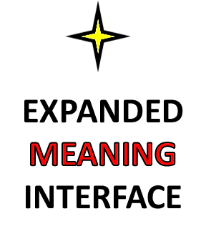
THOUGHT
THOUGHT
THOUGHT
THOUGHT
THOUGHT
As the matrix of thoughts increases understanding deepens
and the awareness of meaning expands.

Slide 4
THOUGHT
IDEA!
THOUGHT
THOUGHT
THOUGHT
THOUGHT
This matrix of thoughts represents an IDEA

Slide 5
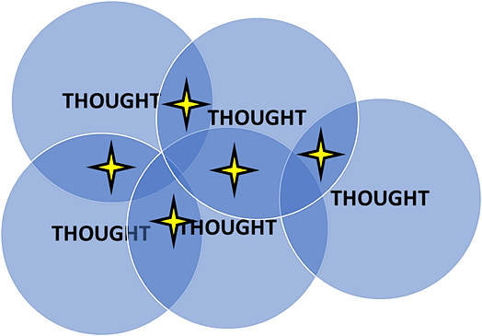
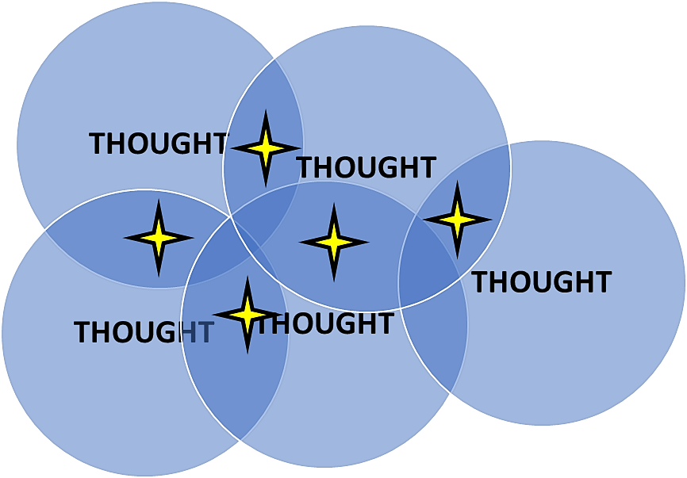
CONCEPT
An integrated series of ideas is a concept

