Slide 1
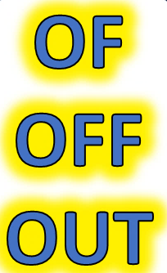
SOME IMPORTANT USES

Slide 3


SOME MAIN USES
OF
OF

Slide 4




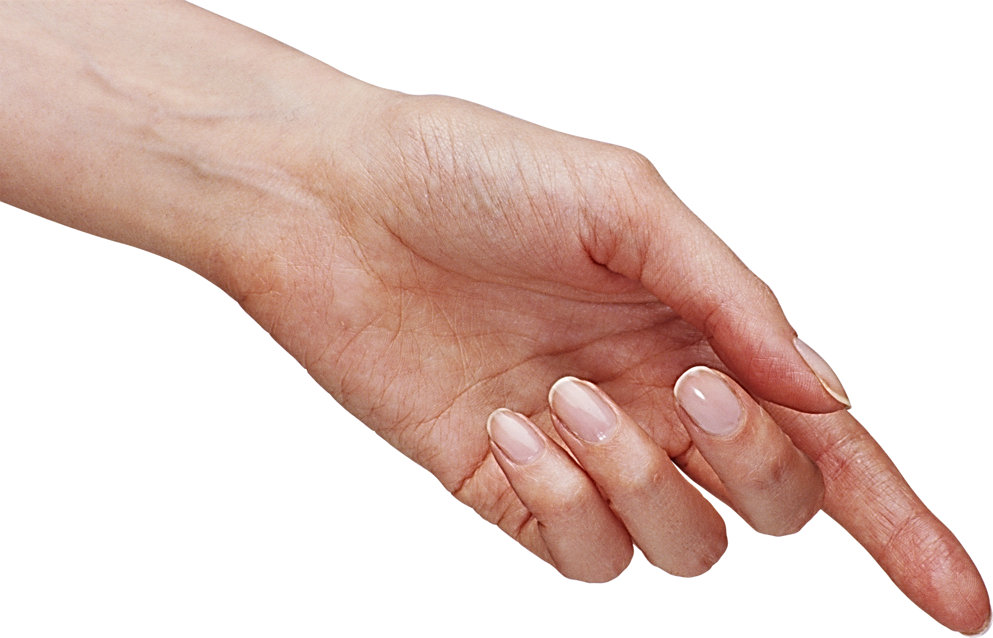
CAUSE
THE REASON WHY
OF
POSSESSIVE
BELONGING
CONTENT
WHAT IS INSIDE
STOP THE VIDEO WHILE YOU CHECK

Slide 5



ENGLISH LANGUAGE STUDY
HERE ARE SOME USUAL
OF
EXAMPLES

Slide 6
EXAMPLES
CAUSE
LOVE OF FRIENDS CREATES TRUST
THE REASON WHY
POSSESSIVE
PETER IS A FRIEND OF MINE
BELONGING
I AM READING A BOOK OF POEMS
CONTENT
WHAT IS INSIDE

Slide 7


CAUSE

Slide 8
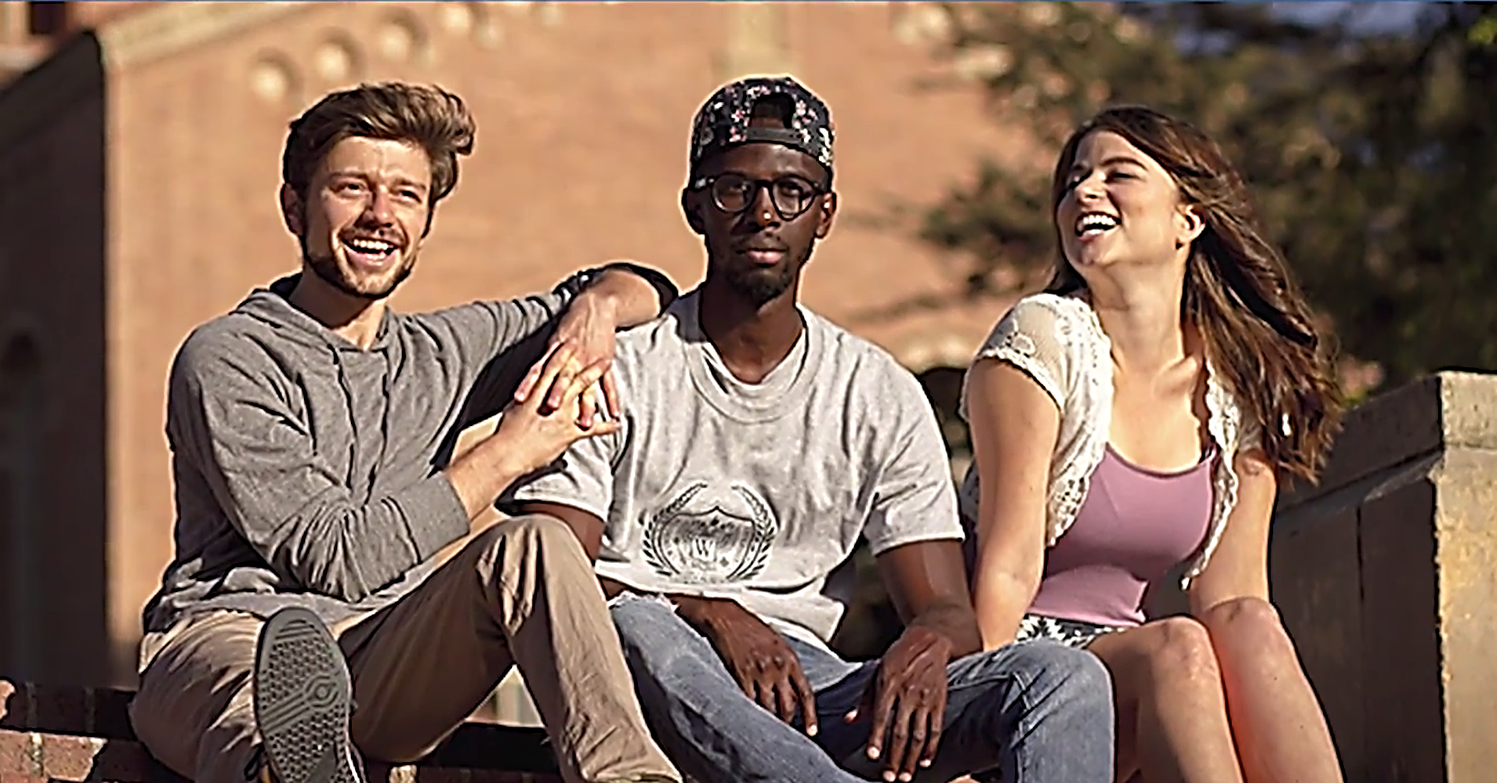

BELONGING

Slide 9


CONTENT

Slide 10

OFF
OFF

Slide 11


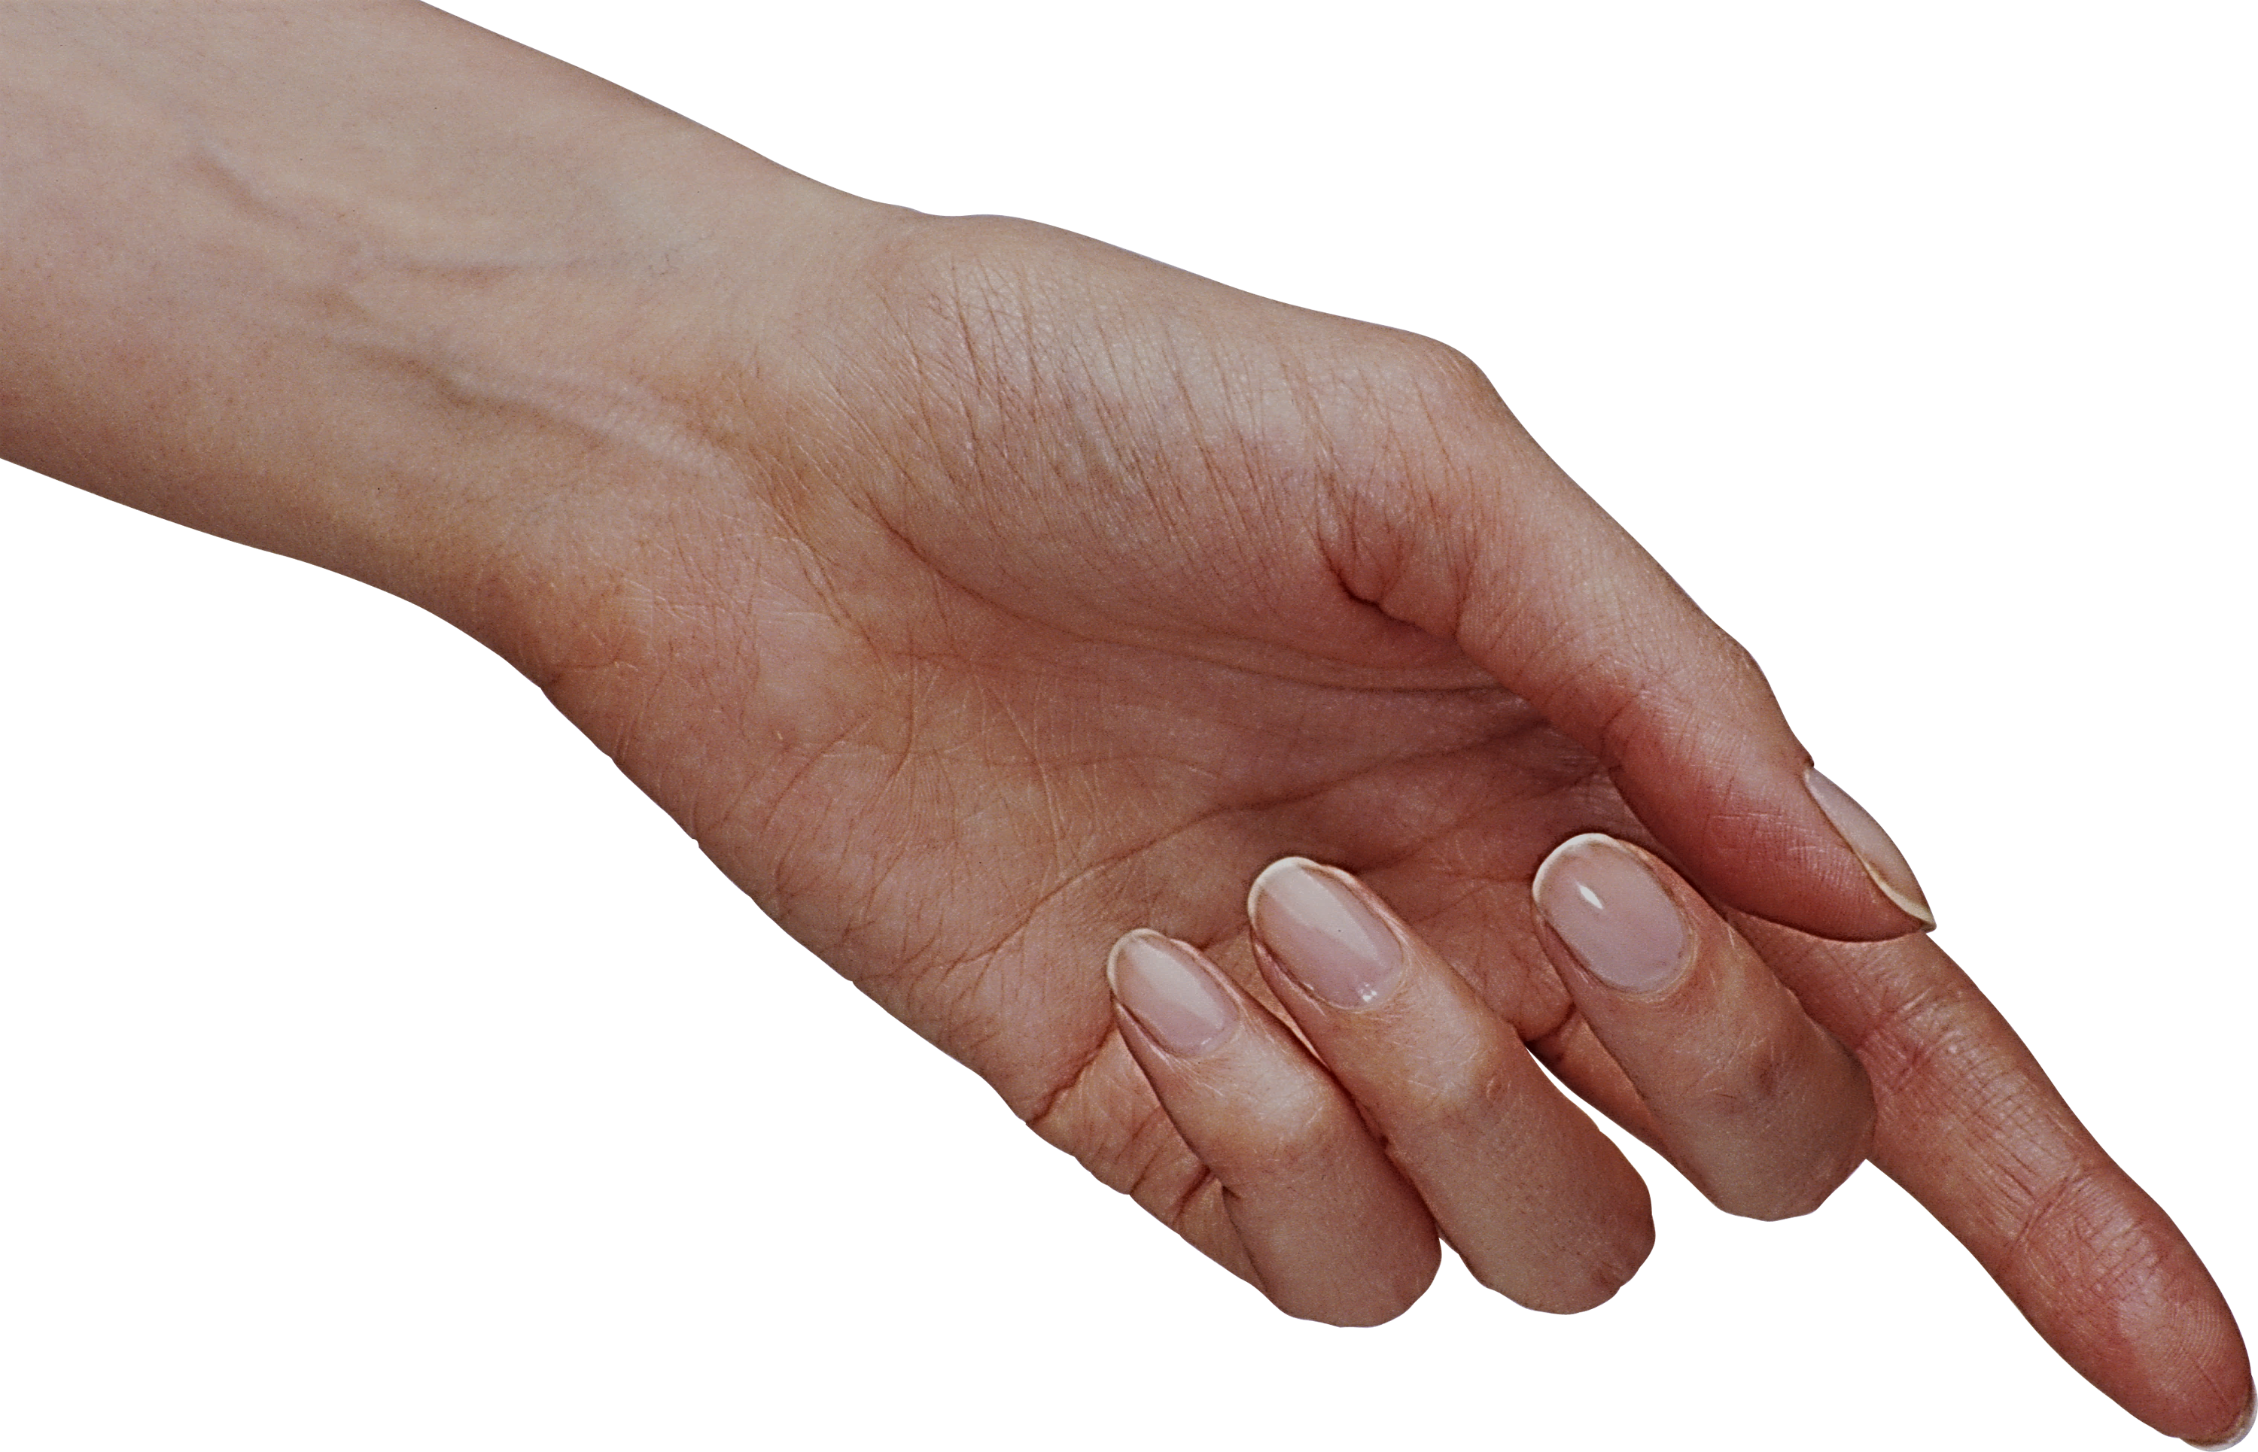
DISTANCE
HOW FAR AWAY
OFF
MODE
STATUS MODE
DEPARTURE
LEAVING
STOP THE VIDEO WHILE YOU CHECK

Slide 12
PLACE
DISTANCE
HOW FAR AWAY
OFF
CHANGE
MOVEMENT
STATUS MODE
DEPARTURE
TIME
LEAVING
STOP THE VIDEO WHILE YOU CHECK

Slide 13
ENGLISH LANGUAGE STUDY
HERE ARE SOME USUAL
OFF
EXAMPLES

Slide 14
EXAMPLES
DISTANCE
AN ISLAND OFF THE BRITISH COAST
NEAR
PLACE
CHANGE
REMEMBER TO SWITCH OFF THE LIGHTS
STATUS MODE
MOVEMENT
I WILL BE OFF SOON AFTER LUNCH
DEPARTURE
LEAVING
TIME

Slide 15
EXAMPLES
DISTANCE
AN ISLAND OFF THE BRITISH COAST
NEAR
MODE
REMEMBER TO SWITCH OFF THE LIGHTS
STATUS CHANGE
I WILL BE OFF SOON AFTER LUNCH
DEPARTURE
LEAVING

Slide 16
EXAMPLES
DISTANCE
AN ISLAND OFF THE BRITISH COAST
NEAR
CHANGE
REMEMBER TO SWITCH OFF THE LIGHTS
STATUS MODE
I WILL BE OFF SOON AFTER LUNCH
DEPARTURE
LEAVING

Slide 17
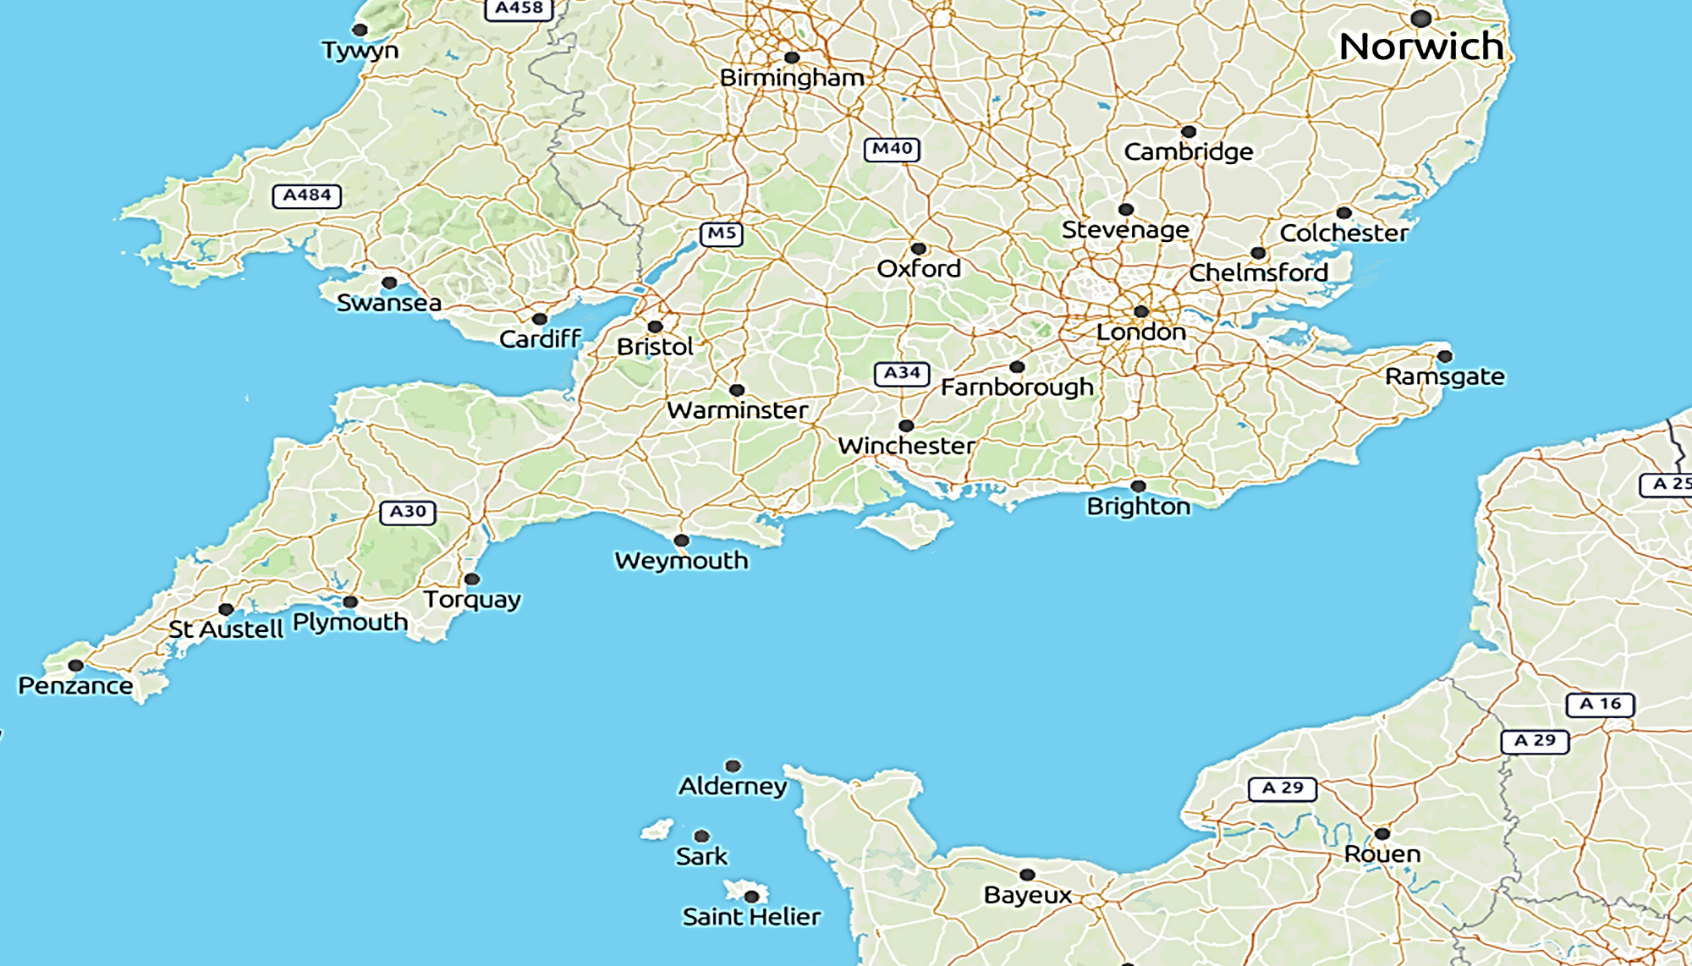

NEAR
ISLE OF WIGHT
NEAR THE ENGLISH MAINLAND
THIS ISLAND IS OFF THE COAST

Slide 18
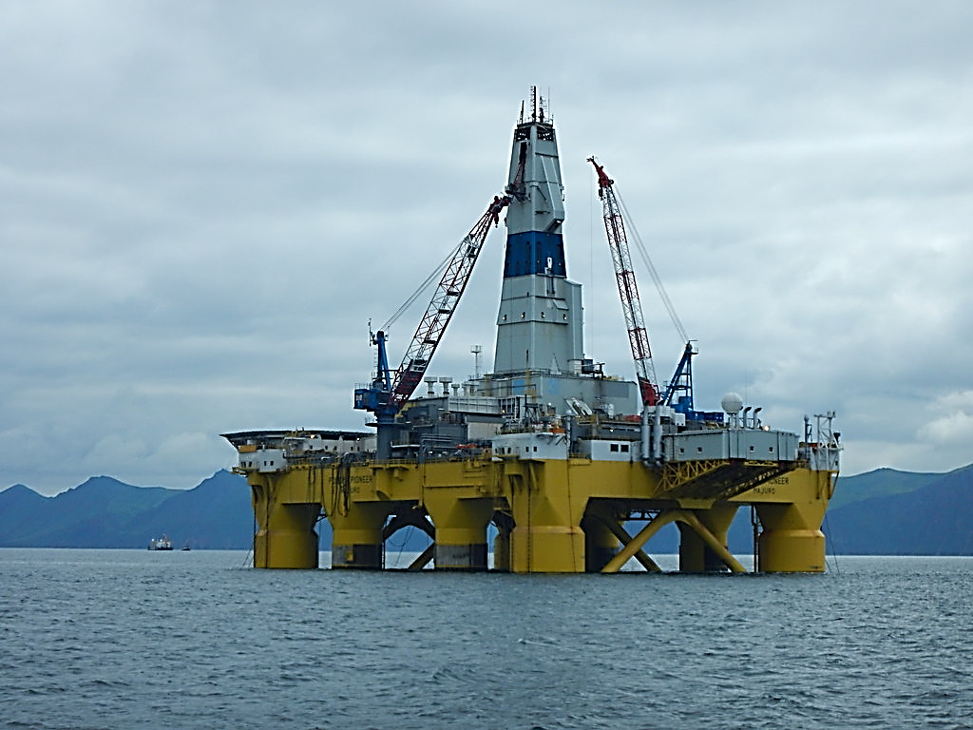
THIS OIL RIG IS LOCATED
OFF
THE COAST
NEAR THE ENGLISH MAINLAND

Slide 19


SAVE ENERGY
CHANGE
SWITCH OFF THE LIGHTS!

Slide 20
DEPARTURE
START LUNCH AT ONE PM
OFF
ABOUT TWO THIRTY

Slide 21
DEPARTURE
START LUNCH AT ONE PM
OFF
ABOUT TWO THIRTY

Slide 22


DEPARTURE
LUNCH TIME
OFF
AFTER LUNCH
LEAVING TIME

Slide 23
OUT
OUT

Slide 24


STOP THE VIDEO WHILE YOU CHECK
EXIT
LEAVING EVENT
OUT
QUANTITY
ALL GONE!
PHRASES
OUT IN ACTION!

Slide 25
ENGLISH LANGUAGE STUDY
HERE ARE SOME USUAL
OUT
EXAMPLES

Slide 26
EXAMPLES
EXIT
FIND THE WAY OUT TO THE CAR PARK !
LEAVING EVENT
QUANTITY
LAND BEFORE THE FUEL IS OUT !
ALL GONE!
OUT IN ACTION!
GET OUT !
PHRASES

Slide 27





EXIT

Slide 28
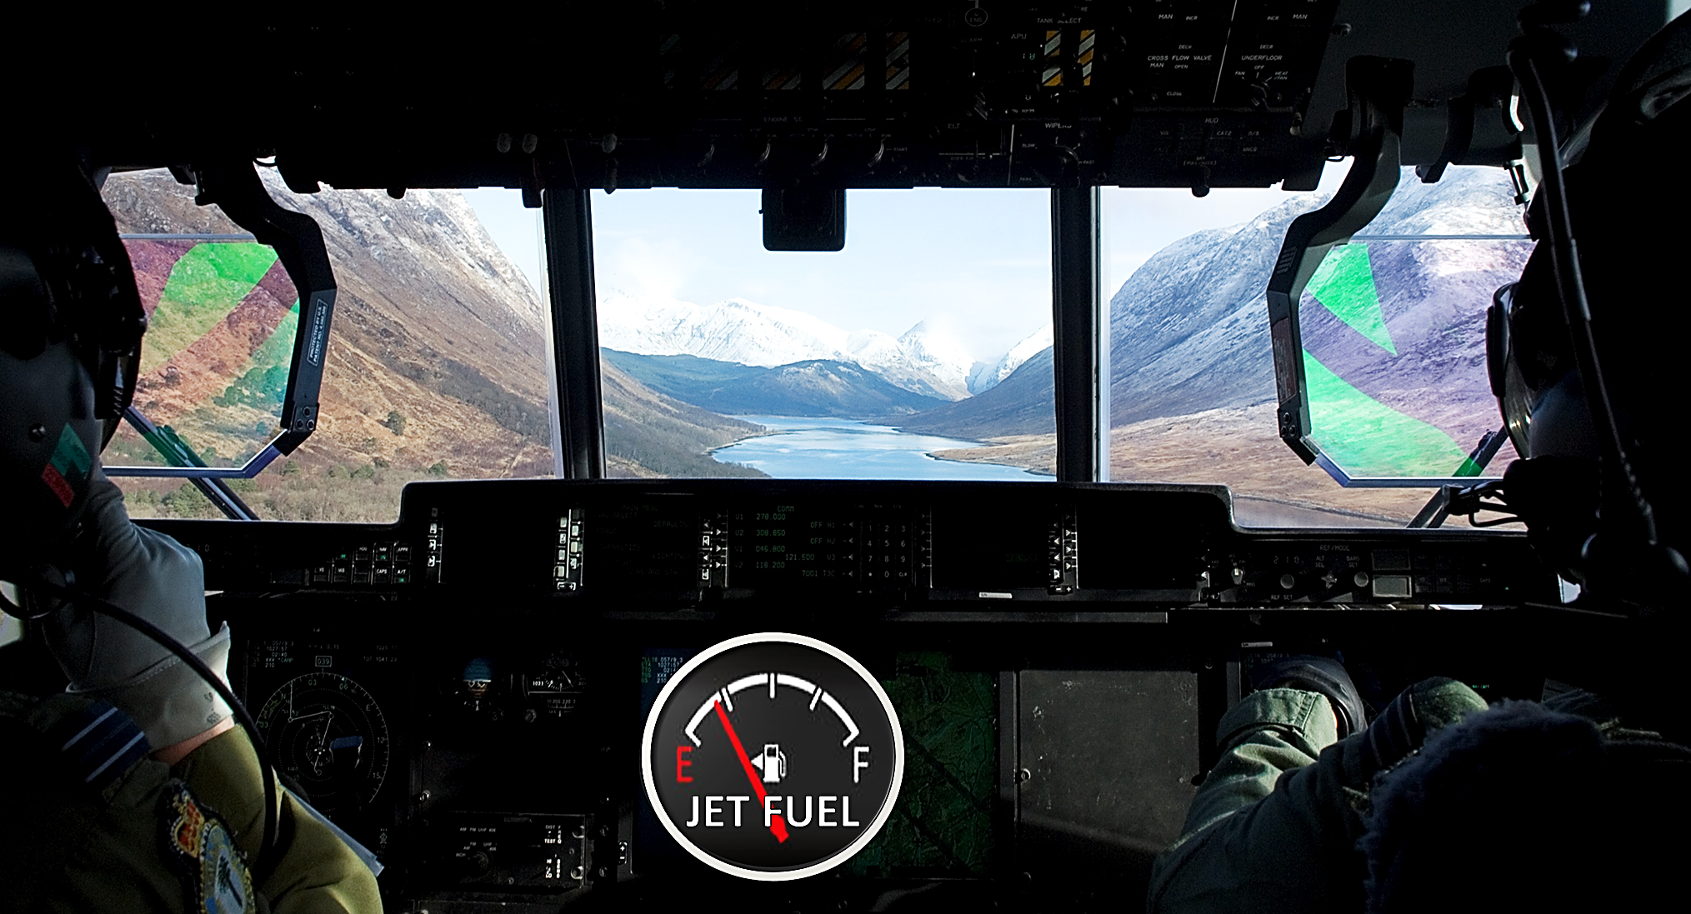
PHRASES
LET’S HOPE WE
LAND BEFORE
THE FUEL IS OUT !

Slide 29
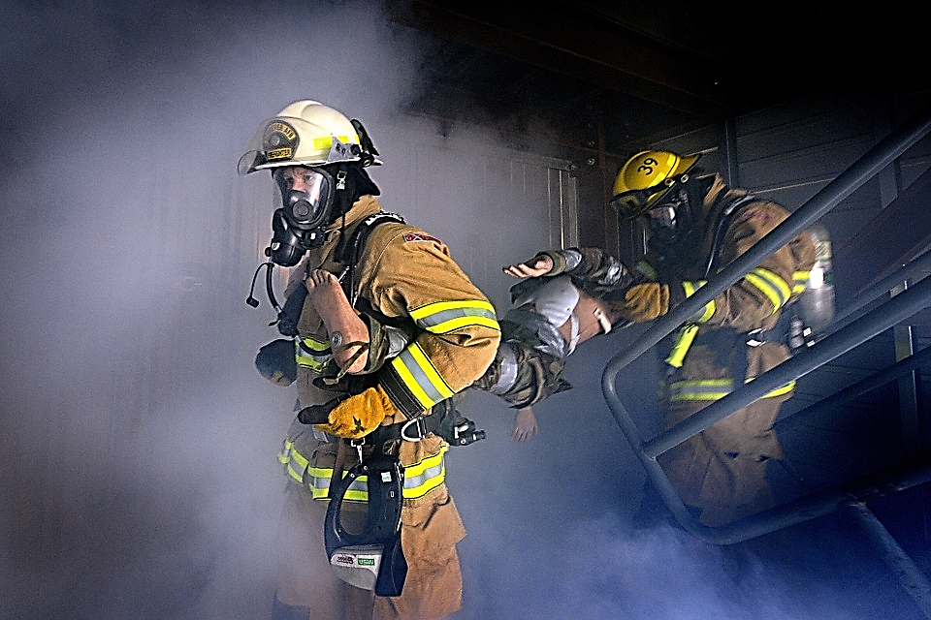

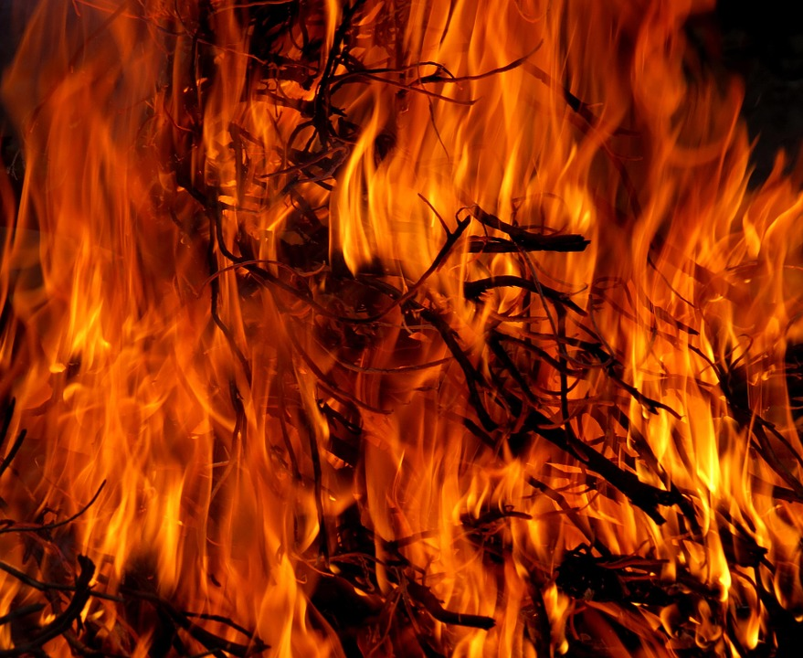
PHRASES

Slide 30
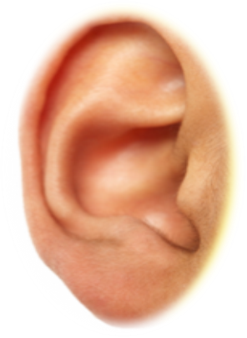

LISTENING PRACTICE

Slide 31

LOVE OF FRIENDS CREATES TRUST
PETER IS A FRIEND OF MINE
I AM READING A BOOK OF HIS POEMS
HIS HOME IS AN ISLAND OFF THE BRITISH COAST
HE MUST REMEMBER TO SWITCH OFF THE LIGHTS AT NIGHT
I WILL BE OFF TO VISIT HIM SOON
IT’S GOOD TO GET OUT AND ABOUT !
I MUST FIND THE WAY OUT TO THE AIRPORT!
I HOPE THE PLANE LANDS BEFORE THE FUEL IS OUT !

Slide 32

JUST
LISTEN AGAIN

Slide 33
ENGLISH LANGUAGE STUDY
THERE ARE MANY MORE
OF OFF OUT
USES IN IDIOMS

Slide 34
ENGLISH LANGUAGE STUDY
SEE
IDIOMS
IN
USE OF ENGLISH MODULES

Slide 35

ENGLISH LANGUAGE STUDY
https://en.oxforddictionaries.com

