Slide 1

CONTEXTS

Slide 2


WHAT ARE…
CONTEXTS
?
CHECK THIS WORD

Slide 3

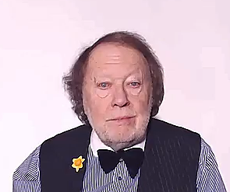
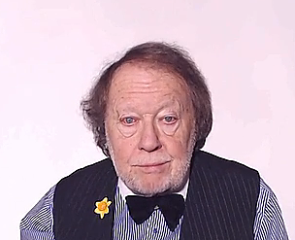
CONTEXTS
All the aspects which define something
are the
CONTEXT

Slide 4
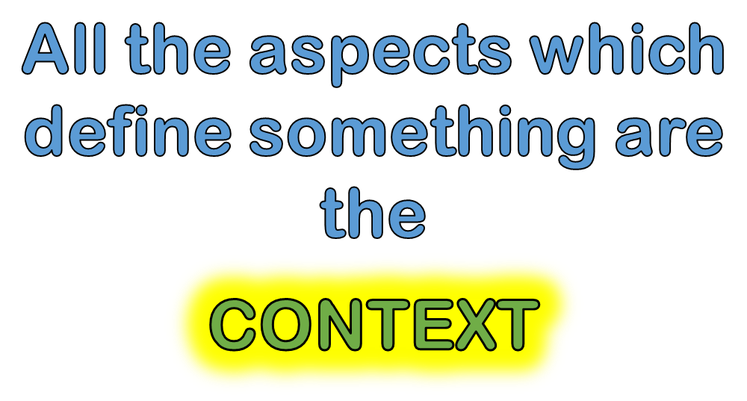
REMEMBER THIS!

Slide 5
KEY WORDS

Slide 6

CHECK THESE WORDS IN YOUR LANGUAGE
KEY WORDS
ACTIVITY HAPPENING
EVENT
CIRCUMSTANCES
EVENT ELEMENTS
THE DEFINING ASPECTS
OF A CHANGE
SITUATION

Slide 7










ARTS

Slide 8
Typical contexts
HOME
HAPPINESS
FAMILY
FRIENDS

Slide 9
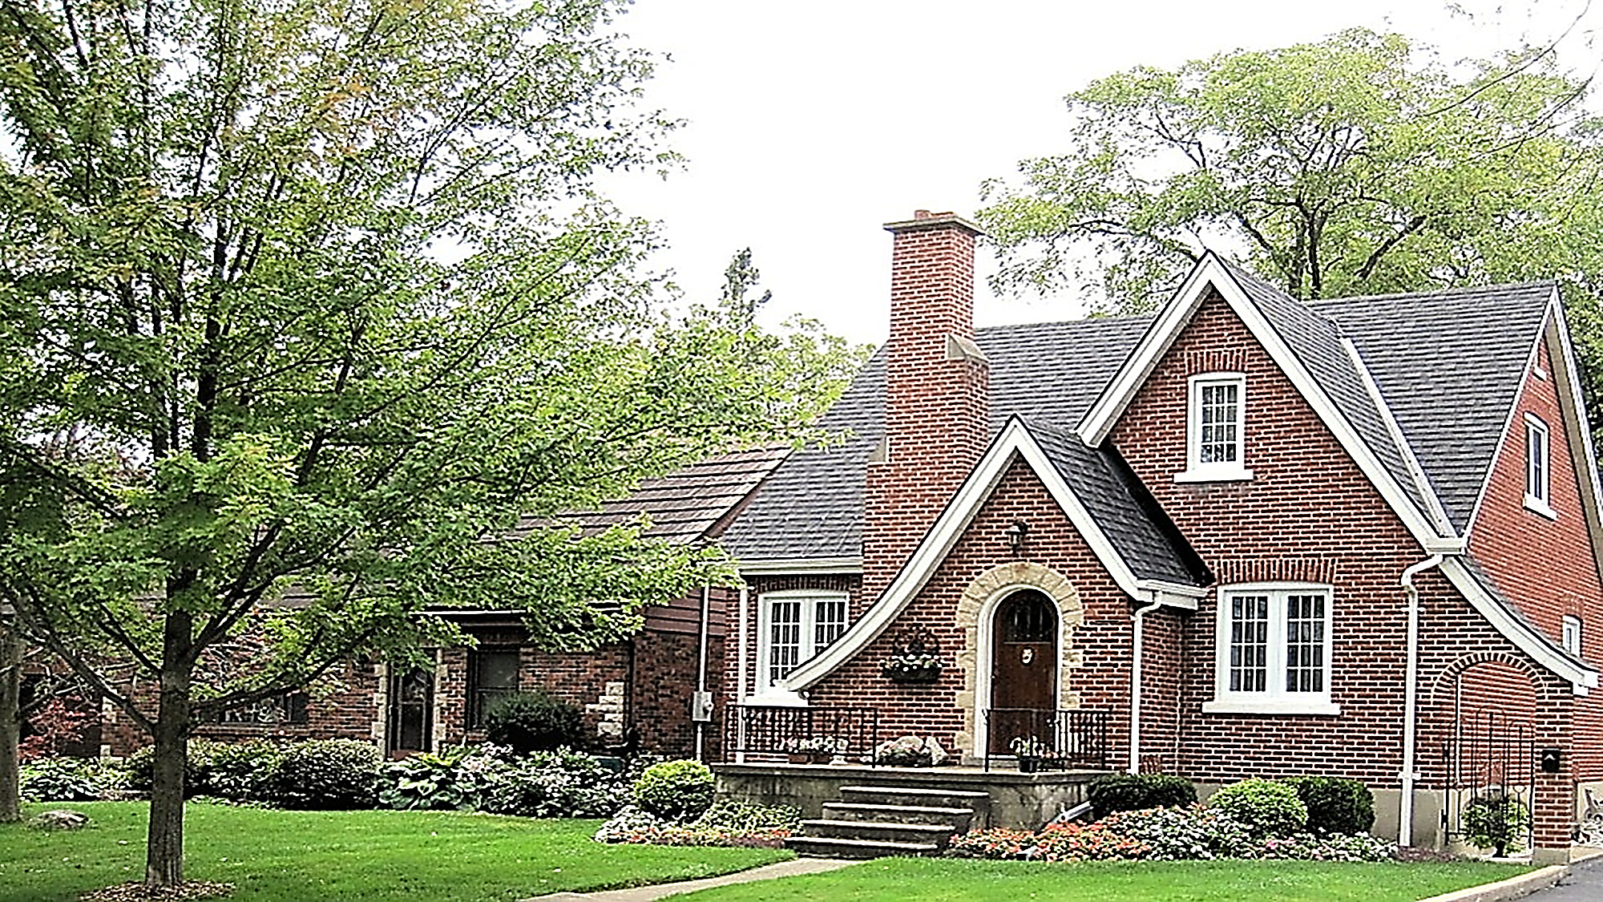
HOME

Slide 10

HAPPY PEOPLE

Slide 11

FRIENDS

Slide 12
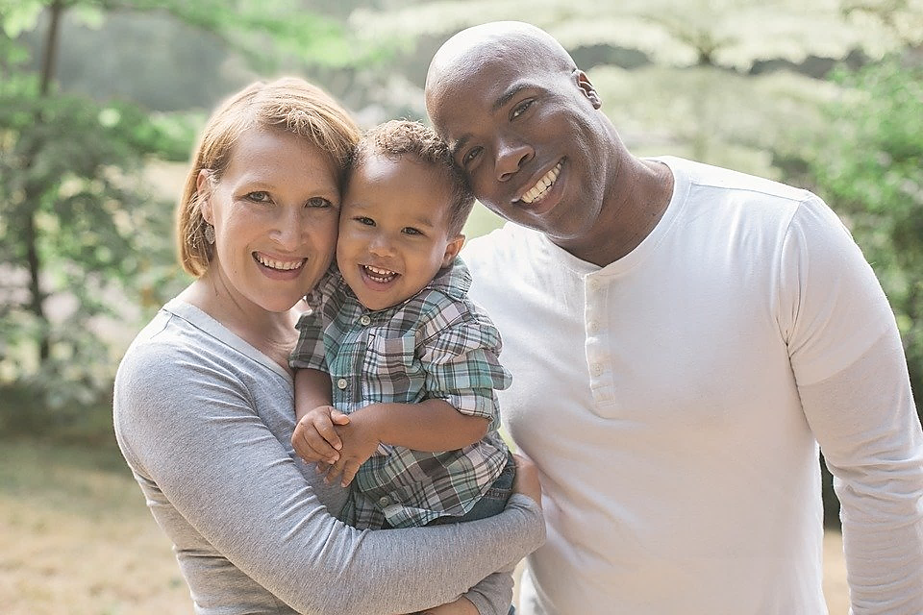
FAMILY

Slide 13
Typical contexts
INFORMATION
PEACE
SCIENCES
LOVE
ARTS
BUSINESS

Slide 14



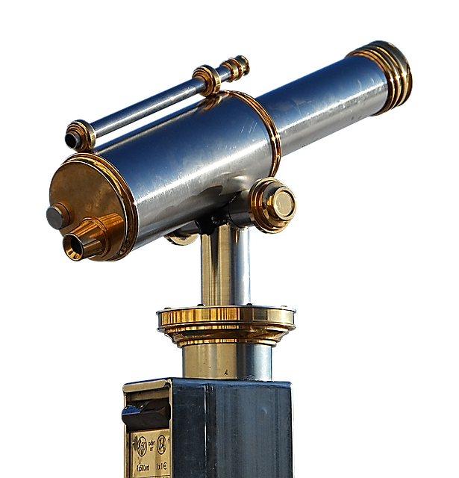
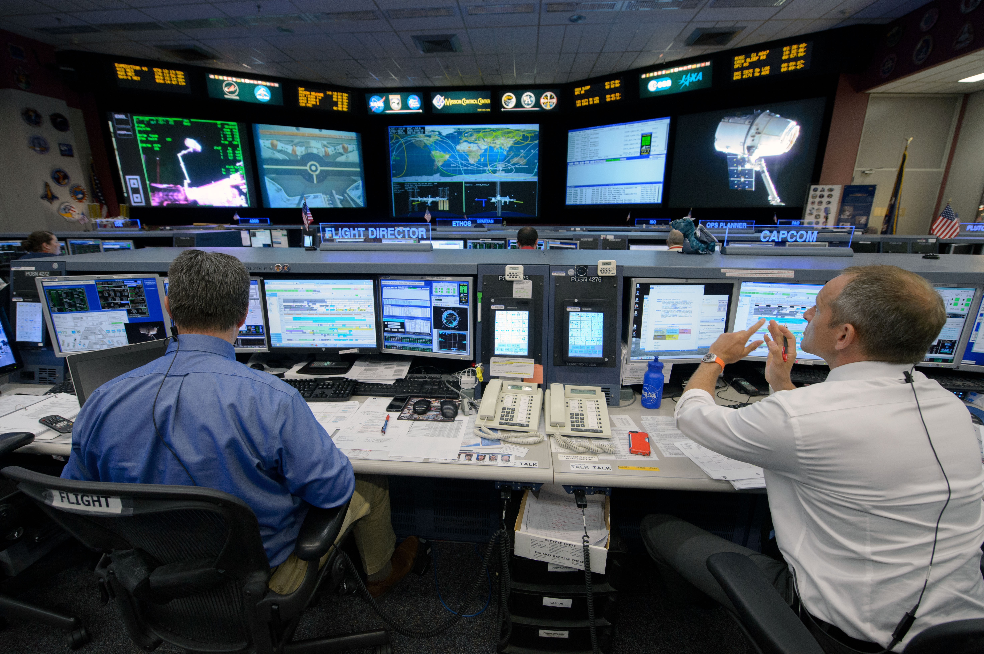
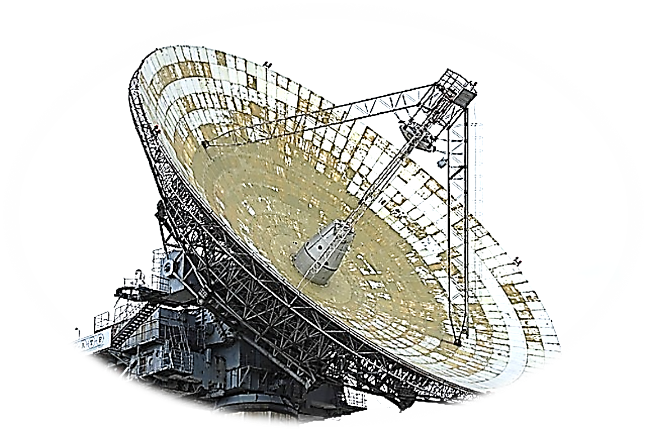
INFORMATION
INFORMATION CONTROL
CENTRE

Slide 15




SCIENCES

Slide 16

ARTS

Slide 17

PEACE

Slide 18
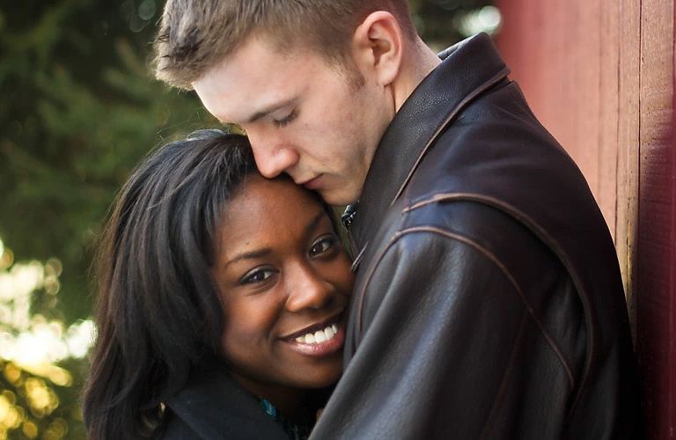
LOVE

Slide 19

BUSINESS

Slide 20
BUSINESS

Slide 21




Slide 22

KEY WORDS
KEY WORDS
KEY WORDS

Slide 24


Slide 27
KEY WORDS
AREA AROUND US
MINUTES AFTER HOURS AFTER DAYS AFTER YEARS
ACTIVITY HAPPENING

Slide 28

KEY WORDS
EVENT
ACTIVITY HAPPENING
CIRCUMSTANCES
EVENT ELEMENTS
THE DEFINING ASPECTS OF
A CHANGE
SITUATION

Slide 29
Circumstances (usually plural) are the facts that are connected with and affect a situation, an event or an action. A situation is all the things that are happening at a particular time and in a particular place. (OALD)
If one person is listening to another, this is what is happening, not really the facts about what is happening.
There is sometimes overlap;for example, the situation is/circumstances are that a tourist, lost, has asked for directions and is listening to the response. It's difficult to make a sharp difference there.

Slide 30


Slide 31



Slide 33
EVENT

Slide 34
EVENT

Slide 36


KEY WORDS

Slide 39


Slide 41


EVENT

Slide 42
EVENT

Slide 43


Slide 45
EVENT
EVENT

Slide 46
EVENT

Slide 47


Slide 48
EVENT

Slide 49


WORDS
WORDS

Slide 50
WORDS
WORDS

Slide 51
WORDS
WORDS

Slide 52
WORDS
WORDS

Slide 53
WORDS
WORDS

Slide 54
WORDS
WORDS

Slide 57
The circumstances in which an event happens- a setting.
The set of circumstances or facts that surround a particular event or situation.
The situation within which something exists or happens, and that can help explain it
The context of an idea or event is the general situation that relates to it, and helps it to be understood
Context can be background information that removes ambiguity or confusion

Slide 58
SITUATION
EVENT
CIRCUMSTANCES

Slide 59
CONTEXTS OF LIFE

Slide 61
CONTEXT EXAMPLES

Slide 64
SCIENCES

Slide 65
SCIENCES

Slide 67
SCIENCES

Slide 68

SOME WAYS WE COMMUNICATE
TO EXPRESS
TO TELL
TO INFORM
SPEAK A THOUGHT OR FEELING
PERSONAL DIRECT PRIVATE
FACTUAL NEUTRAL FORMAL
STOP THE VIDEO WHILE YOU CHECK

Slide 75
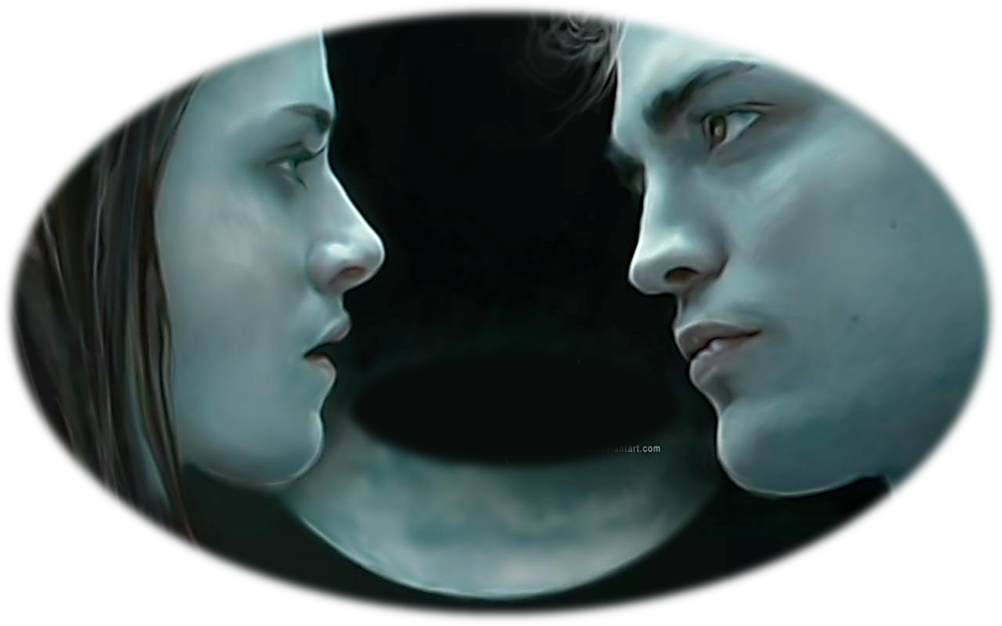
LOVE

Slide 76
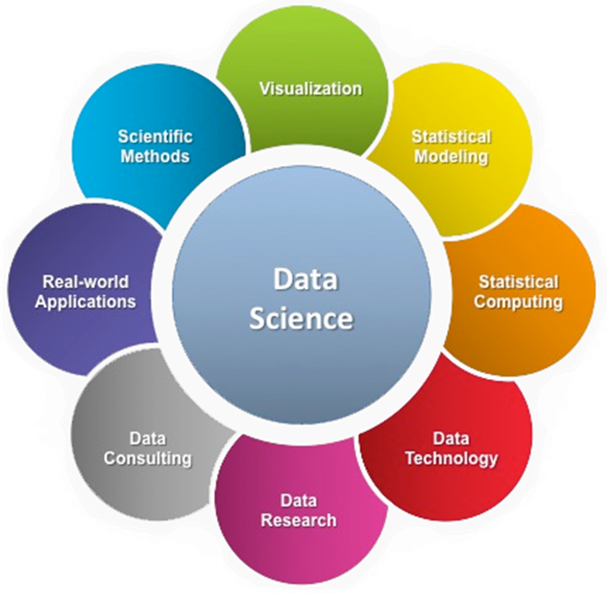


PROCESSING CENTRE

Slide 77


Slide 78
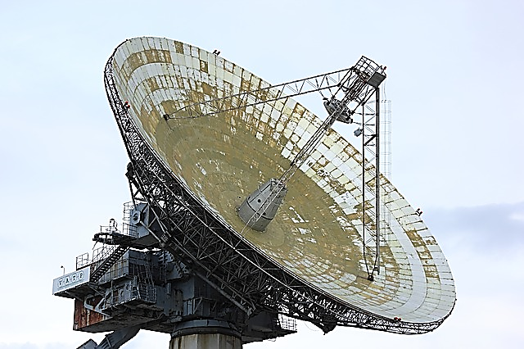

Slide 79



Slide 80
KEY WORDS

Slide 81
SOME WAYS WE COMMUNICATE
TO EXPRESS
TO TELL
TO INFORM
SPEAK A THOUGHT OR FEELING
PERSONAL DIRECT PRIVATE
FACTUAL NEUTRAL FORMAL
STOP THE VIDEO WHILE YOU CHECK

Slide 82



SPACE
TIME
EVENT

