Slide 1

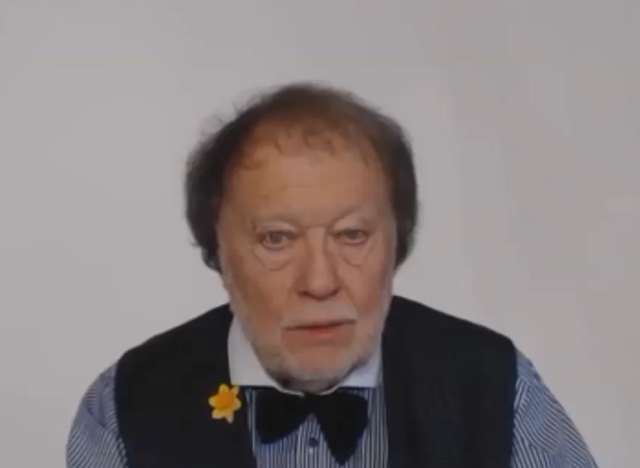

Slide 2
LET’S FIND OUT ABOUT
NOUNS AND VERBS
ADJECTIVES AND ADVERBS
FOUR IMPORTANT PARTS OF SPEECH

Slide 3
WHAT IS A NOUN?

Slide 4


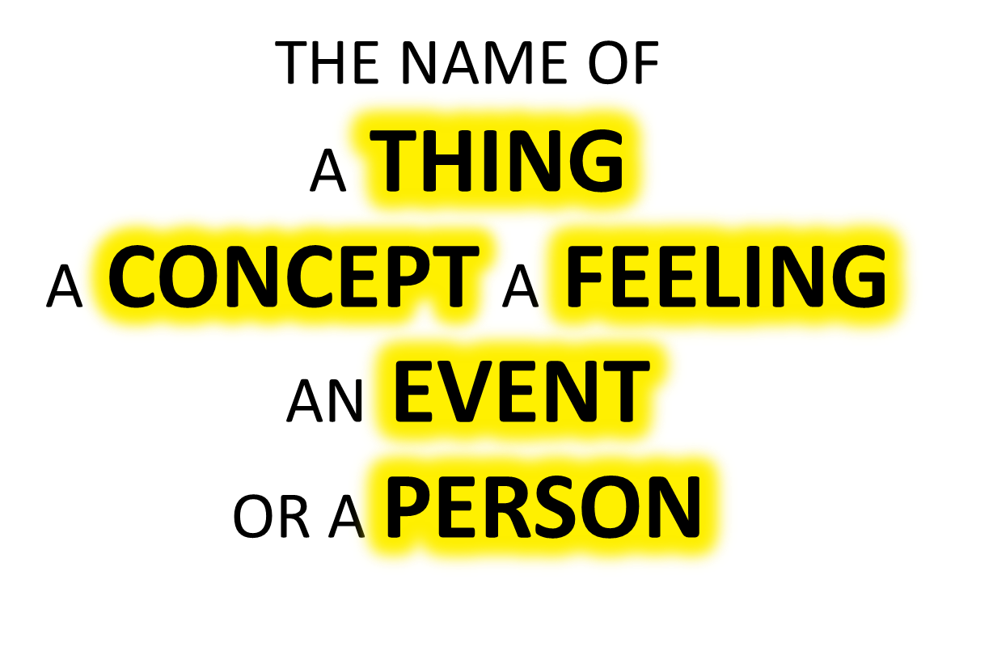

Slide 5
WHAT IS A VERB?

Slide 6

A VERB IS:

Slide 7

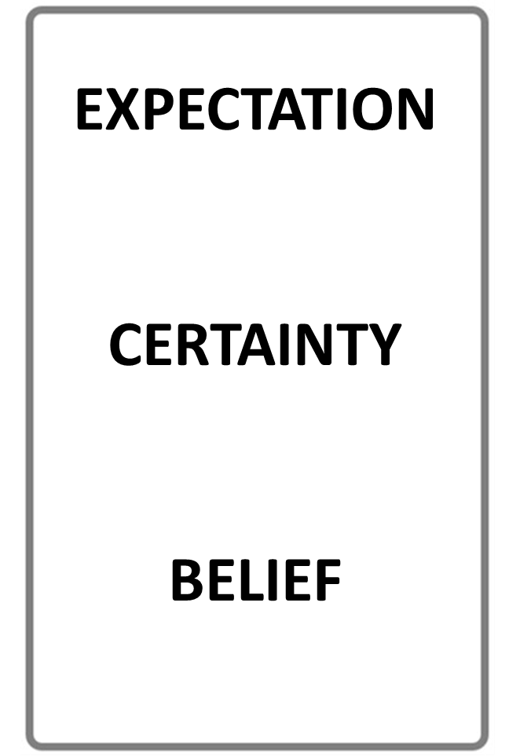


NOUN
VERB
NAME OF A THING
AN ACTIVITY WORD
STOP THE VIDEO WHILE YOU CHECK

Slide 8
USING ADJECTIVES AND ADVERBS
WHAT IS AN ADJECTIVE?
WHAT IS AN ADVERB?

Slide 9
ADJECTIVE
ADVERB
DESCRIBES A NOUN
DESCRIBES A VERB
STOP THE VIDEO WHILE YOU CHECK

Slide 10
DESCRIBE
NOUNS
ADJECTIVES

Slide 11
DESCRIBE
VERBS
ADVERBS

Slide 12
KEY
ADJECTIVE EXAMPLE

Slide 13
KEY
ADVERB EXAMPLE

Slide 14
USING ADJECTIVES AND ADVERBS
LY

Slide 15
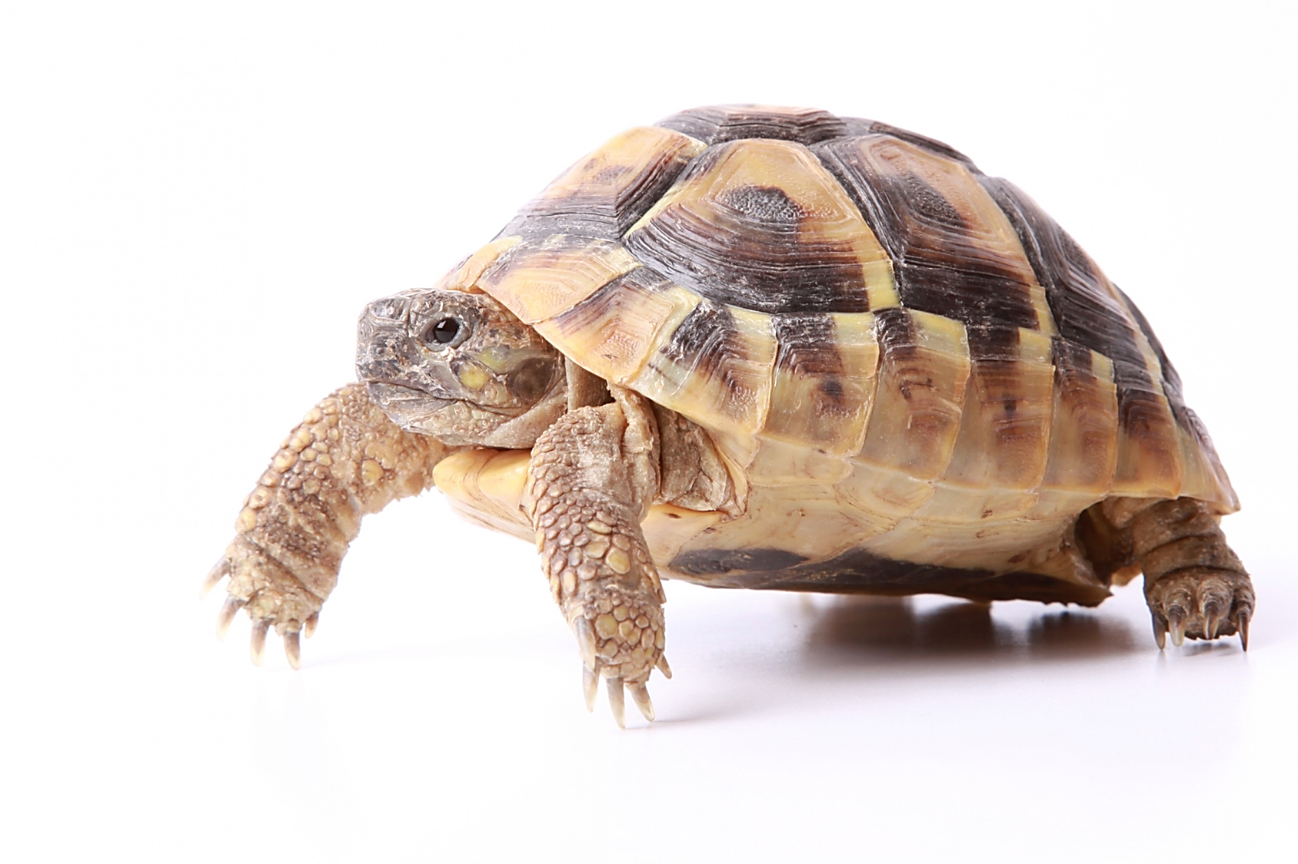

ADJECTIVE
THIS IS A SLOW ANIMAL
THE
ADJECTIVE DESCRIBES
THE NOUN

Slide 16


THE BUTTERFLIES ARE FLYING SLOW LY
THE
ADVERBDESCRIBESTHE
VERB

Slide 17
USING ADJECTIVES AND ADVERBS

Slide 18
USING ADJECTIVES AND ADVERBS
WHAT IS AN ADJECTIVE?
WHAT IS AN ADVERB?

Slide 20
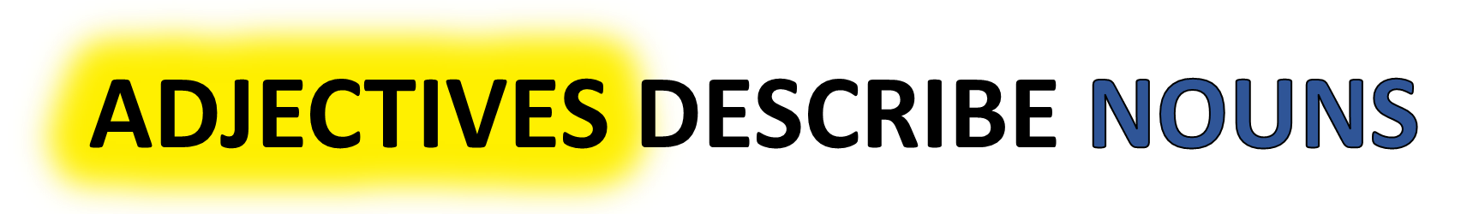
ANSWER THESE QUESTIONS!
WHAT IS AN ADJECTIVE ?
WHAT IS A NOUN ?
ADVERBS DESCRIBE VERBS
WHAT IS A VERB ?
WHAT IS AN ADVERB ?

Slide 23
What does OPSHACOM stand for?
OPSHACOM stands for
Opinion Shape Age Color Origin Material
the order of adjectives in a sentence

Slide 24
Opinion Shape Age Color Origin Material
LOVELY BIG YOUNG RED BRITISH STEEL
EXCELLENT SQUARE OLD BROWN EUROPEAN WOOL
SILLY ROUND ANCIENT YELLOW CANADIAN LIQUID

Slide 25

ADJECTIVE
THIS IS A SLOW ANIMAL
THE
ADJECTIVE DESCRIBES
THE NOUN

Slide 26
WHAT IS AN NOUN?

Slide 28
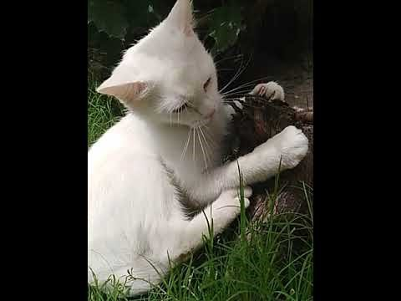

Slide 29


Slide 30
Quantity or number.
Quality or opinion.
Size.
Age.
Shape.
Color.
Proper adjective (often nationality, other place of origin, or material)
Purpose or qualifier.

Slide 31
that horrible big fierce dog
It is very unusual to have more than three adjectives.
Adjectives usually come in this order:
1 2 3 4 5 6 7 8
General
opinion Specific
opinion Size Shape Age Colour Nationality Material
We use some adjectives only after a link verb:
afraid alive alone asleep
content glad ill ready
sorry sure unable well
Some of the commonest -ed adjectives are normally used only after a link verb:
annoyed; finished; bored; pleased; thrilled
We say:

Slide 32
Adjectives usually come in this order:
1 | 2 | 3 | 4 | 5 | 6 | 7 | 8
General opinion | Specific opinion | Size | Shape | Age | Colour | Nationality | Material

Slide 33
WHAT DO WE DESCRIBE?

Slide 34
WHAT IS A NOUN?
WHAT IS A VERB?

Slide 35
NOUN
VERB
NAME OF A THING
AN ACTIVITY WORD
STOP THE VIDEO WHILE YOU CHECK

Slide 36
USING ADJECTIVES AND ADVERBS
WHAT IS AN ADJECTIVE?
WHAT IS AN ADVERB?

Slide 37
ADJECTIVE
ADVERB
DESCRIBES A NOUN
DESCRIBES A VERB
STOP THE VIDEO WHILE YOU CHECK

Slide 38
KEY
NOUN EXAMPLE

Slide 39
KEY
VERB EXAMPLE

Slide 40
ADJECTIVE
THIS IS A SLOW ANIMAL
THE
ADJECTIVE DESCRIBES
THE NOUN

Slide 41
THE BUTTERFLIES ARE FLYING SLOW LY
DESCRIBES
THE
VERB

Slide 42
ADJECTIVES
ADVERBS
DESCRIBE
DESCRIBE
NOUNS
VERBS

Slide 43
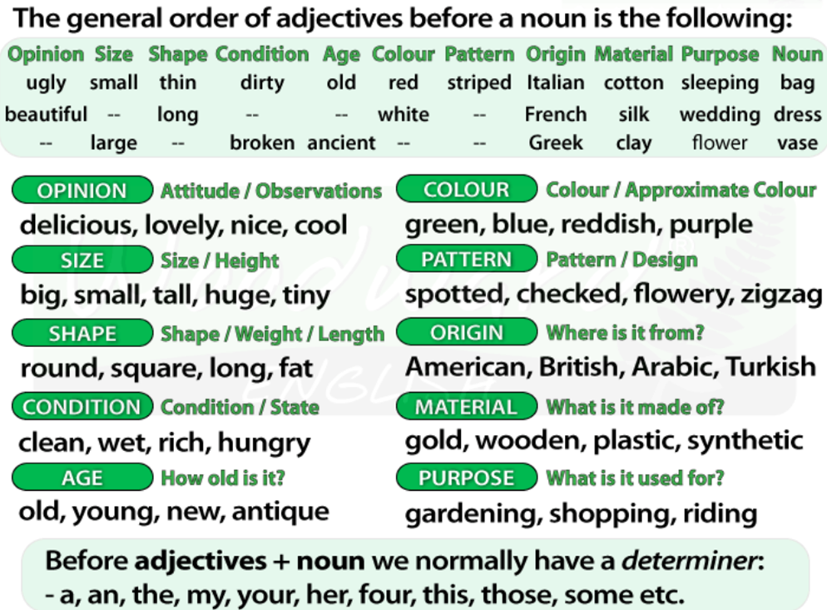
USING ADJECTIVES AND ADVERBS

Slide 44
USING ADJECTIVES AND ADVERBS
WHAT IS AN ADJECTIVE?
WHAT IS AN ADVERB?

Slide 49
Quantity or number.
Quality or opinion.
Size.
Age.
Shape.
Color.
Proper adjective (often nationality, other place of origin, or material)
Purpose or qualifier.

Slide 50
that horrible big fierce dog
It is very unusual to have more than three adjectives.
Adjectives usually come in this order:
1 2 3 4 5 6 7 8
General
opinion Specific
opinion Size Shape Age Colour Nationality Material
We use some adjectives only after a link verb:
afraid alive alone asleep
content glad ill ready
sorry sure unable well
Some of the commonest -ed adjectives are normally used only after a link verb:
annoyed; finished; bored; pleased; thrilled
We say:

Slide 51
Adjectives usually come in this order:
1 | 2 | 3 | 4 | 5 | 6 | 7 | 8
General opinion | Specific opinion | Size | Shape | Age | Colour | Nationality | Material

Slide 52
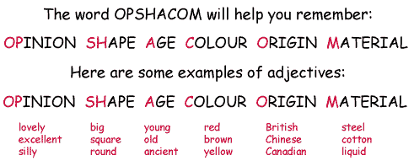

Slide 53
ADVERBS

Slide 54
USING ADJECTIVES AND ADVERBS
WHAT IS AN ADJECTIVE?
WHAT IS AN ADVERB?

Slide 55
ADJECTIVE
ADVERB
DESCRIBES A NOUN
DESCRIBES A VERB
STOP THE VIDEO WHILE YOU CHECK

