Slide 1
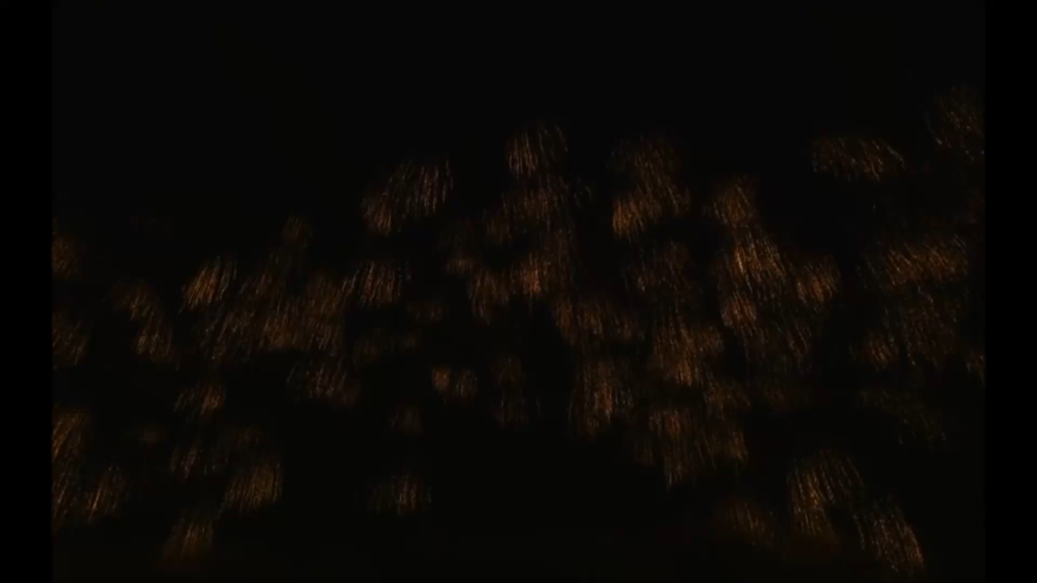

Slide 2

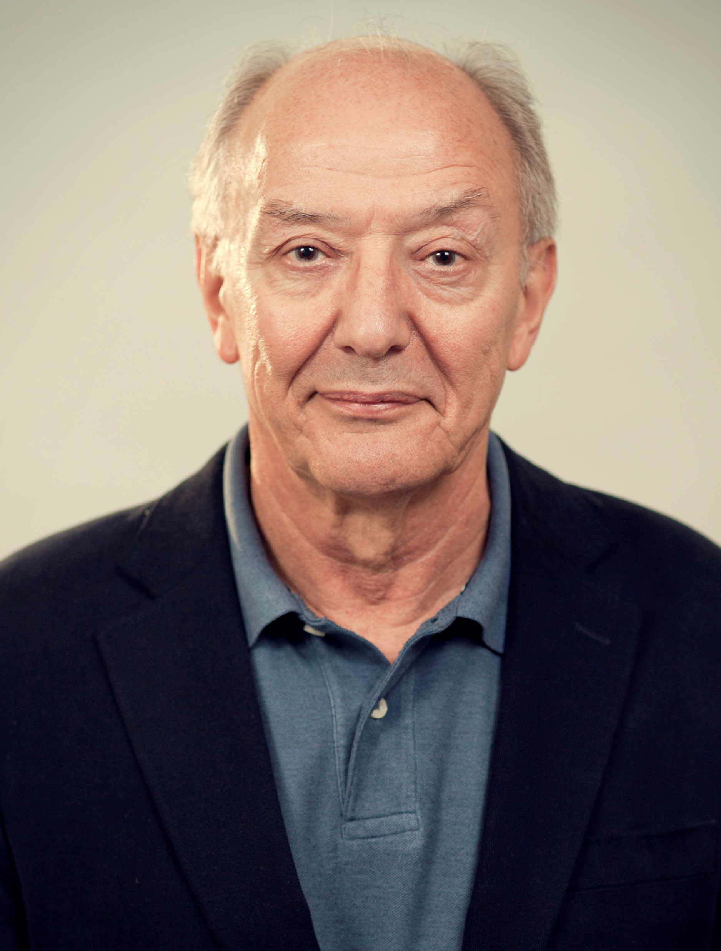


Slide 4
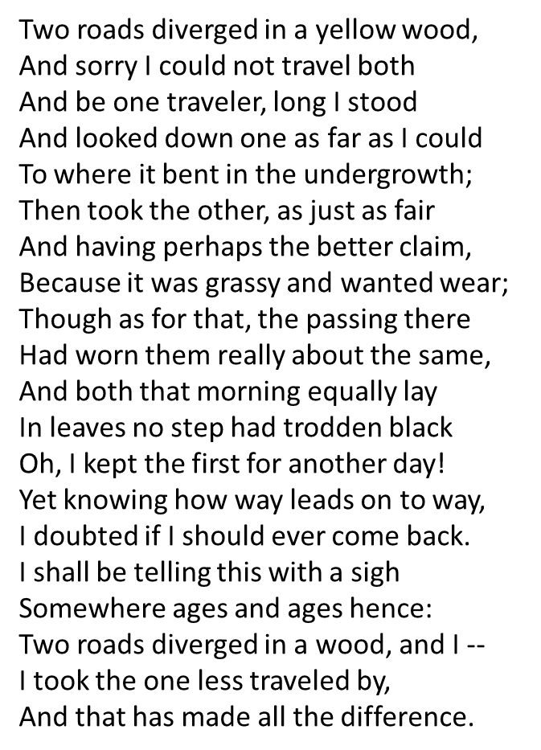
A WORD FROM ROBERT FROST
THANKS CHUM-YOU CERTAINLY MAKE A DIFFERENCE
HAPPY BIRTHDAY!

