Slide 1
OBLIGATION
QUESTIONS AND NEGATIVES

Slide 2


QUESTIONS
YOU
DON’T HAVE TO SIT SO NEAR!
MUST
THE MUSIC BE SO LOUD?
NEGATIVES

Slide 3
OBLIGATION: QUESTIONS AND NEGATIVES
DO WE HAVE TO GET A NEW CAR?
SHOULD WE SUPPORT GREENPEACE?
MUST YOU GO AWAY THIS WEEKEND?

Slide 4
STRONG WISH
FORBIDDEN
I MUST HELP MY FAMILY
WE MUSTN’T HURT PEOPLE!
I HAVE TO WORK
UNNECESSARY
NECESSARY
I NEEDN’T DO THAT

Slide 5
OBLIGATION: QUESTIONS AND NEGATIVES
SHOULDN’T WE HELP PEOPLE ?
WE SHOULD SUPPORT WORLD PEACE SHOULDN’T WE ?
WE DIDN’T HAVE TO HAVE TO PAY! IT WAS FREE !

Slide 6
STORY BOARD
For most of last summer there was a heat wave. It was so hot that we had to stay indoors or under trees in the shade. We didn’t have to worry about storms, there was absolutely no wind at all. It’s now summer again and we hope we won’t have to suffer like last year.
We must remember to put on sun blocker which we should have used last year but didn’t. We needn’t think about it at the moment, it’s actually raining outside!
I think we should learn from past experience, shouldn’t we ?

Slide 7

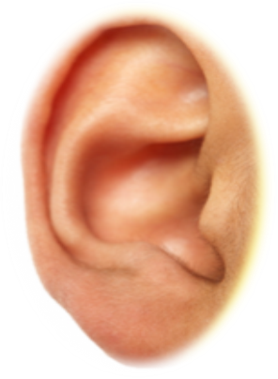

STORY BOARD

Slide 8
STORY BOARD
For most of last summer there was a heat wave. It was so hot that we had to stay indoors or under trees in the shade. We didn’t have to worry about storms, there was absolutely no wind at all. It’s now summer again and we hope we won’t have to suffer like last year.
We must remember to put on sun blocker which we should have used last year but didn’t. We needn’t think about it at the moment, it’s actually raining outside!
I think we should learn from past experience, shouldn’t we ?

Slide 9
DUTY
UNWISE
I SHOULD VISIT
MY UNCLE
WE SHOULDN’T EAT SO MUCH ICE CREAM
UNNECESSARY
YOU DIDN’T HAVE TO DO THAT

Slide 10
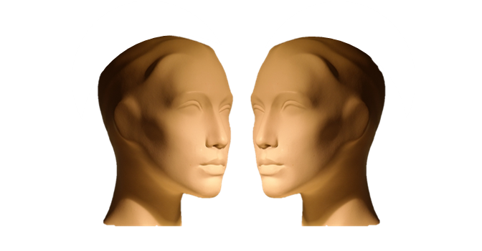
TYPICAL DIALOGUE

Slide 11
TYPICAL DIALOGUE
Sarah: You must help arrange the holiday.
Bob: We mustn’t do it too late, advance booking is best.
Sarah: Yes and we should get a nice hotel which shouldn’t be pricey.
Bob: We don’t have to spend a lot but we do have to rent a car.
Sarah: We must really relax, we both had to work very hard this year.
Bob: Let’s just chill out, we needn’t have a hectic time.
Sarah: That’s right, I must be refreshed for the next hard months.
Bob: Me too! I have to recharge my batteries !

Slide 12
TYPICAL DIALOGUE

Slide 13
TYPICAL DIALOGUE
Sarah: You must help arrange the holiday.
Bob: We mustn’t do it too late, advance booking is best.
Sarah: Yes and we should get a nice hotel which shouldn’t be pricey.
Bob: We don’t have to spend a lot but we do have to rent a car.
Sarah: We must really relax, we both had to work very hard this year.
Bob: Let’s just chill out, we needn’t have a hectic time.
Sarah: That’s right, I must be refreshed for the next hard months.
Bob: Me too! I have to recharge my batteries !

Slide 14
SUMMARY
QUESTIONS
YOU
DON’T HAVE TO SIT HERE!
MUST
THE MUSIC BE SO LOUD?
NEGATIVES

Slide 15


SUMMARY
YOU
MUST
KEEP PROMISES!
WE
HAVE TO RESPECT THE LAW!
UNNECESSARY
I
NEEDN’T BUY A CAR!

Slide 16
SUMMARY
DUTY
WE
SHOULD
HELP OTHER PEOPLE

