Slide 1

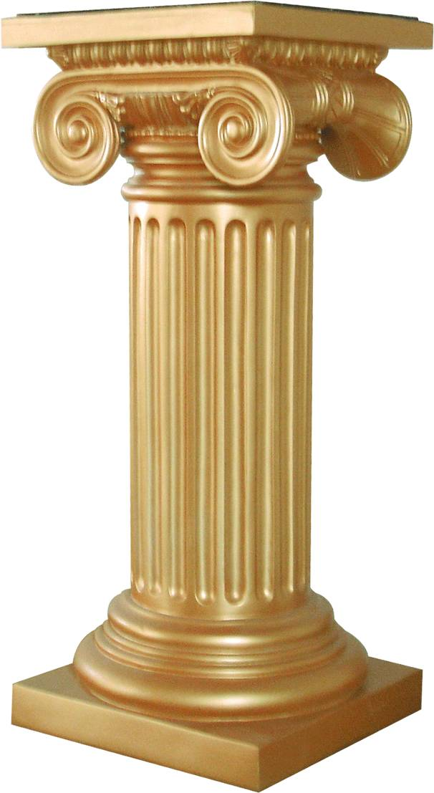

Slide 2
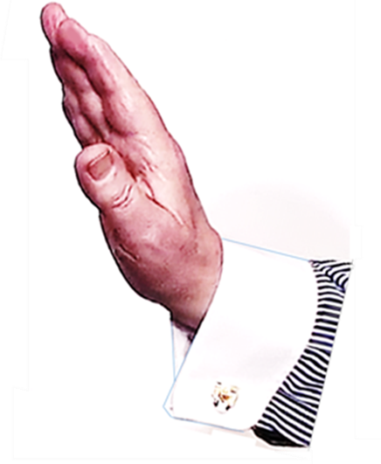

HERE IS A SIMPLE CAUSE WITH A FOLLOWING EFFECT
THIS IS
A DIRECTLY EXPECTED
CONSEQUENCE
CAUSE
EFFECT

Slide 3
HERE IS AN EVENT

Slide 4
WHAT IF... ?
?
IF...

Slide 5
HERE IS A SIMPLE CAUSE WITH A FOLLOWING EFFECT
THIS IS
A DIRECTLY EXPECTED
CONSEQUENCE
CAUSE
EFFECT

Slide 6
WHAT IF... ?

