Slide 1
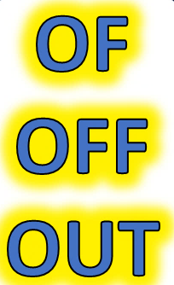
SOME IMPORTANT USES

Slide 3
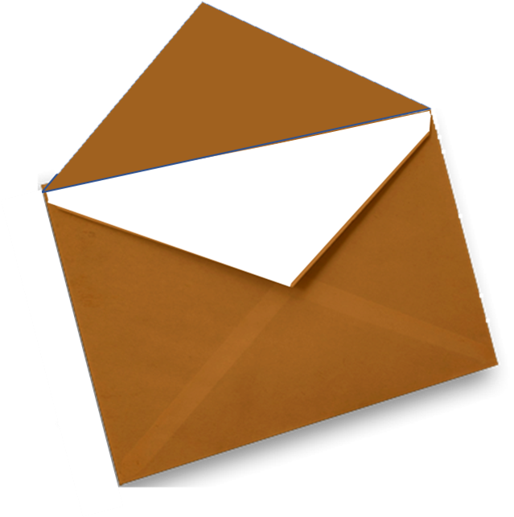
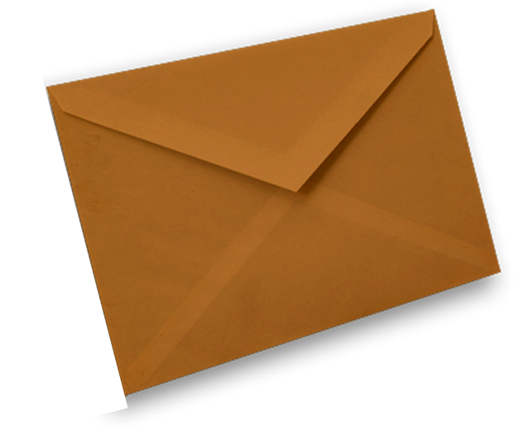
SOME MAIN USES
OF
OF

Slide 4

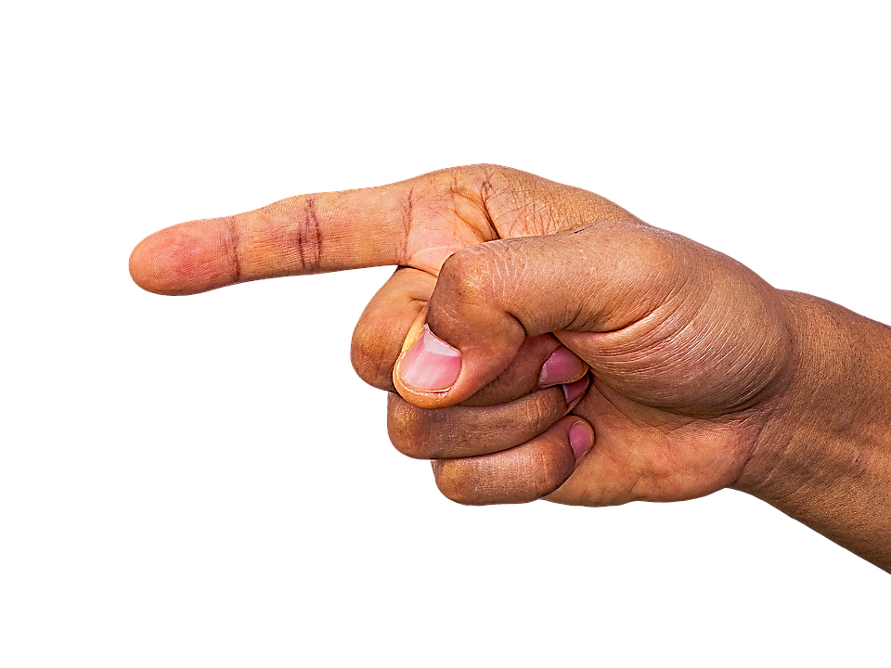

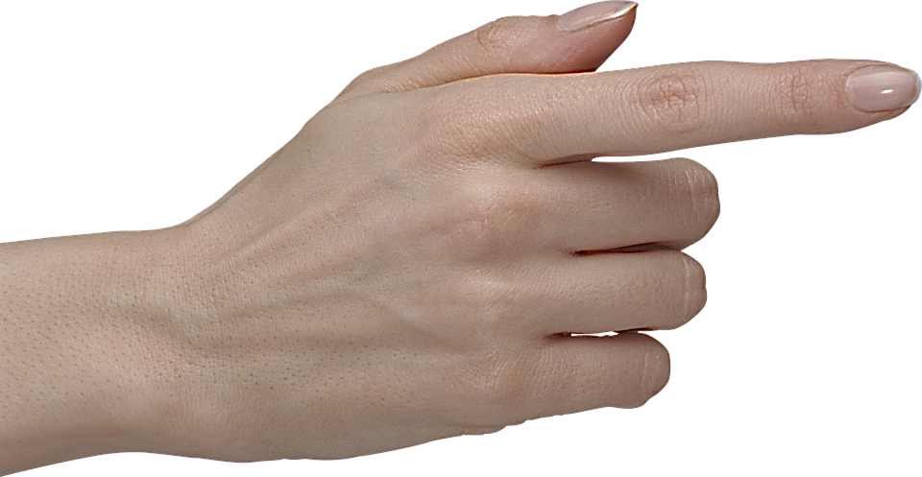
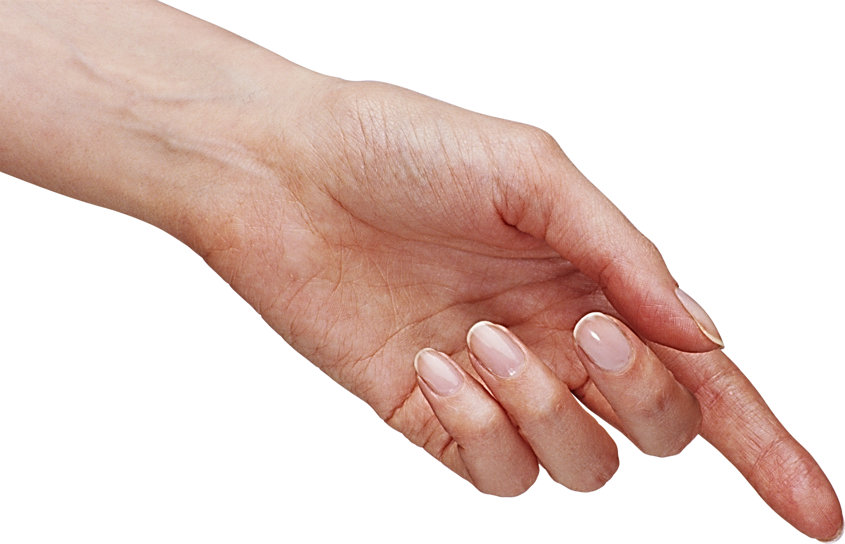
CAUSE
THE REASON WHY
OF
POSSESSIVE
BELONGING
CONTENT
WHAT IS INSIDE
STOP THE VIDEO WHILE YOU CHECK

Slide 5
EXAMPLES

Slide 6

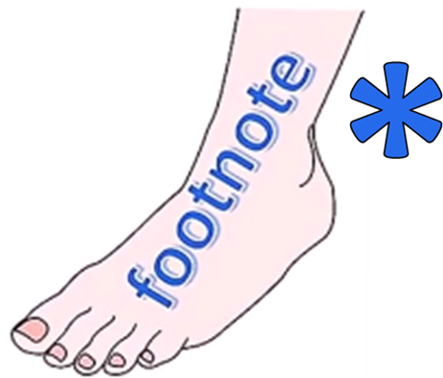
ENGLISH LANGUAGE STUDY
THERE ARE MANY MORE
OF
USES IN IDIOMS

Slide 8

OFF
OFF

Slide 9
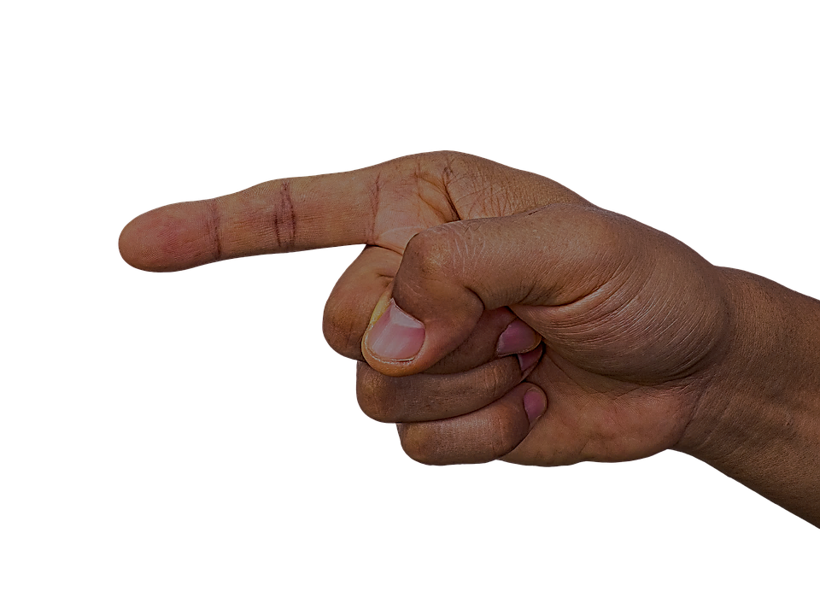
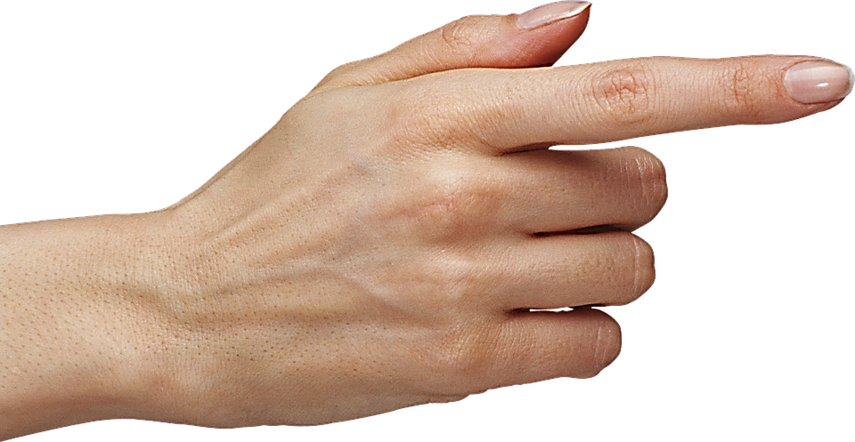
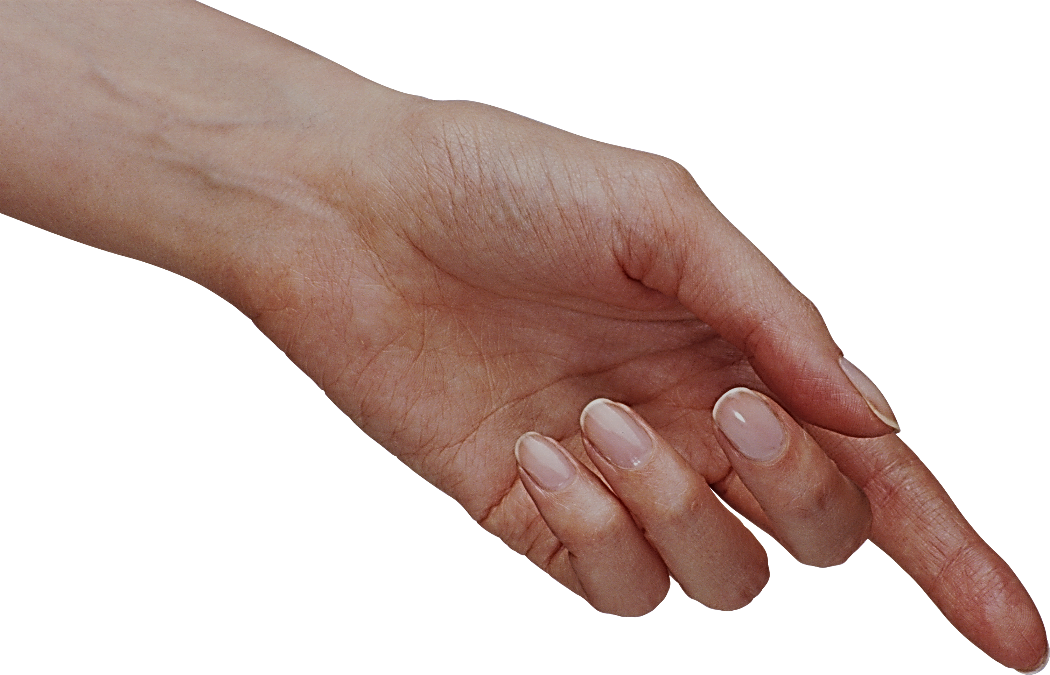
DISTANCE
OFF
MODE
DEPARTURE

Slide 10

ENGLISH LANGUAGE STUDY
HERE ARE SOME USUAL
OFF
EXAMPLES

Slide 11
ENGLISH LANGUAGE STUDY
THERE ARE MANY MORE
OFF
USES IN IDIOMS

Slide 12
EXAMPLES
OFF THE TRACK
OFF THE COAST
OFF THE ROAD
OFF THE HIGH STREET
OFF THE POINT
OFF THE BIKE
FAR OFF
LIGHT OFF

Slide 13
Of' connects words. it is used to denote a relationship. belonging to somebody/something (a member of the team)
coming from a particular background (the people of Wales)
to indicate what something contains (a glass of milk)
a point of reckoning (South of the border)
possession (Queen of England) (Heart of gold)

Slide 14
However, generally it can be considered the opposite of ‘on’.
The light is on’; ‘The light is off’.
‘Off’ is very versatile, it can be used as an adverb, a preposition, an adjective and a noun.
It can be used in various methods, such as:
to denote a location (An island off the coast of Spain)
to describe a situation (She is better off without him.)
to describe something (The milk smells off.)
when speaking of machinery (The air conditioning is off.)
when someone leaves (He is off for the day.)
and many more…

Slide 15
The prepositional function of ‘off’ is also a commonality. Here, it can be used as a word to indicate the physical separation or distance from a position of rest, attachment, or union: ‘Take it off the table’, or ‘a shop just off the main street.’
It should also be noticed that both these words have a common etymology, that is, both terms are derived from the same word. Alongside the similarities in pronunciation, this is probably one of the main reasons why people confuse the two.
So to summarize, the two words differ in the following areas:
1. ‘Of’ is mostly used as a preposition, and therefore, should be used when a preposition is needed. ‘Off’ is usually used as an adverb, and should be used in cases where anadverbisneeded.
2. ‘Of’ is more often used in sentences, while ‘off’ is used less frequently.
3. ‘Off’ is used in conjunction with verbs, which is not the case with ‘of’.
LEAVING POSITION

Slide 16
The manager is a representative of the office leadership.
Wash your hands of everything.
John is a man of good family.
I think I’m dying of hunger.
Mary has a book of poems.
Is that idiot of a salesman calling again?
I’m going to visit the city of love.
Rupert is one of us.
There is talk of peace.
I need three kilos of sugar.
She was born on the 21st of July in New York.
There were a lot of people standing in line.
We're going to reach the top of the hill.
They live in a block of flats on this street.

Slide 17
This button is about to come off.
Take off your hat.
Turn off the light.
Take it off the table.
The gas station is just off the corner ahead.
I am scraping the top layer of icing off of the cake.
The manager is off to a meeting in Chicago.
Wipe the sweat off your face.
Take the wrapping off the gift.
This road branches off to Grove City.
He took 10% off for all cash purchases.
Everything was 50% off.
The alarm goes off at noon.
My headache passed off soon.
Mark the pizza off into equal parts.

Slide 18
OUT
OUT

Slide 19
ffffff
OUT
ffffff
ffffff

Slide 20
EXAMPLES
QUANTITY

Slide 21
ENGLISH LANGUAGE STUDY
THERE ARE MANY MORE
OUT
USES IN IDIOMS

Slide 22
EXAMPLES

Slide 23
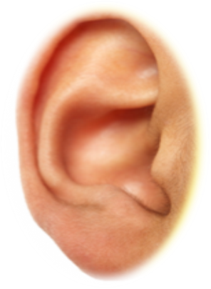
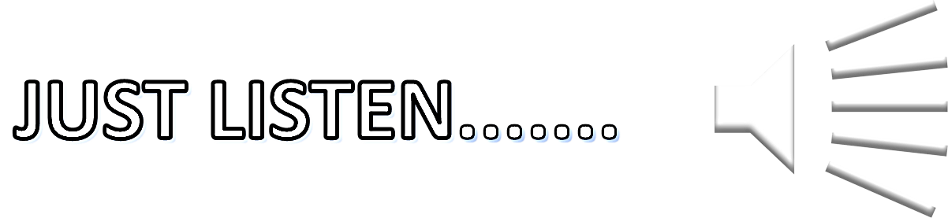
STORY BOARD

Slide 24
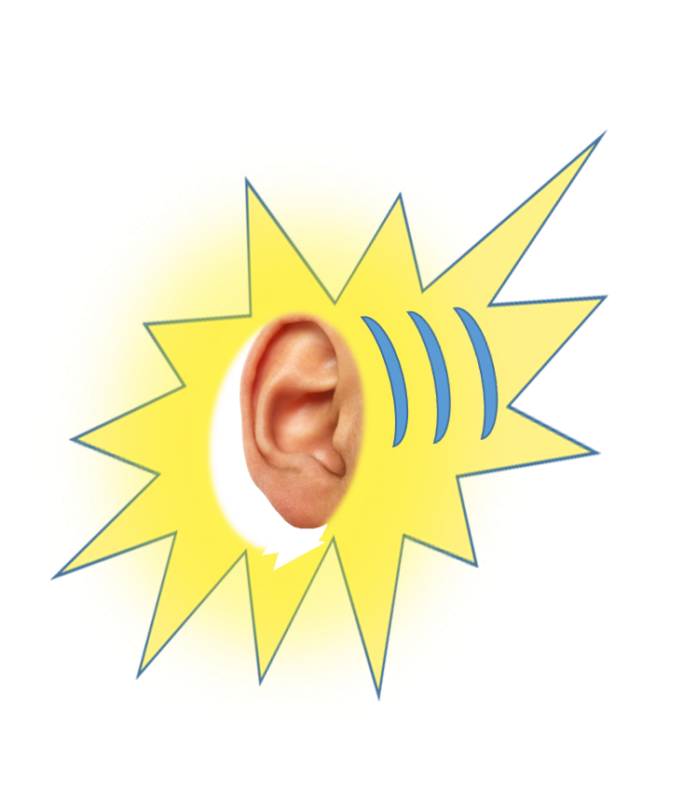
LISTENING PRACTICE EXAMPLES
I WALKED TO THE TOWN
PETER LOOKED TOWARDS ME
I USUALLY GO TO BED TOWARDS MIDNIGHT
JENNY WILL DRIVE TO LONDON AIRPORT
THE JUMBO JET FLEW TOWARDS GREAT BRITAIN

Slide 25
JUST
LISTEN AGAIN

Slide 26
I WALKED TO THE TOWN
PETER LOOKED TOWARDS ME
I USUALLY GO TO BED TOWARDS MIDNIGHT
JENNY WILL DRIVE TO LONDON AIRPORT
I WILL TAKE A HOLIDAY TOWARDS THE END OF THE SUMMER
THE JUMBO JET FLEW TOWARDS GREAT BRITAIN
DESTINATION
DIRECTION
NEAR TO
DESTINATION
NEAR TO
DIRECTION

Slide 32
WORDS
WORDS

