Slide 1
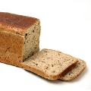
IDIOMS | THE BEST THING SINCE SLICED BREAD
An idiom is a group of words which has a different overall meaning from the meaning of its individual words.
It sounds completely natural and grammatically correct to English speakers.
Idioms are used in every aspect of life and express some things simply and in a few words, often by creating a picture in your mind, even an unlikely one. You might like to research the origins of some of them!

Slide 2
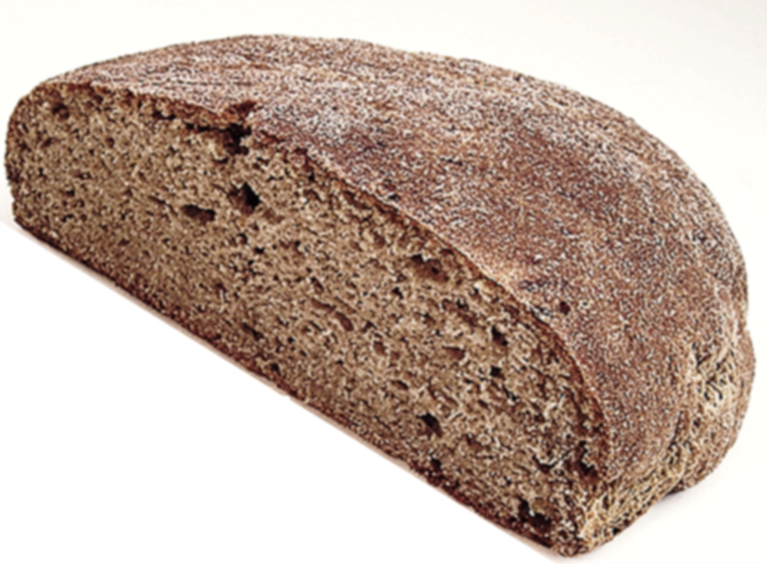
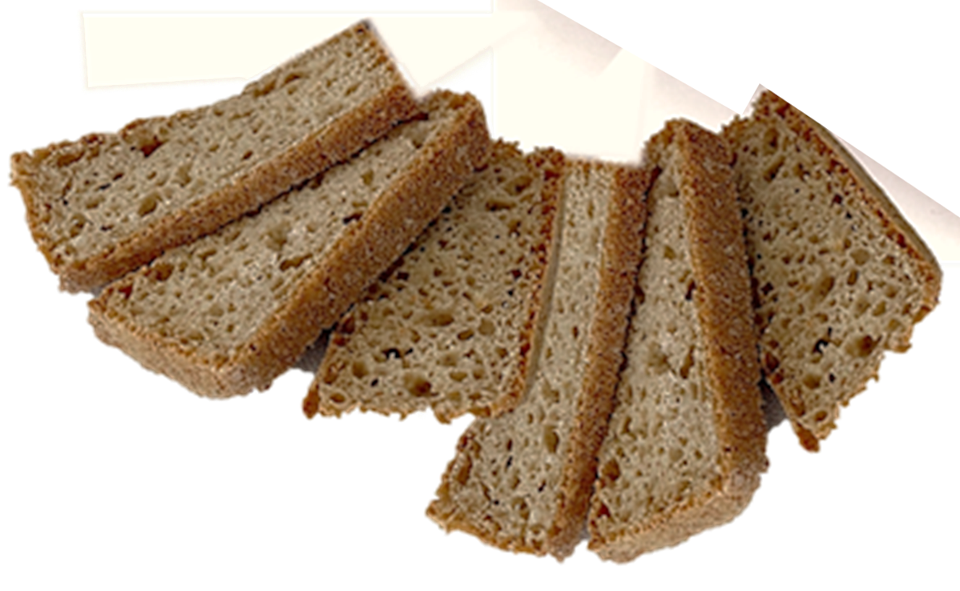

Slide 3
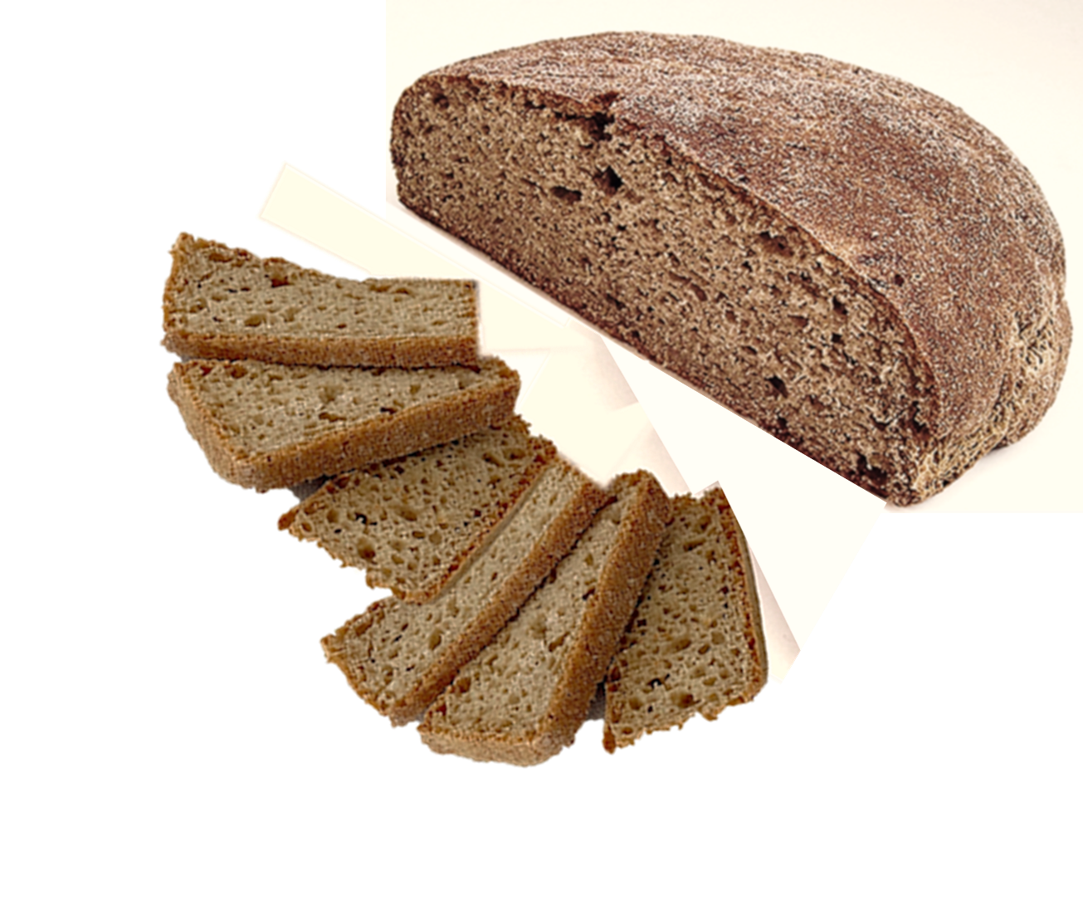

Slide 4



Slide 5
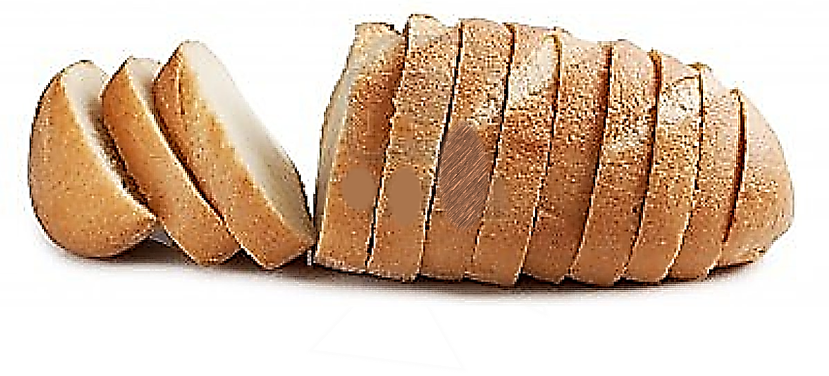

Slide 6
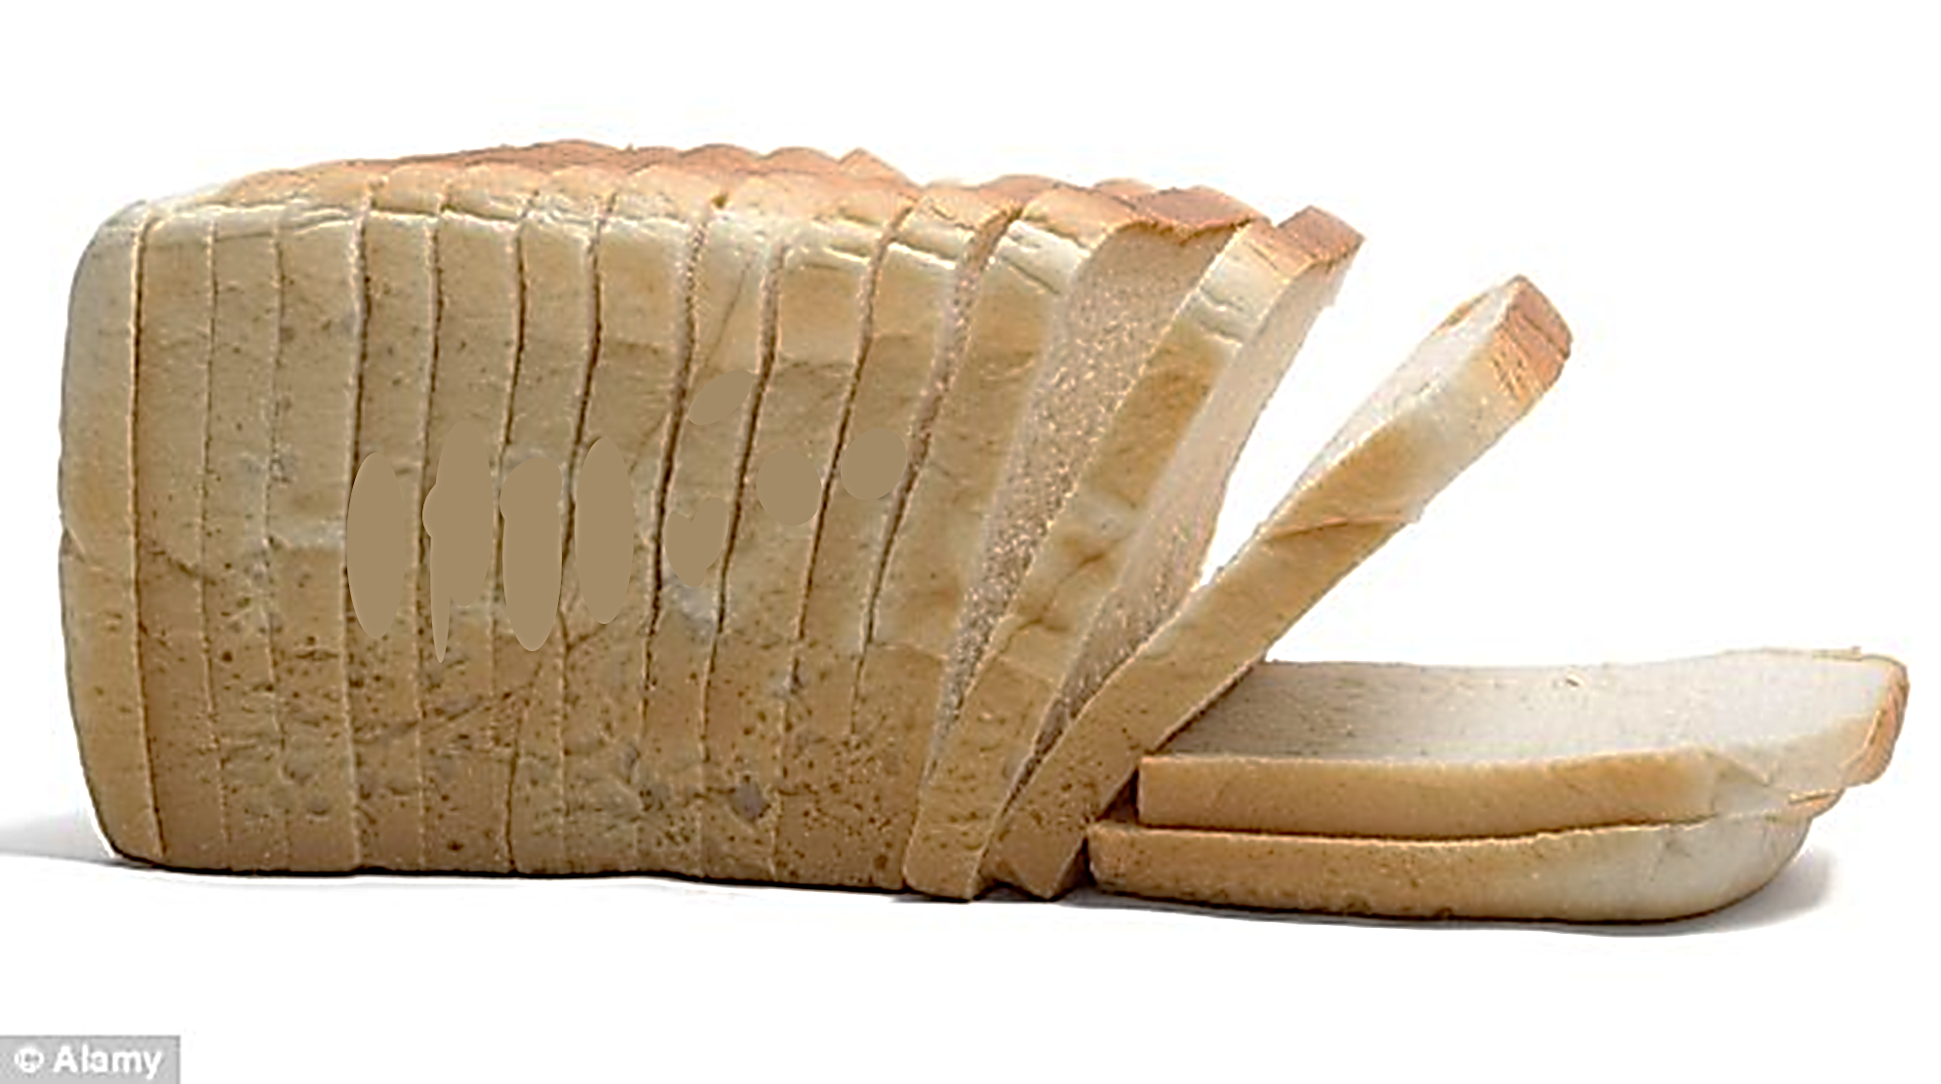

Slide 7
