Slide 1

CONFIRMATION QUESTIONS !

Slide 2
CONFIRMATION QUESTIONS
THIS IS A SIGNAL TO ANSWER
IT IS A NICE DAY,
ISN’T IT?
ANSWER THIS
NOT THIS

Slide 3
CONFIRMATION QUESTIONS
THIS IS ASKING YOU TO ANSWER
IT IS A NICE DAY, ISN’T IT?
SO
ANSWER THIS
NOT THIS!

Slide 4

LET’S TAKE A CLOSER LOOK!

Slide 5




TYPICAL EXAMPLES
POSITIVE
ANSWER EXPECTED
BUT NOT NECESSARY
IT IS ,
ISN’T IT?
YES!

Slide 6
NEGATIVE
ANSWER EXPECTED
BUT NOT NECESSARY
NICE
IT ISN’T ,
COLD
FAIR
IS IT?
EASY
NO

Slide 7
TYPICAL EXAMPLES
POSITIVE
ANSWER EXPECTED
BUT NOT NECESSARY
YOU CAN
HEAR,
CAN’T YOU?
READ,
TALK,
YES!

Slide 8
TYPICAL EXAMPLES
NEGATIVE
ANSWER EXPECTED
BUT NOT NECESSARY
YOU CAN’T
SWIM,
SING,
DIVE,
CAN YOU?
NO

Slide 9
LISTEN TO THIS!
RISING INTONATION
MELODY
CHECK THIS WORD
IT IS A NICE DAY,
ISN’T IT?

Slide 10
LISTEN TO THIS!
MELODY
CHECK THIS WORD
IT ISN’T A NICE DAY,
IS IT?
FALLING INTONATION

Slide 11
TYPICAL EXAMPLES
YOU DO LIKE FRUIT,
DON’T YOU?
WE WON’T DRINK SEA WATER,
WILL WE?
SHE DOESN’T SMOKE,
DOES SHE?
BOB CAN’T SING,
CAN HE?
THEY CAN DRIVE,
CAN’T THEY?
SUE SHOULDN’T BE LATE,
SHOULD SHE?

Slide 12
TYPICAL EXAMPLES
YOU WOULD HELP OLD PEOPLE,
WOULDN’T YOU?
YOU WOULDN’T HURT ANIMALS,
WOULD YOU?
WE MUST BE KIND TO CHILDREN,
MUSTN’T WE?
WE MUSTN’T BREAK THE LAW,
MUST WE?
JACK COULD REPAIR THE CAR,
COULDN’T HE?
SUE COULDN’T REMEMBER HOW,
COULD SHE?

Slide 13



Slide 14



KEY IDEAS

Slide 15
KEY IDEAS
POSITIVE
ANSWER
EXPECTED
YES!
IT IS A NICE DAY,
ISN’T IT?
IT ISN’T A NICE DAY,
IS IT?
NO
NEGATIVE
ANSWER
EXPECTED

Slide 16

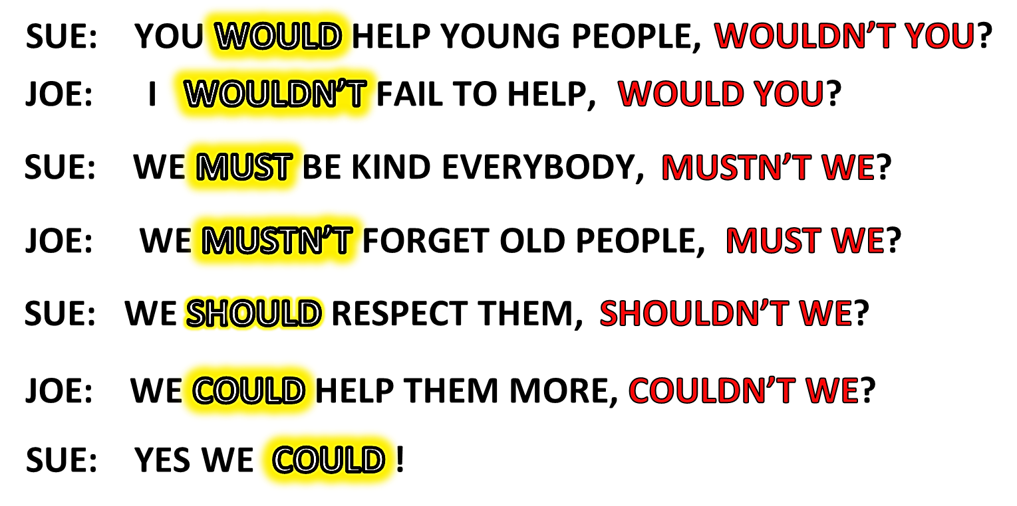

Slide 17

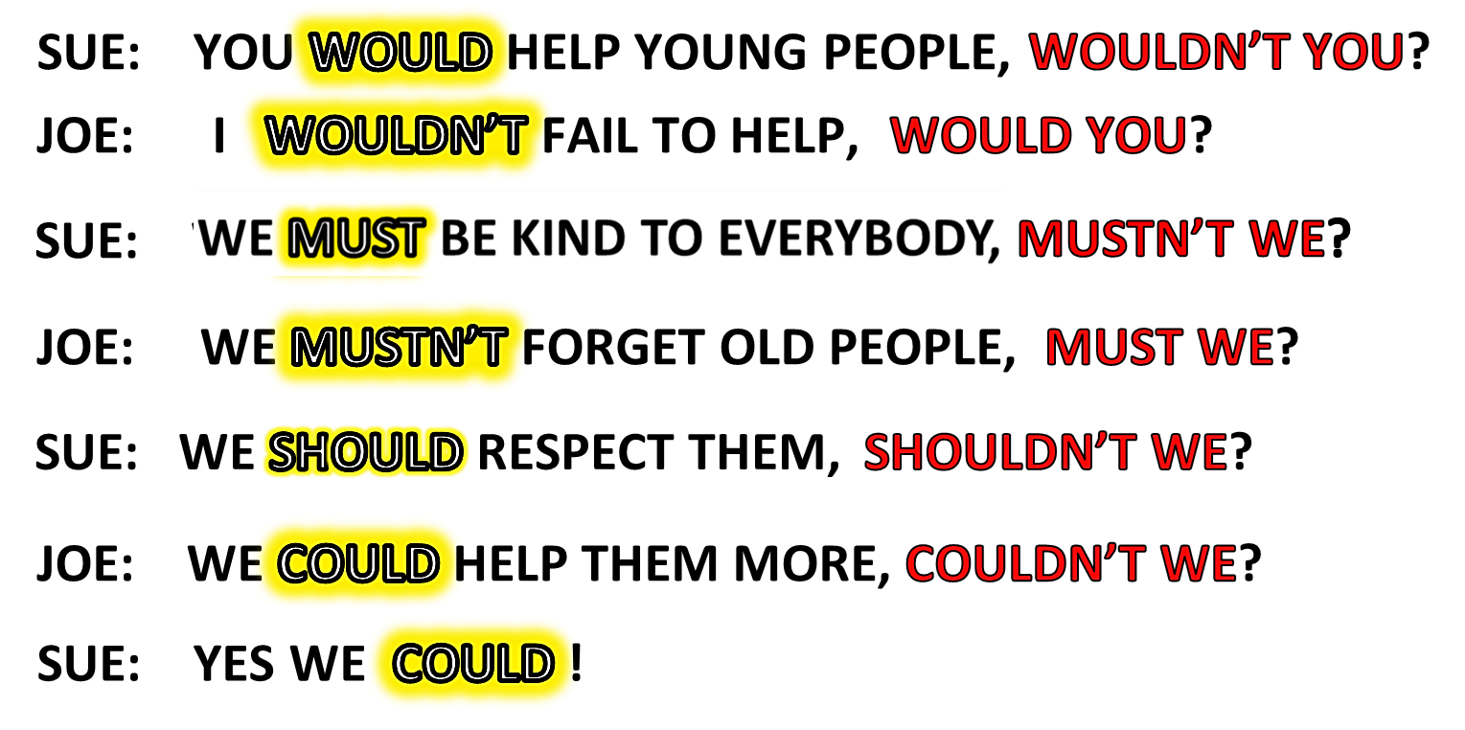

Slide 18
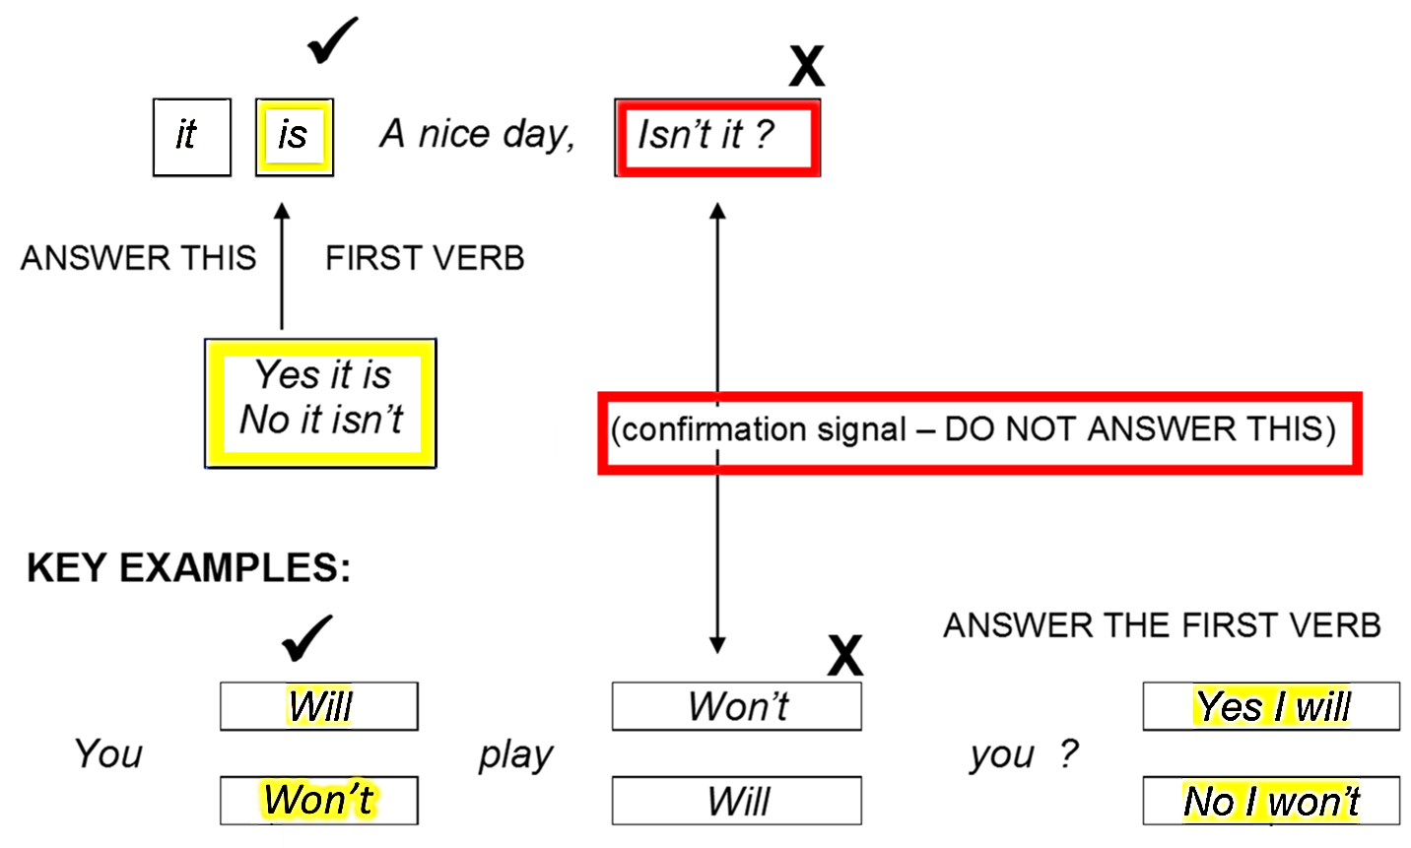
OVERVIEW: CONFIRMATION QUESTION
DON’T ANSWER THIS!
ANSWER THIS!

Slide 19


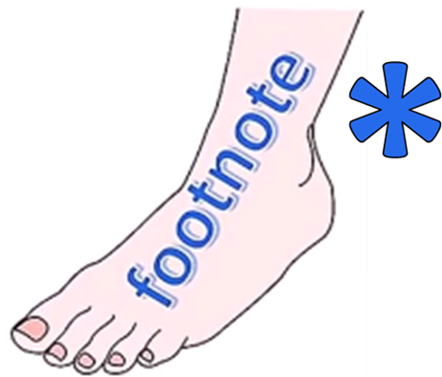
ENGLISH LANGUAGE STUDY
GRAMMAR AND LANGUAGE STUDY BOOKS LIST THIS AS THE
TAG QUESTION

Slide 20
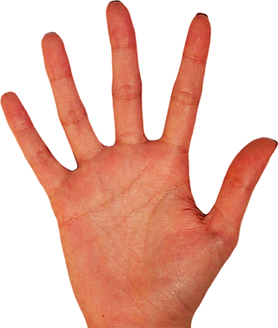



Slide 21


