Slide 1
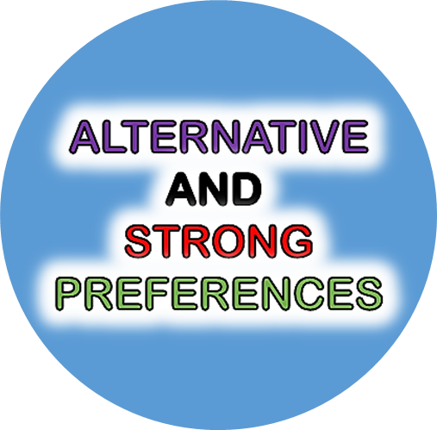
PREFERENCE CONTEXTS
I WOULD
RATHER
VISIT EGYPT
THAN TOKYO
I WANT SOME
MORE ICECREAM !
DIRECT
WOULD RATHER
INSTEAD
WANT
ALTERNATIVE
STRONG

