Slide 1



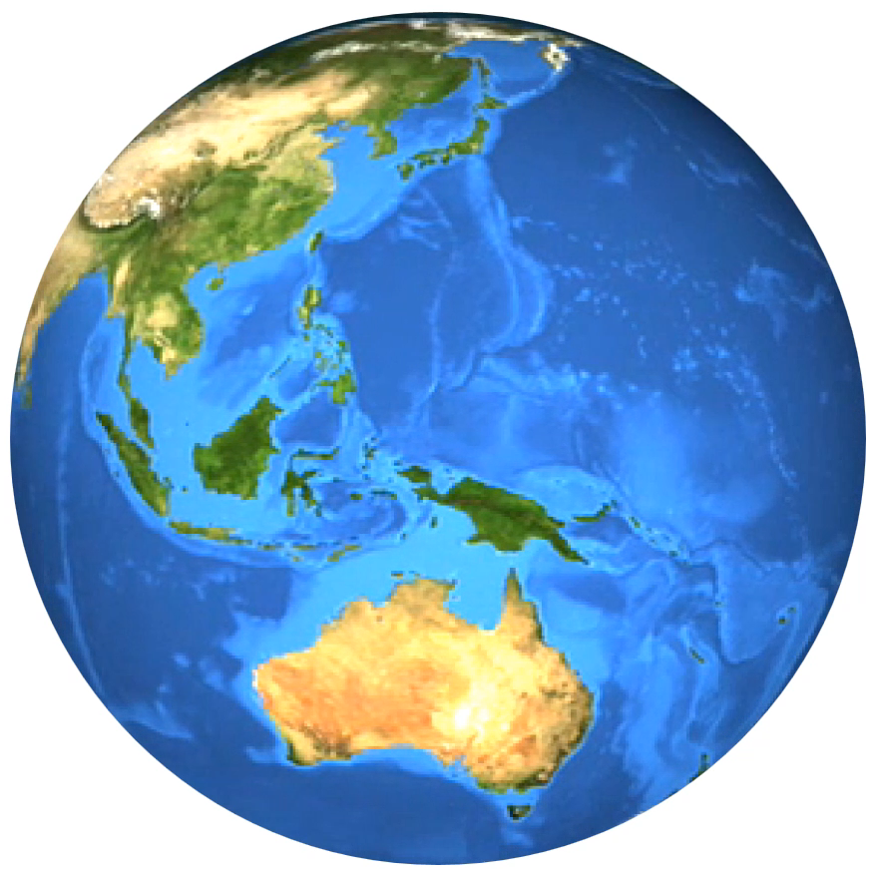
MEDIASPHERE
PRESENTED
BY
BOB COTTON
THE WORLD TURNS !
TO SHOW YOU SOME
BRILLIANT ASPECTS
OF ART AND MEDIA
WHICH DEFINE
OUR CULTURE
OETV

