Slide 1

CHECK THESE WORDS!
HABITS
AND
ROUTINES

Slide 2
STORY TIME: HABITS
This is a story of living habits which often happened, but not routinely.
When I worked in Paris years ago, every weekend I used to relax by the river. I used to go to the same cafe on Saturday mornings and used to read the newspapers and talk to my friends. We used to drink coffee all morning and just enjoy the Parisian atmosphere.
STORY TIME: ROUTINES
This is a story of a routine that always happened.
When I worked in Paris years ago, every weekend I would relax by the river. I would go to the same cafe on Saturday mornings and would read the newspapers and talk to my friends. We would drink coffee all morning and just enjoy the Parisian atmosphere.
HABITS AND ROUTINES

Slide 3
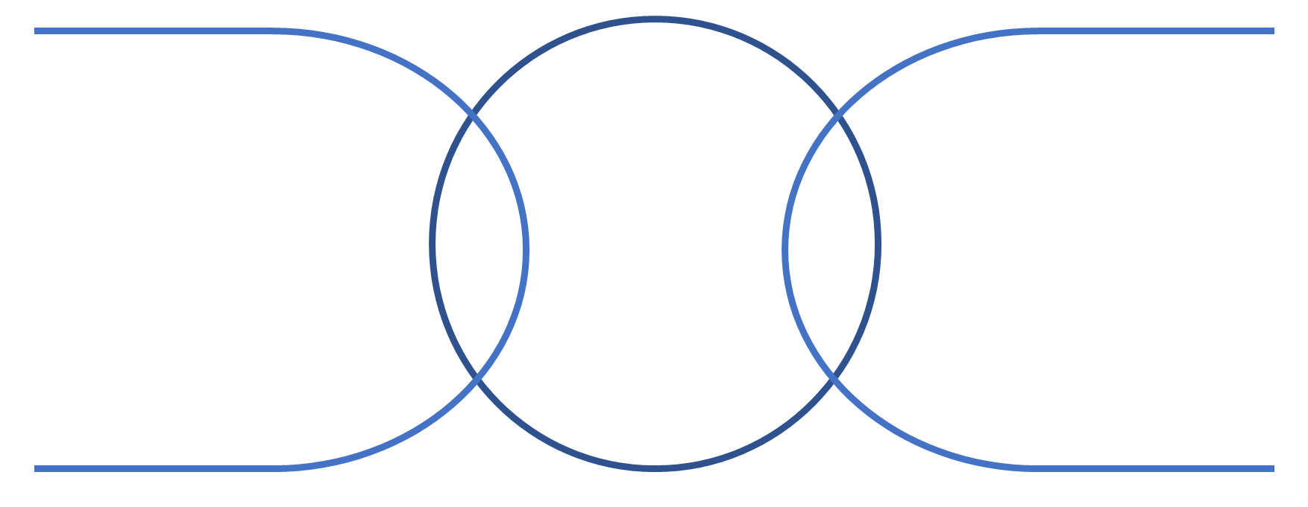
HABITS AND ROUTINES IN THE TIME FIELD

Slide 5
Except in negatives and questions, the correct form is used to.However, in negatives and questions using the auxiliary verb do, the correct form is use to, because the form of the verb required is the infinitive.
Oxford American Dictionary
1 The construction used to is standard, but difficulties arise with the formation of negatives and questions. Traditionally, used to behaves as a modal verb, so that questions and negatives are formed without the auxiliary verb do, as in it used not to be like that and used she to come here? In modern English, this question form is now regarded as very formal or awkwardly old-fashioned, and the use with do is broadly accepted as standard, as in did she use to come here? Negative constructions with do, on the other hand (as in it didn’t use to be like that), although common, are informal and are not generally accepted.
2 There is sometimes confusion over whether to use the form used to or use to, which has arisen largely because the pronunciation is the same in both cases. Except in negatives and questions, the correct form is used to: we used to go to the movies all the time (not we use to go to the movies). However, in negatives and questions using the auxiliary verb do, the correct form is use to, because the form of the verb required is the infinitive: I didn’t use to like mushrooms (not I didn’t used to like mushrooms)

Slide 6
https://www.differencebetween.com/difference-between-habit-and-vs-routine/

Slide 7
