Slide 1
PREFERENCES!
WHAT ?

Slide 2
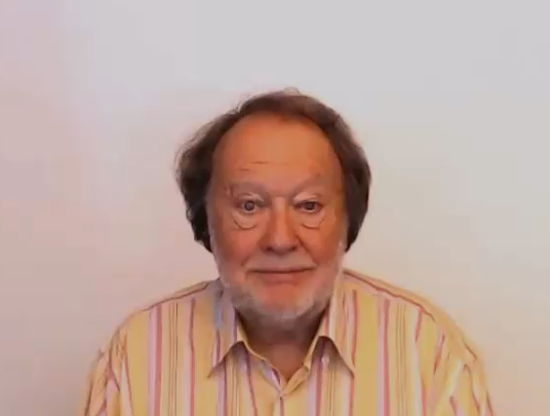
PREFERENCES!

Slide 3

PREFERENCES ARE
FAVORITE ACTIVITIES OR THINGS
THAT YOU WANT MORE THAN OTHERS
ALSO PLACES YOU ENJOY
AND PEOPLE THAT MAKE YOU HAPPY

Slide 4
PREFERENCE CONTEXTS
WHAT’S THE DIFFERENCE ?
LIKE
WOULD LIKE
PERSONAL PREFERENCES
PREFER
WOULD PREFER
BEST PERSONAL PREFERENCES
WANT
WOULD RATHER
DIRECT WISH PREFERENCE INSTEAD

Slide 5

PREFERENCE CONTEXTS
LIKE
WOULD LIKE
GENERAL
SPECIFIC
I LIKE TRAVELLING
OFTEN
I WOULD LIKE TO SEE AFRICA SOON

Slide 6

PREFERENCE CONTEXTS
WOULD PREFER
PREFER
GENERAL
SPECIFIC
I WOULD PREFER ICED TEA RIGHT NOW
I PREFER
TEA TO COFFEE

Slide 7

PREFERENCE CONTEXTS
I WOULD
RATHER
VISIT EGYPT
THAN TOKYO
I WANT SOME
MORE ICECREAM
DIRECT
WOULD RATHER
INSTEAD
WANT

Slide 8



LIKE
PERSONAL GENERAL PREFERENCE

Slide 9

KEY EXAMPLES
WE LIKE SWIMMING AND RELAXING BY THE SEA

Slide 10
WOULD
LIKE
PERSONAL SPECIFIC PREFERENCE

Slide 11

KEY EXAMPLE
BOB WOULD LIKE TO SAIL AROUND THE WORLD
BOB WOULD LIKE TO SAIL AROUND THE WORLD

Slide 12
BEST PERSONAL GENERAL
PREFERENCE
PREFER

Slide 13

KEY EXAMPLE
ANNA PREFERS TO WALK IN THE COUNTRYSIDE TO ENJOY IT

Slide 14
WOULD
PREFER
BEST
SPECIFIC PREFERENCE

Slide 15

KEY EXAMPLE
JAKE WOULD PREFER HIS OWN COOKING AS HE IS A MASTERCHEF

Slide 16
PREFERENCE INSTEAD
WOULD
RATHER

Slide 17

KEY EXAMPLE
JAKE WOULD RATHER GO FISHING THAN ANYTHING ELSE

Slide 18
DIRECT
PREFERENCE
WANT

Slide 19

KEY EXAMPLE
SARAH WANTS HER OWN HOME TO BE TOGETHER WITH JAKE

Slide 20

PREFERENCE CONTEXTS
LIKE
WOULD LIKE
PERSONAL
GENERAL
SPECIFIC
WOULD PREFER
PREFER
BEST PERSONAL PREFERENCES
GENERAL
SPECIFIC
DIRECT
WOULD RATHER
INSTEAD
WANT
ALTERNATIVE
STRONG

Slide 21

PREFERENCES!
I LIKE
I WOULD LIKE
I PREFER
I WOULD PREFER
I WOULD RATHER
I WANT
GENERAL
SPECIFIC
GENERALLY BEST FOR ME
SPECIFICALLY
BEST FOR ME
BETTER ALTERNATIVE FOR ME
DIRECT

Slide 22
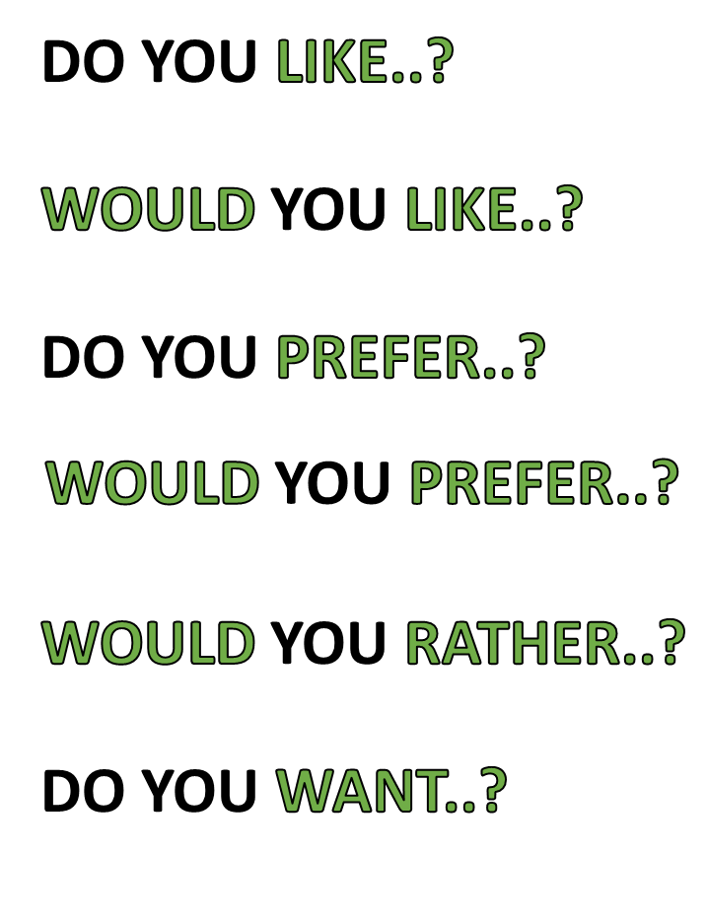
PREFERENCES!
GENERAL
SPECIFIC
GENERALLY BEST FOR YOU
SPECIFICALLY
BEST FOR YOU
BETTER ALTERNATIVE FOR YOU
DIRECT

