Slide 1
PREFERENCES!
WHAT ?
TALKING HEAD

Slide 2


CONTEXTS
CHECK THIS WORD

Slide 3
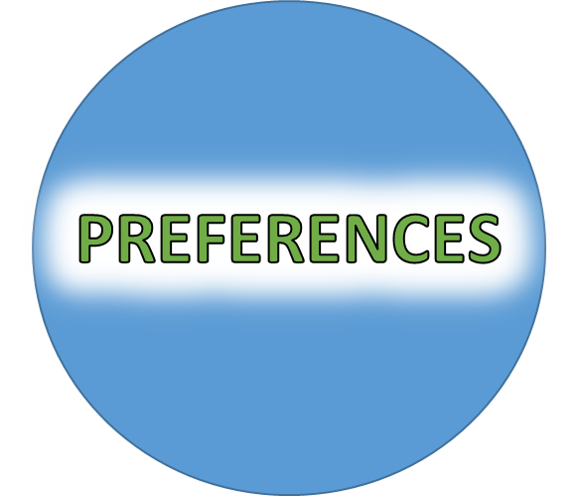
PREFERENCE CONTEXTS
LIKE
WOULD LIKE
GENERAL
SPECIFIC

Slide 4
PREFERENCE CONTEXTS
WOULD PREFER
PREFER
GENERAL
SPECIFIC

Slide 5
PREFERENCE CONTEXTS
DIRECT
WOULD RATHER
INSTEAD
WANT

Slide 6
PREFERENCE CONTEXTS
LIKE
WOULD LIKE
GENERAL
SPECIFIC
WOULD PREFER
PREFER
GENERAL
SPECIFIC
DIRECT
WOULD RATHER
INSTEAD
WANT

Slide 7

LIKE

Slide 8

KEY EXAMPLES

Slide 9
WOULD
LIKE

Slide 10

KEY EXAMPLE

Slide 11
WANT

Slide 12

KEY EXAMPLE

Slide 13
WOULD
PREFER

Slide 14

KEY EXAMPLE

Slide 15
WOULD
RATHER

Slide 16

KEY EXAMPLE

Slide 17
PREFER

Slide 18
WOULD
RATHER
WANT

Slide 20
PREFERENCES!
I LIKE
I WOULD LIKE
I PREFER
I WOULD RATHER
I WANT
GENERAL
SPECIFIC
X
X
DIRECT

Slide 21
PREFERENCES!
DO YOU LIKE..?
WOULD YOU LIKE..?
DO YOU PREFER..?
WOULD YOU RATHER..?
DO YOU WANT..?
GENERAL
SPECIFIC
X
X
DIRECT

Slide 22
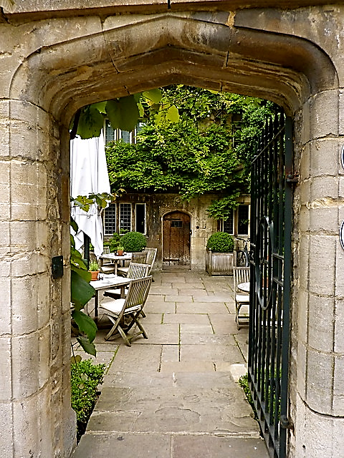
TEATIME IN OXFORD
WHAT
WOULD YOU LIKE?

Slide 23
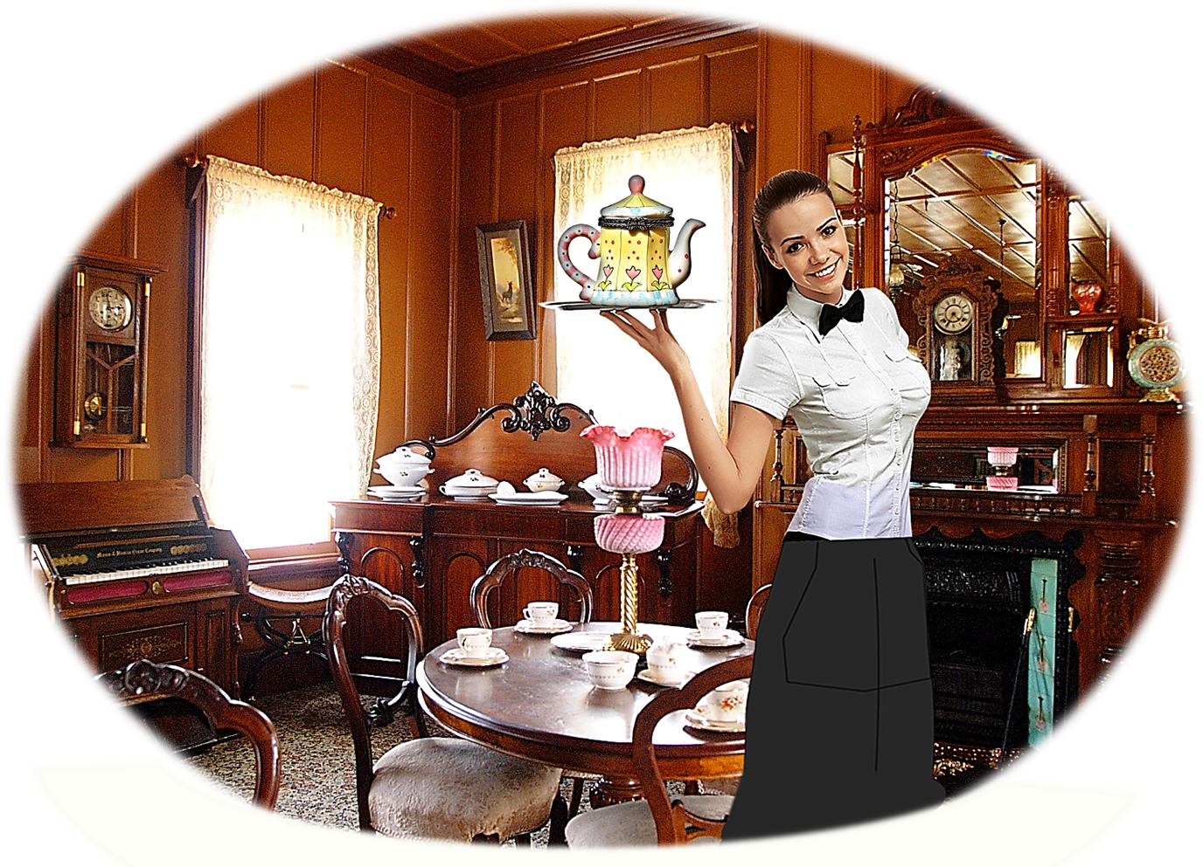
TEATIME IN OXFORD
WELCOME
TO
THE OLD TEA SHOP!

Slide 24



TEA
COFFEE

Slide 25
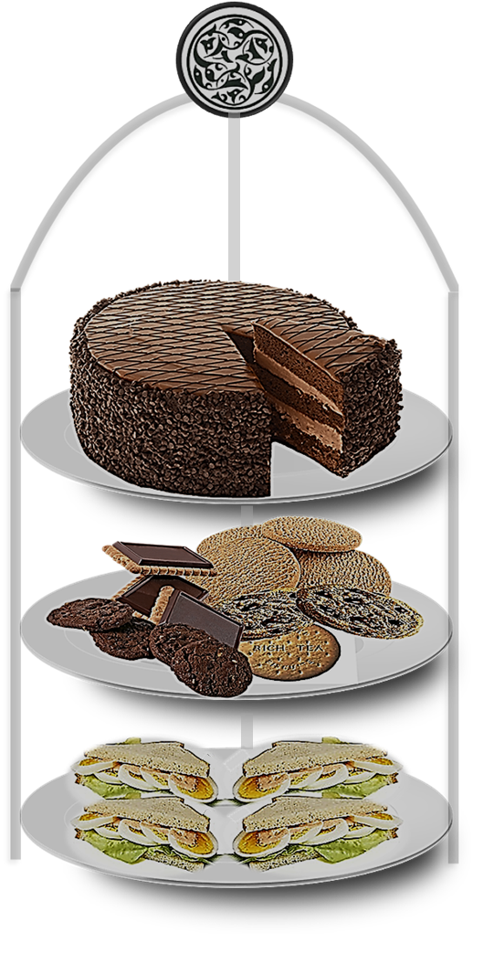
CHOCOLATE CAKE
BISCUITS
SANDWICHES

Slide 26

I LIKE
I WOULD LIKE
I PREFER
I WOULD RATHER
I WANT

Slide 27
LATER IN THE RESTAURANT

Slide 28
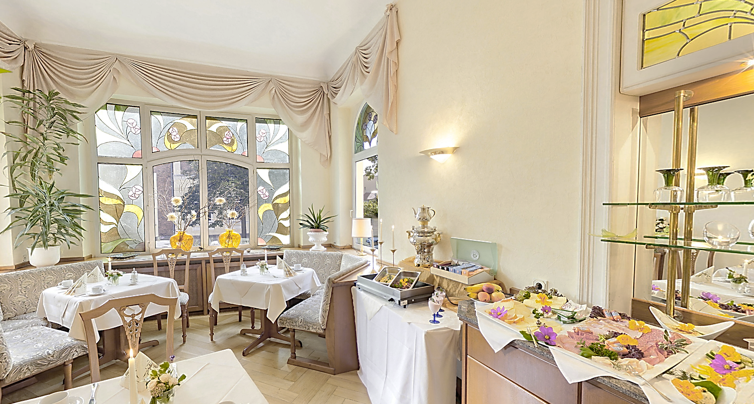
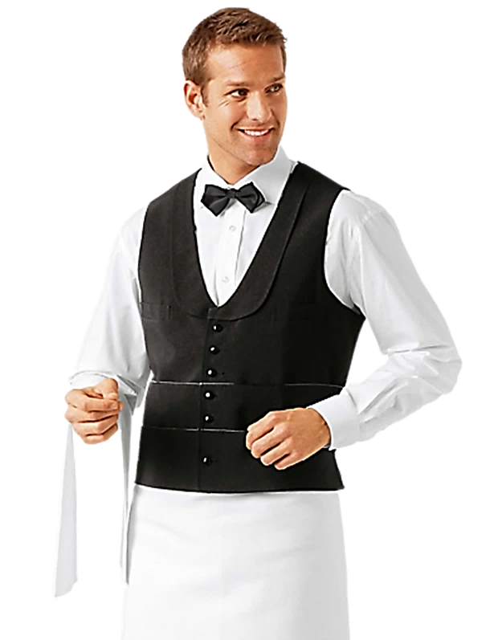
LATER IN THE RESTAURANT

Slide 29
LATER IN THE RESTAURANT

Slide 30




AFTER DINNER IN THE BAR

Slide 31
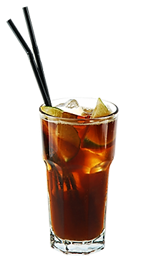

AFTER DINNER IN THE BAR

Slide 32
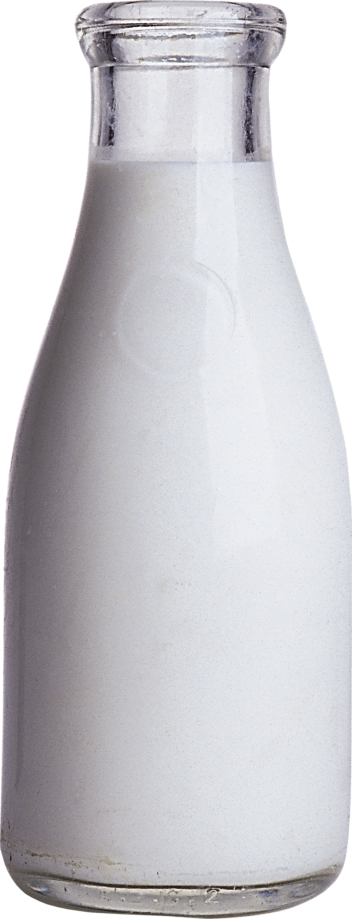

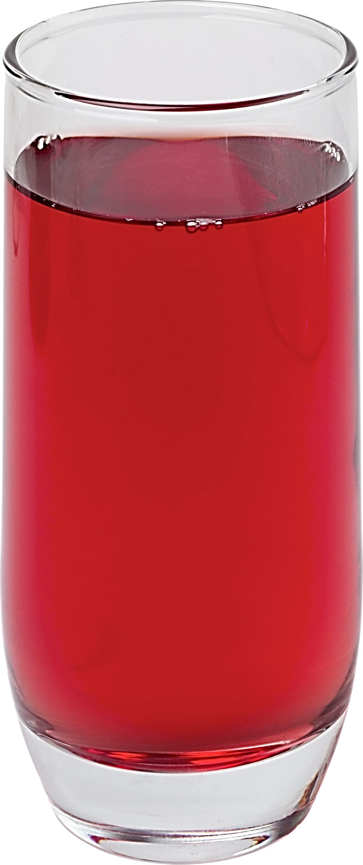

Slide 33
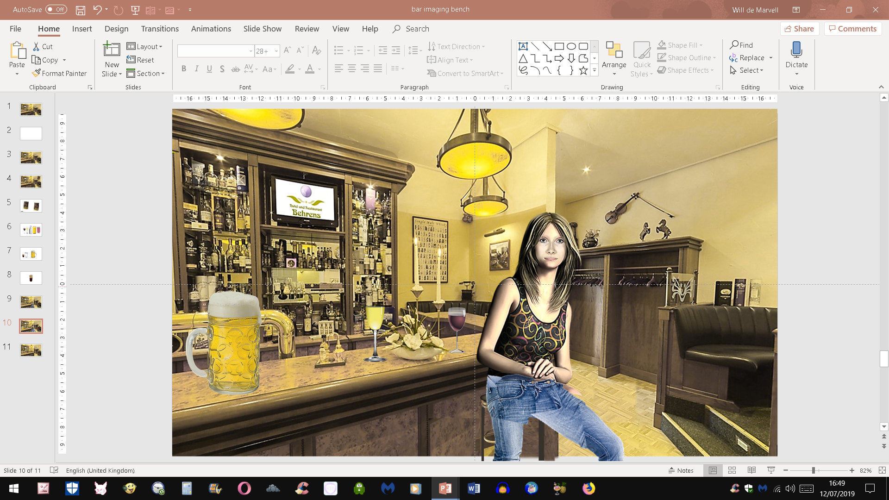

Slide 34
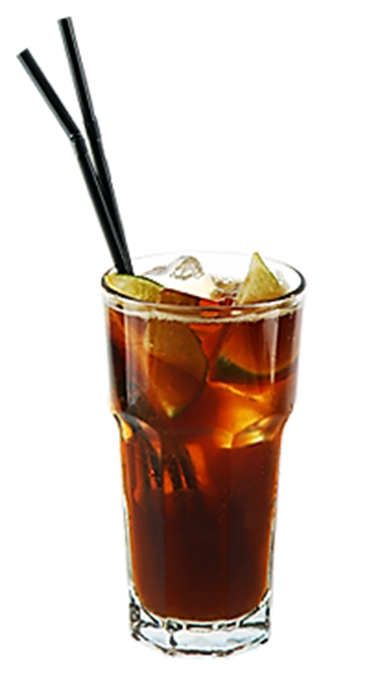
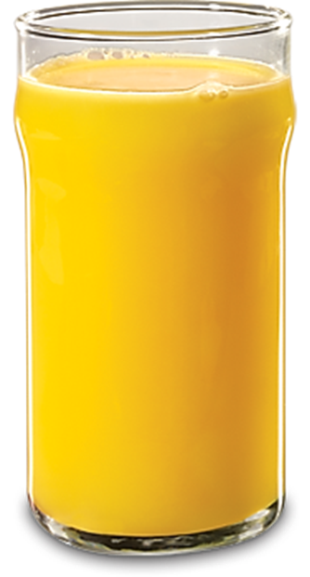
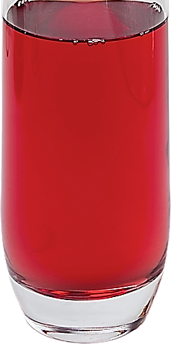

Slide 35
NEW FOOTNOTE

Slide 36




TYPICAL DIALOGUE
JUST LISTEN...

Slide 38
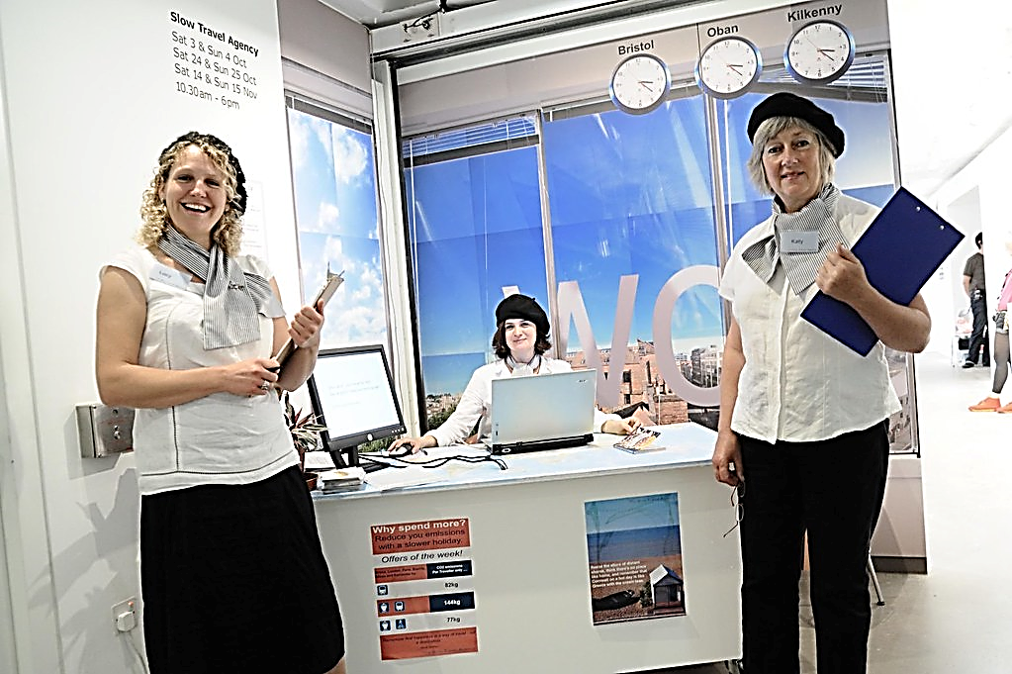
NEXT DAY AT THE TRAVEL AGENCY

Slide 39
WHERE WOULD YOU LIKE TO TRAVEL?

Slide 40
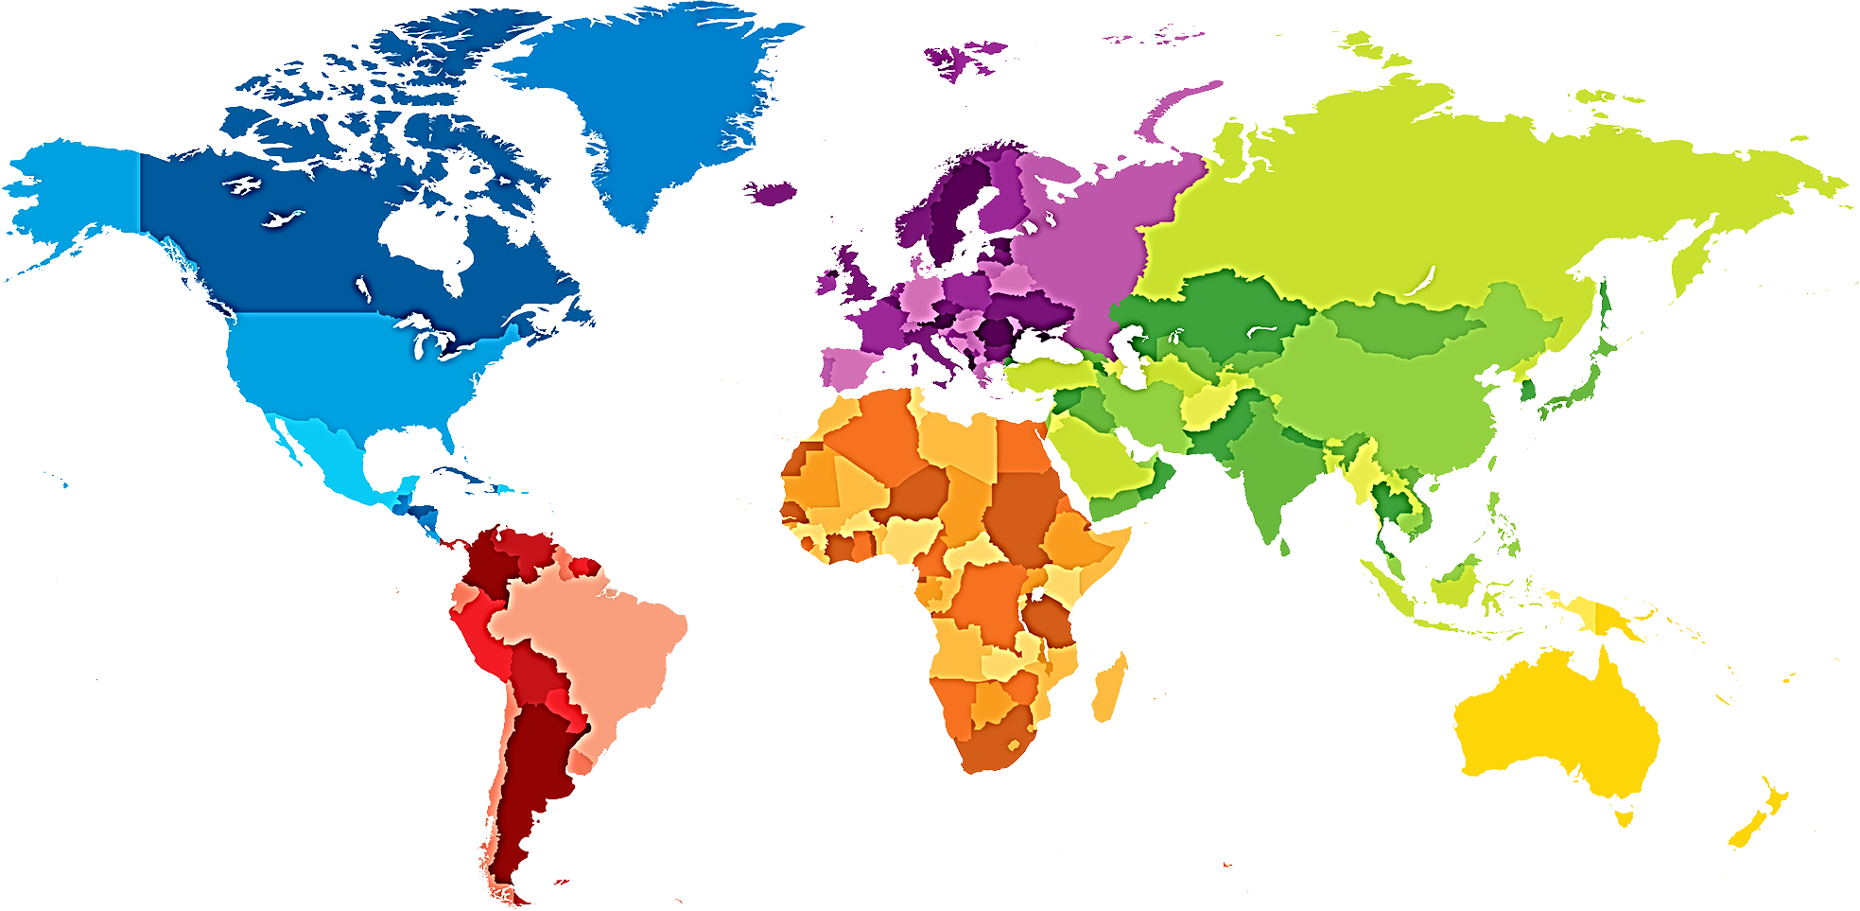
WHERE WOULD YOU LIKE TO TRAVEL?
WOULD YOU LIKE TO GO TO CHINA?
WOULD YOU LIKE TO GO TO EUROPE?
WOULD YOU LIKE TO GO TO NORTH AMERICA?
WOULD YOU LIKE TO GO TO INDIA?
WOULD YOU LIKE TO GO TO SOUTH AMERICA?
WOULD YOU LIKE TO GO TO AUSTRALIA?
WOULD YOU LIKE TO GO TO AFRICA?

Slide 43
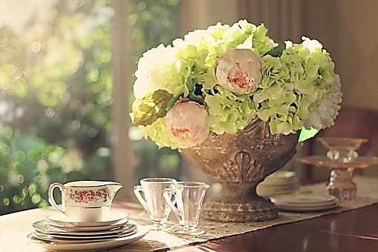

Slide 44
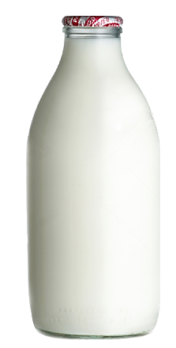
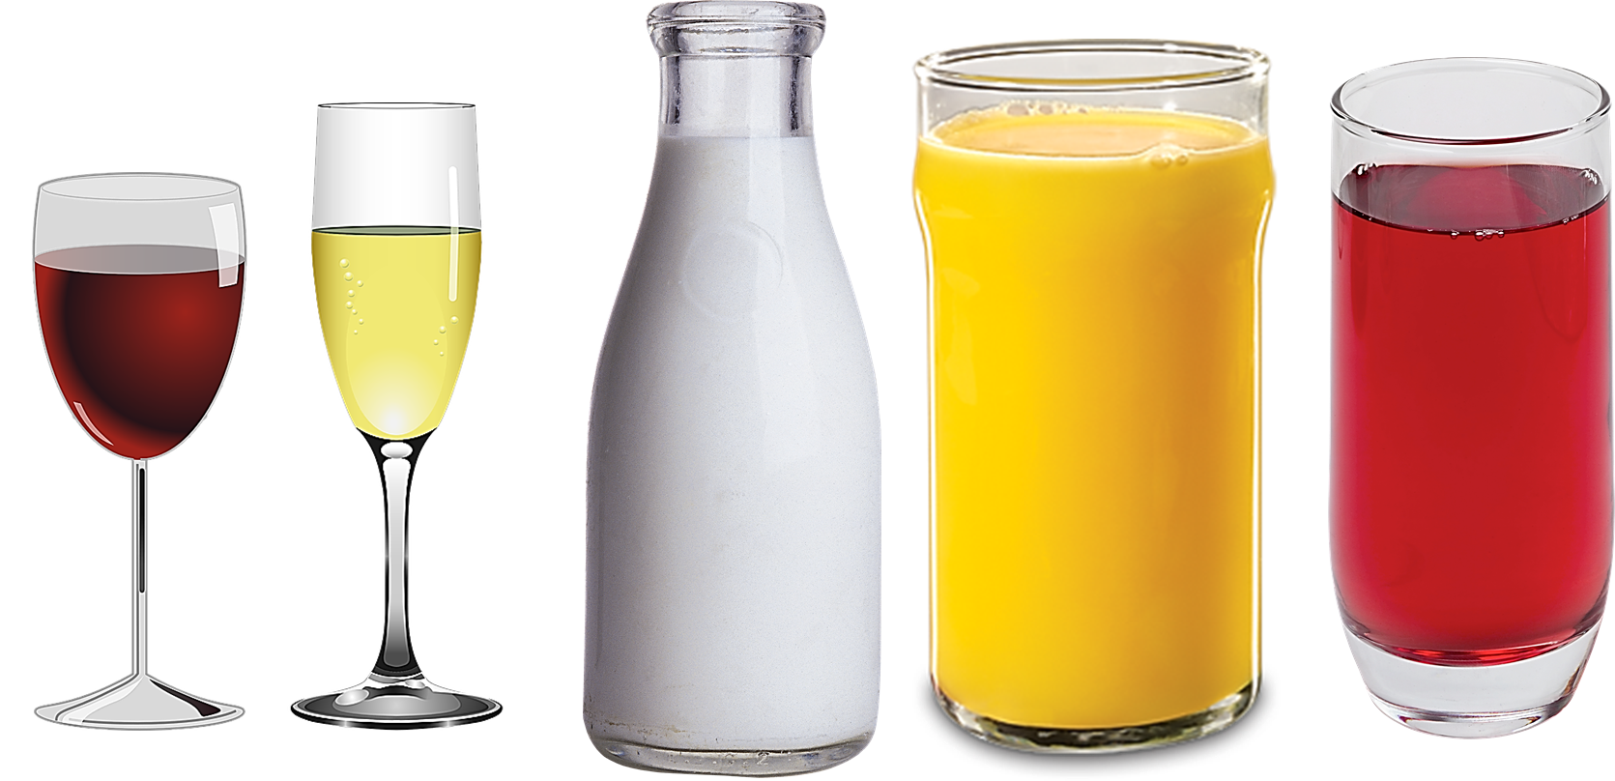

Slide 45



PREFERENCES!

Slide 46
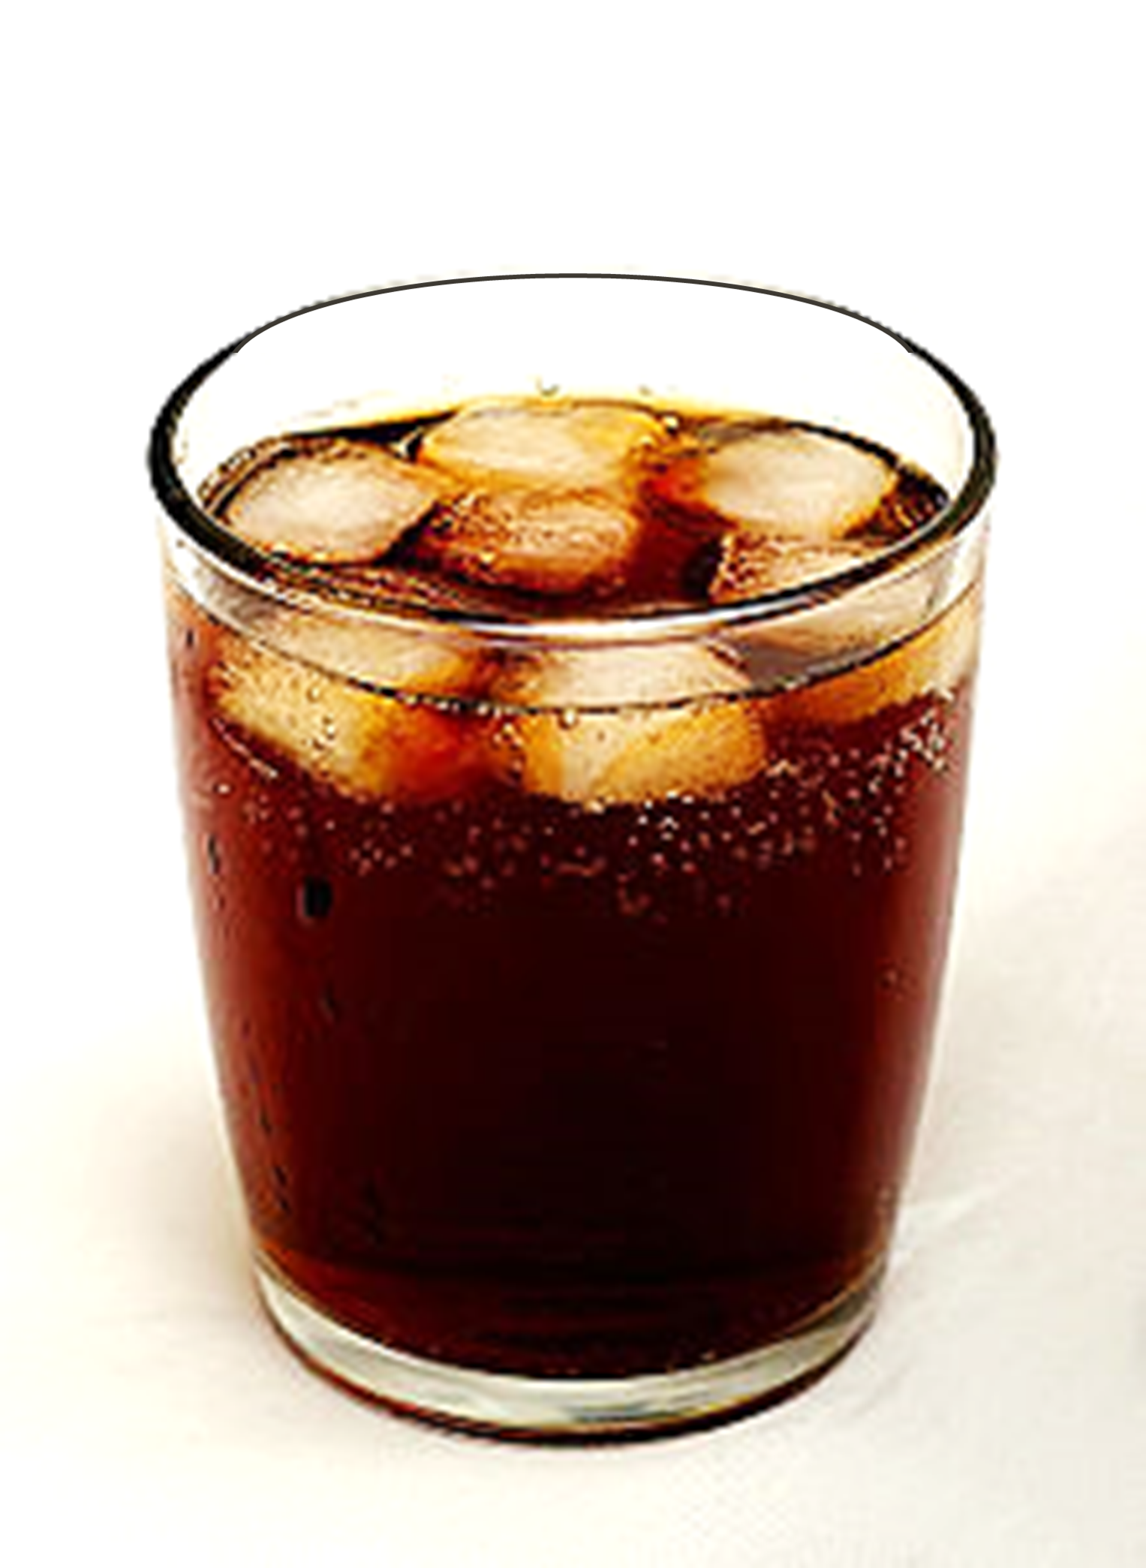

Slide 47
CONCEPTS

Slide 48
CONCEPTS

Slide 49



Slide 50



PREFERENCES!
CONTEXTS

Slide 51
LIKE
WOULD LIKE
PREFER
WOULD PREFER
WOULD RATHER
WANT

Slide 53
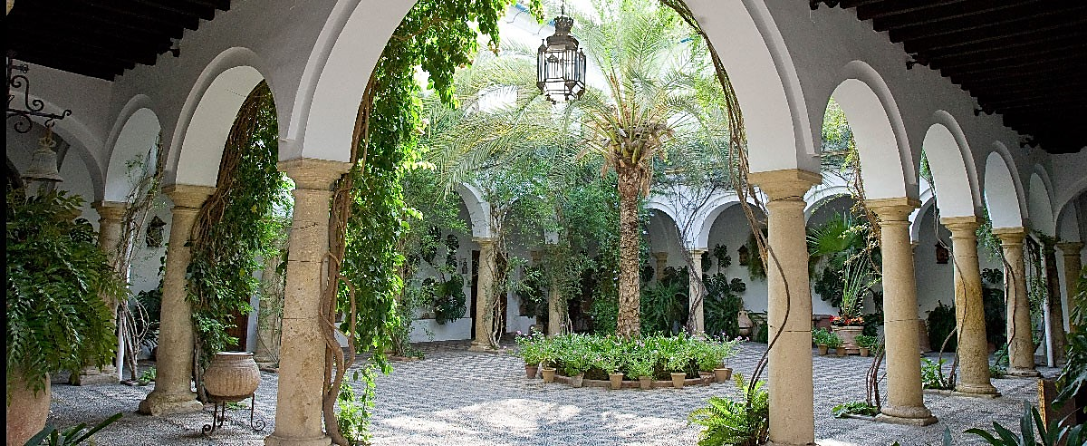

Slide 55
CONCEPTS

