Slide 1
PREFERENCES!
WHAT ?

Slide 2
PREFERENCES!
WHAT ?
TALKING HEAD

Slide 3

PREFERENCES ARE
FAVORITE ACTIVITIES OR THINGS
THAT YOU WANT MORE THAN OTHERS
ALSO PLACES YOU ENJOY
AND PEOPLE THAT MAKE YOU HAPPY

Slide 4



CONTEXTS
CHECK THIS WORD

Slide 5
PREFERENCE CONTEXTS
WHAT’S THE DIFFERENCE ?
LIKE
WOULD LIKE
PERSONAL PREFERENCES
PREFER
WOULD PREFER
BEST PERSONAL PREFERENCES
WANT
WOULD RATHER
DIRECT WISH PREFERENCE INSTEAD

Slide 6
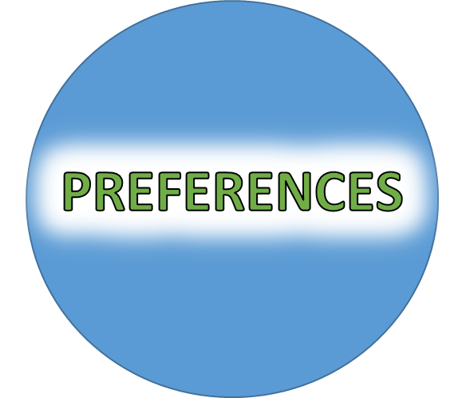
PREFERENCE CONTEXTS
LIKE
WOULD LIKE
GENERAL
SPECIFIC
I LIKE TRAVELLING
I WOULD LIKE TO SEE AFRICA

Slide 7
PREFERENCE CONTEXTS
WOULD PREFER
PREFER
GENERAL
SPECIFIC
I WOULD PREFER ICED TEA RIGHT NOW
I PREFER
TEA TO COFFEE

Slide 8
PREFERENCE CONTEXTS
I WOULD
RATHER
VISIT EGYPT
THAN TOKYO
I WANT SOME
MORE ICECREAM
DIRECT
WOULD RATHER
INSTEAD
WANT

Slide 9
PREFERENCE CONTEXTS
LIKE
WOULD LIKE
GENERAL
SPECIFIC
WOULD PREFER
PREFER
GENERAL
SPECIFIC
DIRECT
WOULD RATHER
INSTEAD
WANT

Slide 10

LIKE
PERSONAL GENERAL PREFERENCE

Slide 11

KEY EXAMPLES
WE LIKE SWIMMING AND RELAXING BY THE SEA

Slide 12
WOULD
LIKE
PERSONAL SPECIFIC PREFERENCE

Slide 13

KEY EXAMPLE
BOB WOULD LIKE TO SAIL AROUND THE WORLD

Slide 14
BEST PERSONAL GENERAL
PREFERENCE
PREFER

Slide 15

KEY EXAMPLE
ANNA PREFERS TO WALK IN THE COUNTRYSIDE TO ENJOY IT

Slide 16
WOULD
PREFER
BEST
SPECIFIC PREFERENCE

Slide 17

KEY EXAMPLE
JAKE WOULD PREFER HIS OWN COOKING AS HE IS A MASTERCHEF

Slide 18
PREFERENCE INSTEAD
WOULD
RATHER

Slide 19

KEY EXAMPLE
JAKE WOULD RATHER GO FISHING THAN ANYTHING ELSE

Slide 20
DIRECT
PREFERENCE
WANT

Slide 21

KEY EXAMPLE
SARAH WANTS HER OWN HOME TO BE TOGETHER WITH JAKE

Slide 22
PREFERENCES
IN LIFE!

Slide 23
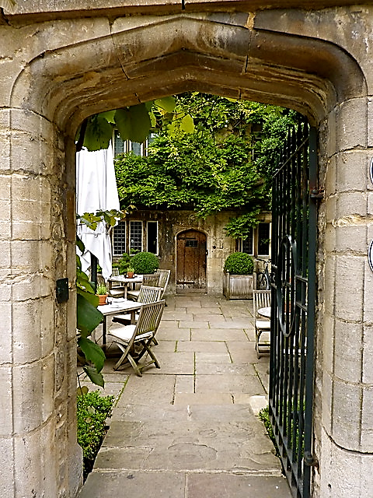
TEATIME IN OXFORD
WHAT
WOULD YOU LIKE?

Slide 24
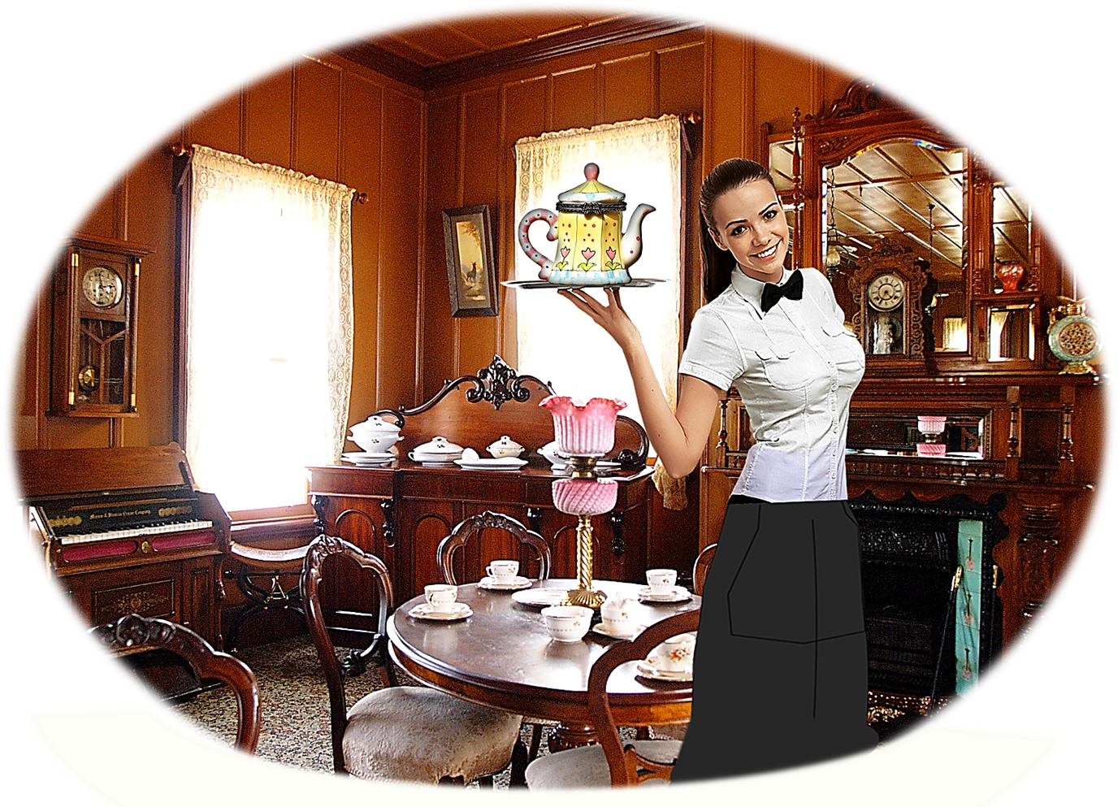
TEATIME IN OXFORD
WELCOME
TO
THE OLD TEA SHOP!

Slide 25

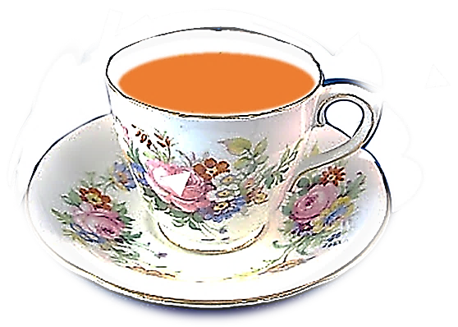
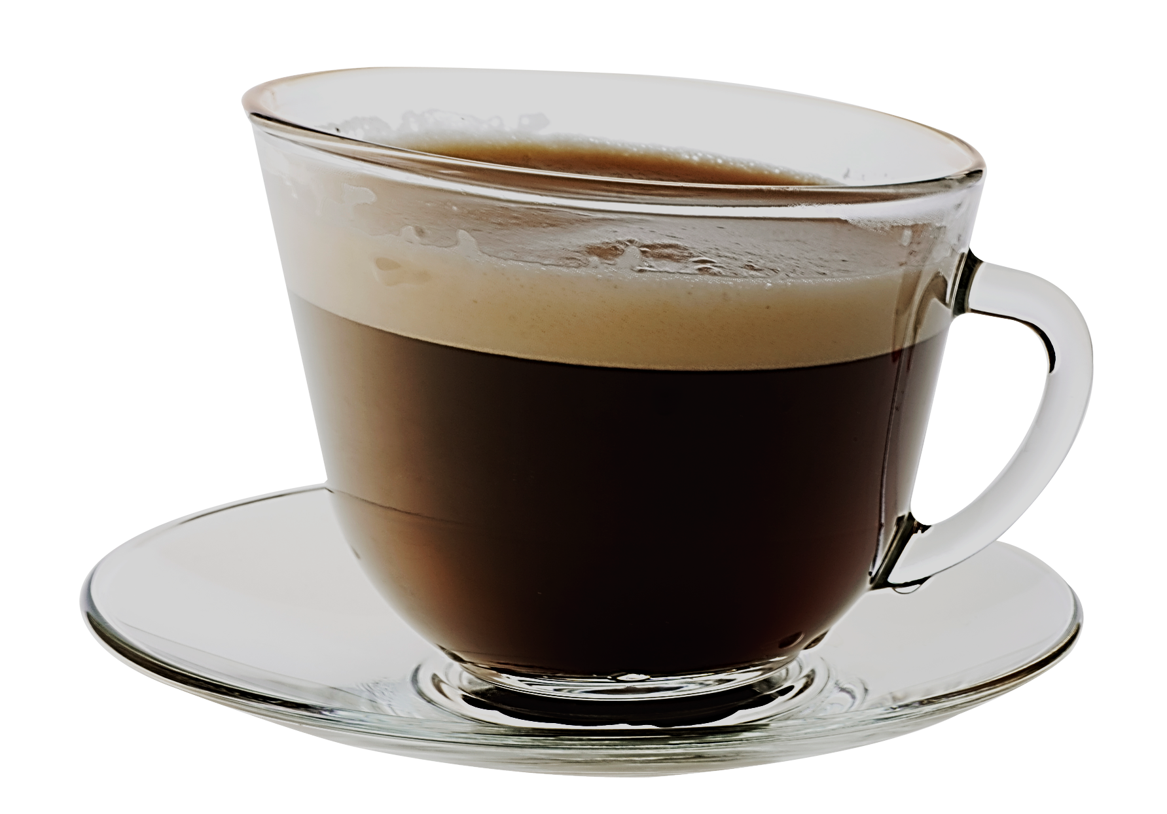
WOULD YOU LIKE
WOULD YOU PREFER
OR
TEA ?
COFFEE ?

Slide 26
WHAT DO
YOU LIKE?
CHOCOLATE CAKE ?
BISCUITS ?
SANDWICHES ?
HAMBURGERS ?

Slide 27
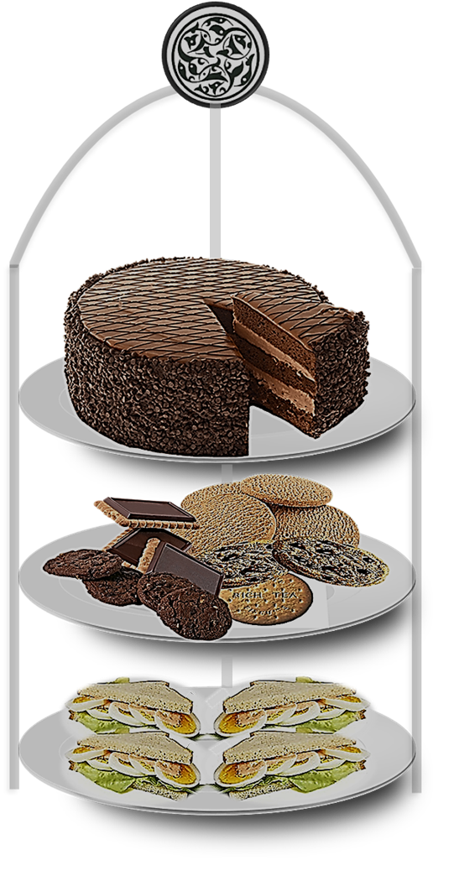
WHICH WOULD YOU LIKE?
CHOCOLATE CAKE
BISCUITS
SANDWICHES

Slide 28
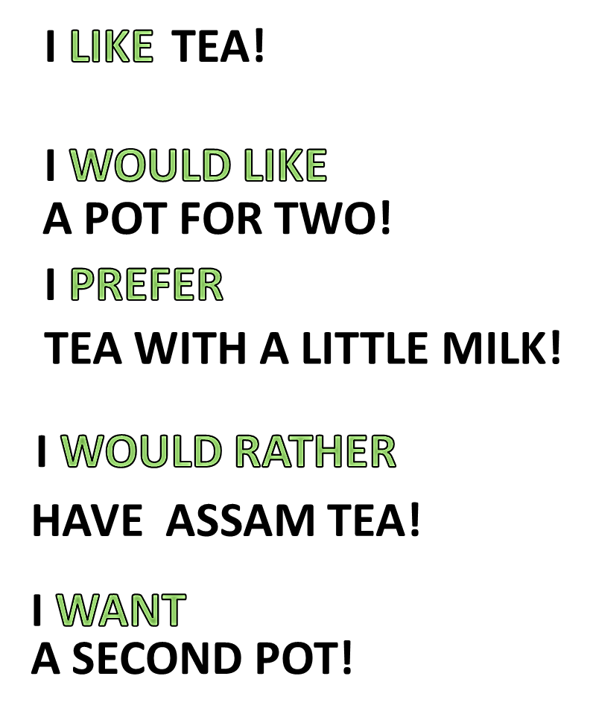
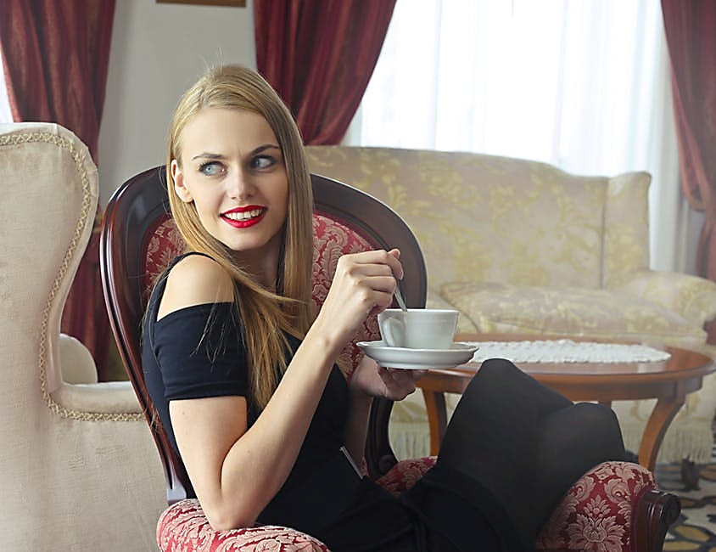
JENNY’S PREFERENCES

Slide 29
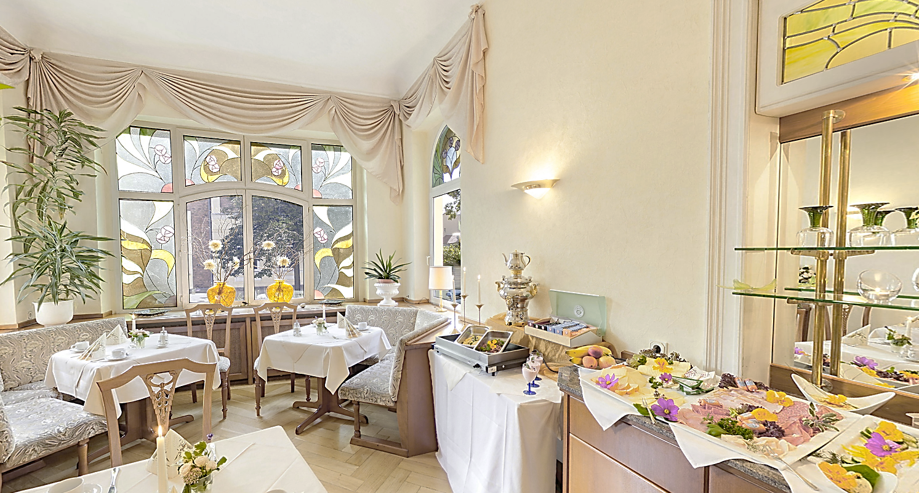
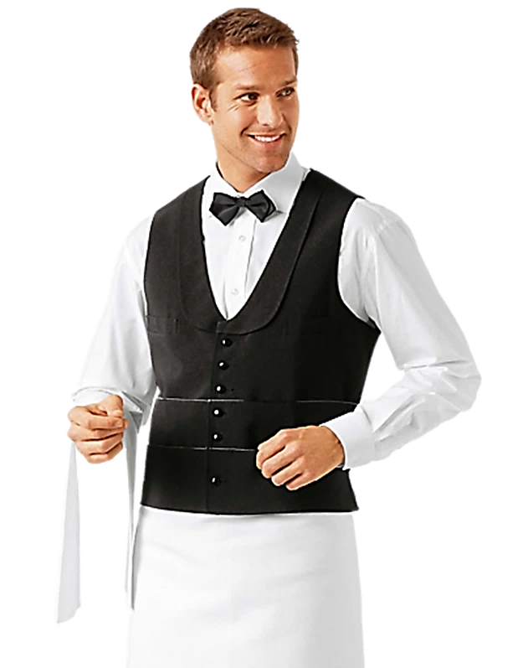
LATER IN THE RESTAURANT

Slide 30

WHAT WOULD YOU LIKE?
HERE’S

Slide 31
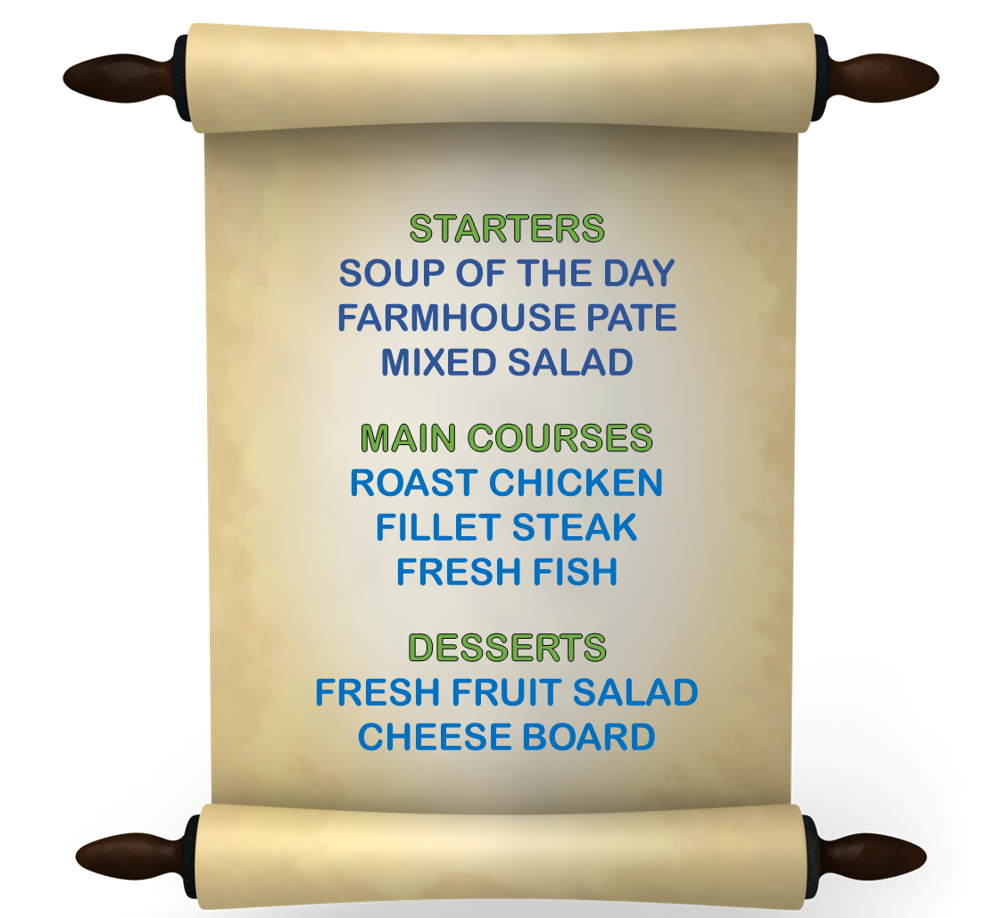
THE MENU
WOULD YOU LIKE A STARTER?
WHICH WOULD YOU LIKE
THE SOUP OR THE PATE?
THE SOUP PLEASE
FOR THE MAIN COURSE
WOULD YOU PREFER
STEAK OR FISH?
THE FISH CERTAINLY
FOR DESSERT
WOULD YOU LIKE
FRUIT SALAD?
I WOULD RATHER HAVE
THE CHEESE, PLEASE

Slide 32
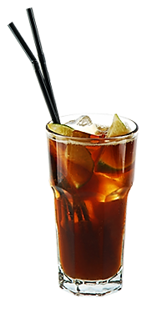
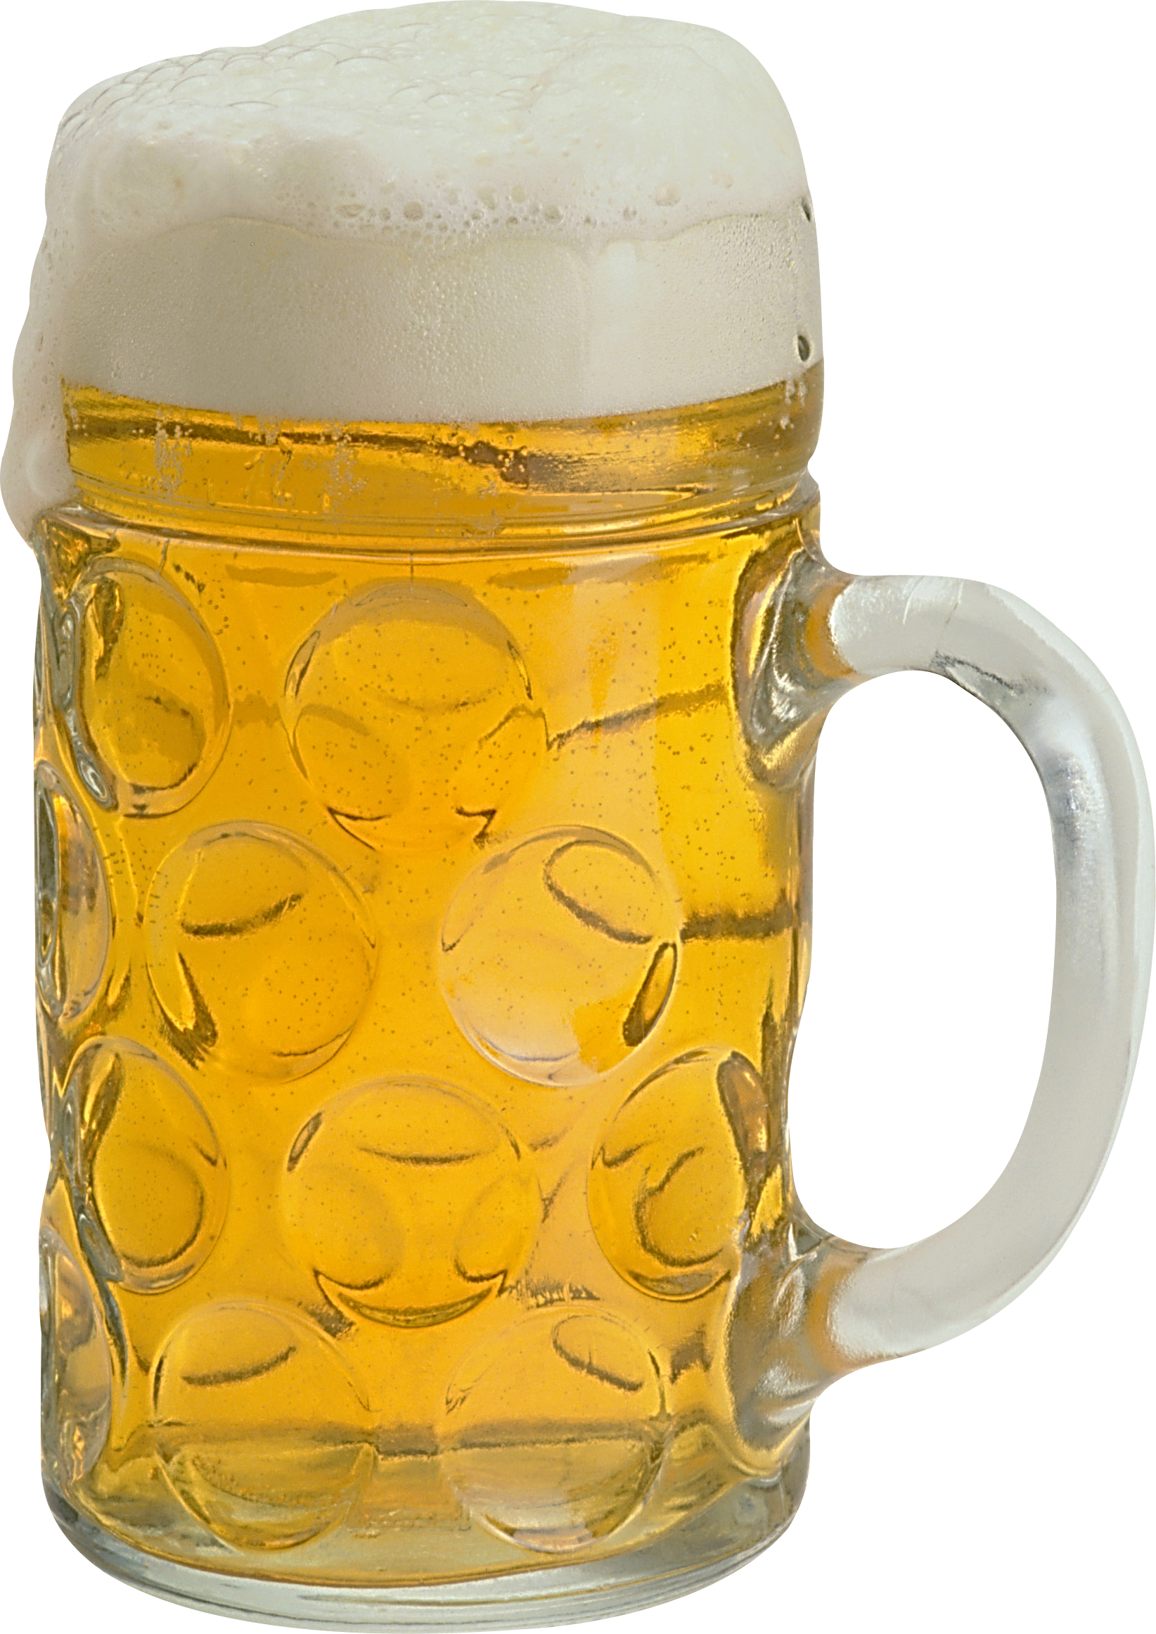
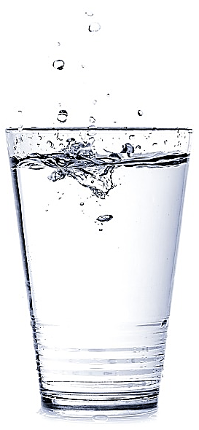

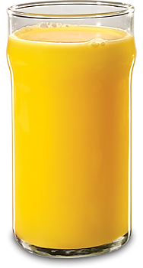
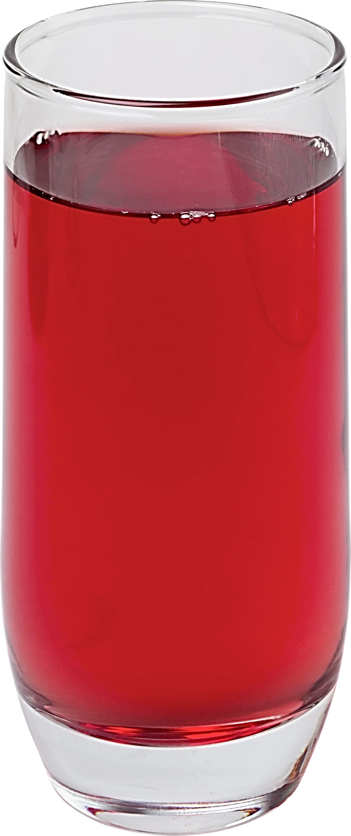

AFTER DINNER IN THE BAR
WHAT WOULD YOU LIKE?

Slide 33

WOULD YOU LIKE
COLA
RED
WINE
WHITE
WINE
MINERAL
WATER
BEER
ORANGE
JUICE
FRUIT
JUICE

Slide 35
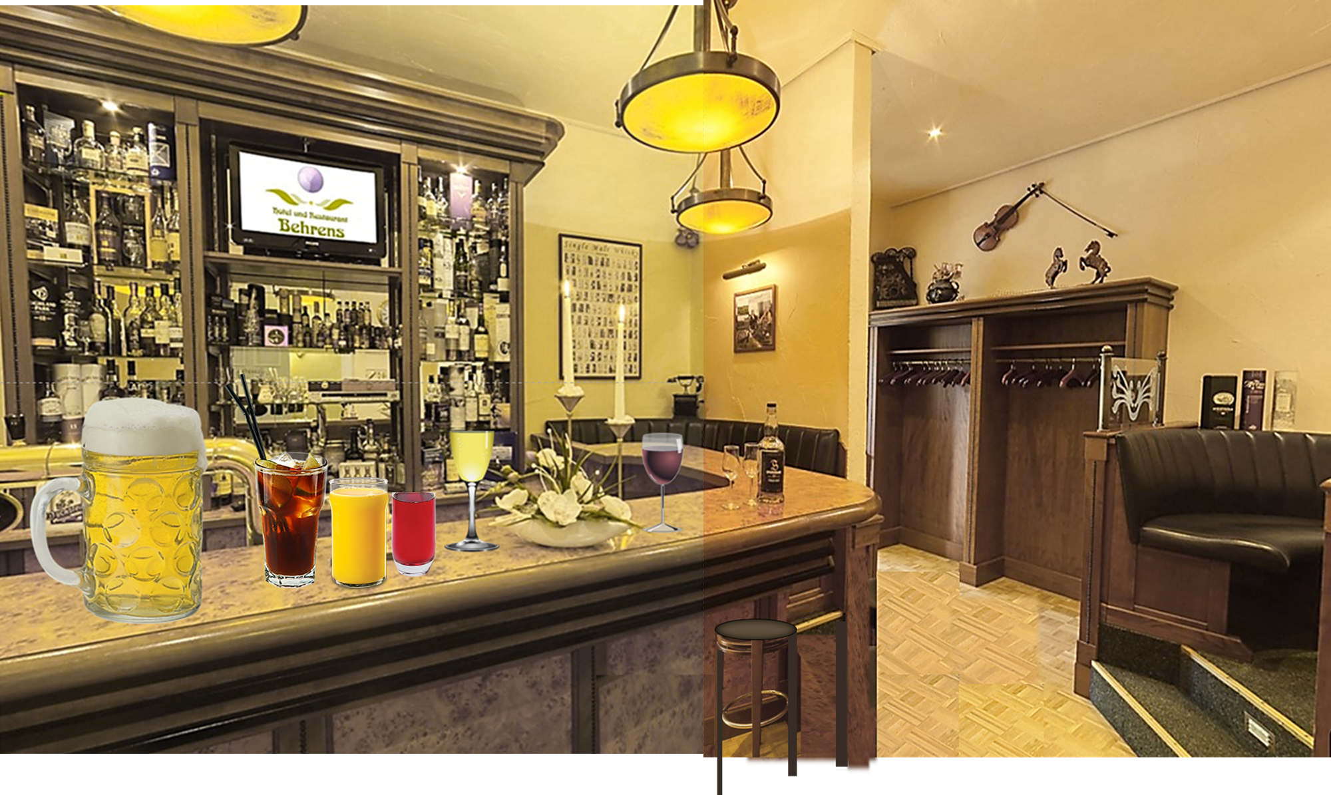
WHO WOULD LIKE WHAT ?
?
?
?
?
?
?

Slide 36
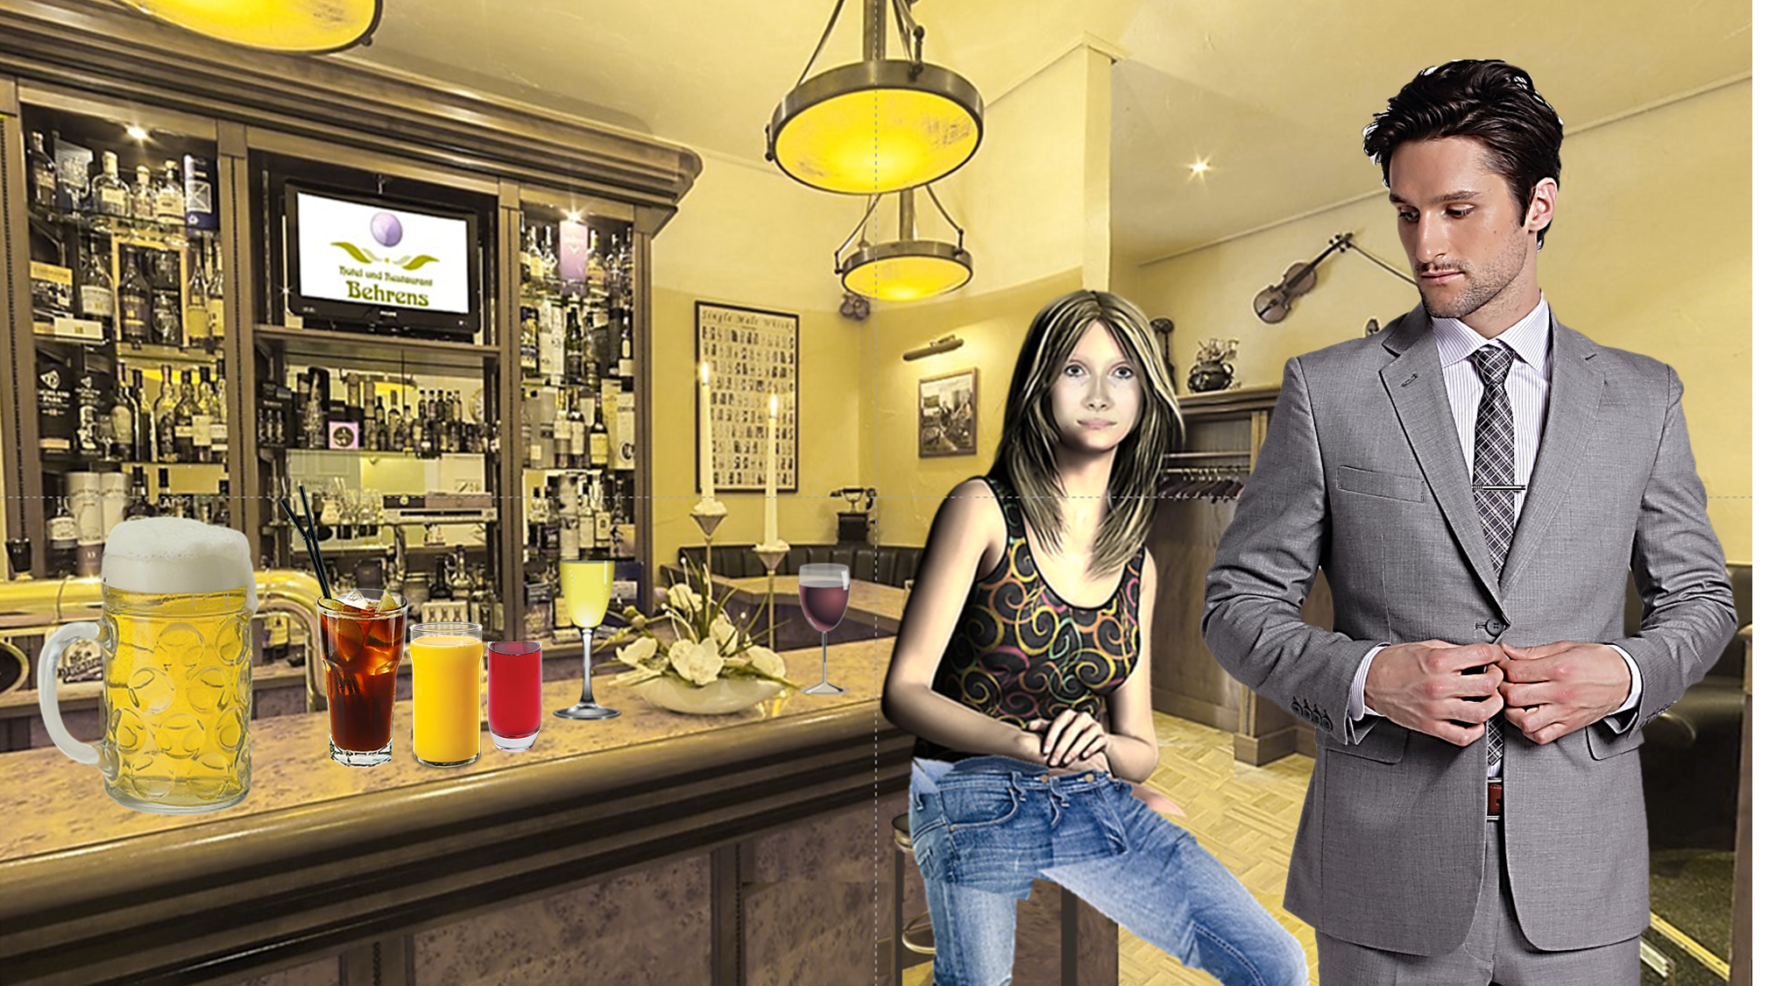
A GOOD QUESTION!

Slide 37

A GOOD QUESTION!

Slide 38

FIONA:
TONY:
FIONA: IT’S A DRINKS PARTY-WHAT WOULD YOU LIKE TONY?
TONY: I WOULD LIKE A BEER THANKS!
FIONA: I PREFER THE RED WINE I WONDER WHAT
THE OTHERS WOULD LIKE ?
TONY: I THINK MARY WOULD PREFER THE WHITE WINE
BUT I’M SURE THE THREE GUYS WITH CARS
WOULD RATHER HAVE THE SOFT DRINKS
FIONA:
TONY:

Slide 39

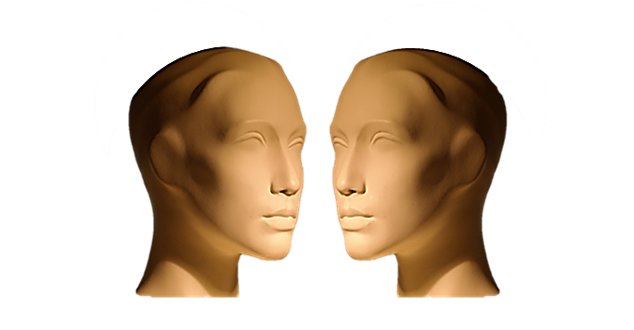

TYPICAL DIALOGUE
JUST LISTEN...

Slide 41
FIONA:
TONY:
FIONA: IT’S A DRINKS PARTY-WHAT WOULD YOU LIKE TONY?
TONY: I WOULD LIKE A BEER THANKS!
FIONA: I PREFER THE RED WINE I WONDER WHAT
THE OTHERS WOULD LIKE ?
TONY: I THINK MARY WOULD PREFER THE WHITE WINE
BUT I’M SURE THE THREE GUYS WITH CARS
WOULD RATHER HAVE THE SOFT DRINKS
FIONA:
TONY:

Slide 42
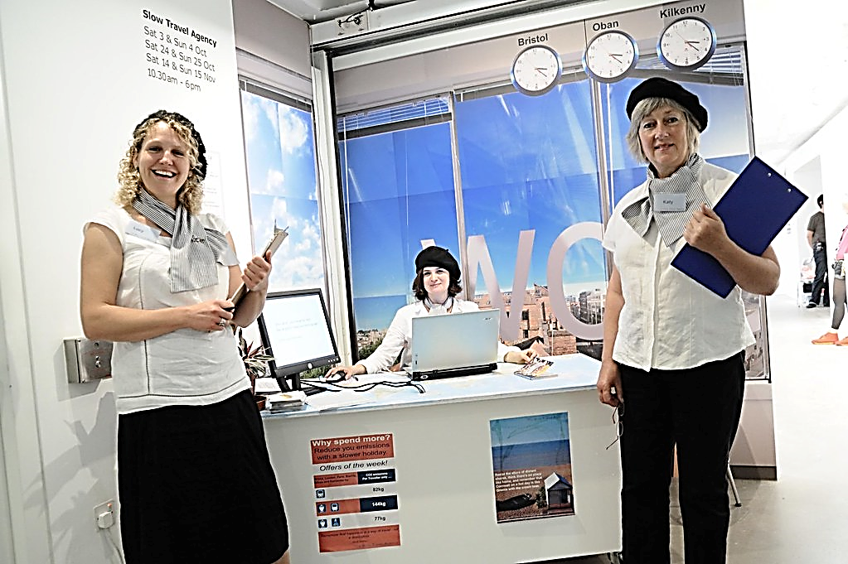
NEXT DAY AT THE TRAVEL AGENCY

Slide 43
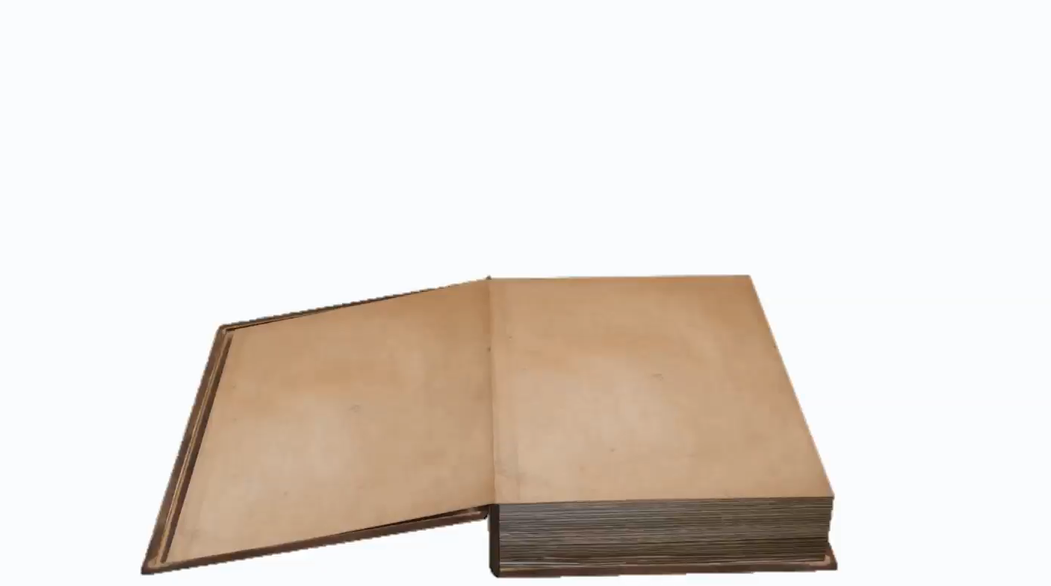
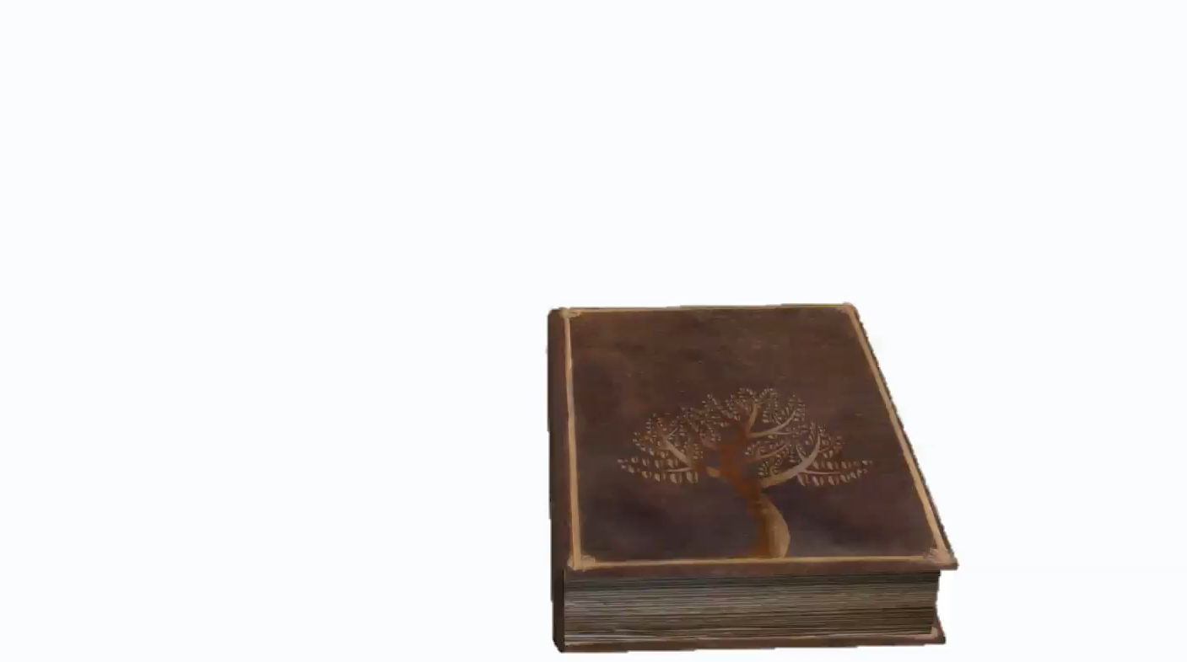
LANGUAGE IN CONTEXT

Slide 44
LANGUAGE IN CONTEXT

Slide 45
WHERE WOULD YOU LIKE TO GO?
WHAT KIND OF ACTIVITIES DO YOU LIKE?
HOW WOULD YOU PREFER TO TRAVEL?
WHAT SORT OF ACCOMMODATION WOULD YOU RATHER HAVE?
DO YOU HAVE ANY PREFERENCES FOR TIME OF YEAR?

Slide 46
WHERE WOULD YOU LIKE TO GO?
SPECIFIC PREFERENCE
WHAT KIND OF ACTIVITIES DO YOU LIKE?
PERSONAL GENERAL PREFERENCE
HOW WOULD YOU PREFER TO TRAVEL?
BEST SPECIFIC PREFERENCE
WHAT SORT OF ACCOMMODATION WOULD YOU RATHER HAVE?
BETTER ALTERNATIVE
DO YOU HAVE ANY PREFERENCES FOR TIME OF YEAR?
FAVORITE

Slide 47
WHERE WOULD YOU LIKE TO TRAVEL?

Slide 48
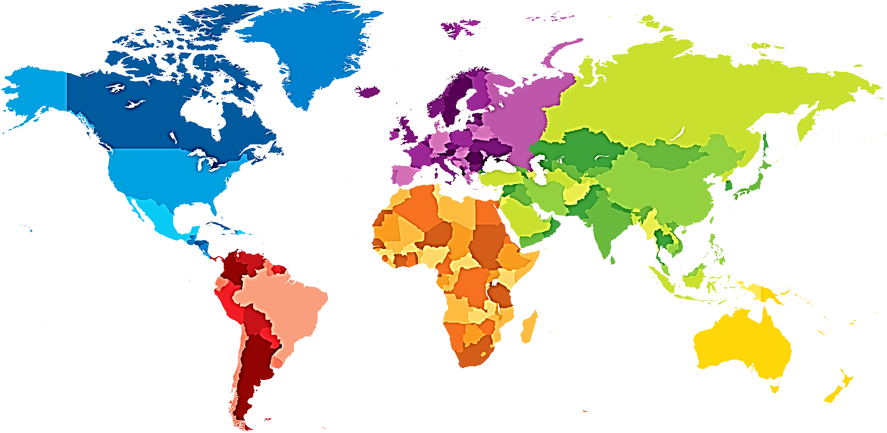
WHERE WOULD YOU LIKE TO TRAVEL?
WOULD YOU LIKE TO GO TO CHINA?
WOULD YOU LIKE TO GO TO EUROPE?
WOULD YOU LIKE TO VISIT NORTH AMERICA?
WOULD YOU LIKE TO SEE INDIA?
WOULD YOU LIKE TO TRAVEL TO AUSTRALIA?
WOULD YOU LIKE TO GO TO SOUTH AMERICA?
WOULD YOU LIKE A TRIP TO AFRICA?

Slide 49
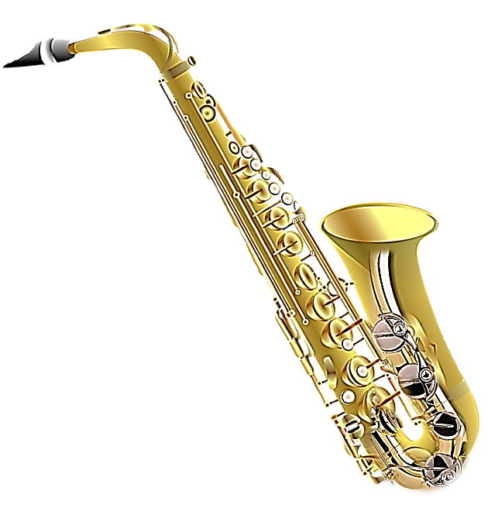

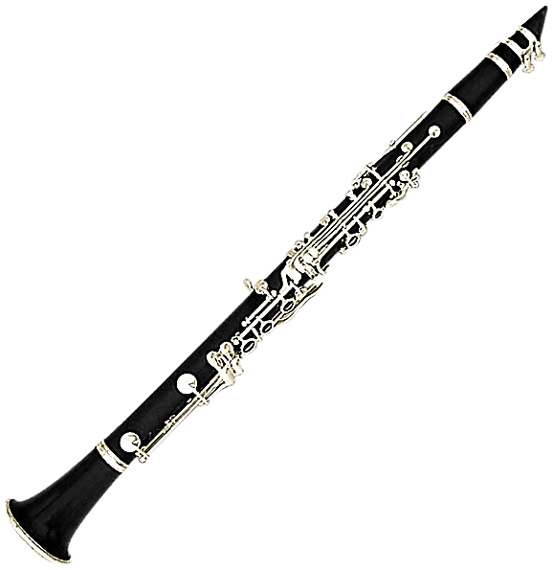
WHAT MUSICAL INSTRUMENTS
DO YOU LIKE?
WE BOTH LIKE
THE CLARINET
I WOULD RATHER
LISTEN TO THE SAXAPHONE
I LIKE
THE VIOLIN

Slide 50

PREFERENCES!
I LIKE
I WOULD LIKE
I PREFER
I WOULD PREFER
I WOULD RATHER
I WANT
GENERAL
SPECIFIC
GENERALLY BEST FOR ME
SPECIFICALLY
BEST FOR ME
BETTER ALTERNATIVE FOR ME
DIRECT

Slide 51
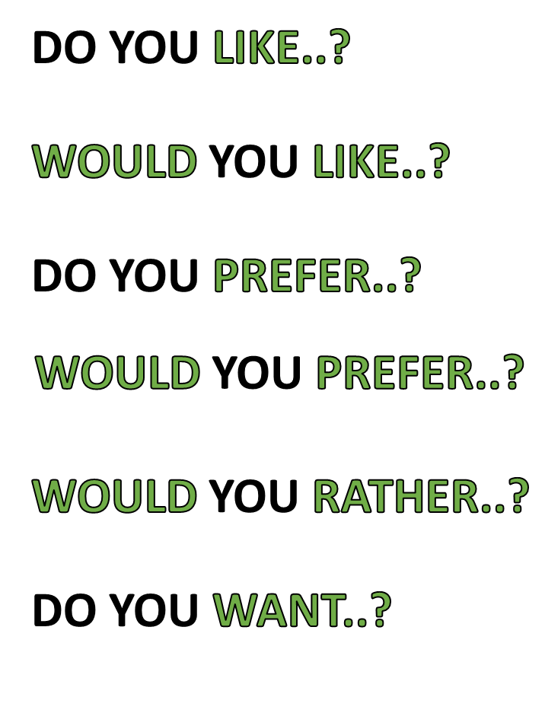
PREFERENCES!
GENERAL
SPECIFIC
GENERALLY BEST FOR YOU
SPECIFICALLY
BEST FOR YOU
BETTER ALTERNATIVE FOR YOU
DIRECT

Slide 52
REMEMBER PREFERENCE CONTEXTS
WOULD LIKE
LIKE
GENERAL
SPECIFIC
WOULD PREFER
PREFER
GENERAL
SPECIFIC
DIRECT
WOULD RATHER
INSTEAD
WANT

Slide 53

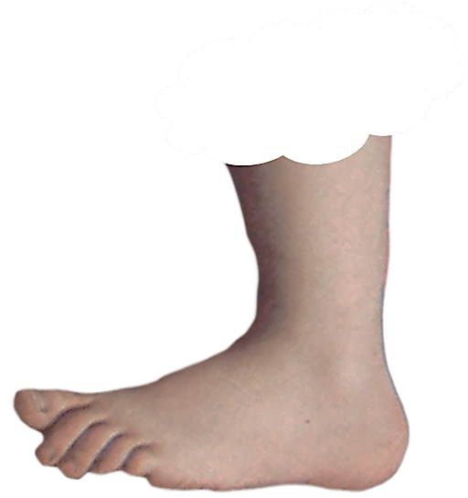
PREFERENCES ARE ABOUT
FAVORITE ACTIVITIES OR THINGS
THAT YOU WANT MORE THAN OTHERS
FOOTNOTE
FOOTNOTE

Slide 54
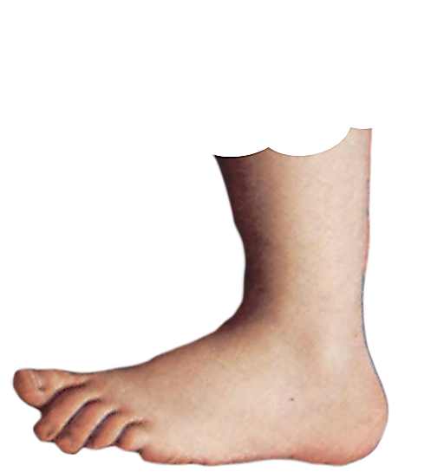
LIKE
CAN HAVE OTHER MEANINGS
FOOTNOTE
FOOTNOTE

Slide 55
FOOTNOTE
FOOTNOTE

Slide 57


Slide 59
FOOTNOTE
FOOTNOTE

Slide 60
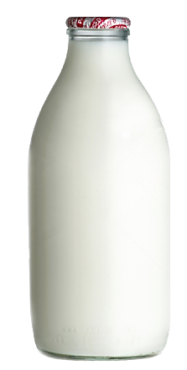
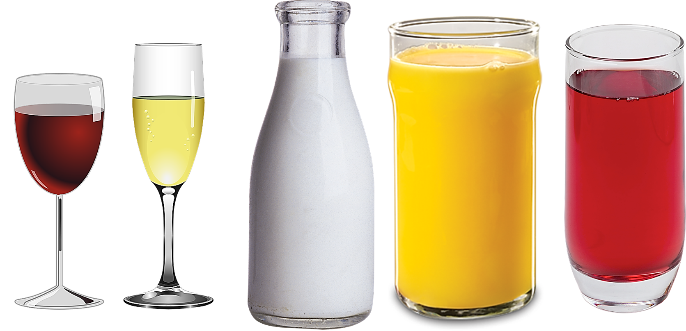

Slide 61
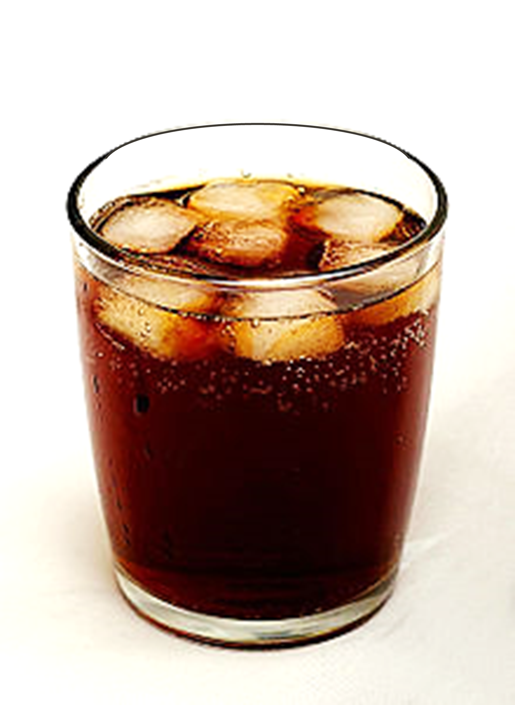

Slide 62


Slide 63
CONCEPTS

Slide 64



Slide 65



PREFERENCES!
CONTEXTS

Slide 66
LIKE
WOULD LIKE
PREFER
WOULD PREFER
WOULD RATHER
WANT

Slide 67
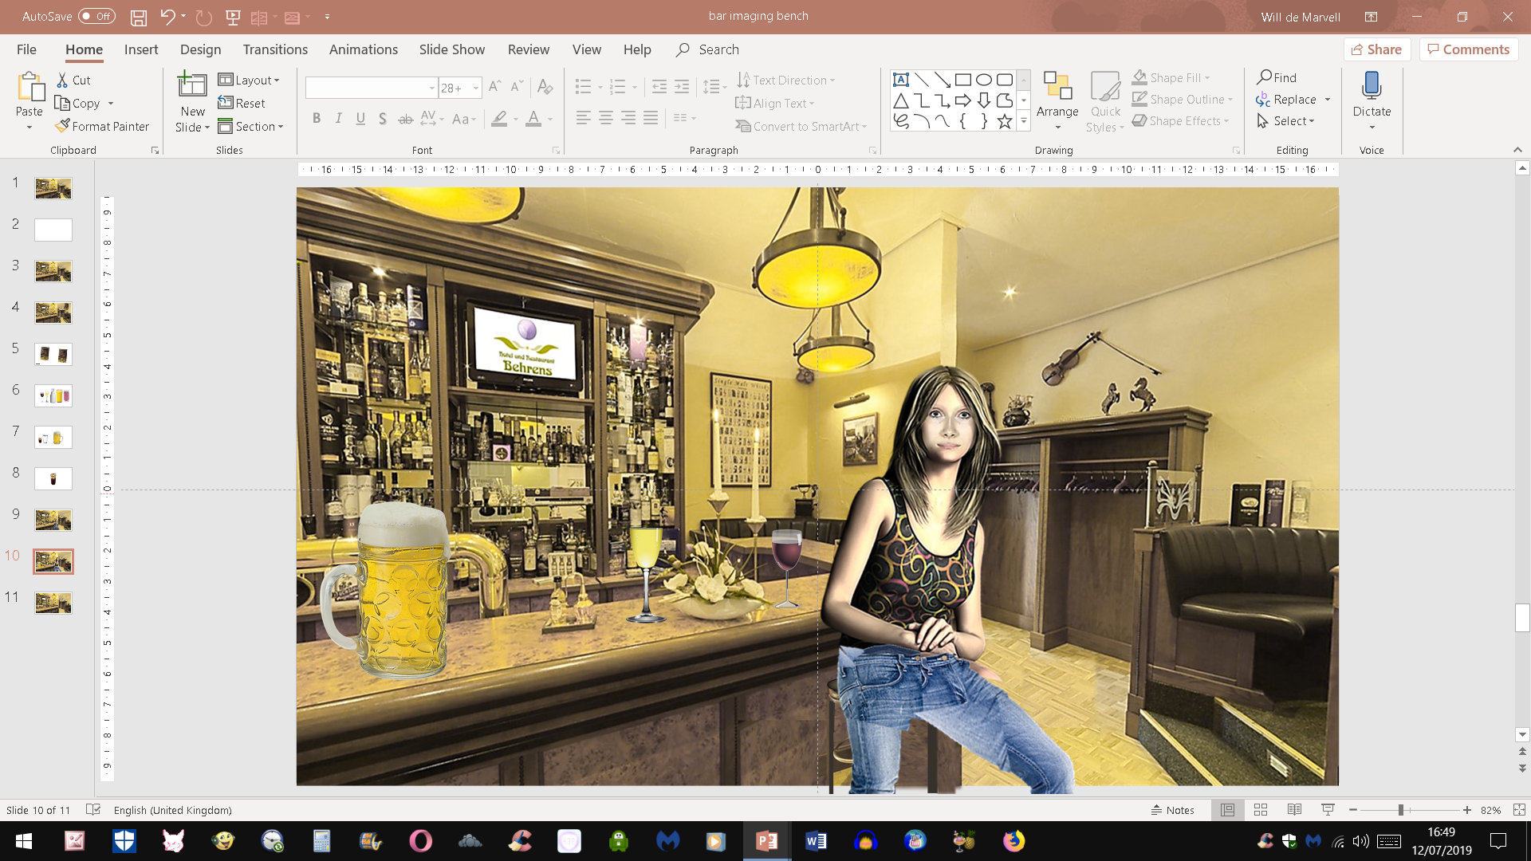

Slide 68
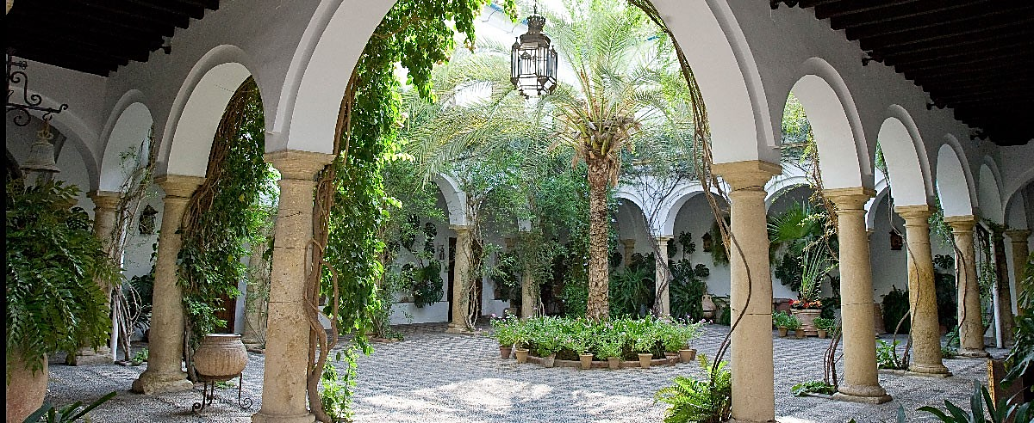

Slide 69
MEANING: to feel a desire or want.
We can go swimming if you like.
SIMILAR WORDS: prefer,care, please, wish
MEANING: to find pleasure in; enjoy.
Joe likes going to the movies.
SIMILAR WORDS: prefer enjoy, love, appreciate, fancy,
OPPOSITE WORDS: dislike, hate
MEANING: to have positive feelings for.
I really like her a lot.
SIMILAR WORDS adore, fancy, favour, admire
OPPOSITE WORDS: dislike, hate
MEANING: similar to
He is like his mother
SIMILAR WORDS the same as or similar to
OPPOSITE WORD unlike

Slide 71
CONCEPTS

Slide 72
WOULD
RATHER
WANT

Slide 73
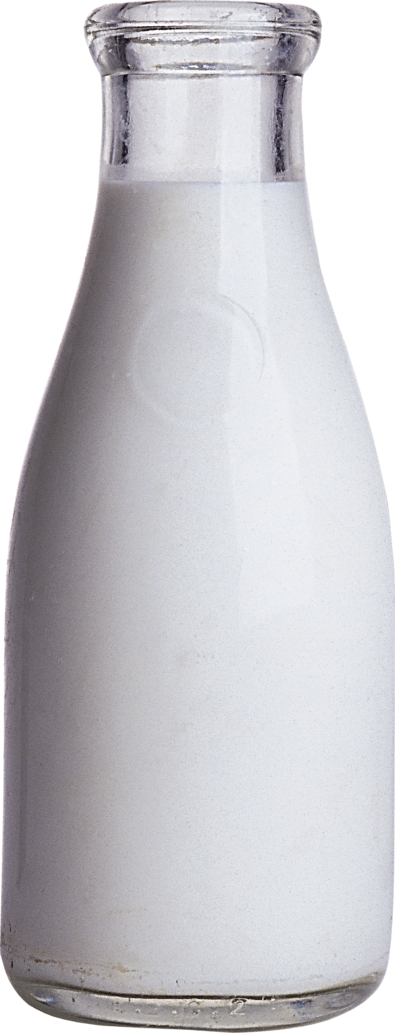

Slide 75

AFTER DINNER IN THE BAR

Slide 76
LATER IN THE RESTAURANT

Slide 77
JUST LISTEN...

Slide 78
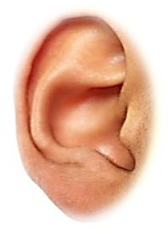
NOW LISTEN...

Slide 79
JUST LISTEN...

Slide 80
LATER IN THE RESTAURANT

Slide 81
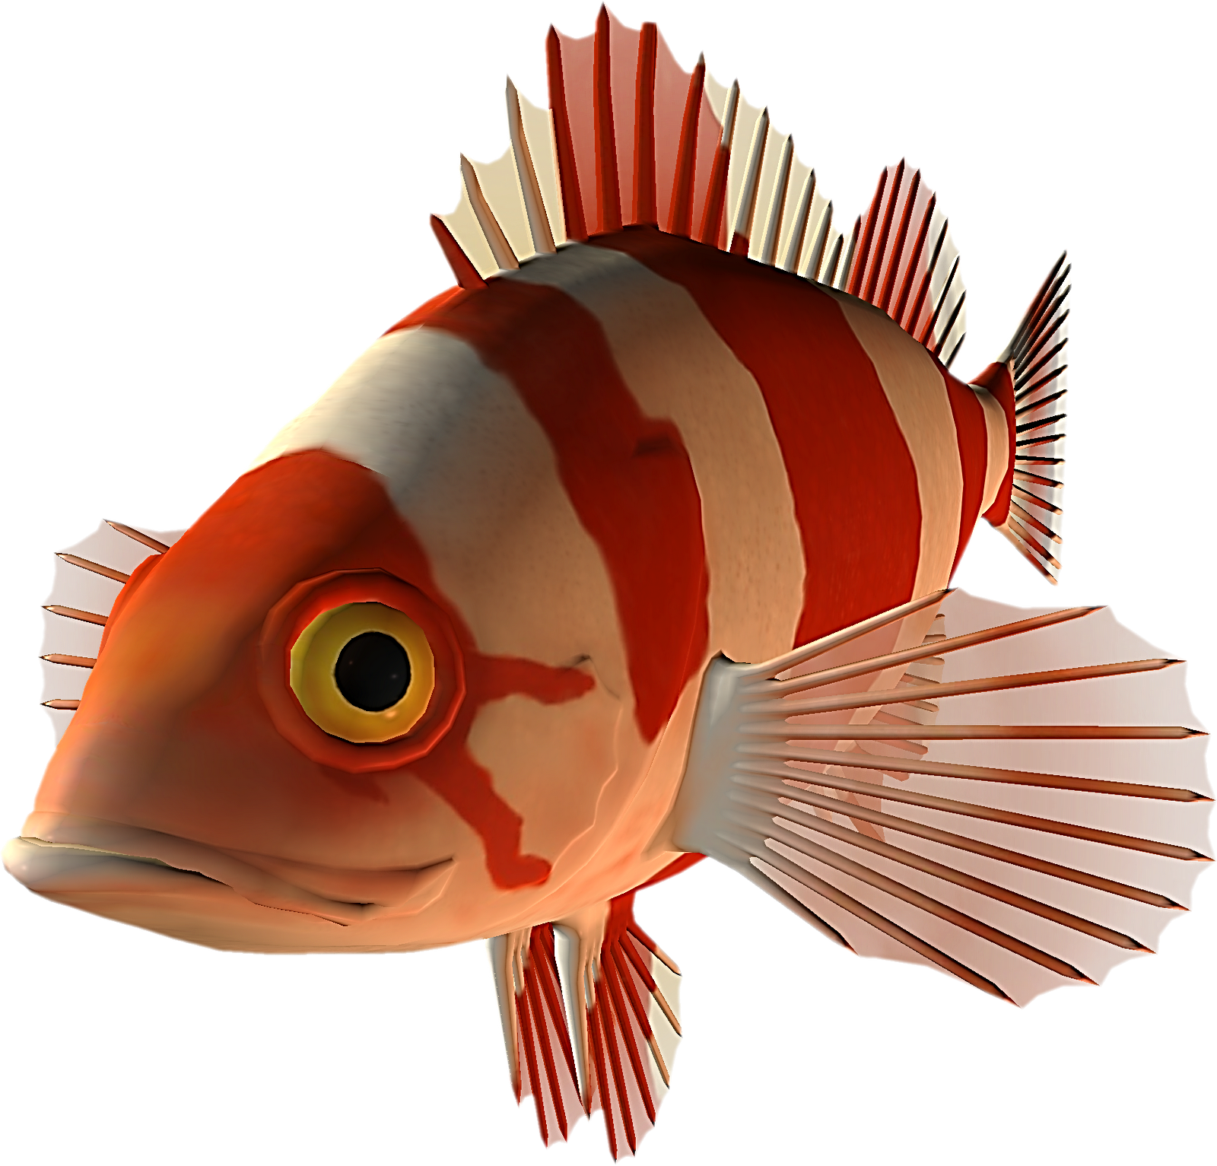

Slide 82
