Slide 1
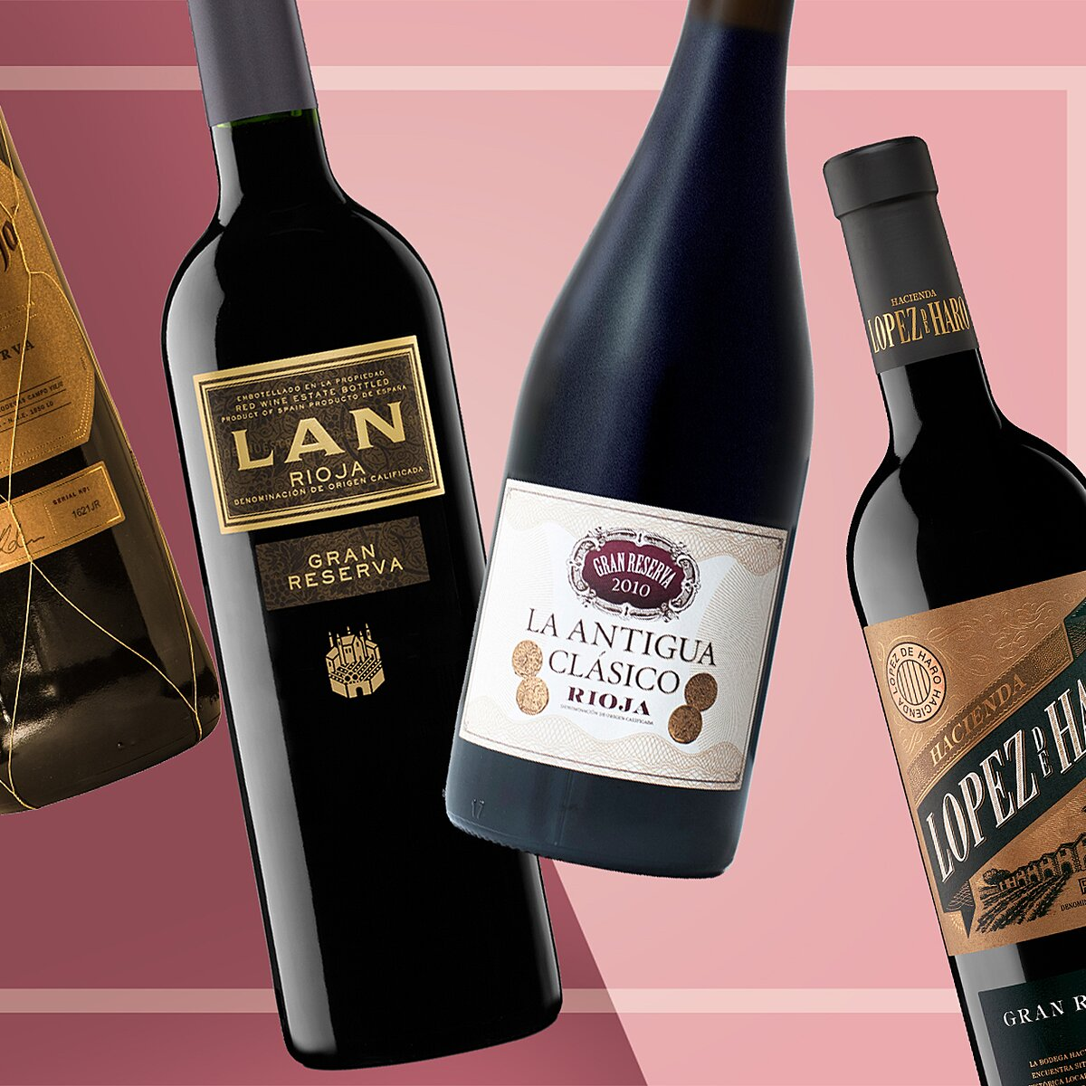

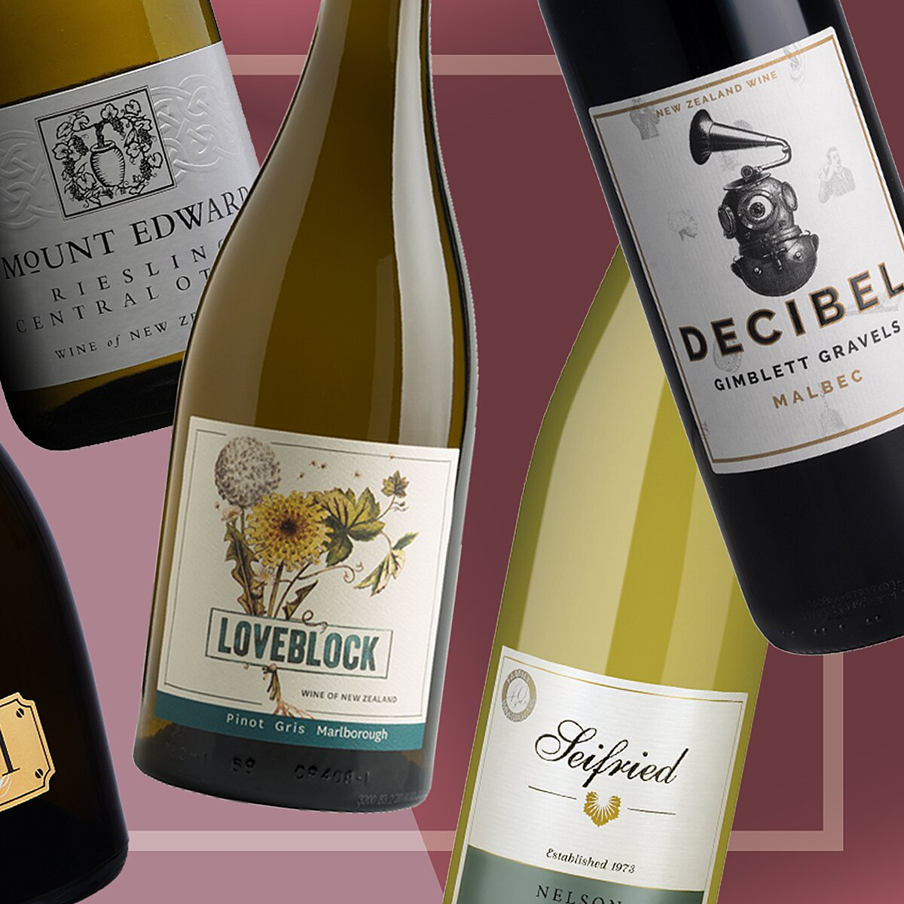
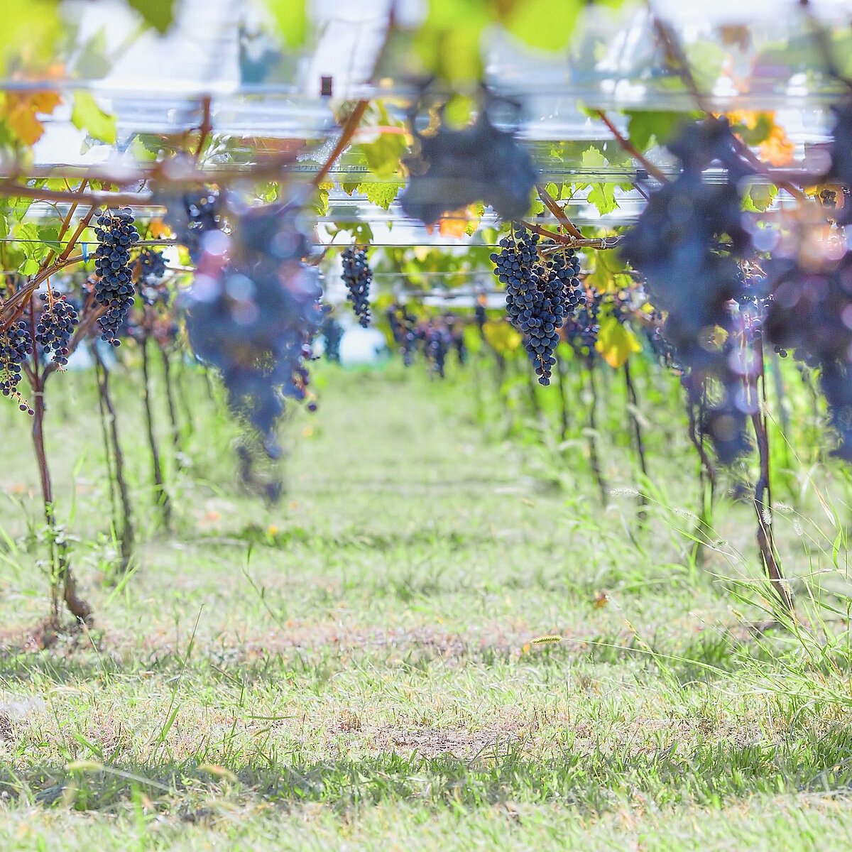
Top Navigation
Food & Wine
Profile Menu
Login
Subscribe
Home
Wine
7 Ways to Make Bad Wine Drinkable
7 Ways to Make Bad Wine Drinkable
By Lawrence Marcus
Updated December 23, 2019
Pin FB
© adoc-photos/Corbis
So, the real wine shop was closed and you’ve lost the liquor store lottery. Must you suffer with your medium-gross wine until you’ve consumed enough not to care? No. There are steps you can take to improve almost any wine, or at least trick yourself into tolerating it. Here are seven ways to make the most of not-so-stellar selections.
1. Chill it down.
As temperatures drop, flavors become muted. Most of us drink our worthy white wine too cold, but just-above-freezing is the perfect temperature for lesser bottles.
2. Adulterate it.
That is, make a spritzer. Or sangria. Or the Basque specialty kalimotxo (red wine and Coke).
3. If it’s red, drink it with mushrooms.
For reasons that wine-world pseudoscience hasn’t yet ventured to explain, umami-rich mushrooms tend to make ho-hum reds taste better. If your wine’s specific problem is a sandpapery mouthfeel, add red meat: Fat and protein both neutralize rough tannins.
4. If it’s sweet, drink it with something spicy.
Sadly, assertive cuisines like Thai and Indian tend to obliterate the delicious nuances of great wines. Happily, they’ll also obliterate the unpleasant nuances of bad wines. If your palate is busy dealing with garam masala or another intense spice combination, it’s not going to notice that your low-rent Riesling is lacking a bit in acidity.
5. If it’s oaky, drink it while you’re grilling.
Does your cheap Chardonnay smell like a burning 2-by-4? It may have been subjected to a process whereby big tea bags full of charred wood chips were dunked in it prior to bottling. No matter. Smoky foods work well with smoky wines, and a charcoal-grilled burger is the best kind of distraction for your palate.
6. Drop a penny into it.
This won’t work on any old not-so-great wine, but if you have a bottle that smells like struck matches or rotten eggs, adding a penny to your glass might actually help. Certain sulfur-related compounds can cause these smells, and copper makes them dissipate. Clean a coin, drop it in, swirl, remove and enjoy. When it works, the difference is amazing.
7. Bake it into a chocolate cake.
OK, this is actually a tip for making bad wine eatable. While you typically shouldn’t cook with a wine you wouldn’t drink, that rule can be relaxed a bit for baking. With sugar, chocolate and whipped cream involved, the wine contributes only a mild boozy note to this surprisingly good dessert.
Related: 10 Ways to Fool People into Thinking You Know About Wine
How to Live Off Wine in Paris
5 Things You Don't Actually Need to Know About Wine
Advertisement
Popular in Wine
This Affordable Wine Is One of the Most Underrated in the World
Pin
This Affordable Wine Is One of the Most Underrated in the World
10 Excellent Chablis Wines for Under $40
Pin
10 Excellent Chablis Wines for Under $40
9 Excellent New Zealand Wines That Aren’t Sauvignon Blanc
Pin
9 Excellent New Zealand Wines That Aren’t Sauvignon Blanc
Where to Eat, Drink, and Stay in Japan's Stunning Yamanashi Wine Region
Pin
Where to Eat, Drink, and Stay in Japan's Stunning Yamanashi Wine Region
Remembering Georges Duboeuf, the ‘King of Beaujolais’
Pin
Remembering Georges Duboeuf, the ‘King of Beaujolais’
The 13 Best South African Wines to Score Right Now
Pin
The 13 Best South African Wines to Score Right Now
The Year in Wine: 2019
Pin
The Year in Wine: 2019
It’s Mulled Wine Season—Here’s How to Make It
Pin
It’s Mulled Wine Season—Here’s How to Make It
The Best Tuscan Wines You’ve Never Heard Of
Pin
The Best Tuscan Wines You’ve Never Heard Of
Looking for the Wine List? Check Instagram
Pin
Looking for the Wine List? Check Instagram
How Not to Give Someone a Bottle of Wine
Pin
How Not to Give Someone a Bottle of Wine
The 15 Champagnes to Drink If You Want to Be a Real Expert
Pin
The 15 Champagnes to Drink If You Want to Be a Real Expert
The Best Wine Pairings for Holiday Cookies
Pin
The Best Wine Pairings for Holiday Cookies
What Is Mulled Wine and How Do You Make It?
Pin
What Is Mulled Wine and How Do You Make It?
How to Not Embarrass Yourself at a Winery
Pin
How to Not Embarrass Yourself at a Winery
11 New Natural Wines to Buy Right Now
Pin
11 New Natural Wines to Buy Right Now
Your Guide to Miami's Major Natural Wine Moment
Pin
Your Guide to Miami's Major Natural Wine Moment
A Beginner's Guide to 5 Essential French Wine Regions
Pin
A Beginner's Guide to 5 Essential French Wine Regions
This Is Hands Down the Best Boxed Wine You Can Buy
Pin
This Is Hands Down the Best Boxed Wine You Can Buy
The Best Gifts for Wine Lovers
Pin
The Best Gifts for Wine Lovers
All Topics in Wine
Winemakers
Fruit Wine
Dessert Wine
Rose Wine
Sake
Champagne + Sparkling Wine
White Wine
Red Wine
Food & Wine
Magazines & More
Learn More
Subscribe this link opens in a new tab
Contact Us
Media Kit
Content Licensing
Connect
Follow Us
Subscribe to Our Newsletter
Other Meredith Sites
Food & Wine is part of the Meredith Corporation Allrecipes Food Group. © Copyright 2019 Meredith Corporation. All Rights Reserved. Privacy Policythis link opens in a new tab Data Policythis link opens in a new tab Terms of Servicethis link opens in a new tab Ad Choicesthis link opens in a new tab Cookies Settings Web Accessibilitythis link opens in a new tab
this link is to an external site that may or may not meet accessibility guidelines.

Slide 2
