Slide 1
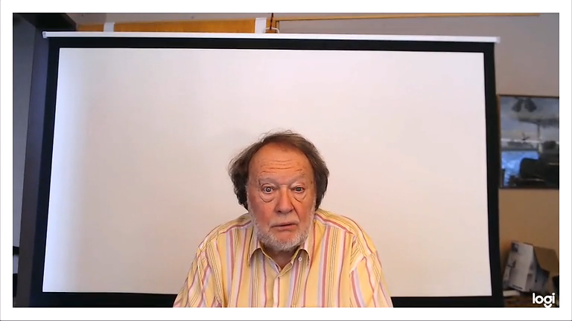
SIMILARITIES
AND
DIFFERENCES

