Slide 1











ARTS

Slide 2
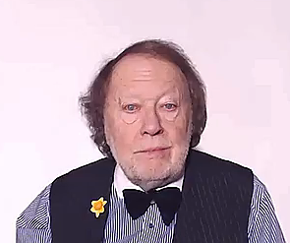
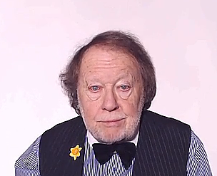
CONTEXTS
All the aspects which define the meaning
of something
are the
CONTEXT

Slide 3
CONTEXTS
All the aspects which define the meaning
of something
are the
CONTEXT

Slide 4


MELODY

Slide 5
THE MELODY HELPS TO IDENTIFY THE FEELING
AND
THE ATMOSPHERE OF THE CONTEXT

Slide 6




THE CONTEXTS OF THE
USE OF ENGLISH
MODULES
HAVE THEIR OWN MELODIES
LISTEN TO THEM CAREFULLY!

Slide 7
NOW CHOOSE A TOPIC FROM THE
USE OF ENGLISH
LIST

Slide 9
ARTS

