Slide 1
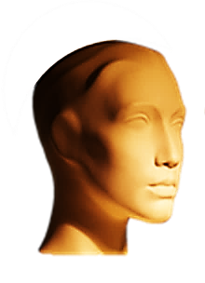

WHAT ARE…
CONTEXTS
?
CHECK THIS WORD

Slide 2
All the aspects which define something are the
CONTEXT
REMEMBER THIS!

Slide 3
KEY WORDS

Slide 4



CHECK THESE WORDS IN YOUR LANGUAGE
KEY WORDS
EVENT
CIRCUMSTANCES
SITUATION

Slide 5
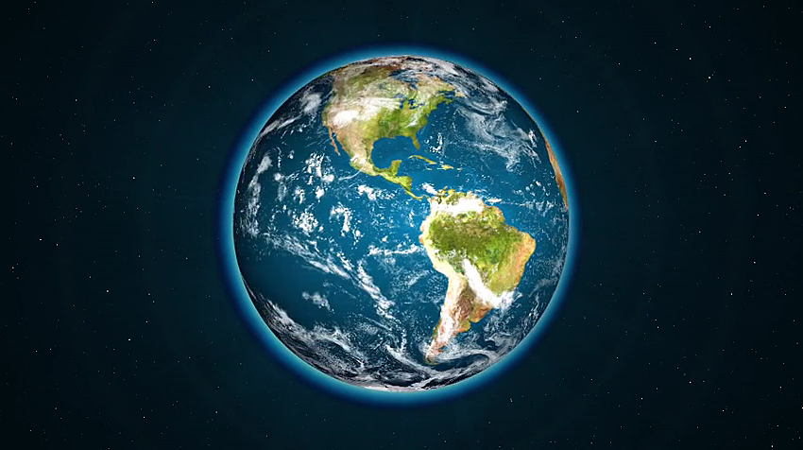









ARTS

Slide 6
Typical contexts
HOME
HAPPINESS
FAMILY
FRIENDS

Slide 7
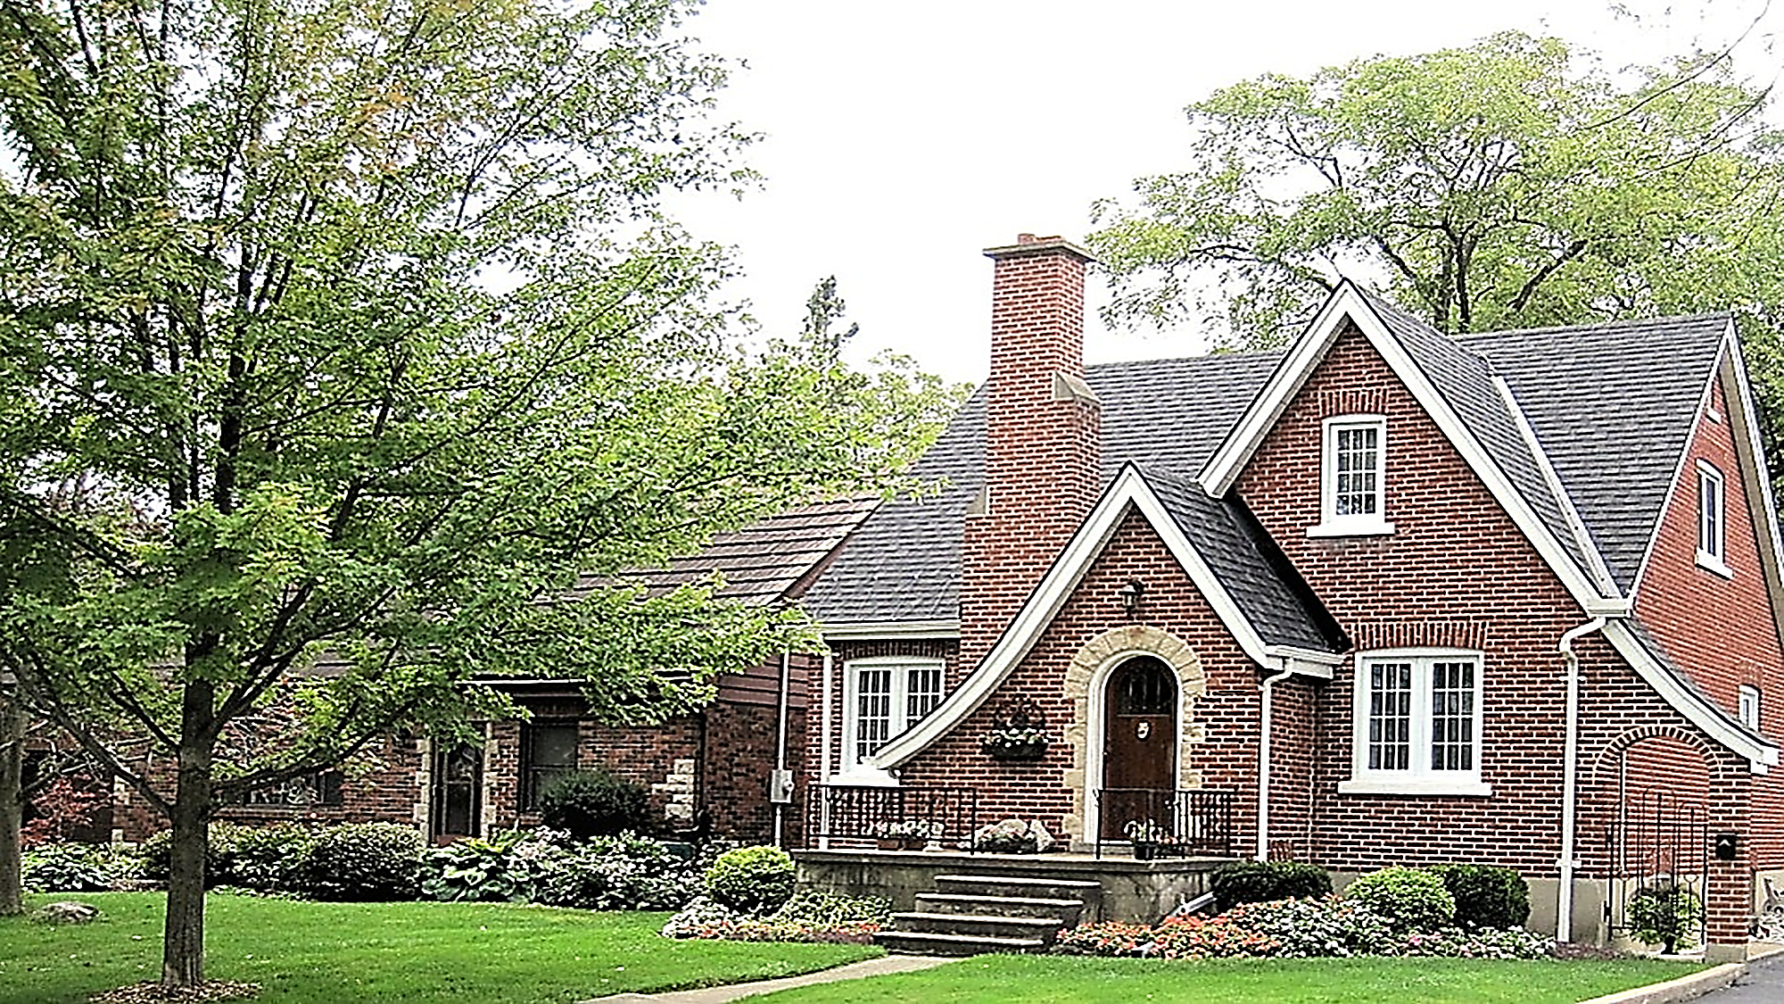
HOME

Slide 8

HAPPY PEOPLE

Slide 9

FRIENDS

Slide 10
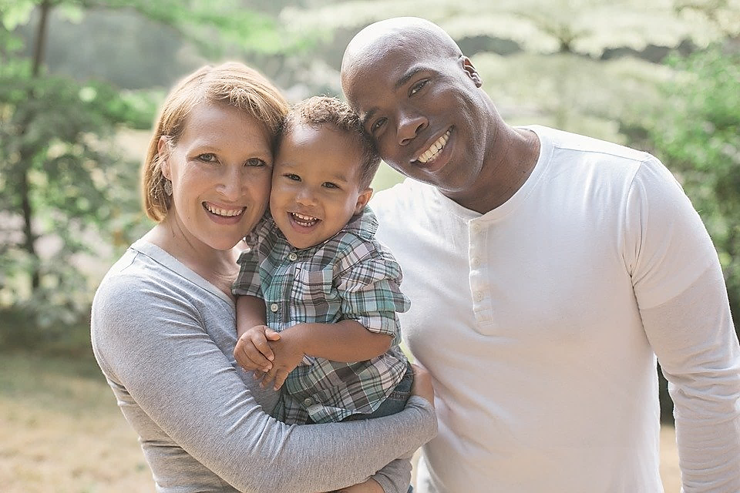
FAMILY

Slide 11
Typical contexts
INFORMATION
PEACE
SCIENCES
LOVE
ARTS
BUSINESS

Slide 12

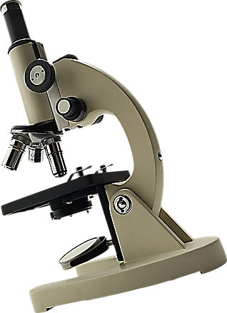

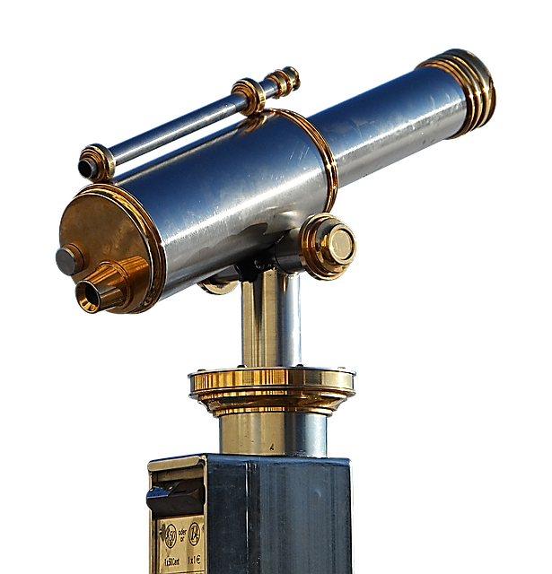
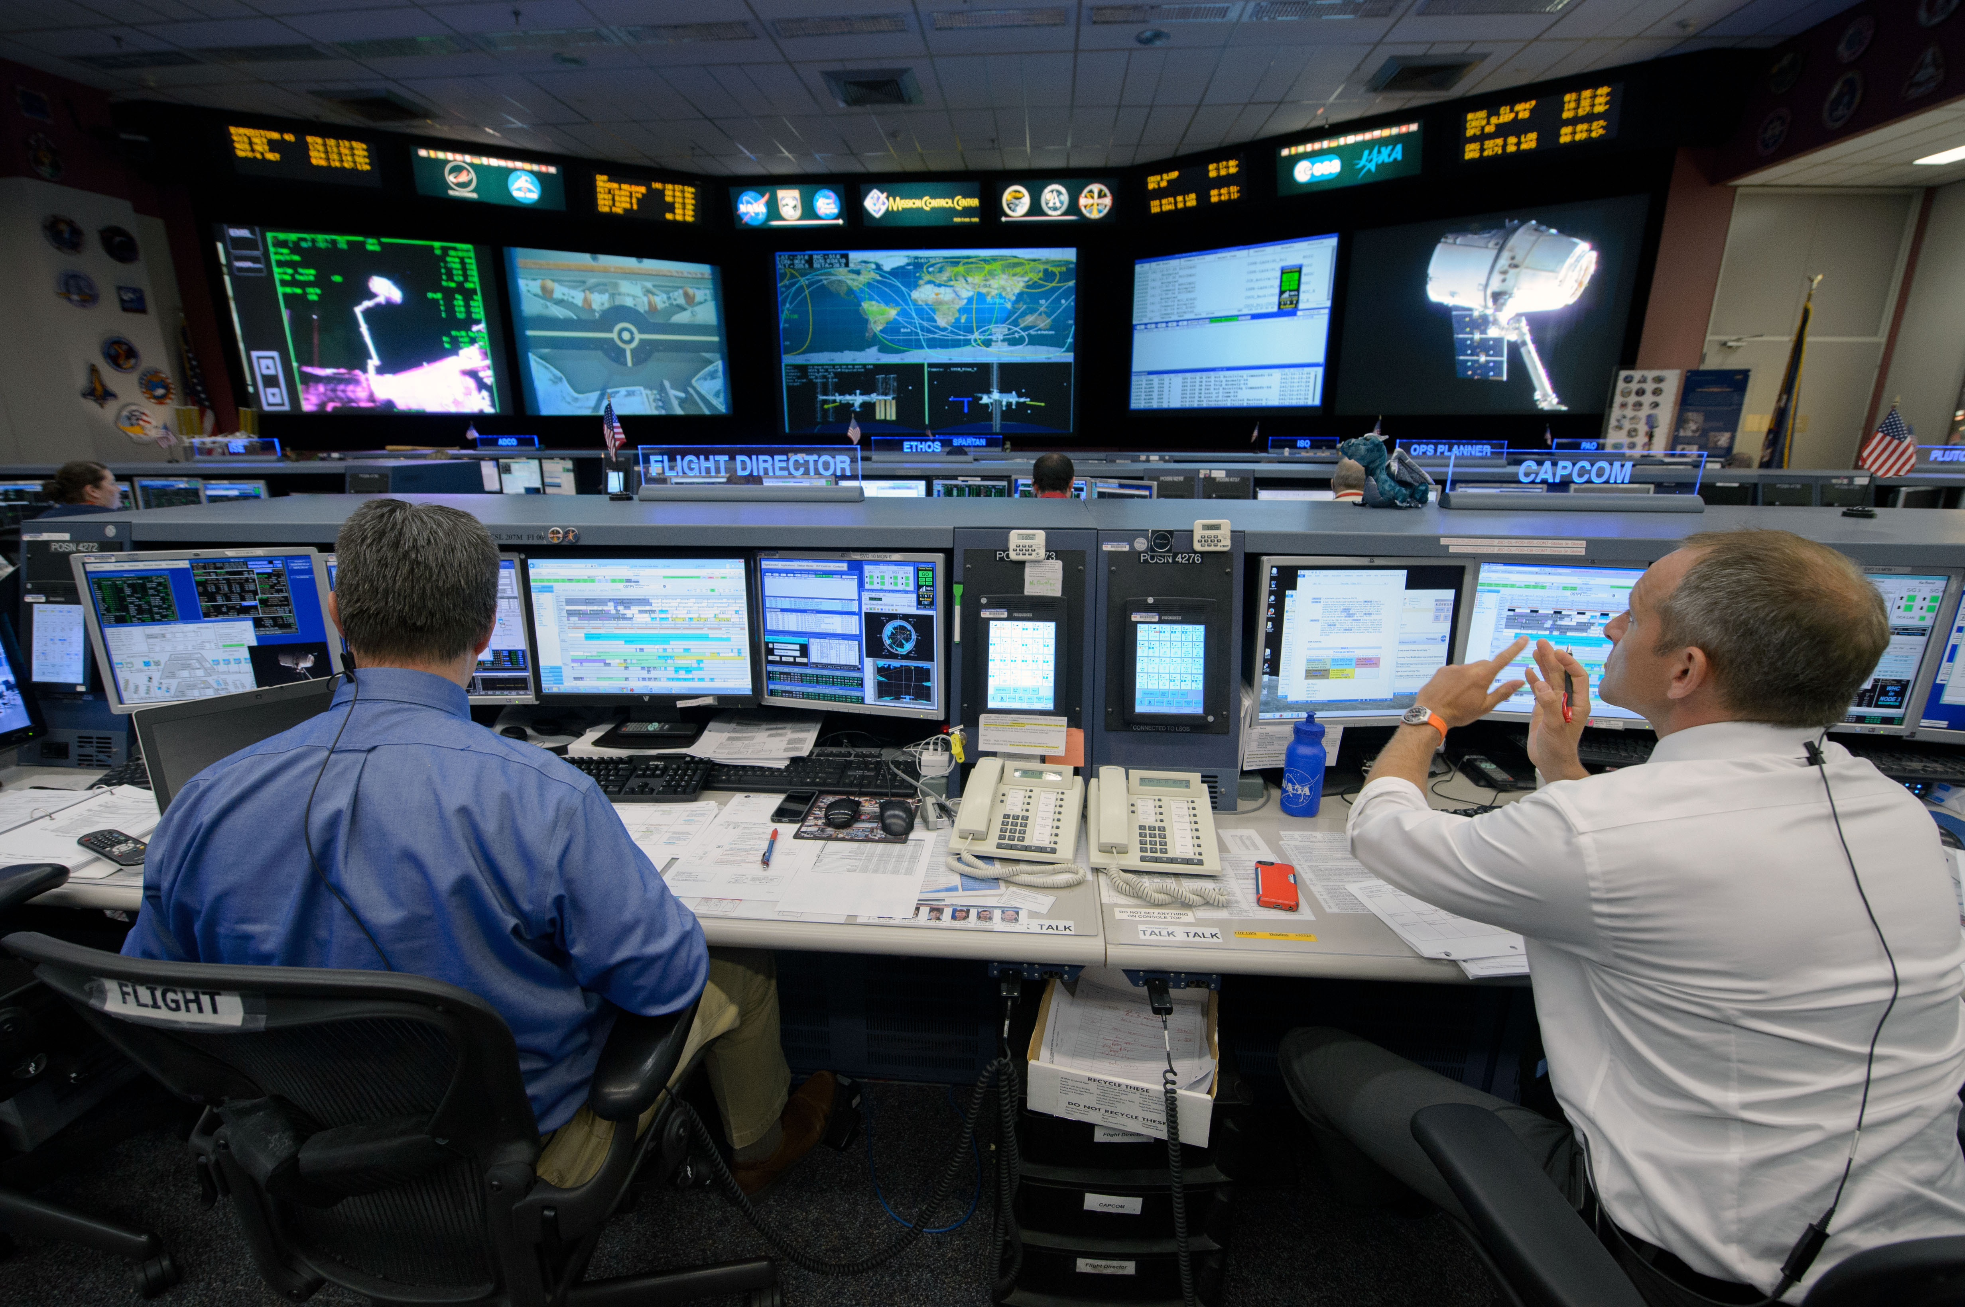
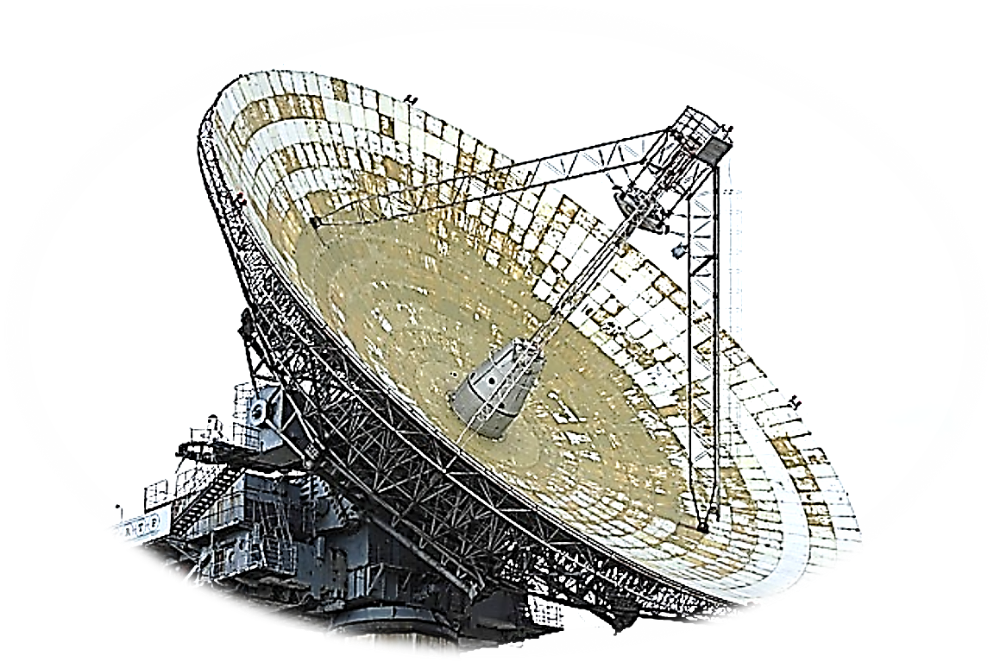
INFORMATION
INFORMATION CONTROL
CENTRE

Slide 13




SCIENCES

Slide 14
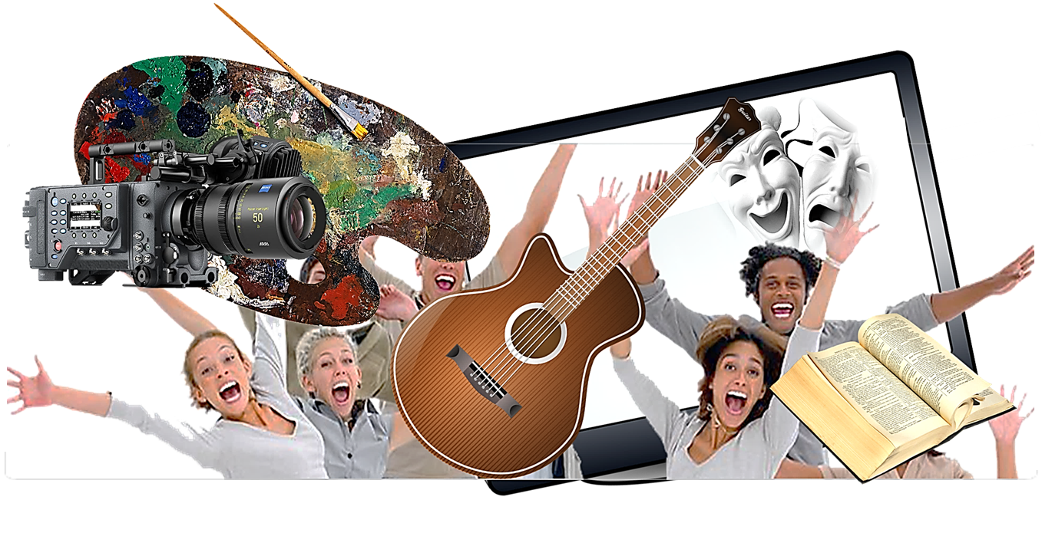
ARTS

Slide 15

PEACE

Slide 16
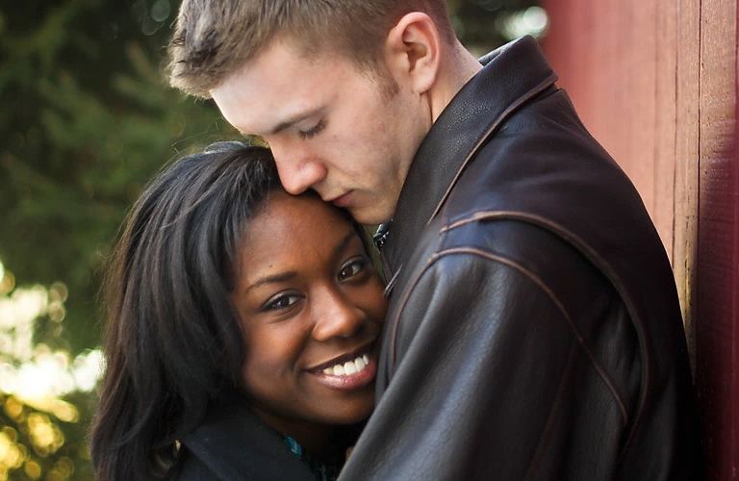
LOVE

Slide 17

BUSINESS

