Slide 1

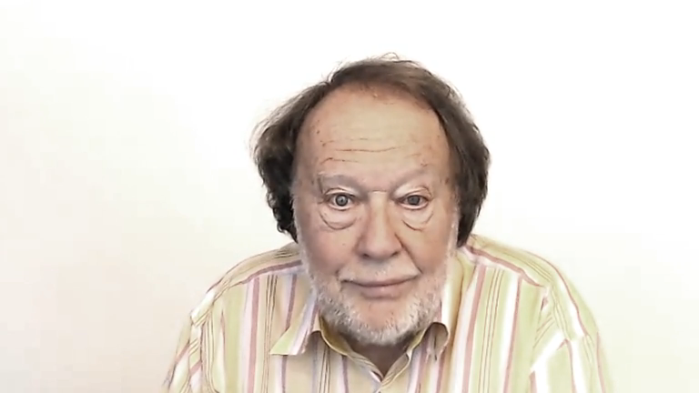
EVALUATING
WHAT IS IT?

