Slide 1
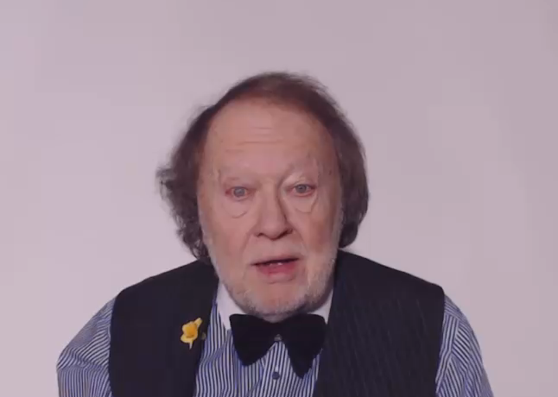
CHECK THIS
WORD
LET’S INVESTIGATE
THE
SOUNDS OF ENGLISH

Slide 2
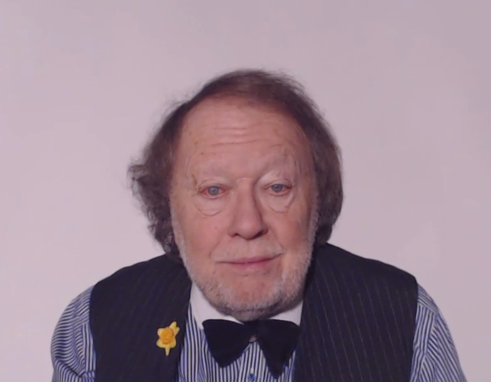
A CLEAR VOICE IMPROVES COMMUNICATION !

