Slide 2
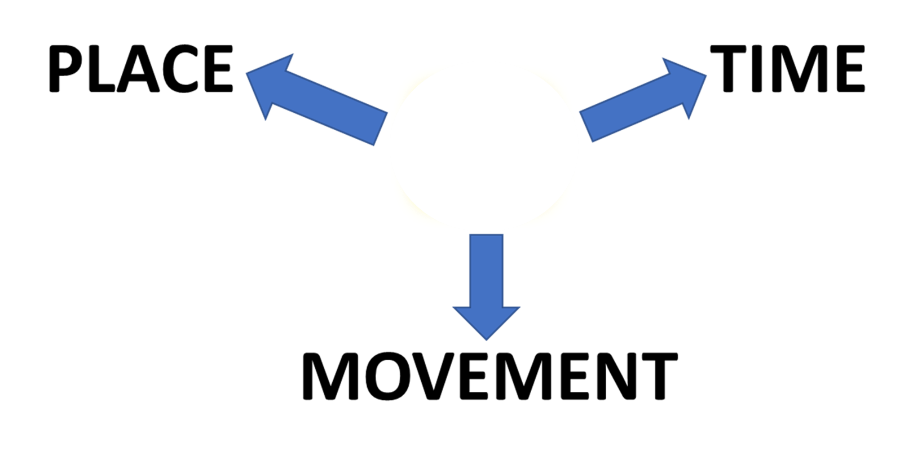

PREPOSITIONS
AT
AT

Slide 3
PREPOSITIONS
AT

Slide 4

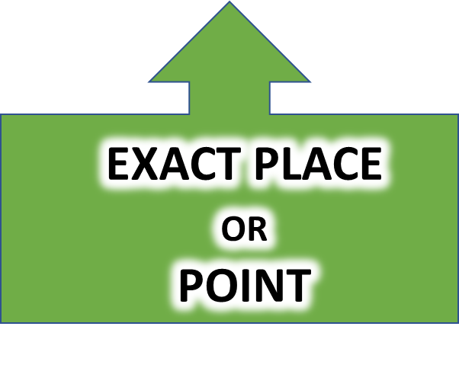

IMPORTANT NOTE!
PLACE
HAS TWO ASPECTS
LOCATION AND POSITION
GENERAL AREA
STOP THE VIDEO WHILE YOU CHECK

Slide 5
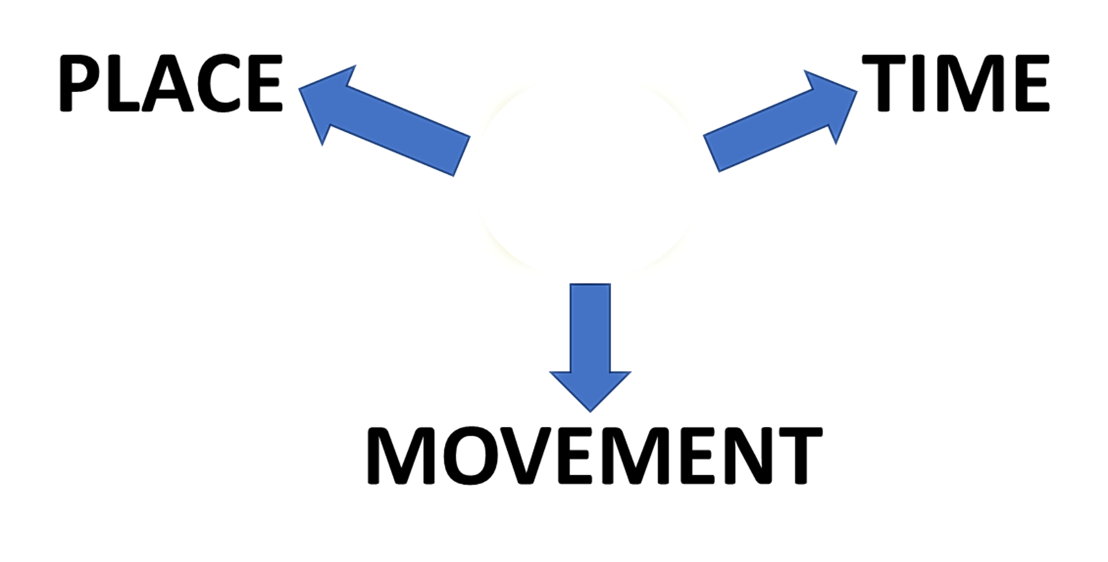
PREPOSITIONS
AT
GENERAL
LOCATION
RELATIVE POSITION
SPECIFIC POSITION

Slide 6
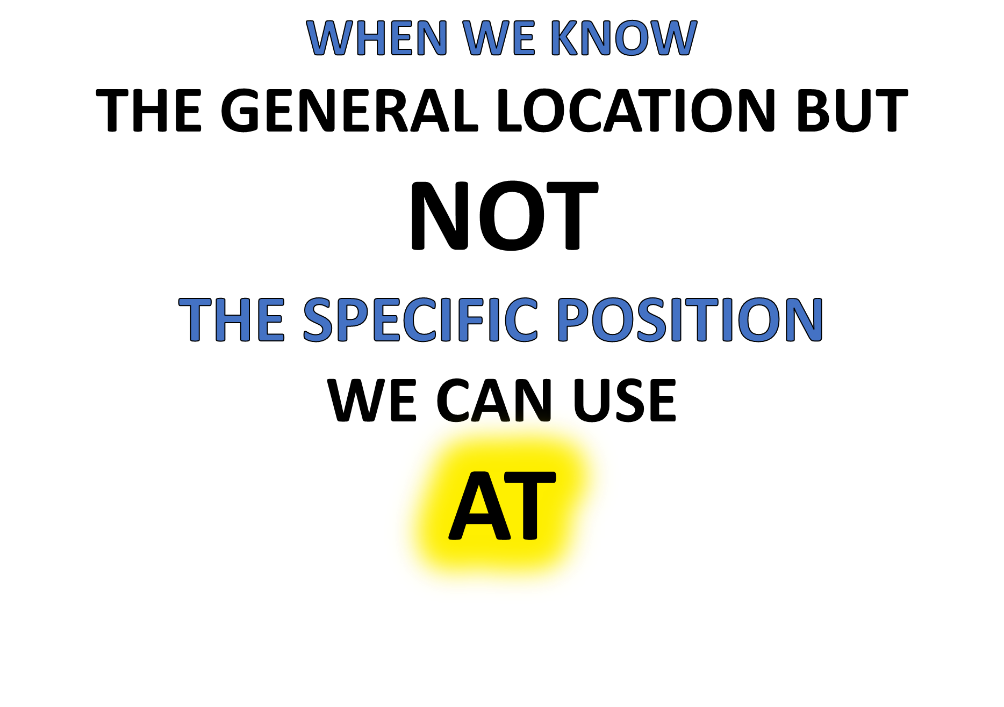
CHECK THIS WORD
“BOB IS AT THE AIRPORT BUT I DON’T KNOW WHEREABOUTS”

Slide 7
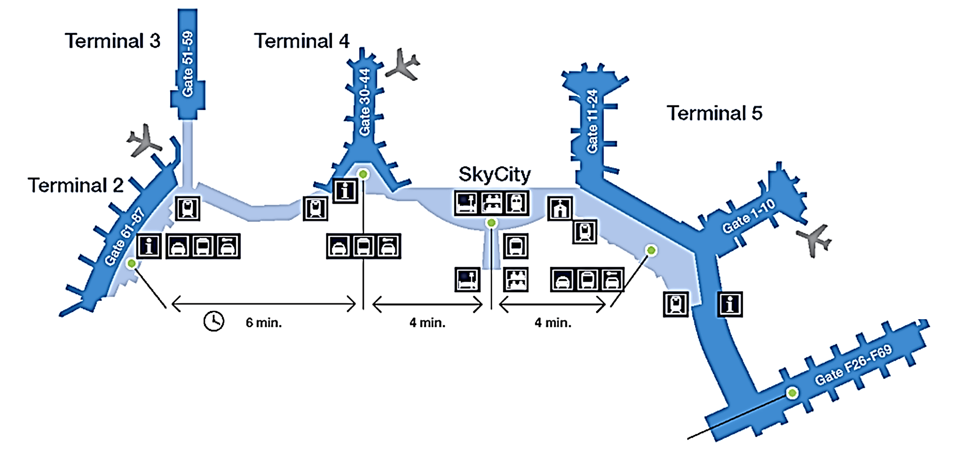
IS HE
AT TERMINAL 3?
AT THE AIRPORT!
IS HE
AT TERMINAL 5?
WHERE IS BOB?
IS HE
AT
THE INFORMATION POINT?

Slide 8
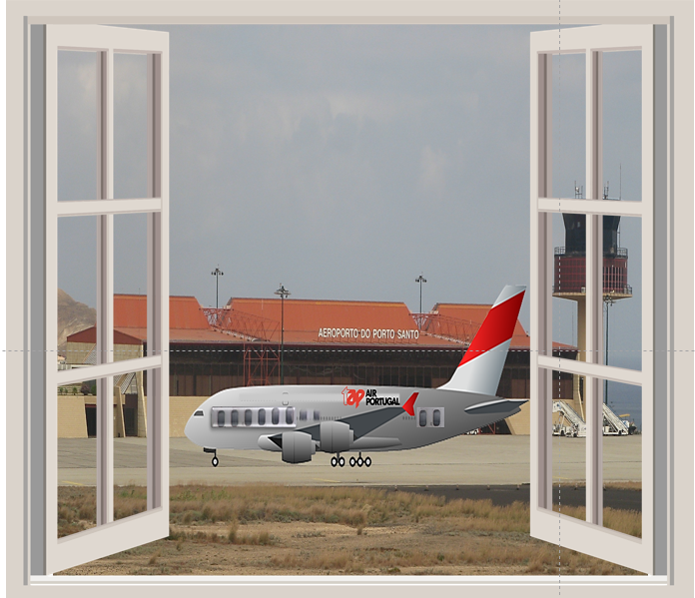


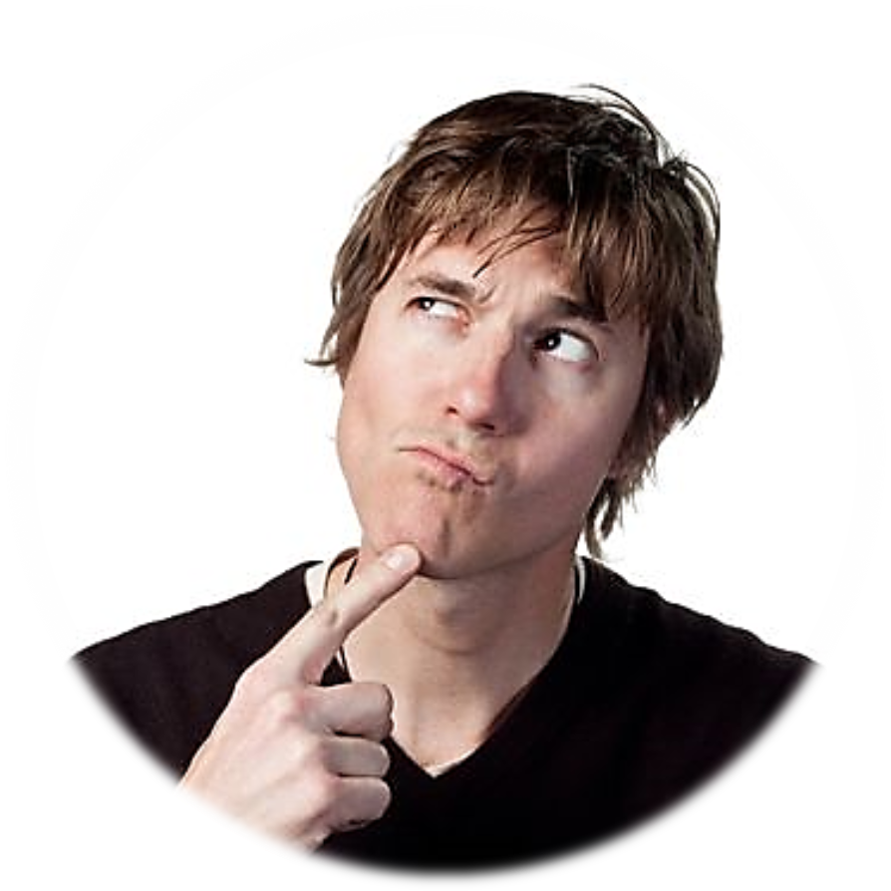
I WONDER WHERE SHE IS AT
THE AIRPORT?

Slide 9
WHEN WE KNOW
THE RELATIVE POSITION
WE CAN ALSO USE
AT
THE HOUSE IS AT THE BEACH NEAR THE SEA

Slide 10


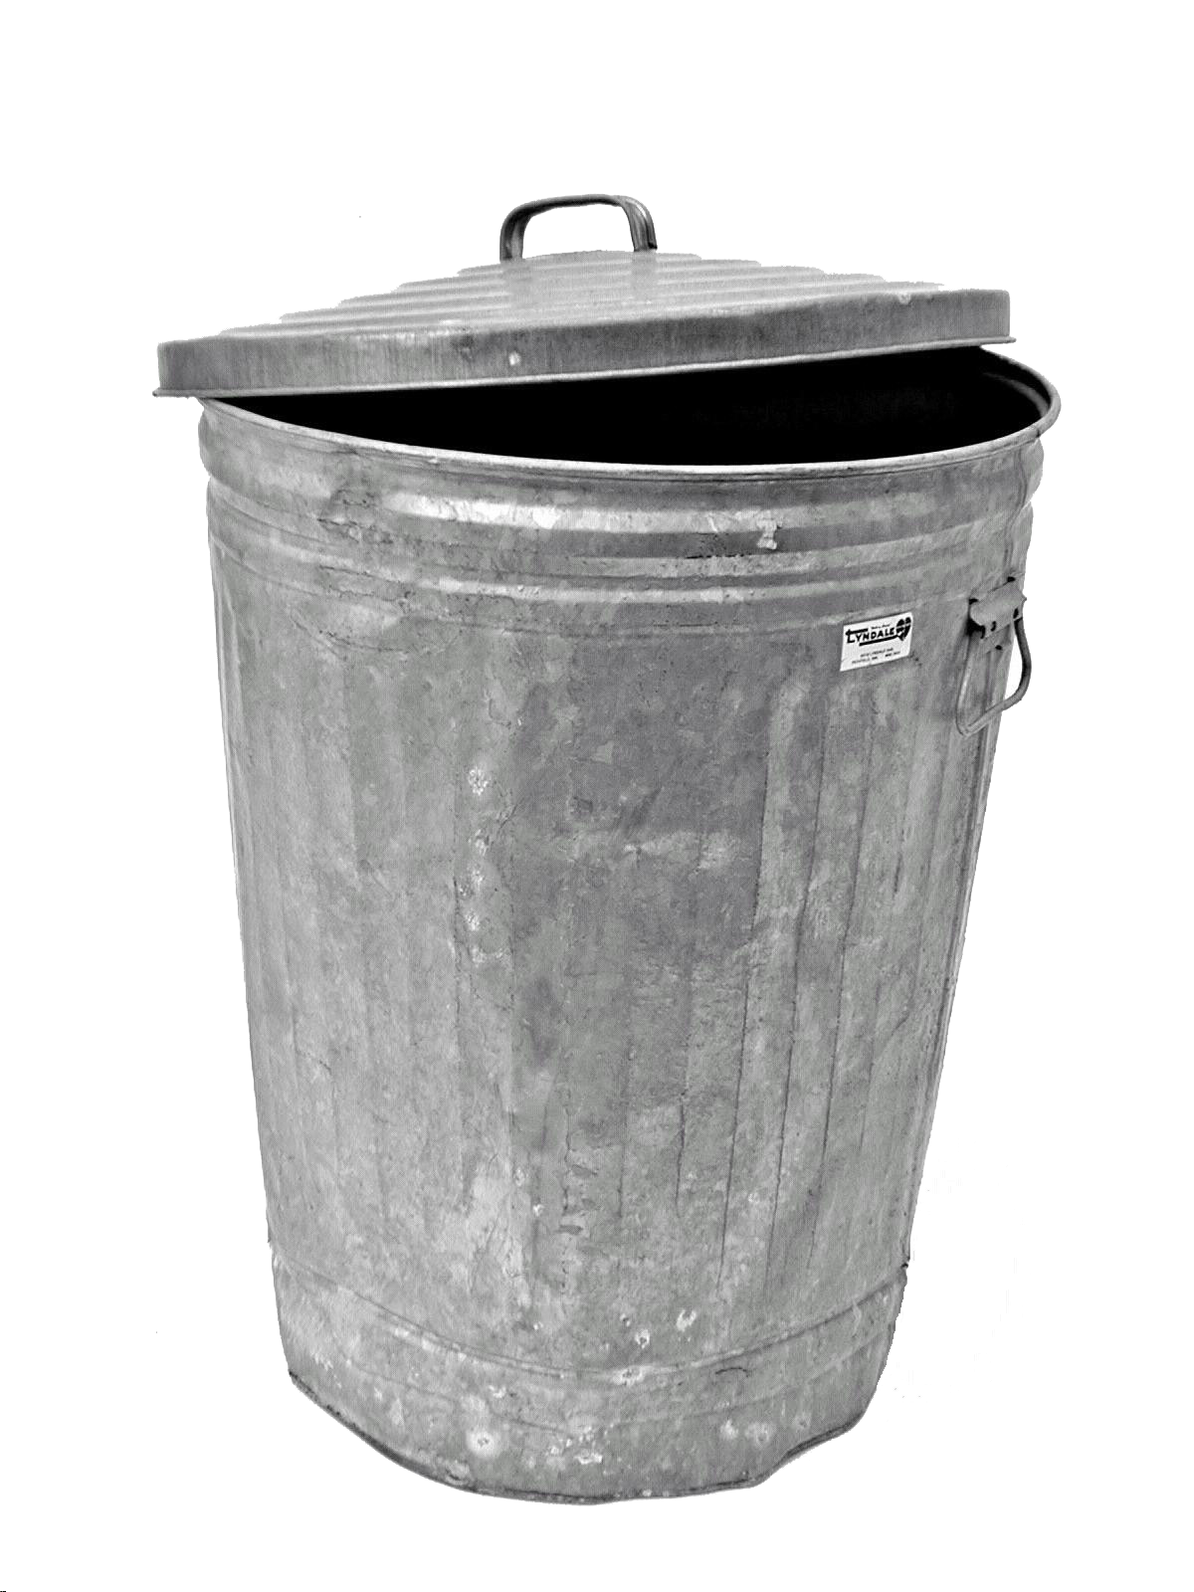



THE TREE IS
AT
THE BACK OF THE HOUSE
THE BIN IS
AT
THE SIDE OF THE HOUSE
THE DOOR IS
AT
THE FRONT OF THE HOUSE
THE HOUSE IS AT THE BEACH NEAR THE SEA
RELATIVE POSITIONS!

Slide 11
WE CAN USE
AT
WHEN WE KNOW
THE SPECIFIC POSITION
EXACTLY

Slide 12

THE TREASURE IS…
AT
THE WHITE ROCKS

Slide 13
THE TREASURE IS…
AT
THE WHITE ROCKS

Slide 14
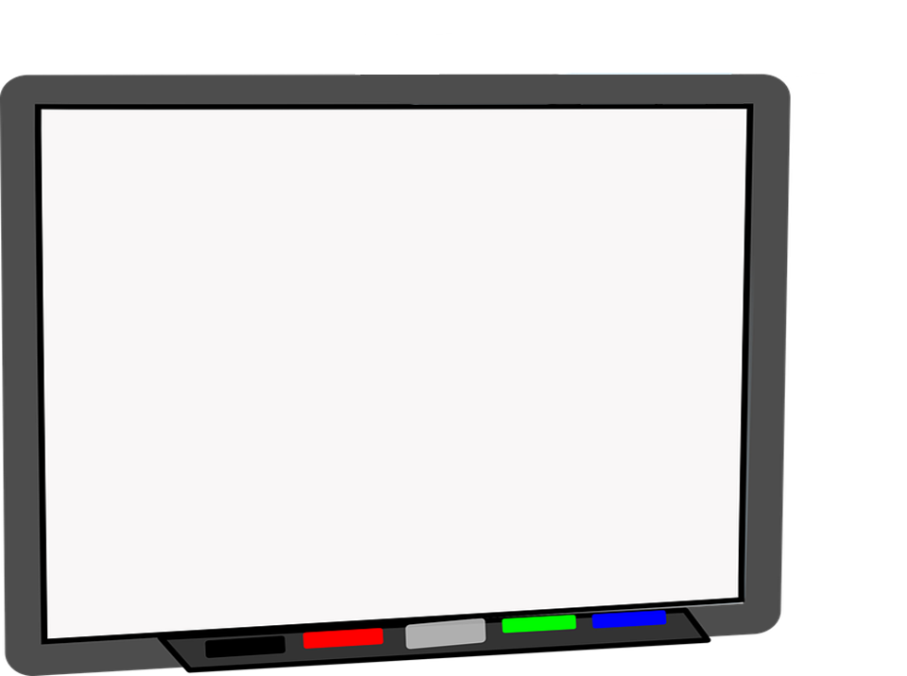
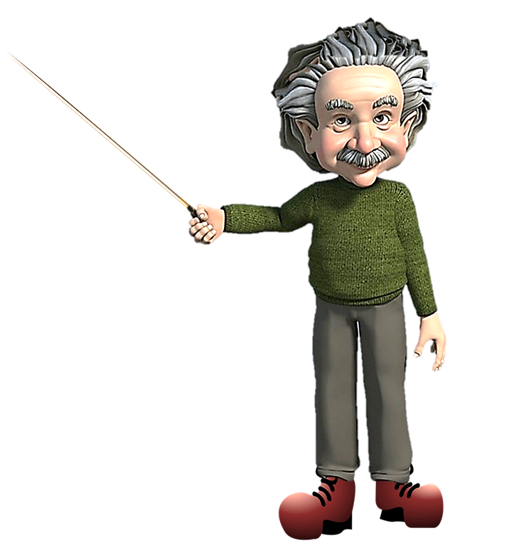
MY EXACT POSITION IS
THIS BOARD!
AT
THE PROFESSOR IS AT THE WHITEBOARD

Slide 15
AT

Slide 16
AT

Slide 17
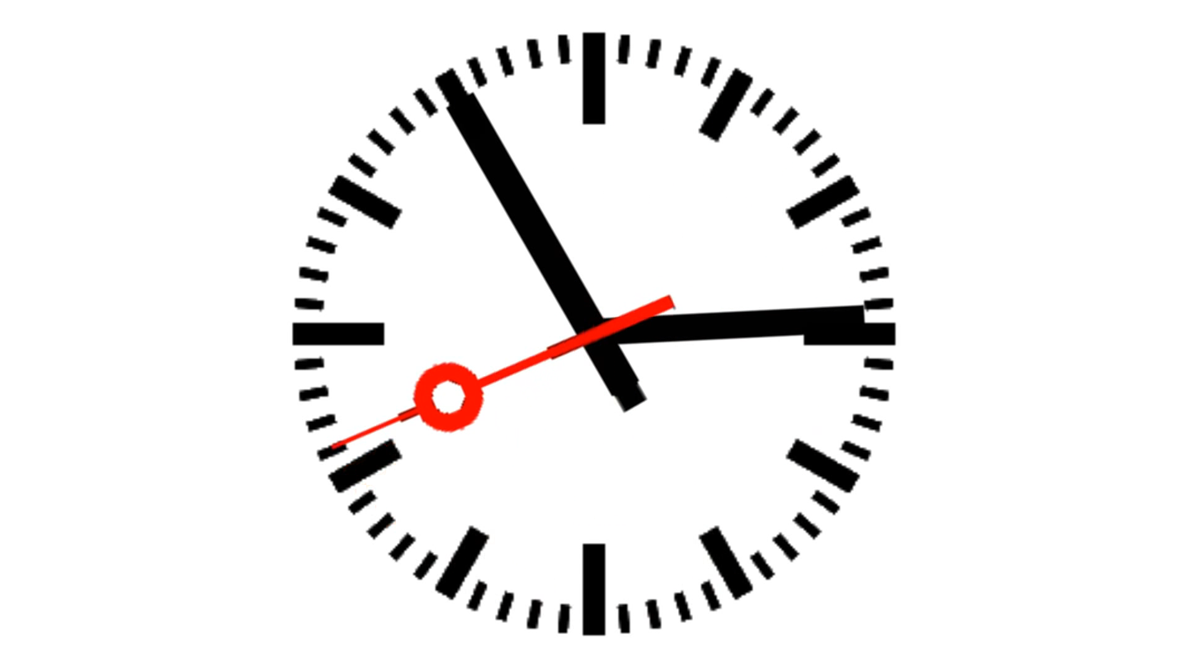
TIME
THE HARBOUR CLOCK WILL CHIME
AT
THREE O’CLOCK
EXACTLY
CHECK THIS WORD

Slide 18
I SAY THAT WORKING AT WEEKENDS IS AWFUL!

Slide 19

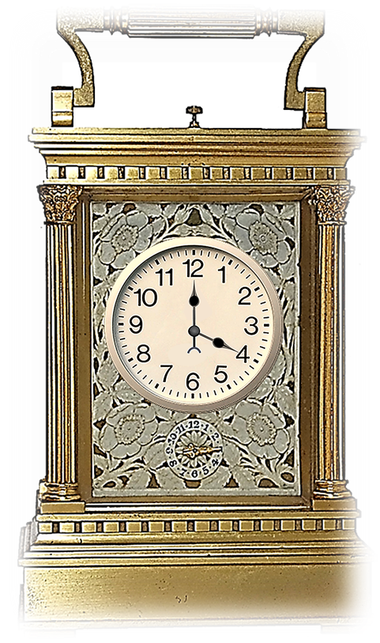


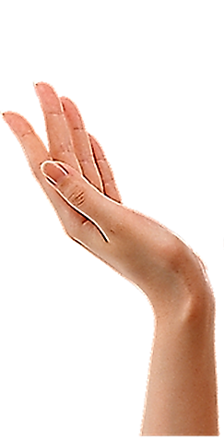



TEA FOUR O’CLOCK IS VERY TRADITIONAL!
IT’S VERY BRITISH!

Slide 21
TYPICAL EXAMPLES!

Slide 23

PREPOSITIONS
AT
MOVEMENT

Slide 24
PREPOSITIONS
AT
AT FOR MOVEMENT SHOWS THE DIRECTION OF MOVEMENT
MOVEMENT

Slide 25
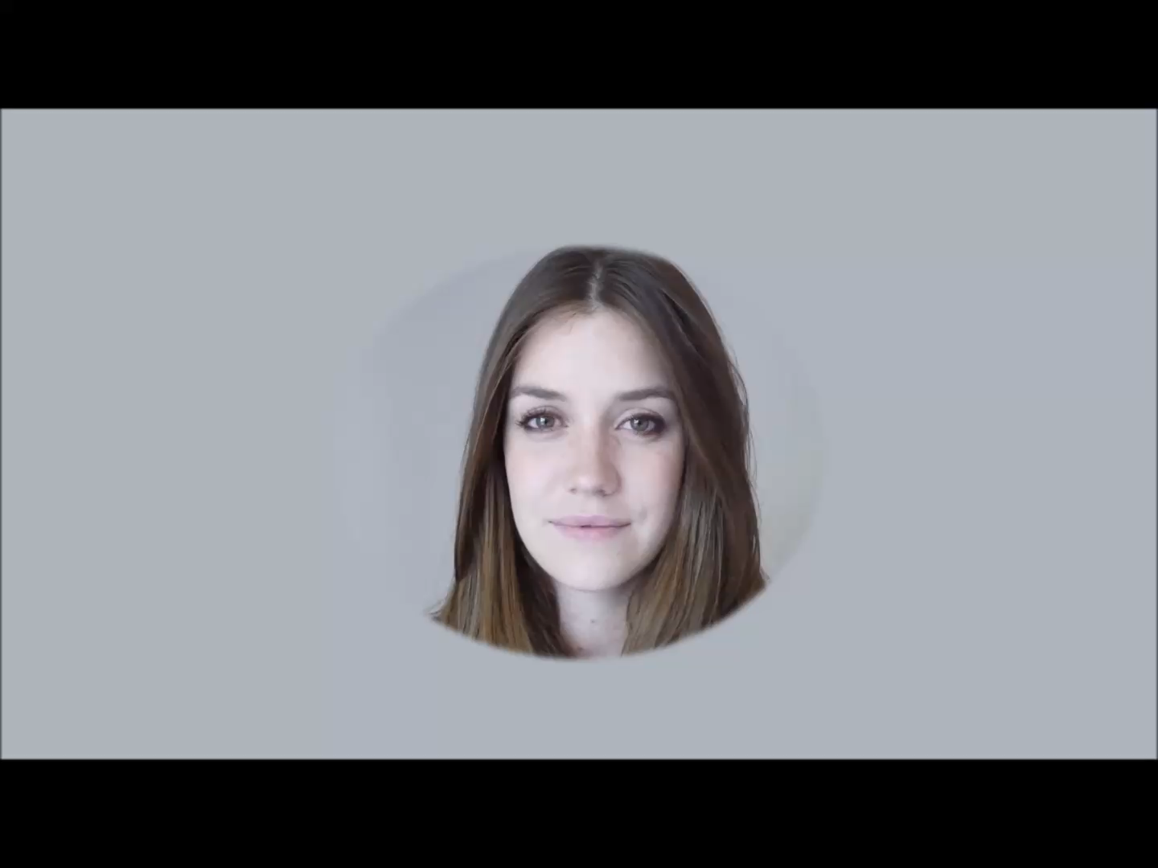


Slide 26
YES I’M LOOKING AT
YOU AND YOU’RE LOOKING AT
ME!

Slide 27
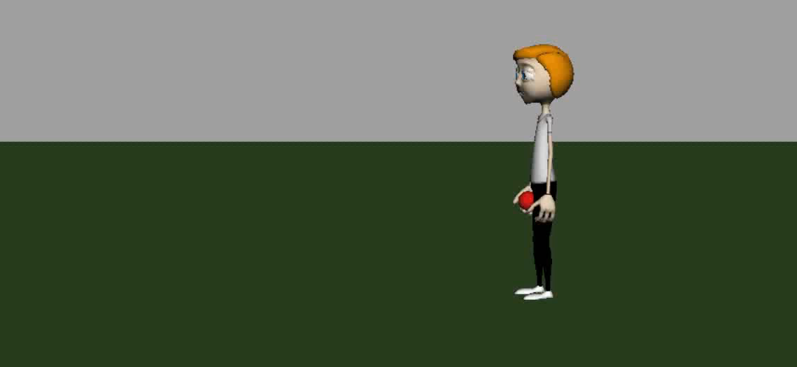
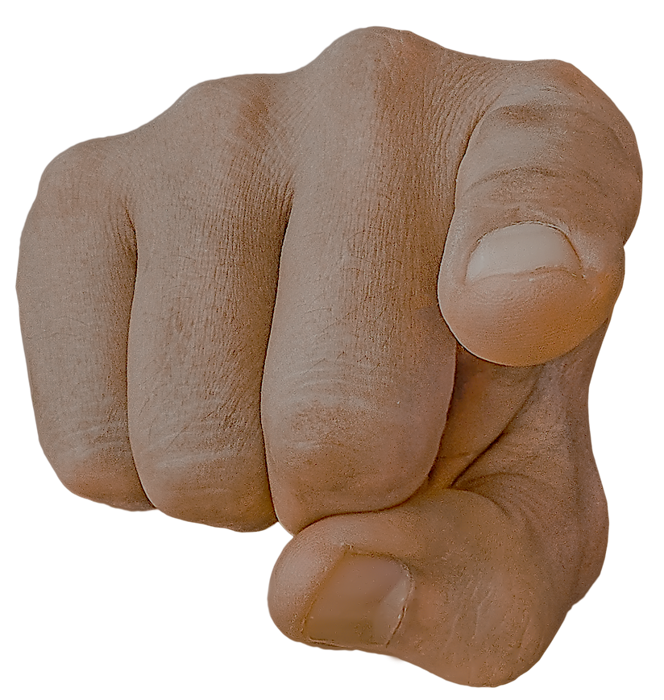
LOOK OUT HE’S GOING TO THROW THE BALL
AT
YOU !
HE’S JUST THROWN THE BALL
AT
YOU !

Slide 28

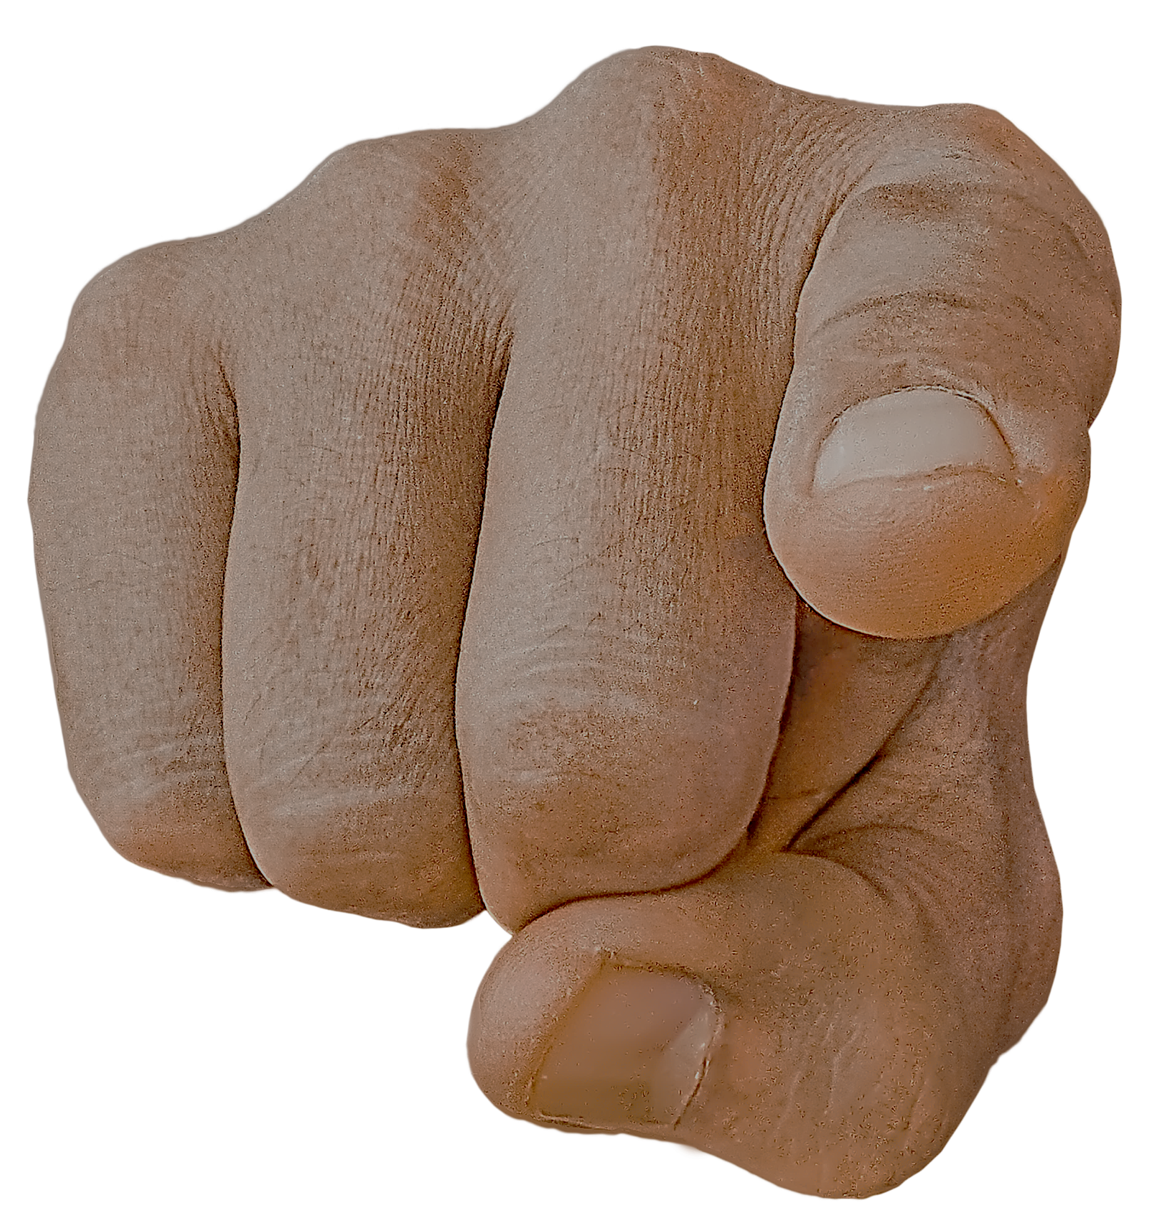


Slide 29


Slide 32


Slide 34
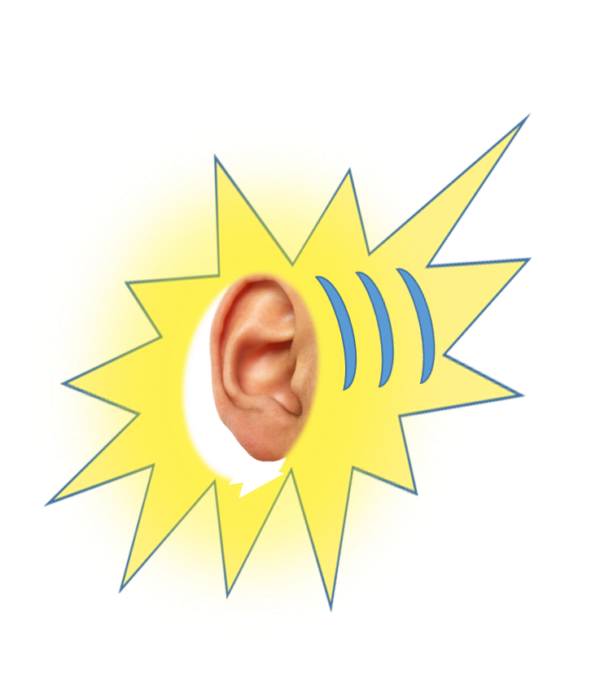

LISTENING PRACTICE
JUST LISTEN...

Slide 36
TYPICAL EXAMPLES!

Slide 37
AT SUMMARY
AT
I’M AT THE THEATRE
ACTUALLY I’M HAVING TEA AT THE BAR
AT
SIX O’CLOCK I’LL LEAVE THE BAR
SALLY THE BAR KEEPER IS SMILING AT ME

Slide 38
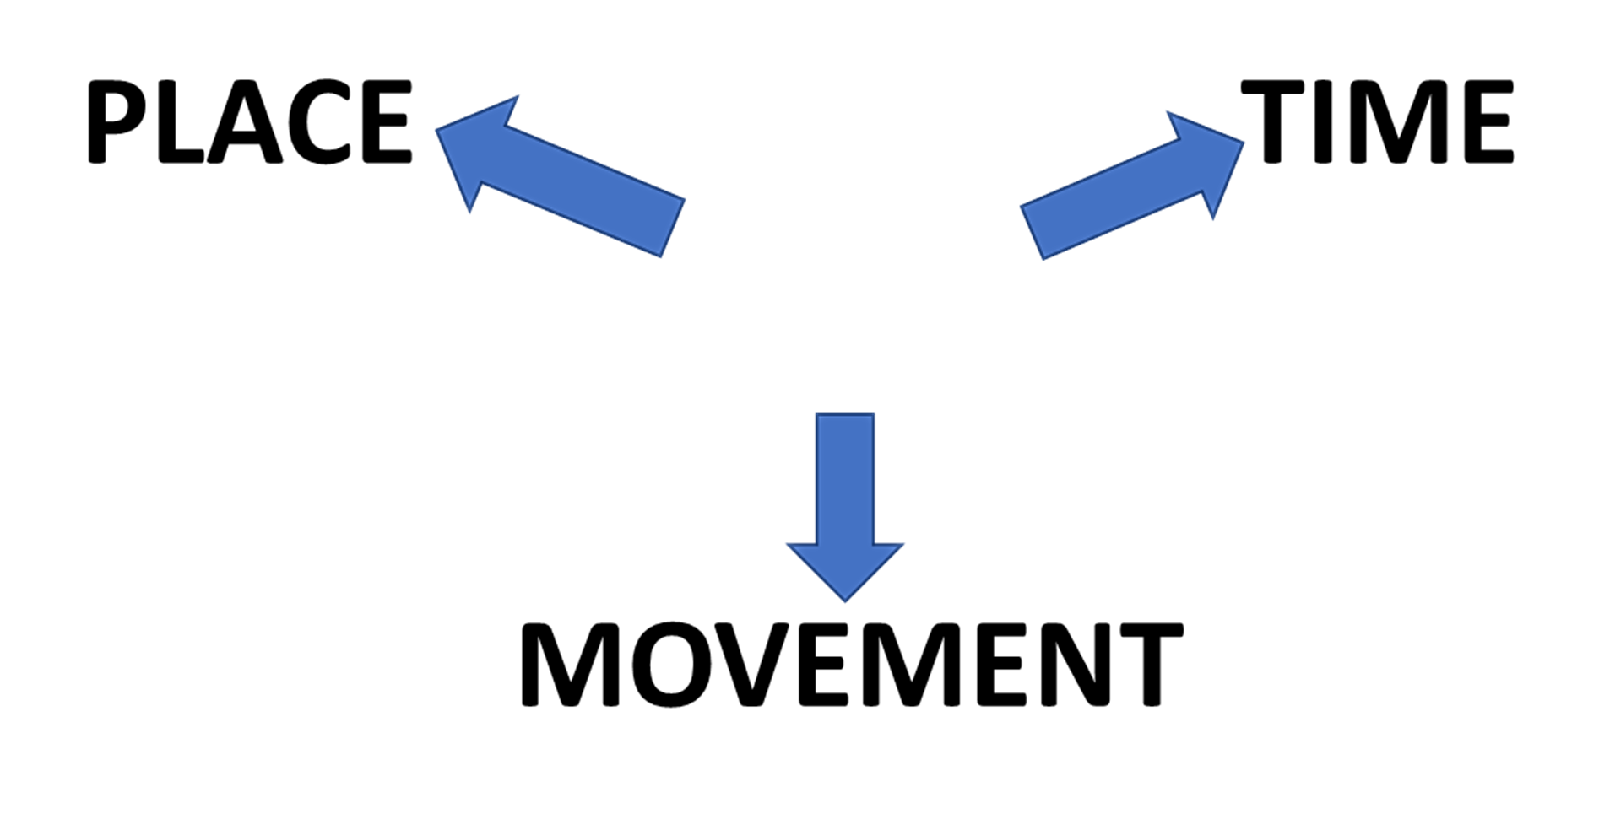
AT SUMMARY
AT
I’M AT THE THEATRE
ACTUALLY I’M HAVING TEA AT THE BAR
AT
SIX O’CLOCK I’LL LEAVE THE BAR
SALLY THE BAR KEEPER IS SMILING AT ME

Slide 39
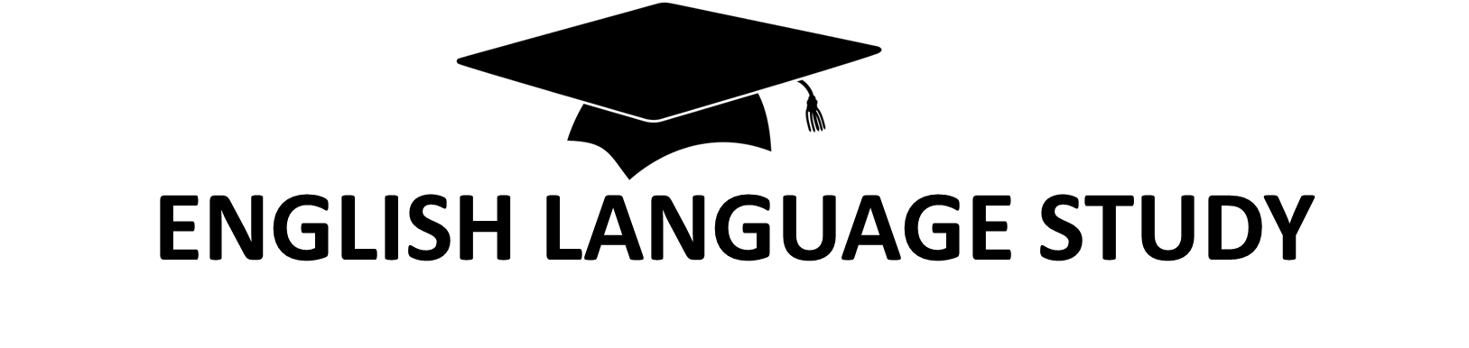

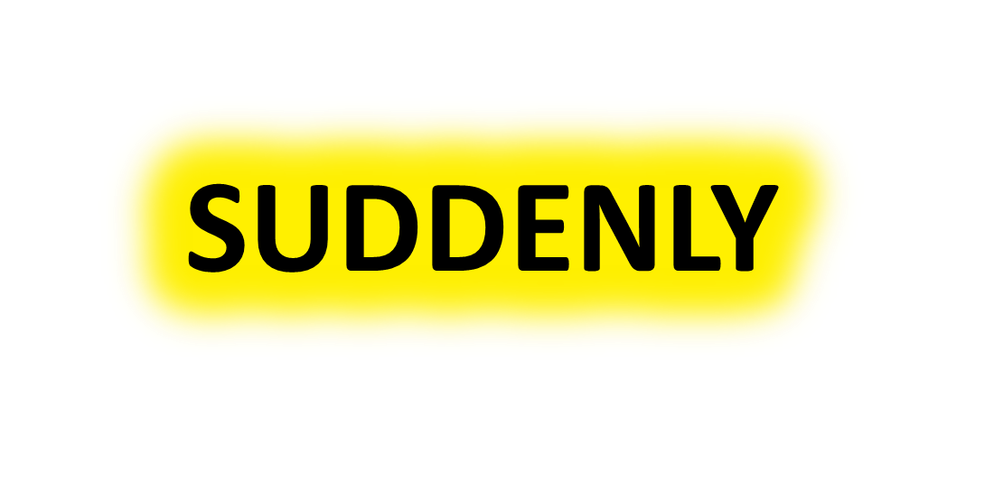
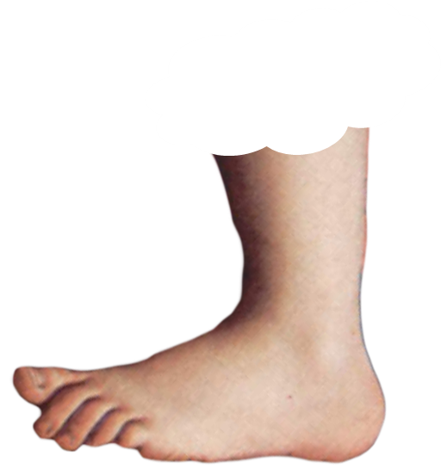
AT THE DROP OF A HAT!
MEANS
FOOTNOTE
FOOTNOTE

Slide 40
THE DICTIONARY NAME FOR THE PAST IN THE FUTURE
IS
THE
FUTURE PERFECT
FOOTNOTE

Slide 43
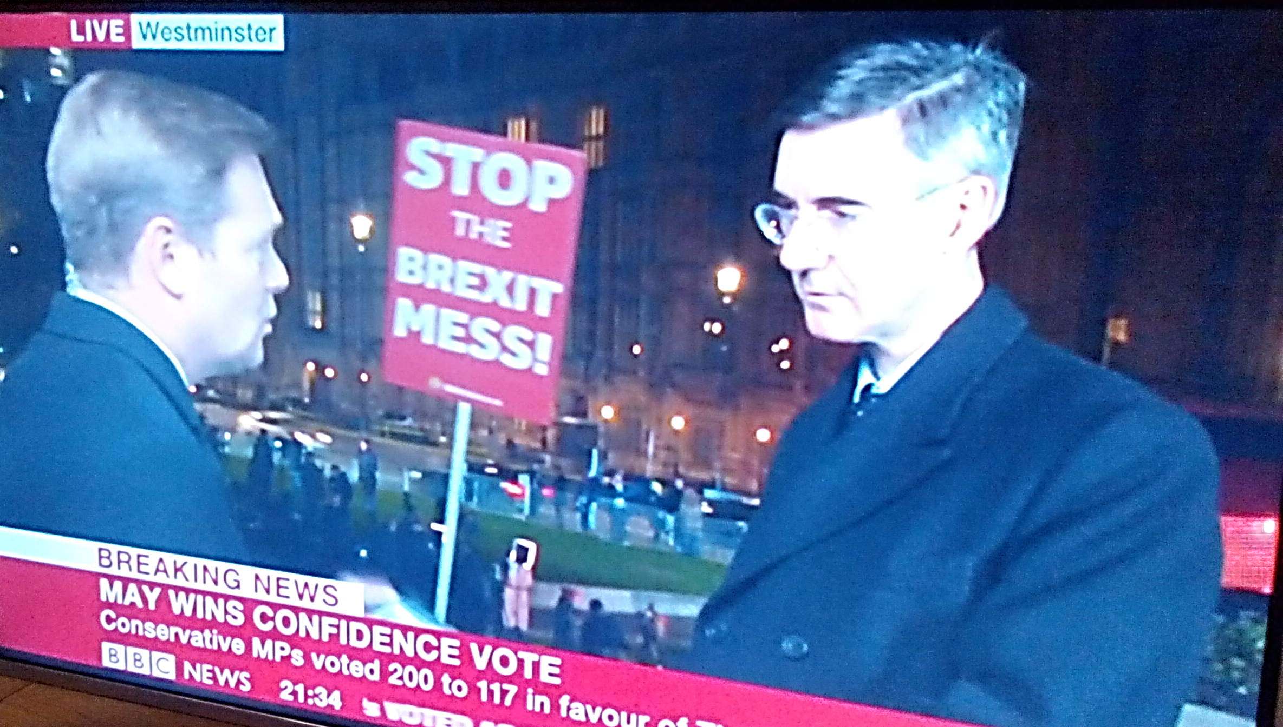

Slide 44


Slide 45
AT
FOR MOVEMENT SHOWS THE DIRECTION OF MOVEMENT

Slide 46
TYPICAL EXAMPLES!

Slide 47
THE BUSINESS MEETING…

