Slide 2
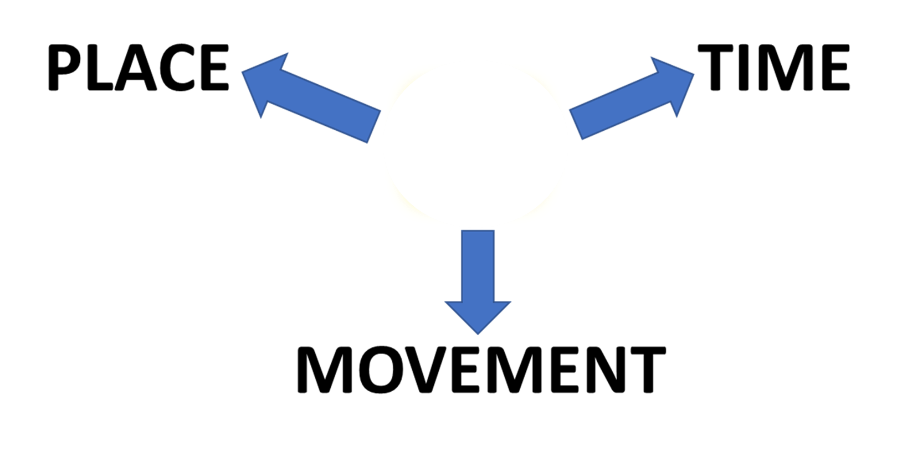

PREPOSITIONS
AT
AT

Slide 3
PREPOSITIONS
AT

Slide 4
PREPOSITIONS
AT
GENERAL
LOCATION
RELATIVE POSITION
SPECIFIC POSITION

Slide 5
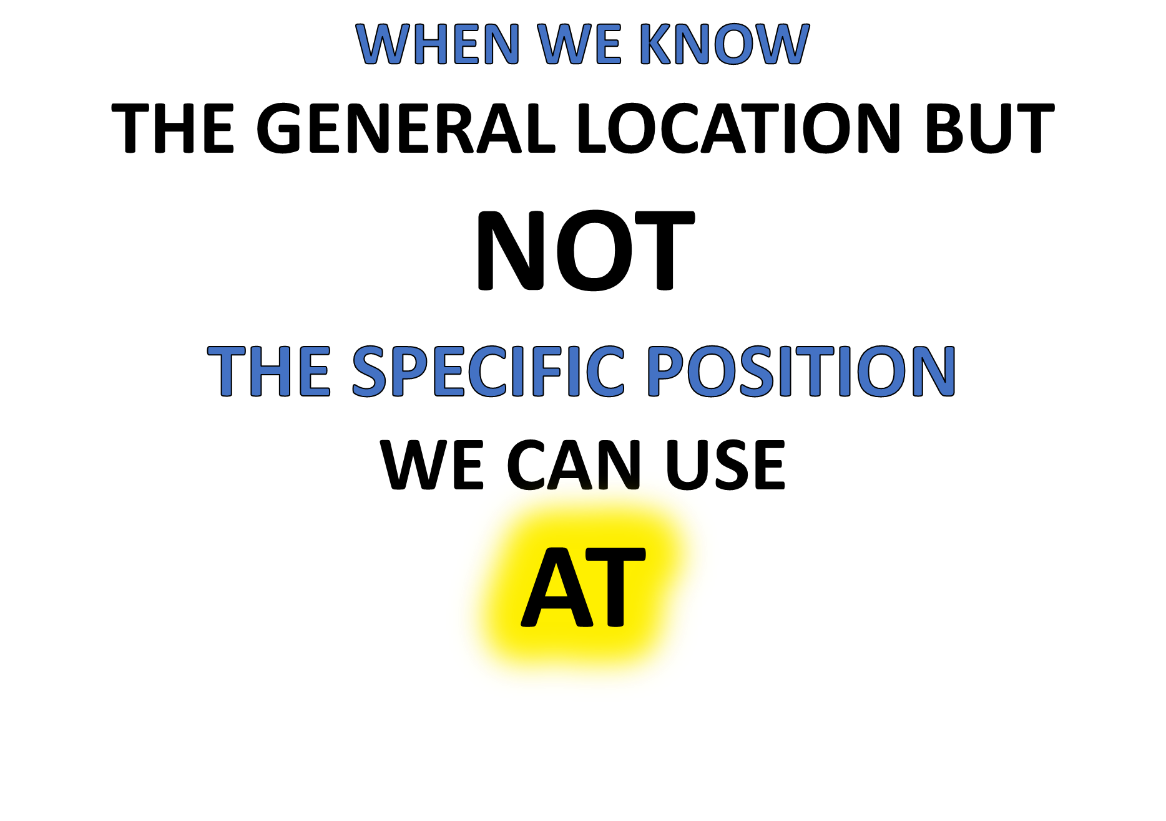
CHECK THIS WORD
“BOB IS AT THE AIRPORT BUT I DON’T KNOW WHEREABOUTS”

Slide 6

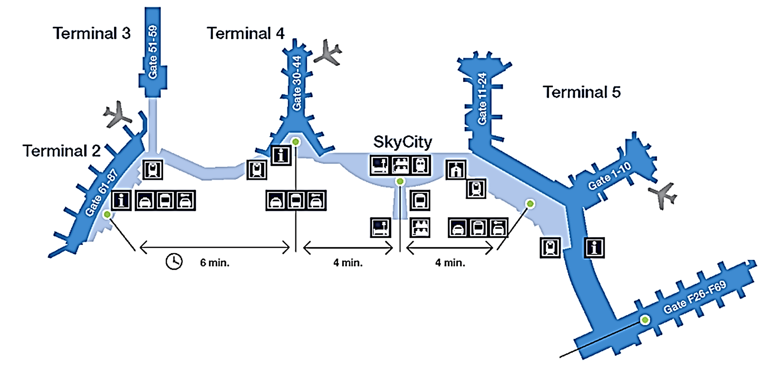
IS HE
AT TERMINAL 3?
AT THE AIRPORT!
IS HE
AT TERMINAL 5?
WHERE IS BOB?
IS HE
AT
THE INFORMATION POINT?

Slide 7
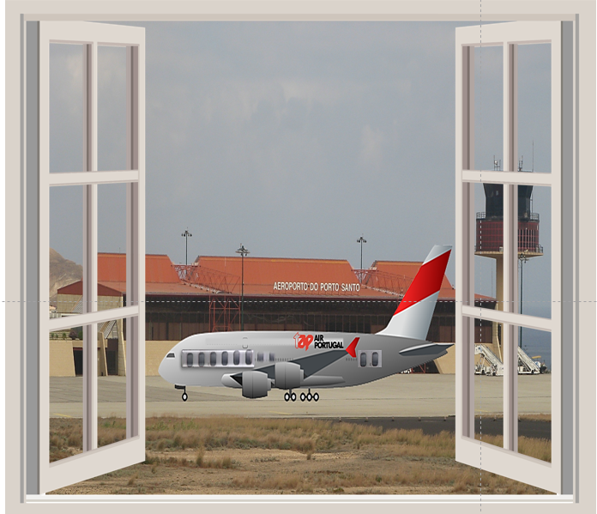



I WONDER WHERE SHE IS AT
THE AIRPORT?

Slide 8
WHEN WE KNOW
THE RELATIVE POSITION
WE CAN ALSO USE
AT
THE HOUSE IS AT THE BEACH NEAR THE SEA

Slide 9


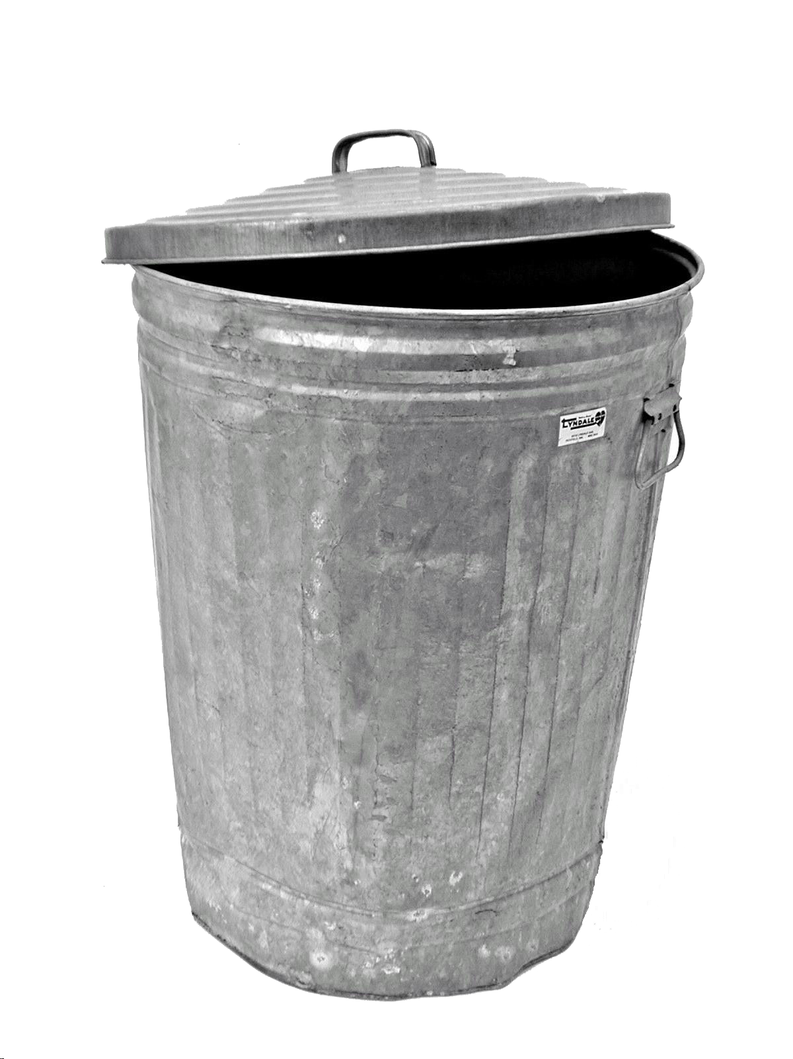



THE TREE IS
AT
THE BACK OF THE HOUSE
THE BIN IS
AT
THE SIDE OF THE HOUSE
THE DOOR IS
AT
THE FRONT OF THE HOUSE
THE HOUSE IS AT THE BEACH NEAR THE SEA
RELATIVE POSITIONS!

Slide 10
TYPICAL EXAMPLES!

Slide 11
DD
WE CAN USE
AT
WHEN WE KNOW
THE SPECIFIC POSITION
EXACTLY

Slide 12
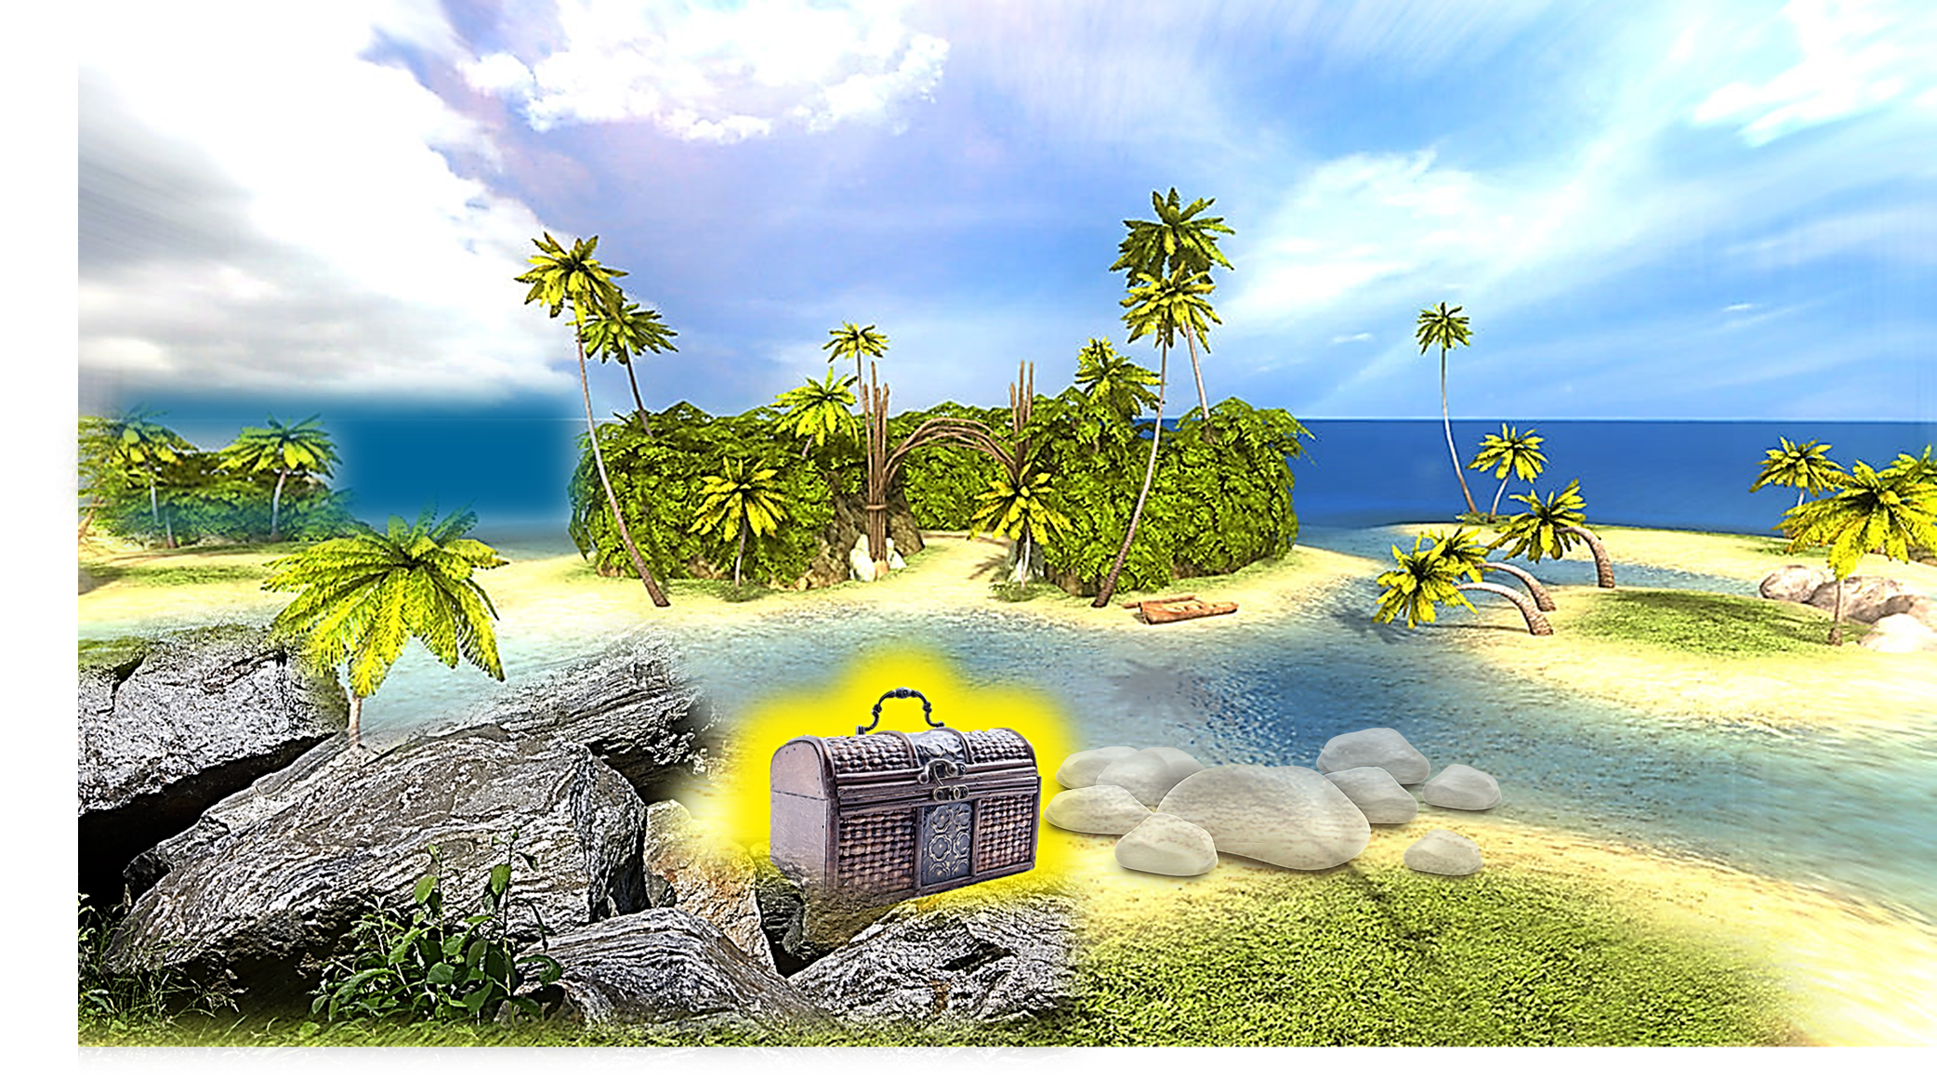
THE TREASURE IS…
AT
THE WHITE ROCKS

Slide 13
THE TREASURE IS…
AT
THE WHITE ROCKS

Slide 14
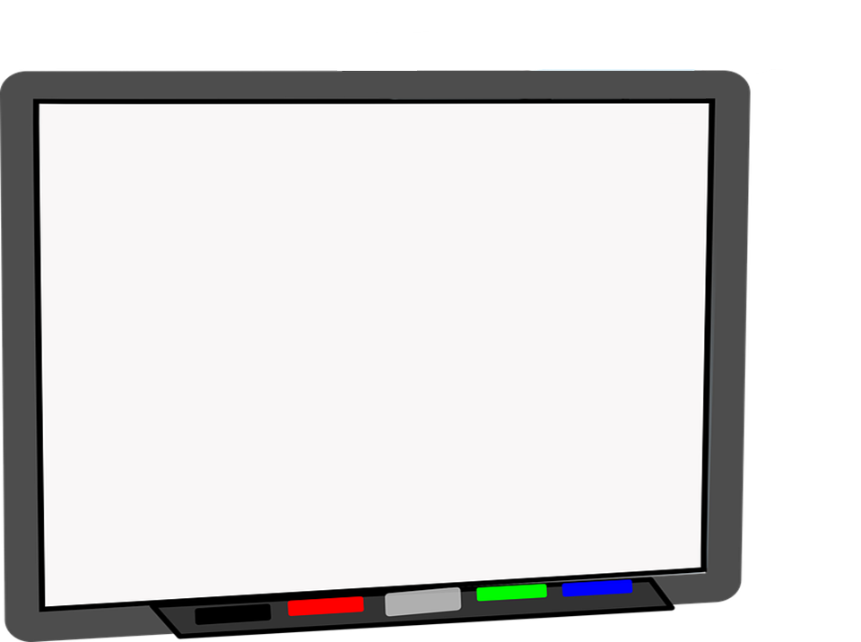
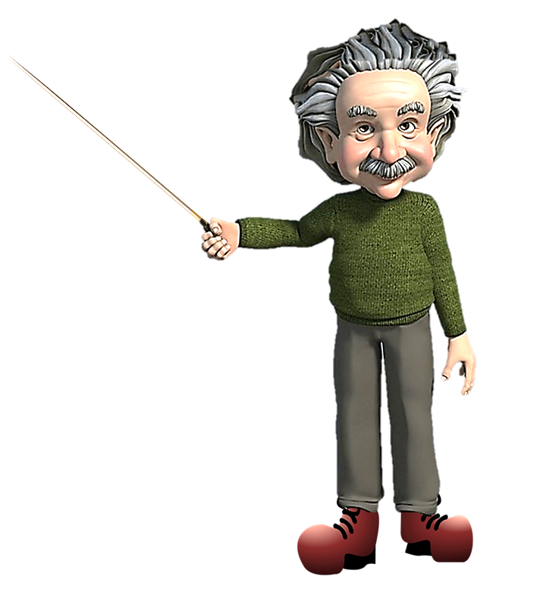
MY EXACT POSITION IS
THIS BOARD!
AT
THE PROFESSOR IS AT THE WHITEBOARD

Slide 15
TYPICAL EXAMPLES!

Slide 16
AT

Slide 17
AT

Slide 18

TIME
THE HARBOUR CLOCK WILL CHIME
AT
THREE O’CLOCK
EXACTLY
CHECK THIS WORD

Slide 19
I SAY THAT WORKING AT WEEKENDS IS AWFUL!

Slide 20

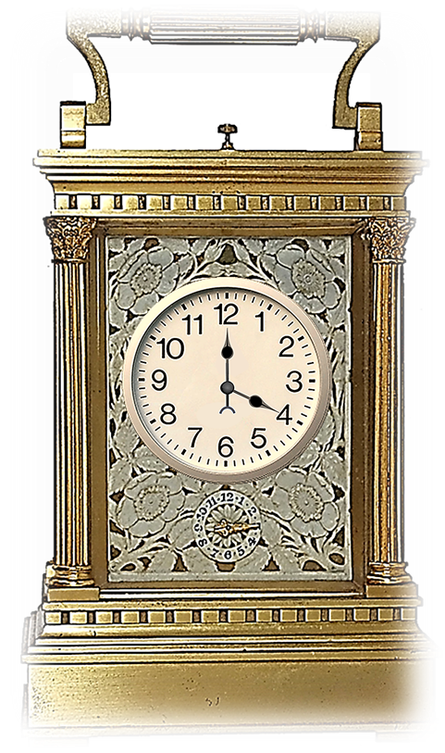


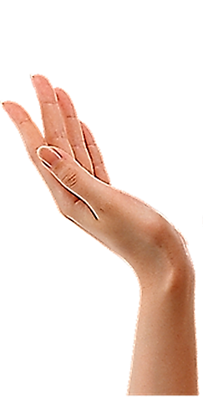


TEA FOUR O’CLOCK IS VERY TRADITIONAL!
IT’S VERY BRITISH!

Slide 21
TYPICAL EXAMPLES!

Slide 23
AT

Slide 24
PREPOSITIONS
AT
AT FOR MOVEMENT SHOWS THE DIRECTION OF MOVEMENT
MOVEMENT

Slide 25
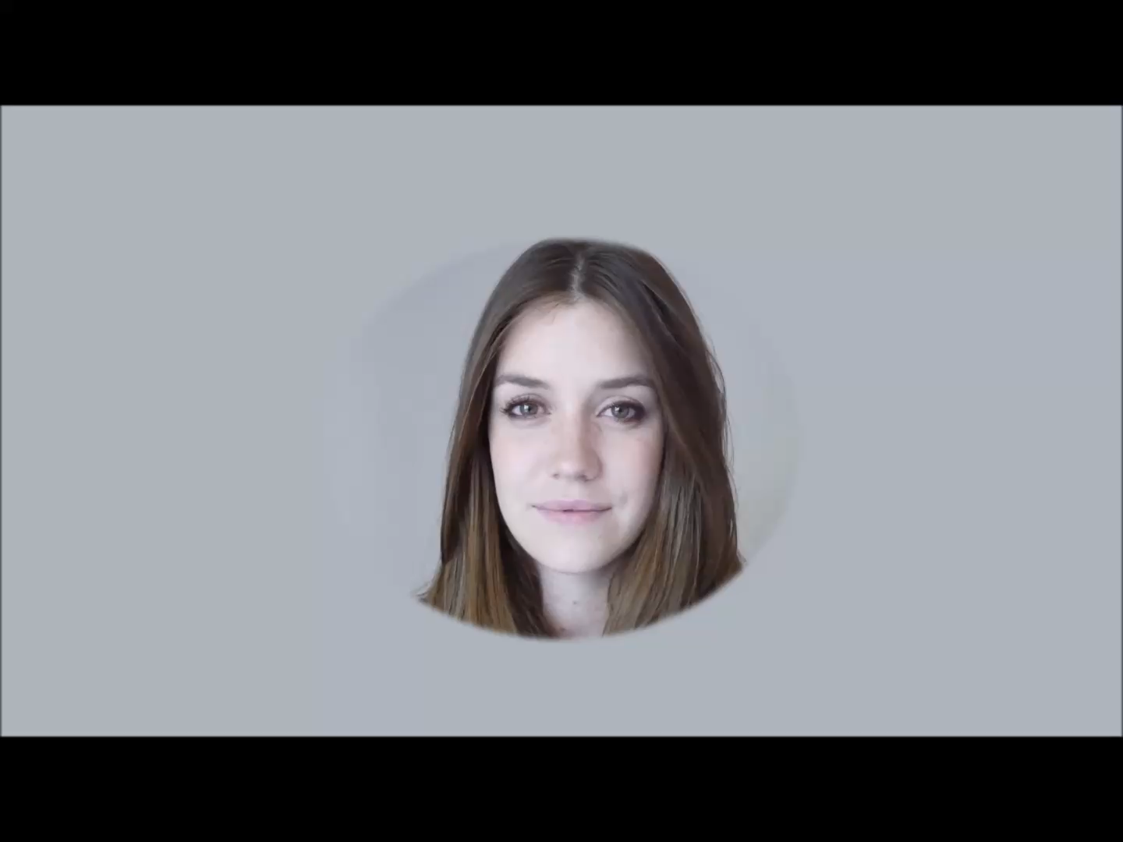


Slide 27




Slide 28

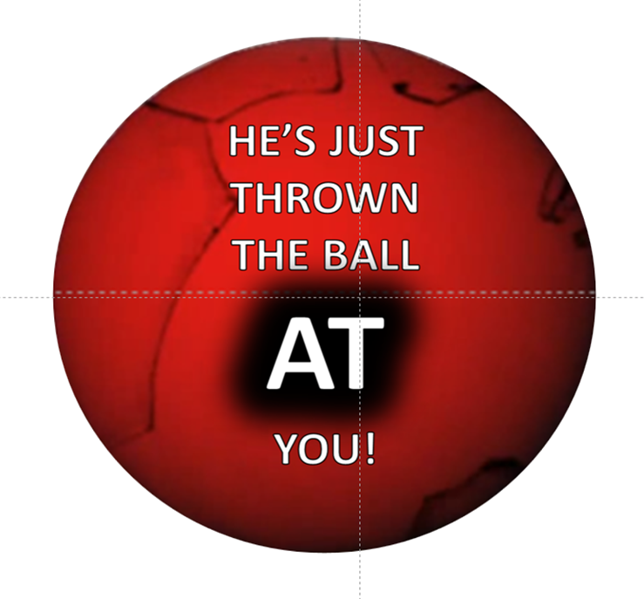
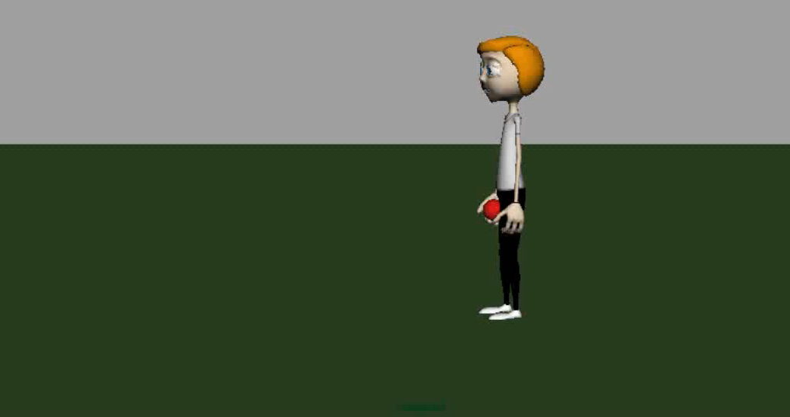

Slide 31


LISTENING PRACTICE
JUST LISTEN...

Slide 33
TYPICAL EXAMPLES!

Slide 34
AT SUMMARY
AT

Slide 35



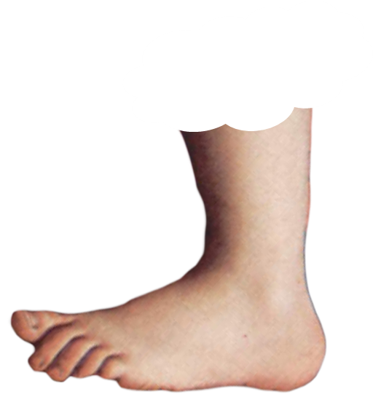
AT THE DROP OF A HAT!
MEANS
FOOTNOTE
FOOTNOTE

Slide 36
THE DICTIONARY NAME FOR THE PAST IN THE FUTURE
IS
THE
FUTURE PERFECT
FOOTNOTE

Slide 40


Slide 41
AT
FOR MOVEMENT SHOWS THE DIRECTION OF MOVEMENT

Slide 42
THE BUSINESS MEETING…

