Slide 3
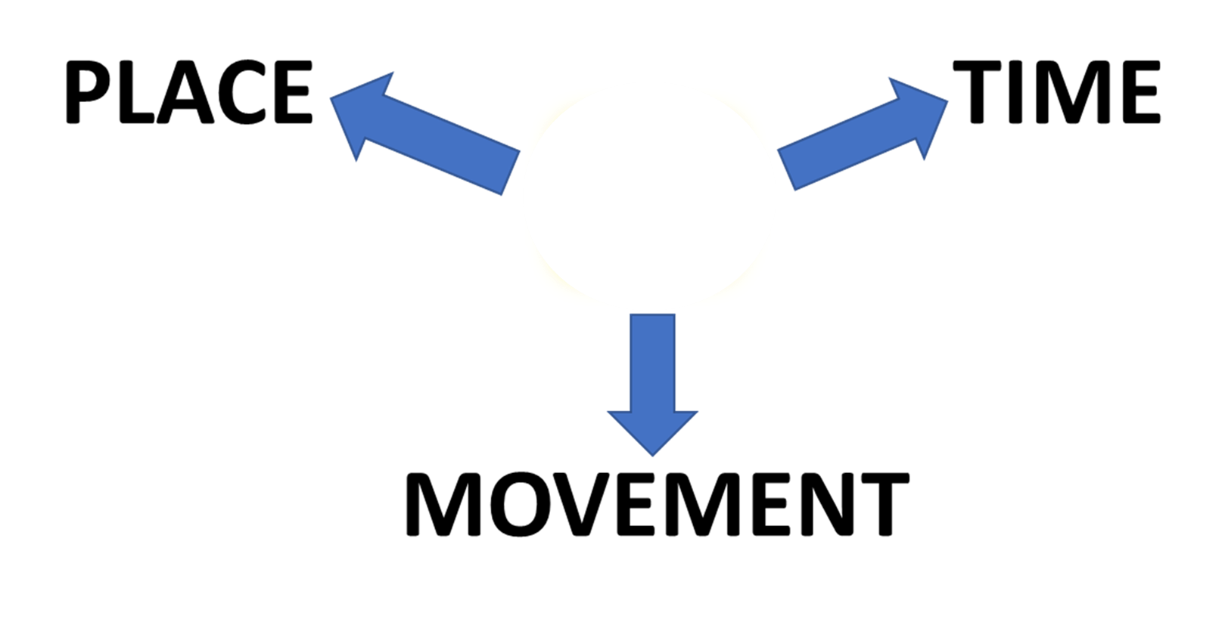

PREPOSITIONS
AT
AT

Slide 4
PREPOSITIONS
AT

Slide 5
PREPOSITIONS
AT
GENERAL
LOCATION
RELATIVE POSITION
SPECIFIC POSITION

Slide 6
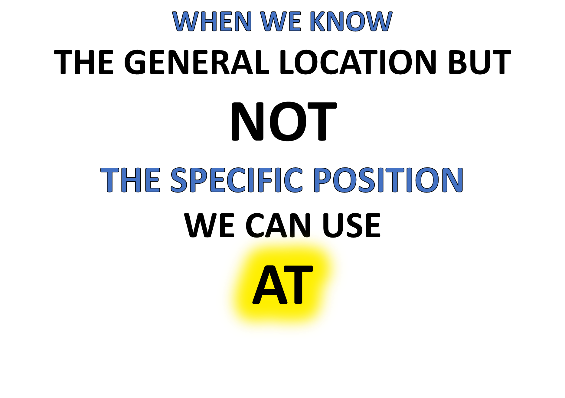
CHECK THIS WORD
“BOB IS AT THE AIRPORT BUT I DON’T KNOW WHEREABOUTS”

Slide 7

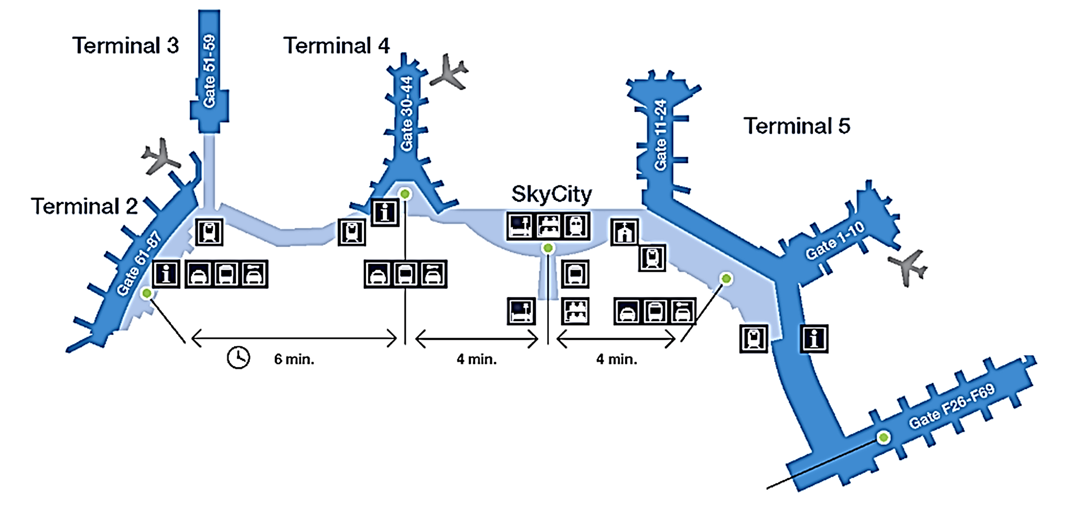
IS HE
AT TERMINAL 3?
AT THE AIRPORT!
IS HE
AT TERMINAL 5?
WHERE IS BOB?
IS HE
AT
THE INFORMATION POINT?

Slide 8
TYPICAL EXAMPLES
PLACE
TYPICAL EXAMPLE
TYPICAL EXAMPLE
TIME
TYPICAL EXAMPLE
MOVEMENT

Slide 9
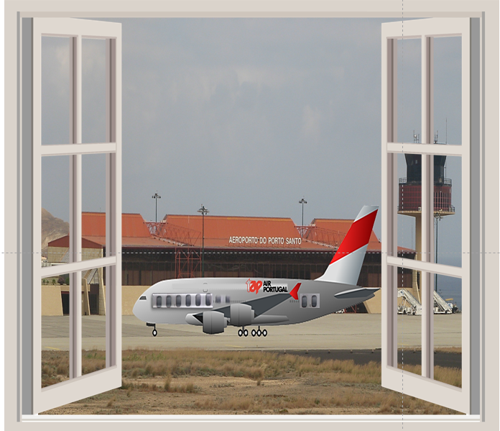



I WONDER WHERE SHE IS AT
THE AIRPORT?

Slide 10
WHEN WE KNOW
THE RELATIVE POSITION
WE CAN ALSO USE
AT
THE HOUSE IS AT THE BEACH NEAR THE SEA

Slide 11


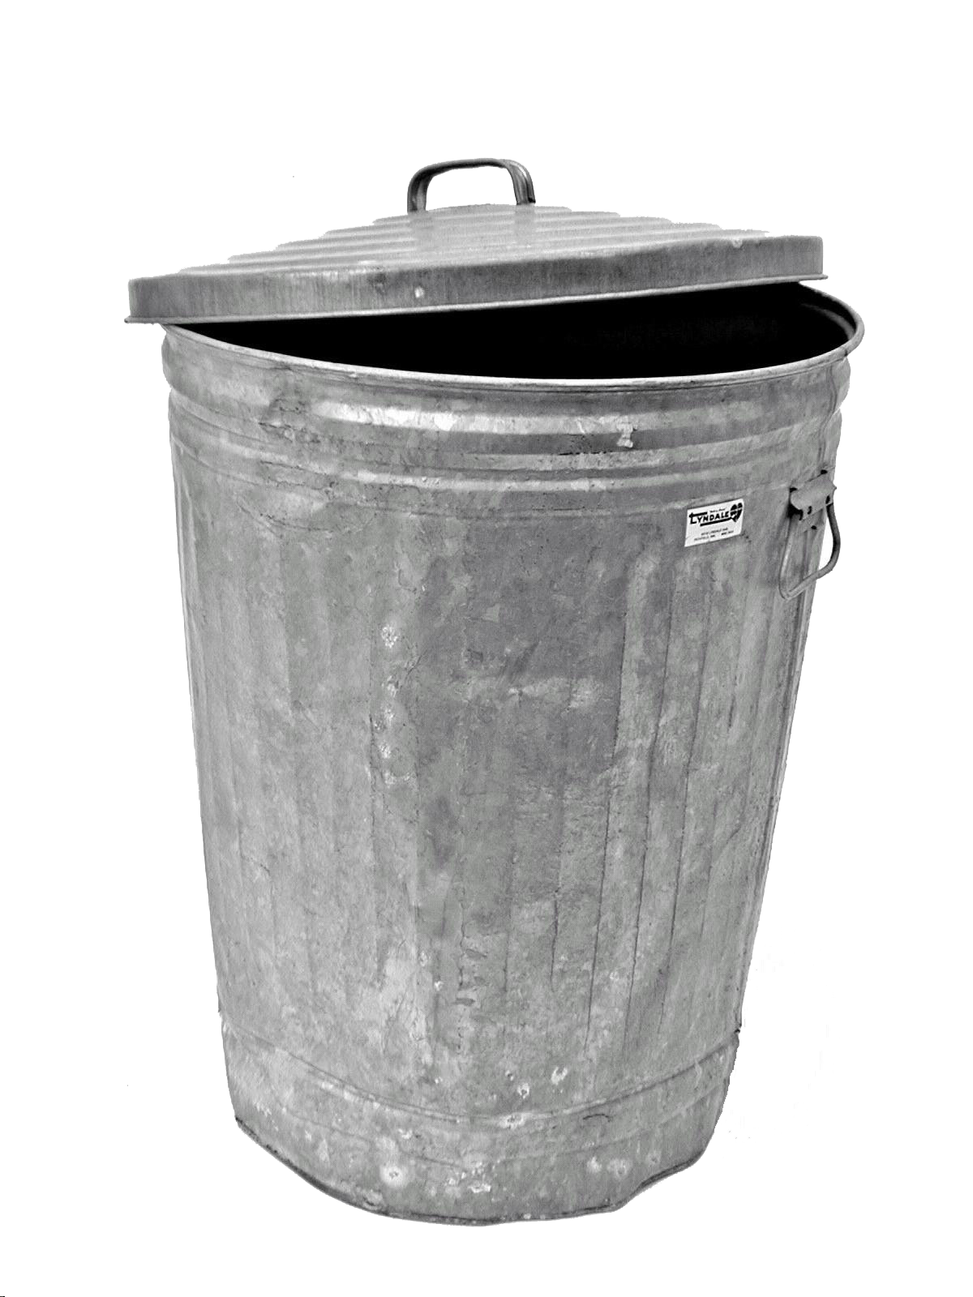



THE TREE IS
AT
THE BACK OF THE HOUSE
THE BIN IS
AT
THE SIDE OF THE HOUSE
THE DOOR IS
AT
THE FRONT OF THE HOUSE
THE HOUSE IS AT THE BEACH NEAR THE SEA
RELATIVE POSITIONS!

Slide 12
TYPICAL EXAMPLES
PLACE
TYPICAL EXAMPLE
TYPICAL EXAMPLE
TIME
TYPICAL EXAMPLE
MOVEMENT

Slide 13
TYPICAL EXAMPLES!

Slide 14
WE CAN USE
AT
WHEN WE KNOW
THE SPECIFIC POSITION
EXACTLY

Slide 15

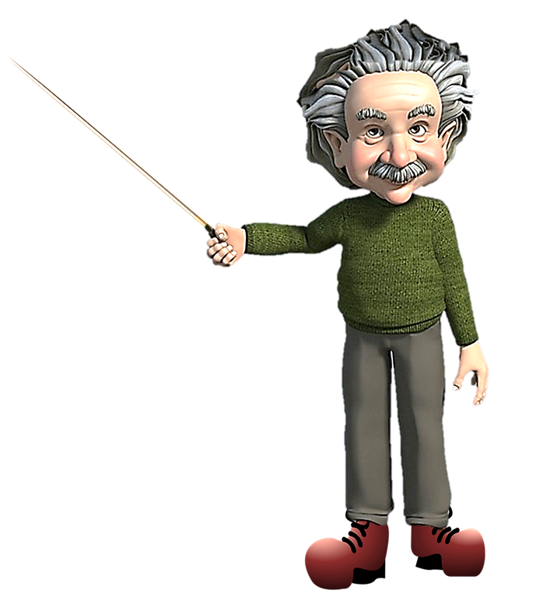
MY EXACT POSITION IS
AT
THIS BOARD!
AT
THE PROFESSOR IS AT THE WHITEBOARD

Slide 16
TYPICAL EXAMPLES
PLACE
TYPICAL EXAMPLE
TYPICAL EXAMPLE
TIME
TYPICAL EXAMPLE
MOVEMENT

Slide 17
TYPICAL EXAMPLES!

Slide 18
TYPICAL EXAMPLES!

Slide 19
PREPOSITIONS
TIME
AT

Slide 20

TIME
THE HARBOUR CLOCK WILL CHIME
AT
THREE O’CLOCK
EXACTLY

Slide 21

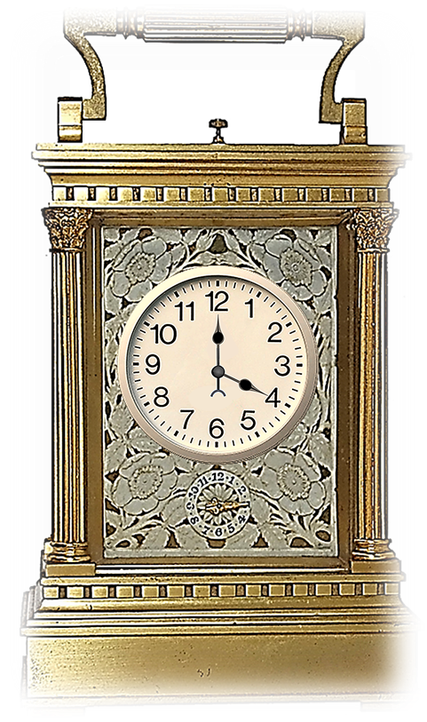


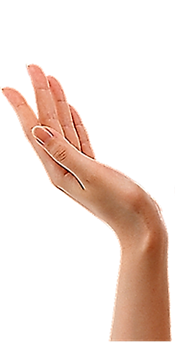

TEA FOUR O’CLOCK IS VERY TRADITIONAL!
IT’S VERY BRITISH!

Slide 22
TEA AT FOUR O’CLOCK IS VERY TRADITIONAL!
IN MANY PARTS OF THE ENGLISH SPEAKING WORLD!

Slide 23
TYPICAL EXAMPLES
PLACE
TYPICAL EXAMPLE
TYPICAL EXAMPLE
TIME
TYPICAL EXAMPLE
MOVEMENT

Slide 24
TYPICAL EXAMPLES!

Slide 25
TYPICAL EXAMPLES!

Slide 27
PREPOSITIONS
AT
AT FOR MOVEMENT SHOWS THE DIRECTION OF MOVEMENT
MOVEMENT

Slide 28
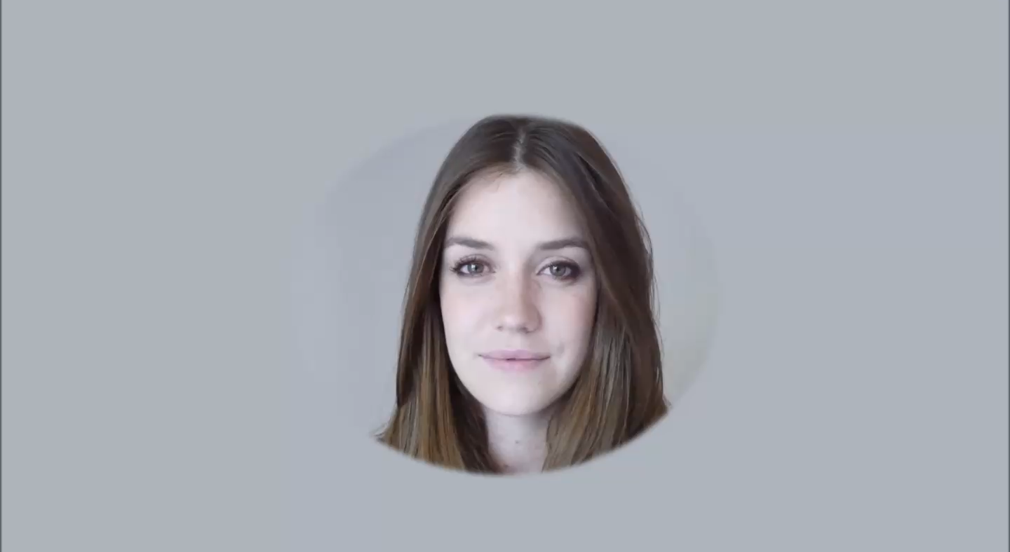


Slide 29




Slide 30


Slide 31
AT
FOR MOVEMENT SHOWS THE DIRECTION OF MOVEMENT

Slide 32
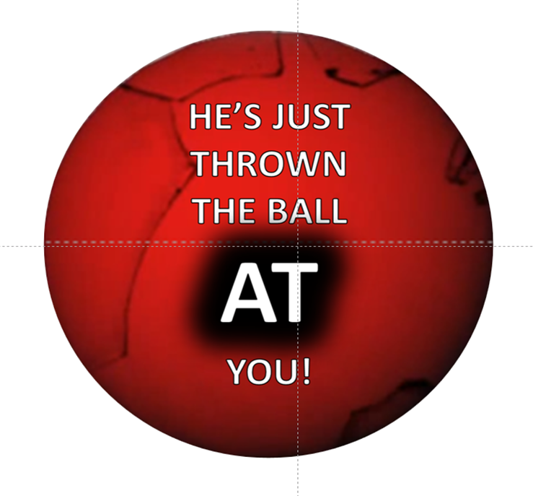
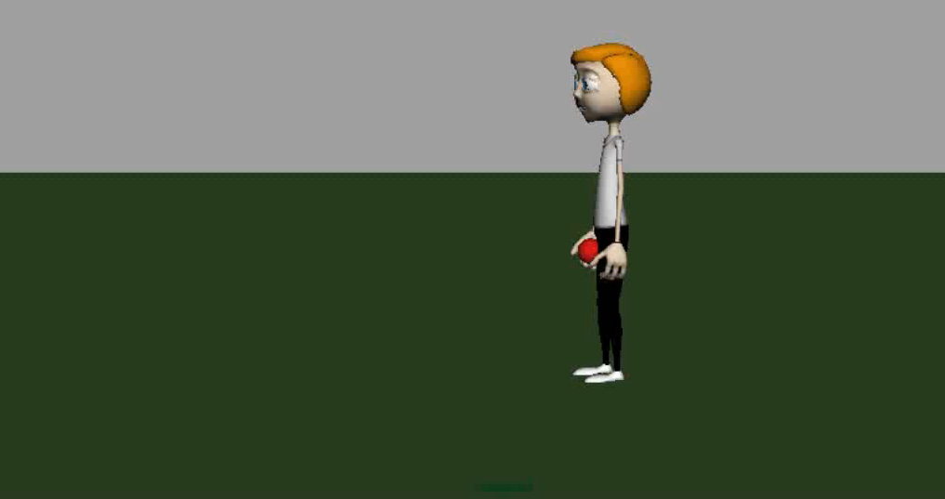

Slide 33
TYPICAL EXAMPLES
PLACE
TYPICAL EXAMPLE
TYPICAL EXAMPLE
TIME
TYPICAL EXAMPLE
MOVEMENT

Slide 36
TYPICAL EXAMPLES!

Slide 37
AT SUMMARY
AT

Slide 41



