Slide 1
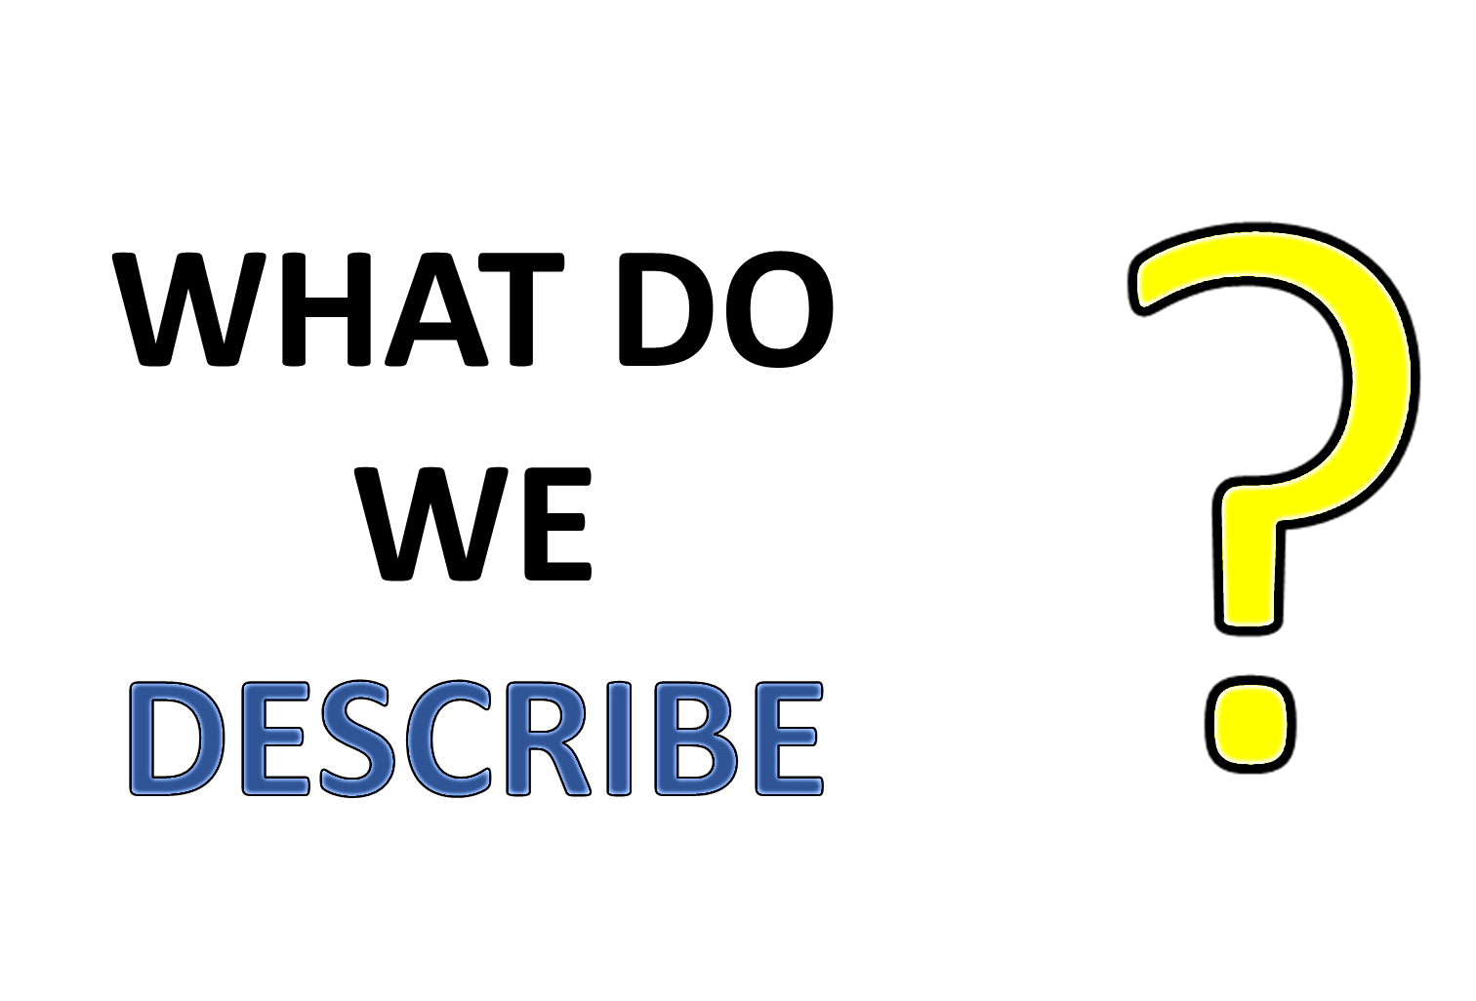

Slide 2
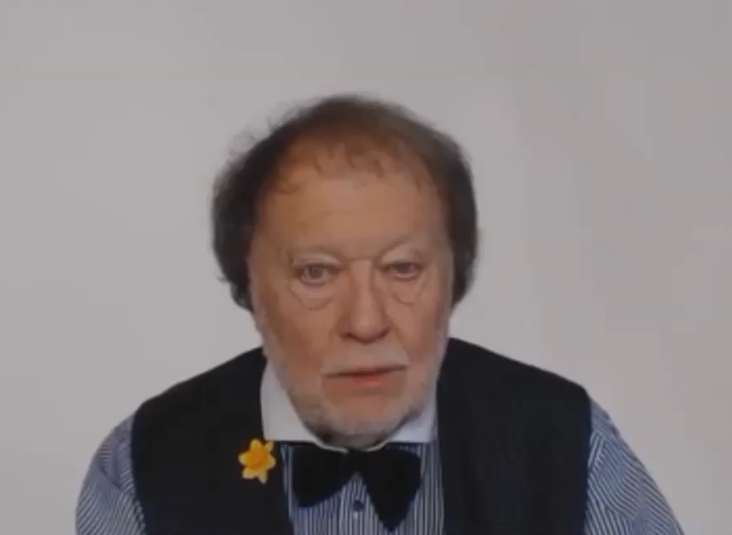

Slide 3
LET’S FIND OUT ABOUT
NOUNS AND VERBS
ADJECTIVES AND ADVERBS
FOUR IMPORTANT PARTS OF SPEECH

Slide 4
USING ADJECTIVES AND ADVERBS
WHAT IS AN ADJECTIVE?
WHAT IS AN ADVERB?

Slide 5

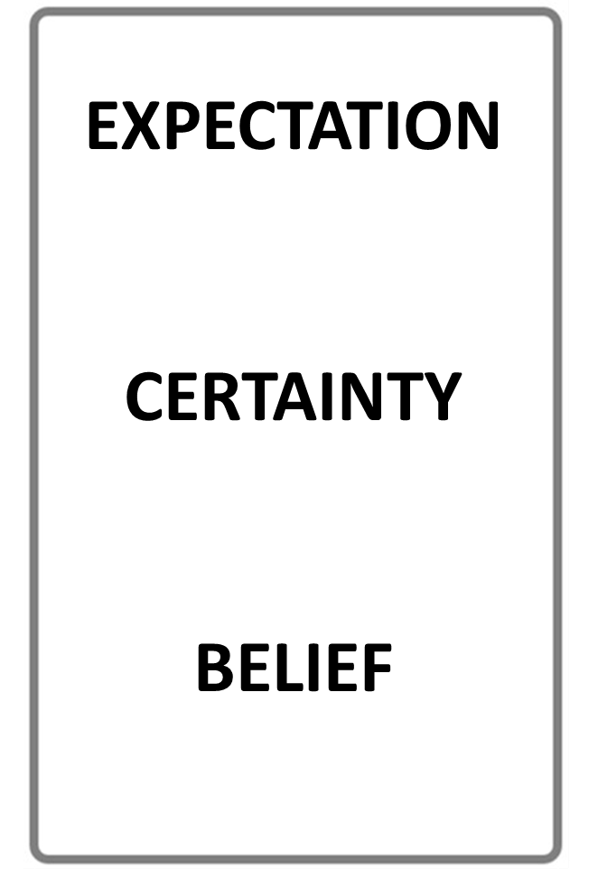


ADJECTIVE
ADVERB
DESCRIBES A NOUN
DESCRIBES A VERB
STOP THE VIDEO WHILE YOU CHECK

Slide 6
WHAT IS A NOUN?

Slide 7


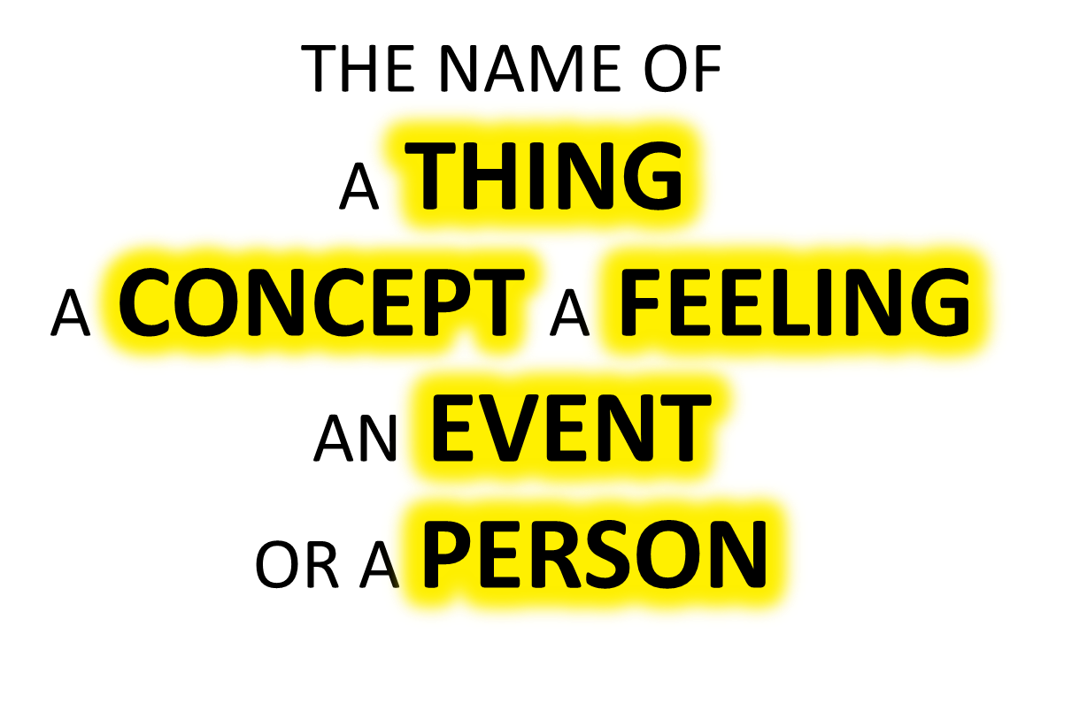

Slide 8
WHAT IS A VERB?

Slide 9

A VERB IS:

Slide 10
NOUN
VERB
NAME OF A THING
AN ACTIVITY WORD
STOP THE VIDEO WHILE YOU CHECK

Slide 11
ADJECTIVES
ADVERBS
DESCRIBE
DESCRIBE
NOUNS
VERBS

Slide 12
DESCRIBE
NOUNS
ADJECTIVES

Slide 13
DESCRIBE
VERBS
ADVERBS

Slide 14
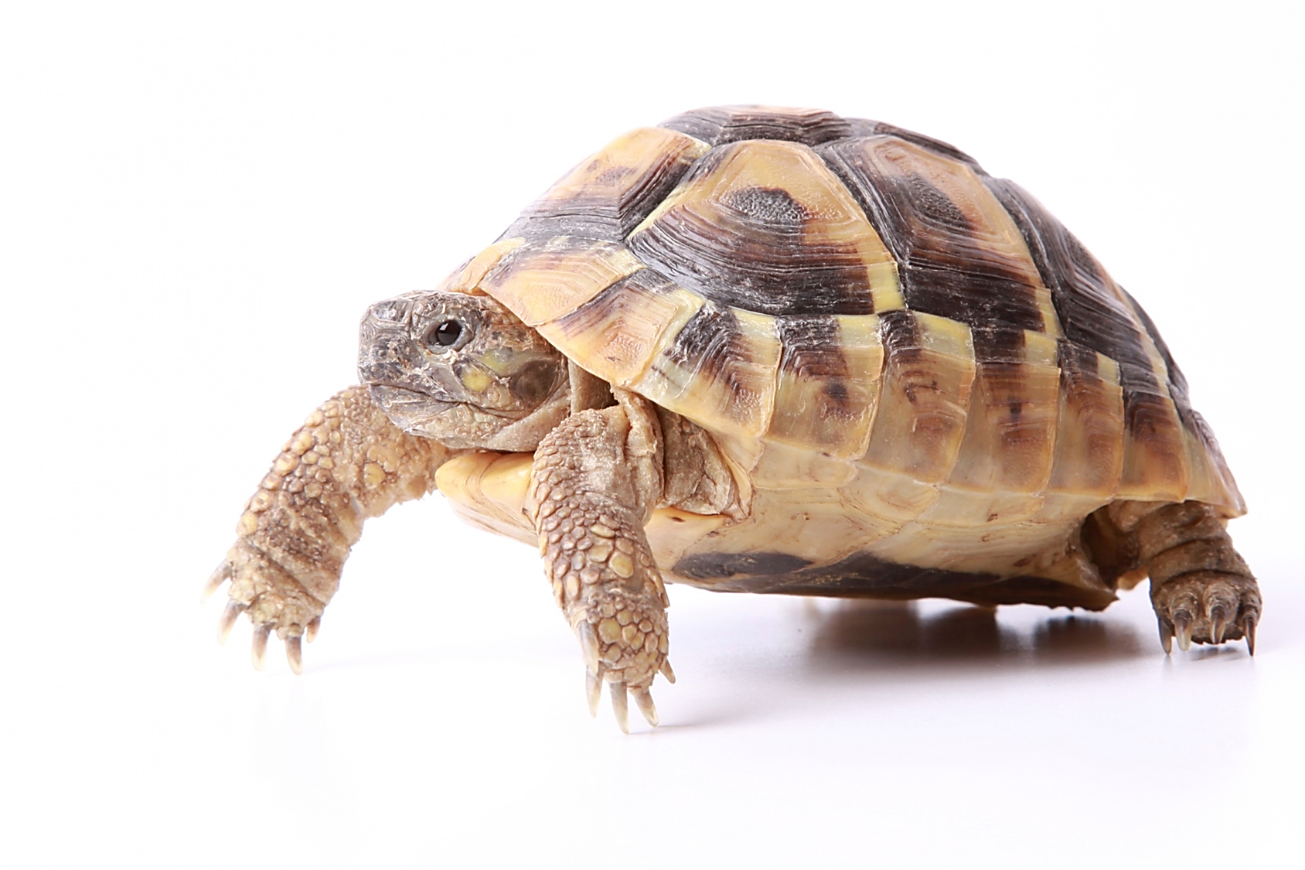

ADJECTIVE
THIS IS A SLOW ANIMAL
THE
ADJECTIVE DESCRIBES
THE NOUN

Slide 15


THE BUTTERFLIES ARE FLYING SLOW LY
THE
ADVERBDESCRIBESTHE
VERB

Slide 16
USING ADJECTIVES AND ADVERBS

Slide 20
What does OPSHACOM stand for?
OPSHACOM stands for
Opinion Shape Age Color Origin Material
the order of adjectives in a sentence

Slide 21
Opinion Shape Age Color Origin Material
LOVELY BIG YOUNG RED BRITISH STEEL
EXCELLENT SQUARE OLD BROWN EUROPEAN WOOL
SILLY ROUND ANCIENT YELLOW CANADIAN LIQUID

Slide 22

ADJECTIVE
THIS IS A SLOW ANIMAL
THE
ADJECTIVE DESCRIBES
THE NOUN

Slide 23

WHAT IS AN NOUN?

Slide 25
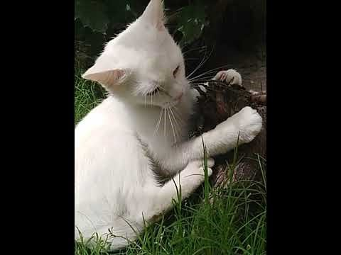

Slide 26


Slide 27
Quantity or number.
Quality or opinion.
Size.
Age.
Shape.
Color.
Proper adjective (often nationality, other place of origin, or material)
Purpose or qualifier.

Slide 28
that horrible big fierce dog
It is very unusual to have more than three adjectives.
Adjectives usually come in this order:
1 2 3 4 5 6 7 8
General
opinion Specific
opinion Size Shape Age Colour Nationality Material
We use some adjectives only after a link verb:
afraid alive alone asleep
content glad ill ready
sorry sure unable well
Some of the commonest -ed adjectives are normally used only after a link verb:
annoyed; finished; bored; pleased; thrilled
We say:

Slide 29
Adjectives usually come in this order:
1 | 2 | 3 | 4 | 5 | 6 | 7 | 8
General opinion | Specific opinion | Size | Shape | Age | Colour | Nationality | Material

Slide 30
WHAT DO WE DESCRIBE?

Slide 31
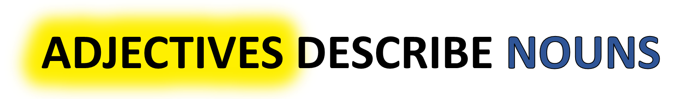
WHAT IS A NOUN ?
WHAT IS AN ADJECTIVE ?
ADVERBS DESCRIBE VERBS
WHAT IS AN ADVERB ?
WHAT IS A VERB ?

Slide 32
WHAT IS A NOUN?
WHAT IS A VERB?

Slide 33
NOUN
VERB
NAME OF A THING
AN ACTIVITY WORD
STOP THE VIDEO WHILE YOU CHECK

Slide 34
USING ADJECTIVES AND ADVERBS
WHAT IS AN ADJECTIVE?
WHAT IS AN ADVERB?

Slide 35
ADJECTIVE
ADVERB
DESCRIBES A NOUN
DESCRIBES A VERB
STOP THE VIDEO WHILE YOU CHECK

Slide 36
KEY
ADJECTIVE EXAMPLE

Slide 37
KEY
ADVERB EXAMPLE

Slide 38
KEY
NOUN EXAMPLE

Slide 39
KEY
VERB EXAMPLE

Slide 40
ADJECTIVE
THIS IS A SLOW ANIMAL
THE
ADJECTIVE DESCRIBES
THE NOUN

Slide 41
THE BUTTERFLIES ARE FLYING SLOW LY
DESCRIBES
THE
VERB

Slide 42
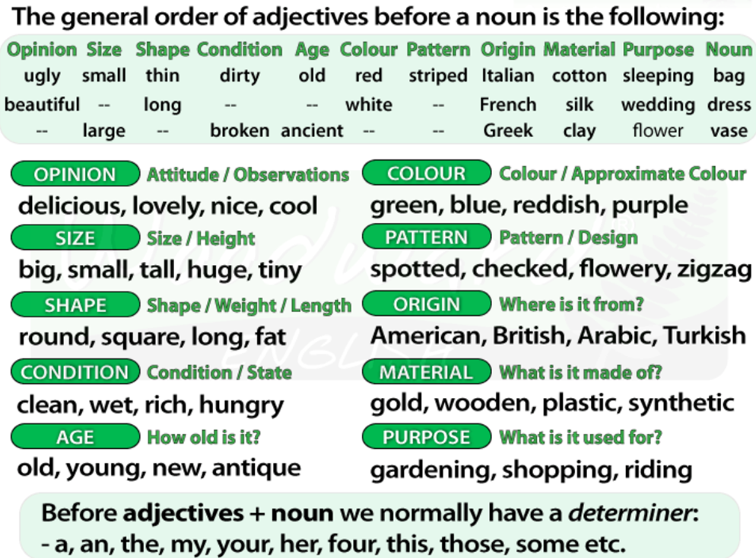
USING ADJECTIVES AND ADVERBS

Slide 43
USING ADJECTIVES AND ADVERBS
WHAT IS AN ADJECTIVE?
WHAT IS AN ADVERB?

Slide 48
Quantity or number.
Quality or opinion.
Size.
Age.
Shape.
Color.
Proper adjective (often nationality, other place of origin, or material)
Purpose or qualifier.

Slide 49
that horrible big fierce dog
It is very unusual to have more than three adjectives.
Adjectives usually come in this order:
1 2 3 4 5 6 7 8
General
opinion Specific
opinion Size Shape Age Colour Nationality Material
We use some adjectives only after a link verb:
afraid alive alone asleep
content glad ill ready
sorry sure unable well
Some of the commonest -ed adjectives are normally used only after a link verb:
annoyed; finished; bored; pleased; thrilled
We say:

Slide 50
Adjectives usually come in this order:
1 | 2 | 3 | 4 | 5 | 6 | 7 | 8
General opinion | Specific opinion | Size | Shape | Age | Colour | Nationality | Material

Slide 51
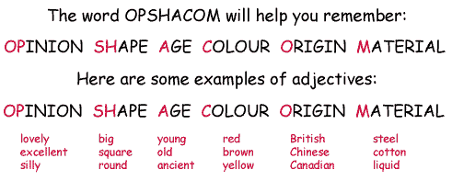

Slide 52
ADVERBS

Slide 53
USING ADJECTIVES AND ADVERBS
WHAT IS AN ADJECTIVE?
WHAT IS AN ADVERB?

Slide 54
ADJECTIVE
ADVERB
DESCRIBES A NOUN
DESCRIBES A VERB
STOP THE VIDEO WHILE YOU CHECK

