Slide 1

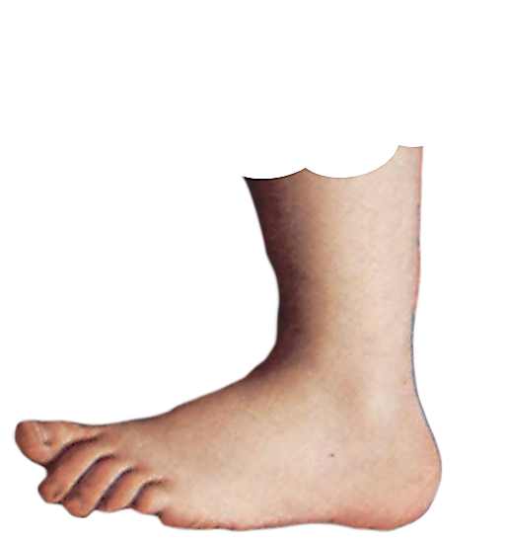
ADVERBS CAN OFTEN BE FORMED BY ADDING
TO AN ADJECTIVE
LY
LY
FOOTNOTE
FOOTNOTE

