Slide 1
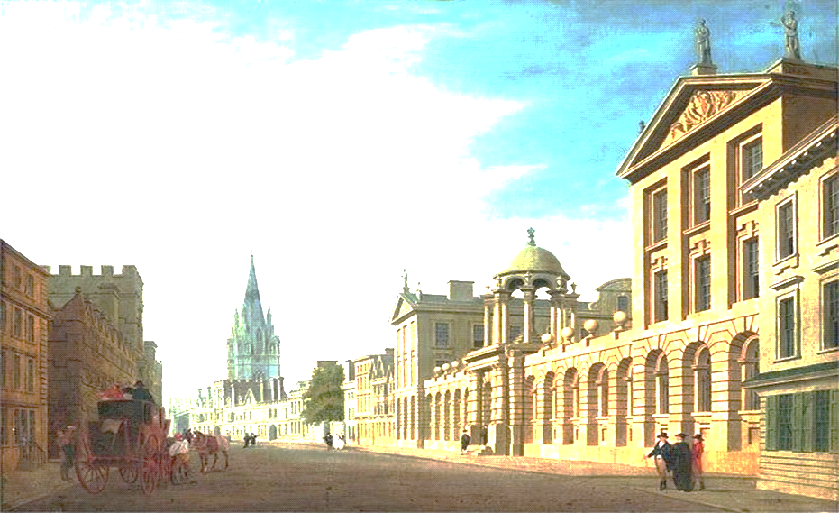


THE PROFESSOR ENGLISH TEAM
HEARTILY THANKS
DR PETER LEGGET
PROFESSOR MIKE PATTERSON
PROFESSOR BOB COTTON
JOHN HAYCRAFT
ROBIN CAMERON
KEVIN SHAW
ANNIE HUDSON

Slide 2



LIZ OLDHAM
IKA SKOBEL
COLIN DEXTER
FREDDIE CHARLESWORTH WOOLEY
COLIN LYNES
DR JOHN CROCKETT
HEINRICH VON NATUSIUS
CLEMENS AULICH
DR UWE STOHWASSER
DIETER LEMKE
ROS BEARD
HEINZ FRY
PETER MEIR ZU EISEN
RUSSELL TROTMAN
DR PETER LEGGET
PROFESSOR MIKE PATTERSON
PROFESSOR BOB COTTON
JOHN HAYCRAFT
ROBIN CAMERON
KEVIN SHAW
ANNIE HUDSON
THE
PROFESSOR ENGLISH TEAM
HEARTILY THANKS

Slide 3
LIZ OLDHAM
IKA SKOBEL
COLIN DEXTER
FREDDIE CHARLESWORTH WOOLEY
COLIN LYNES
DR JOHN CROCKETT
HEINRICH VON NATUSIUS
THE
PROFESSOR ENGLISH TEAM
HEARTILY THANKS

Slide 4
CLEMENS AULICH
DR UWE STOHWASSER
DIETER LEMKE
ROS BEARD
HEINZ FRY
PETER MEIR ZU EISEN
RUSSELL TROTMAN
THE
PROFESSOR ENGLISH TEAM
HEARTILY THANKS

Slide 5
RICHARD KENT RAMSEY
DR MICHAEL LENNOX BROWN
DR RUDOLF STEINER
PROFESSOR JEAN PIAGET
DR ALEXANDER SUTHERLAND NEIL
THE
PROFESSOR ENGLISH TEAM
HEARTILY THANKS

Slide 6
OXFORD UNIVERSITY
DEPARTMENT FOR CONTINUING EDUCATION
BODLEAN LIBRARY
UNIVERSITY OF SURREY
DR ARTHUR KOESTLER
PHILLIP LE BAS
CHRISTOPHER MAILAENDER
THE
PROFESSOR ENGLISH TEAM
HEARTILY THANKS

Slide 7
THE
BRITISH BROADCASTING CORPORATION
THE BRITISH COUNCIL
THE OPEN UNIVERSITY
THE
PROFESSOR ENGLISH TEAM
HEARTILY THANKS

Slide 8
PROFESSOR JOHN F. DANBY
PROFESSOR CLEMENT W.K. MUNDLE
DR JACOB BRONOWSKI
THE
PROFESSOR ENGLISH TEAM
HEARTILY THANKS

Slide 9
THANKS ALSO
TO
WILLIAM
THE
PROFESSOR ENGLISH TEAM
HEARTILY THANKS

Slide 10
DEDICATED TO
T.H.S.
THE GREATEST TEACHER

Slide 12


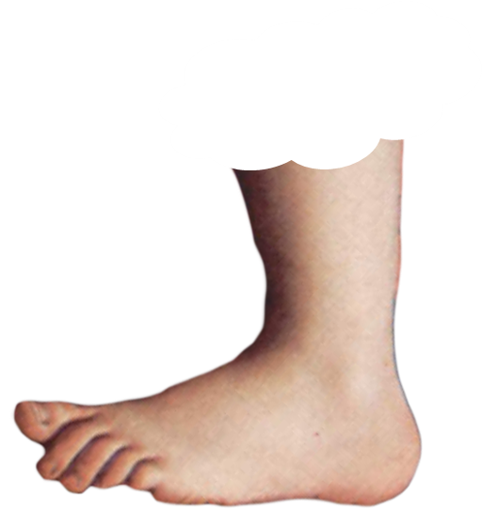
THE DICTIONARY NAME FOR THE PAST IN THE FUTURE
IS
THE
FUTURE PERFECT
FOOTNOTE

