Slide 2


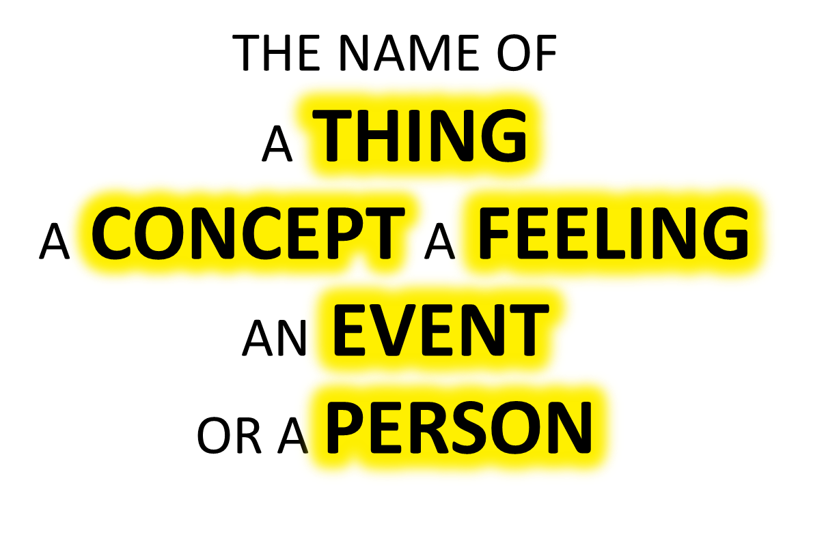

Slide 3

A NOUN IS:

Slide 4
A VERB IS:
AN ACTION
AN ACTIVITY
OR A
PROCESS

Slide 5
A VERB IS:
AN ACTION
AN ACTIVITY
OR A
PROCESS

Slide 6

A NOUN IS:

Slide 7
A VERB IS:
AN ACTION
AN ACTIVITY
OR A
PROCESS

Slide 8


Slide 9


Slide 10


Slide 12
